Slide 1
Concept of fashion trend forecasting
Chapter 6

Slide 2

Introduction
Fashion trend forecasting resources help to predict trends in the fashion industry.
Prediction of mood, behaviour and buying habits of the consumer at particular time of season.
Royalty-free photo sourced from Pexels

Slide 3
Fashion trend Forecasting
Fashion Analysis
Fashion Scan
COMBINED
ANALYSIS
Consumer Scan
Trend Analysis
Cultural Indicators
Competitive Analysis
Partners & Competitors
Present
Future
Reference: Brannon, E., 2010. Fashion Trend Forecasting. Fairchild Books. New York.

Slide 4
Fashion trend Forecasting
Fashion Scan
To analyse and predict fashion trend (Fashion Shows).
Consumer Scan
To analyse and understand needs and lifestyles of target consumers.
Cultural Indicators
To analyse and understand cultural development and influence.
Partners & Competitors
To analyse fashion market and competitors’ development.
Present
Reference: Brannon, E., 2010. Fashion Trend Forecasting. Fairchild Books. New York.

Slide 5
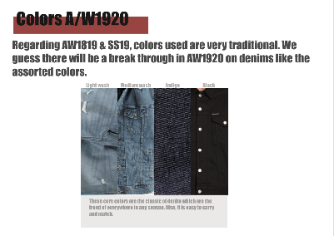
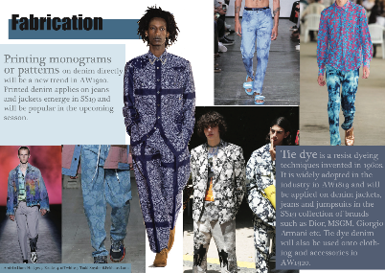
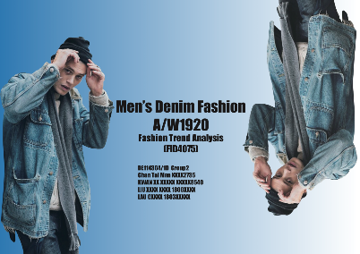
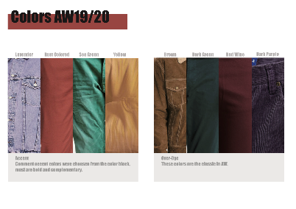
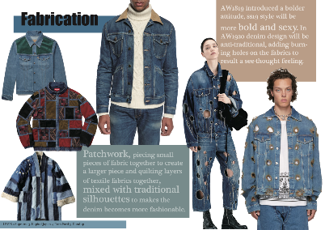
Fashion trend ANALYSIS reporT
Trend report by HD in Fashion Branding & Buying students in Hong Kong Design Institute

Slide 6
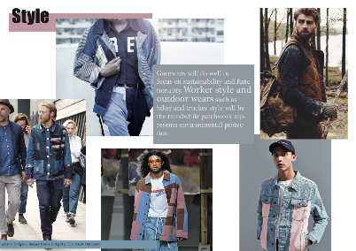
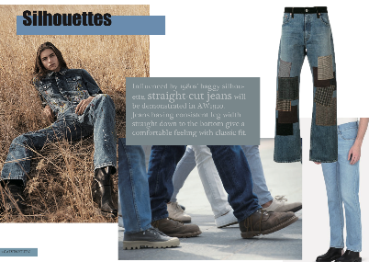
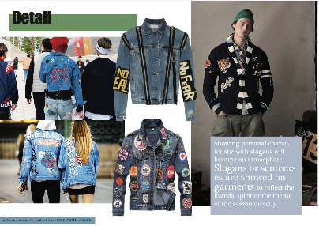
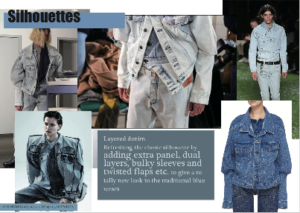
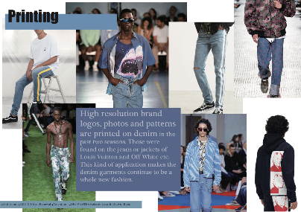
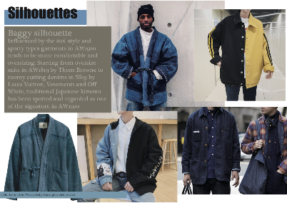
Fashion trend ANALYSIS reporT
Trend report by HD in Fashion Branding & Buying students in Hong Kong Design Institute

Slide 7
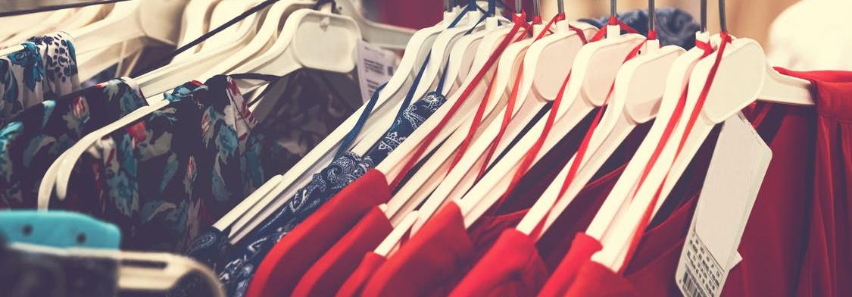
The importance of fashion trend Forecasting
Royalty-free photo sourced from Pexels
Accurate forecasting enables the fashion industry segments to prepare for and meet consumer’s demand with design that will be accepted and purchased.

Slide 8
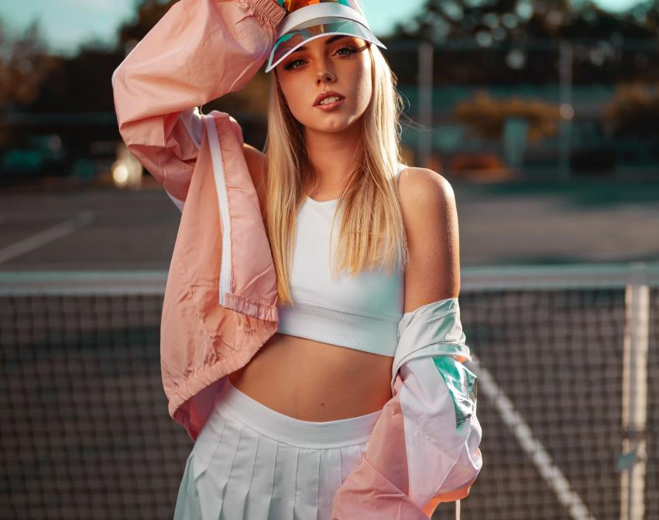
chapter activity
“TREND SPOTTING”
Can you name this trendy style from the picture on the left?
Royalty-free photo sourced from Pexels

