Slide 1
Appearance and clothing psychology
Chapter 8

Slide 2
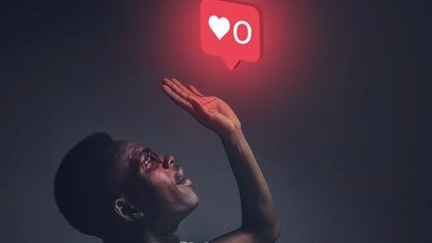
SOCIO-Psychological dynamics in clothing to enhance confidence, self-acceptance and self-esteem
Royalty-free photo sourced from Pexels

Slide 3
Your appearance tells NON-VERBAL Communication
  Clothing is regarded as a silent language
  It could tell:
  What kind of person you are
  What kind of person you think you are
  What kind of person you would like to be
  What you think about a person you represent
Royalty-free photo sourced from Pexels.
Reference from Marshall (2012). Marshall, S. G. (2012). Individuality in clothing selection and personal appearance. Prentice Hall.

Slide 4
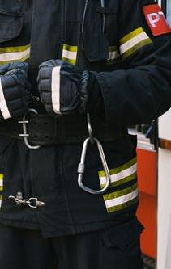
Clothing SymbolS
It expresses meanings and provide information to others
People as observer could understand the “message” if the ideas attached to a symbol could be interpreted
E.g. organisation logo badge or print makes the wearer looks belong to a group
Clothing messages are massive; it represents a wide range of messages e.g. cultural belief, school and work loyalties and needs
Uniform is a typical example that represents clothing symbols, e.g. power, rank, loyalty
Royalty-free photo sourced from Pexels.
Reference from Marshall (2012). Marshall, S. G. (2012). Individuality in clothing selection and personal appearance. Prentice Hall.

Slide 5
IMPRESSION FORMATION
Clothing tells others about age, sex, race, social status, roles
The first four minutes rule: Initial human contact established in the first four minutes of the meeting
Wearing appropriate and suitable clothes could enable others to understand you
You can enhance your sense of individuality, self-image and personality by dressing
Royalty-free photo sourced from Pexels
Reference from Marshall (2012). Marshall, S. G. (2012). Individuality in clothing selection and personal appearance. Prentice Hall.

Slide 6
Individuality
It helps people identify themselves, in terms of physical or personal characteristics
To present your individuality, you could decide:
To be trendy or not trendy
To wear or not to wear same style of garment, hair style and accessories as someone else
To wear a favourite colour often or not
To have or not to have a signature “look”
To be Intended or reluctant to try new styles
Royalty-free photo sourced from Pexels.
Reference from Marshall (2012). Marshall, S. G. (2012). Individuality in clothing selection and personal appearance. Prentice Hall.

Slide 7
self-image & PErsonality
Apparel as a tool by individuals to establish self-image and express personality
Natural personalities are more comfortable in relaxed-style clothing with a roomy fit and layered look
Classic personalities focus on elegant, well-fitted, tailored clothing styles
Creative personalities tend to use a variety of clothing items in different combination to reflect the mood and show taste
When clothing is selected well to express personality, it could enhance self confidence, self-acceptance and self-esteem
Royalty-free photo sourced from Pexels
Reference from Marshall (2012). Marshall, S. G. (2012). Individuality in clothing selection and personal appearance. Prentice Hall.

Slide 8
Attitudes & Clothing choices
Attitude refers to a person’s mood, opinion or disposition
It is highly individual
Attitude about clothing tends to focus on comfort, utility, conformity, economy, fashion, self-expression and status, that could be reflected by apparel choice
An effective choice of clothing could gain status and recognition which enhance self image and self esteem.
Royalty-free photo sourced from Pexels.
Reference from Marshall (2012). Marshall, S. G. (2012). Individuality in clothing selection and personal appearance. Prentice Hall.

