Slide 1
CHAPTER 9
Wardrobe planning for interviews

Slide 2
Appropriate dressing for formal occasions
Royalty-free photo sourced from Pexels

Slide 3

how to be presentable and SMART in interview?
Royalty-free photo sourced from Pexels

Slide 4
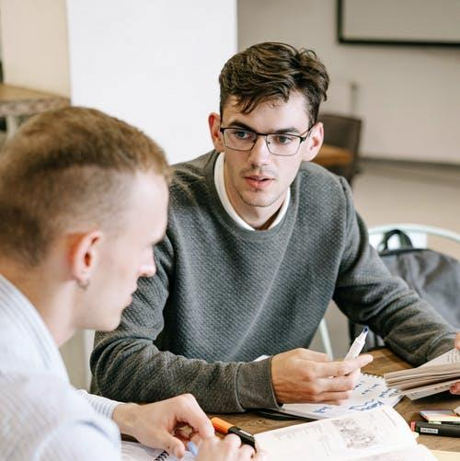
Why is wearing the right outfit to an interview important?
Wearing the right outfit to an interview shows that you're prepared for the interview helps to present a sense of maturity
A neat and appropriate look and image also implies responsibility and enthusiasm
Royalty-free photo sourced from Pexels

Slide 5
INSTEAD OF TOO FORMAL LIKE THIS
You could wear ……
Royalty-free photo sourced from Pexels

Slide 6
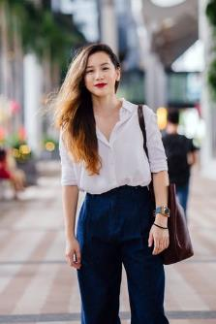
WHAT TO WEAR TO AN INTERVIEW?
Button-down shirt with slacks
If the interview requires a more formal style such as works in office
A button-down shirt combined with slacks is a good option for male and female
It's a step up from a polo for males, but it's not as dressy as a suit and a tie
Royalty-free photo sourced from Pexels

Slide 7
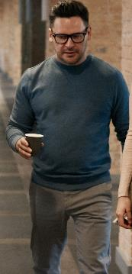
Other than shirt, you could wear……
Polo shirt Or sweater with skirt or slacks
For summer, a polo shirt or sweater with a skirt or slacks is a great choice
Not too casual, but not too formal
Since a polo shirt is more casual, should wear with a stylish skirt or a pair of slacks and that the polo shirt is tucked in to demonstrate professionalism
Polo is more suitable in summer while sweater is perfect in the rest of seasons
Royalty-free photo sourced from Pexels.

Slide 8
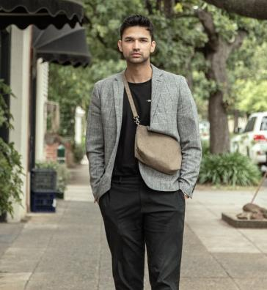
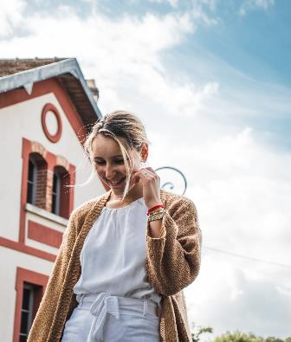
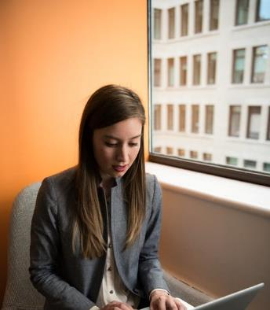
JaCKETs or CARDIGANS with
T-shirt or basic tops
Sstyle with crew neck tops, basic blouse for girls, button-down shirt or even T-shirt
Grey, khaki, beige, navy are great choices for mix and match
Royalty-free photo sourced from Pexels

Slide 9
ONE PIECE DRESs/
dress shirt
In summer, one-piece dress with pattern print could help to show a strong image
A pair of jeans that complement the colour and style of the dress shirt
Royalty-free photo sourced from Pexels

Slide 10
WHAT NOT TO WEAR TO AN INTERVIEW?
Open-toed shoes
Shorts or low-cut shirts
Hats or athletic-style attire
Hooded sweatshirts and jackets
Mismatched or bright colours
Royalty-free photo sourced from Pexels.

Slide 11
TIPS to Consider when dressing for an interview
Research the company's dress code
Avoid revealing clothing
Choose clothes you're confident in
Royalty-free photo sourced from Pexels

