Slide 1
Food Product Development
Sensory Evaluation

Slide 2
Topics
Introduction
Sensory Characteristics of Food
Sensory Evaluation Methods
Discrimination tests
Descriptive tests
Affective / Hedonic tests
Steps / processes in carrying out sensory evaluation
Good practices in sensory evaluation
Steps in sensory evaluation

Slide 3
Introduction

Slide 4
Introduction
“Sensory evaluation is a scientific discipline that is used to measure, analyze, evoke, and interpret the reactions to those characteristics of foods and materials as they are perceived by the senses of sight, smell, taste, touch, and hearing.
Sensory evaluation involves the measurement and evaluation of the sensory properties of foods and other materials.
Sensory evaluation also involves the analysis and the interpretation of the responses by the sensory professionals.”
Stone, H., & Sidel, J. L. (2004). Introduction to Sensory Evaluation. Sensory Evaluation Practices, 1–19. doi: 10.1016/b978-012672690-9/50005-6

Slide 5
Sensory Evaluation
The characteristics of food that affect our sensory organs are called organoleptic properties
Sensory evaluation means tasting food to find out what these qualities are
There are three main types of tests:
discrimination
descriptive
affective / hedonic

Slide 6
Three main types of sensory tests
Discrimination
Is the product different or similar to a competitor’s product or low-fat product?
Descriptive
What does the product taste like?
How does a change in production, storage and packaging affect its taste?
Affective / Hedonic
How much do people like the product?
Which parts do they like?
Is the product an improvement to the previous one?
Would people notice the difference?

Slide 7
Sensory characteristics of food

Slide 8
The Senses
We use our five sensory organs (eyes to see, nose to smell, tongue to taste, skin to feel/touch and ears to hear) when we eat
These give information about the food we eat

Slide 9
The Senses
Hearing
Fizzy drink
Smelling
Fresh coffee
Stinky tofu
Seeing
Decorated cake
Blue ketchup
Tasting
Touching
Sweetness in sugar cane
Sour gherkins
Soft overripe peach
Mealy mashed potato
Crunchy cucumber

Slide 10
Sensory Descriptors
Sense organ | Characteristics | Descriptors
Eye | Appearance (colour, texture/pattern) | Golden brown, dull red, bright orange, light, dark, shiny, glowing, smooth, dull
Nose | Smell (aroma/odour) | Burnt, acid, fishy, fruity, herby, spicy
Skin | Touch (texture/mouthfeel) | Airy, brittle, chewy, crispy, crumbly, crunchy, dry, firm, fizzy, flaky, foamy, gritty, hard, lumpy, mushy, soggy, springy, tender, tough
 | Temperature (hot/cold) | Hot, warm, cold, sizzling hot, blazing, smoking
Tongue | Taste (flavour) | Sweet, salty, bitter, bland, hot (spicy), sharp, stale
 | Food type | Onion, lemon, coconut, chocolate, aniseed, peppermint, garlic, meat
Ear | Sound | Crackling, fizzing, popping, crunchy, rustling

Slide 11
Sensory Evaluation Methods

Slide 12
Sensory Evaluation Methods
Are the products different?
Discrimination Tests
Triangle Test
Duo-Trio Test
Paired Comparison Test
How are they different?
Descriptive Tests
Quantitative Descriptive Analysis
What is the acceptability of one product over another?
Affective/Hedonic Tests
- Consumer Acceptance Tests

Slide 13
Discrimination Tests
Basic Question: Are two products different from one another?
Basic Setup
25-50 panellists
Screened for acuity
(keenness or sharpness of perception, i.e. can they smell and taste well?)
Given triangle, duo-trio or paired comparison tests
Analysis is done using tables which compare results to chance
- Ensures that the difference was real and not because people chose the correct sample by luck/chance
Advantage
- Quick and simple
Limitations
- Limited results, i.e. only yes if they are different or no if they are not

Slide 14
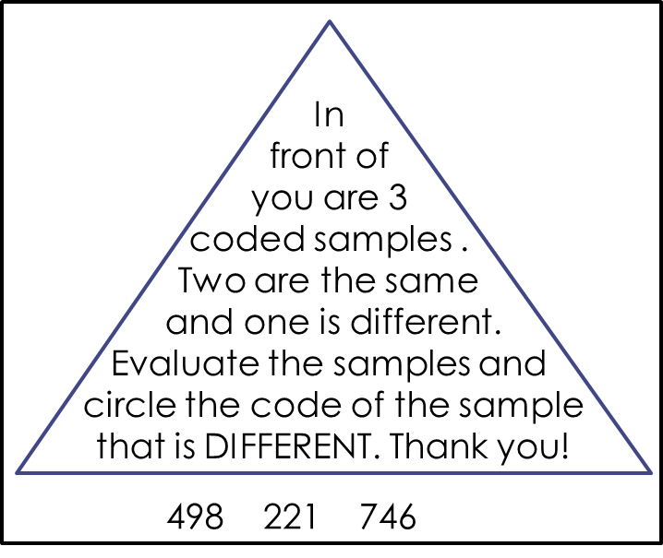
Discrimination Tests: Triangle Test
Question: Are two products different from one another?
Triangle Test: Choose the sample that is most different
A
A
B
498
221
746

Slide 15
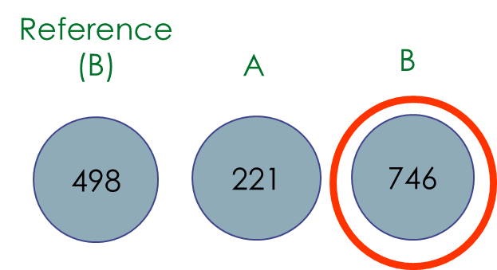
Discrimination Tests: Duo-Trio
Question: Are two products different from one another?
Duo-trio Test: Choose the sample that matches the reference sample
Duo –Trio
In front of you are two coded samples and a reference
sample B. One of the coded samples is identical to the reference B. Evaluate the samples and circle the code of the sample that is IDENTICAL to the reference B. Thank you!
B 221 746

Slide 16
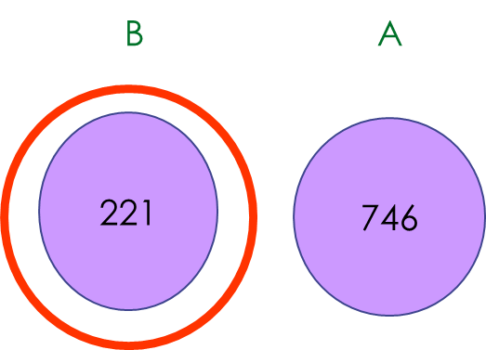
Discrimination Tests: Paired Comparison Test
Question: Are two products different from one another?
Paired Comparison Test: Which sample is sweeter?

Slide 17
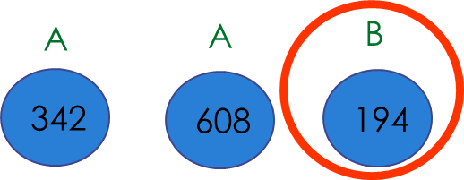
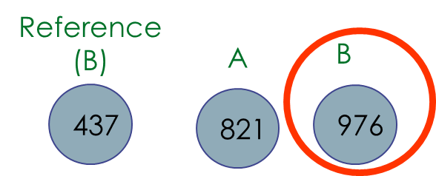
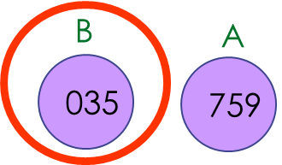
Discrimination Tests
Triangle Test: Choose the sample that is most different
Duo-trio Test: Choose the sample that matches the reference sample
Paired Comparison Test: Which sample is sweeter?

Slide 18
Descriptive Tests
Basic Question: How do products differ in all sensory attributes?
Basic Setup
8-12 panellists
Screened for acuity
Trained
Asked to rate intensity for all sensory attributes
Analysis is done using a t-test to determine if means are statistically different
Advantages
Detailed quantitative information
Limitations
Time consuming

Slide 19
Descriptive Tests
Descriptive tests are used to measure the type and intensity of particular attributes of a food product
The test requires panellists to describe the product in terms of its characteristics and to measure the intensity of those characteristics and to measure the intensity of those characteristics using scaling methods
Most food companies have a panel that is trained on each of their products
Examples of descriptive tests :
Flavour profile
Texture profile
Sensory Spectrum
Quantitative Descriptive Analysis

Slide 20
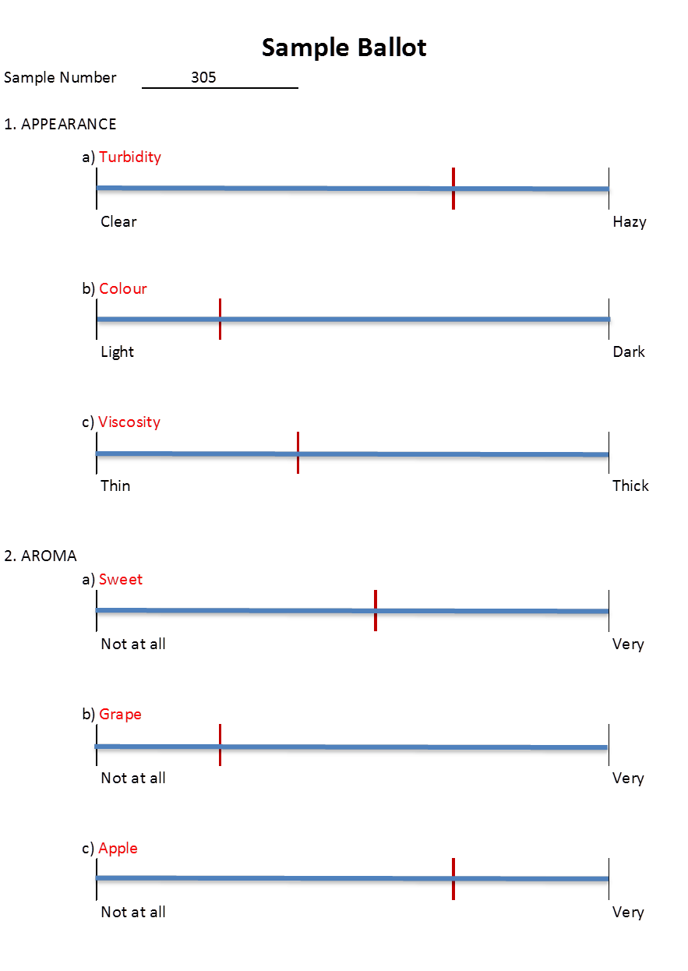
Descriptive Tests: Quantitative Descriptive Analysis (examples)
Scale Line
Panellists develop a list of sensory attributes before testing a product
Panellists evaluate the product and mark the rate on respective lines
For example, the panel would be given a sample of grape juice and they would rate the level of turbidity, colour, viscosity, etc.

Slide 21
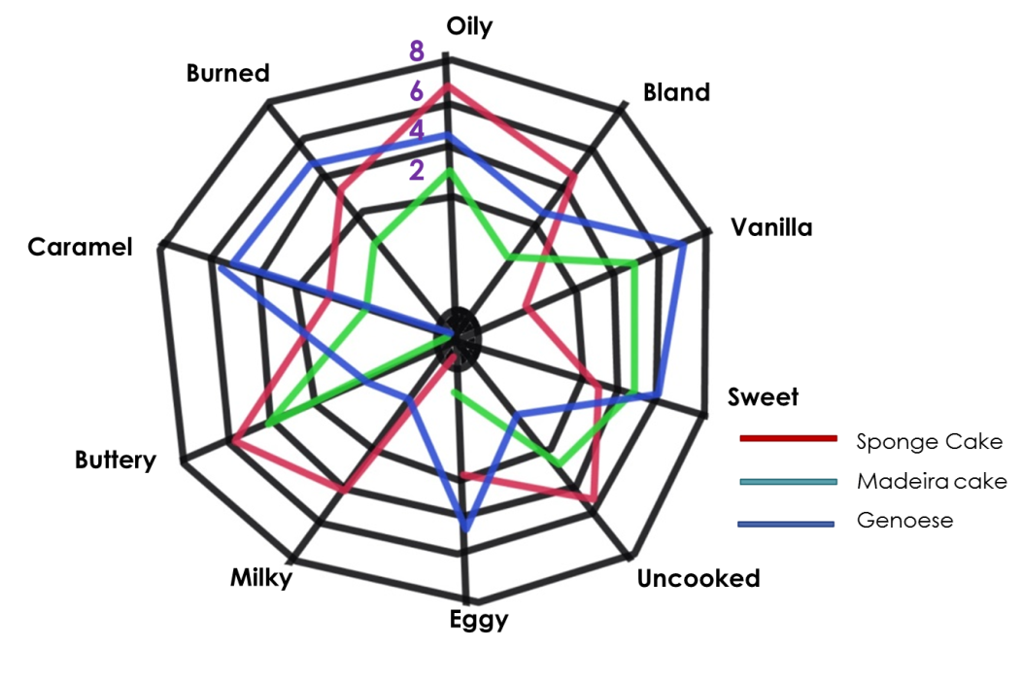
Descriptive Tests: Quantitative Descriptive Analysis (examples)
Star / Attribute Profile
Panellists develop a list of sensory attributes before testing a single product or a range of products
The panellists evaluate the product(s) and record the rating by plotting the data onto graphs – for easy comparison among samples
For example, the panel would be given samples of Sponge Cake, Madeira Cake and Genoese Sponge Cake and they would draw a star chart / diagram based on the intensity of each attribute

Slide 22
Affective / Hedonic Tests: Consumer Acceptance Tests
Basic Question: Are the products liked?
Basic Setup
75-150 consumers per test
Screened for product use (Do they buy the product? And how often?)
Asked degree of liking (how much do they like it) and/or preference questions
Advantages
Provides essential information – Do they like it or not?
Disadvantages
May be difficult to get a representative sample of consumers

Slide 23
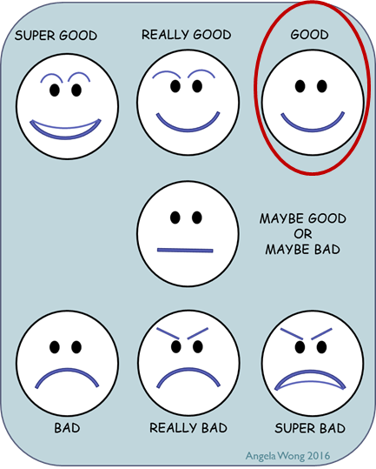
Affective / Hedonic Tests: Consumer Acceptance Tests
Used to measure how much people like a product
There are several types of scales that can be used
Sample Ballot
Taste each product in the order listed. Circle how much you like the product.
Quartermaster Corp. 9-point hedonic (liking) scale. [Most commonly used]
9 Like Extremely
8 Like very Much
7 Like Moderately
6 Like Slightly
5 Neither Like nor Dislike
4 Dislike Slightly
3 Dislike Moderately
2 Dislike Very Much
1 Dislike Extremely
The Smiley Scale Used with children

Slide 24
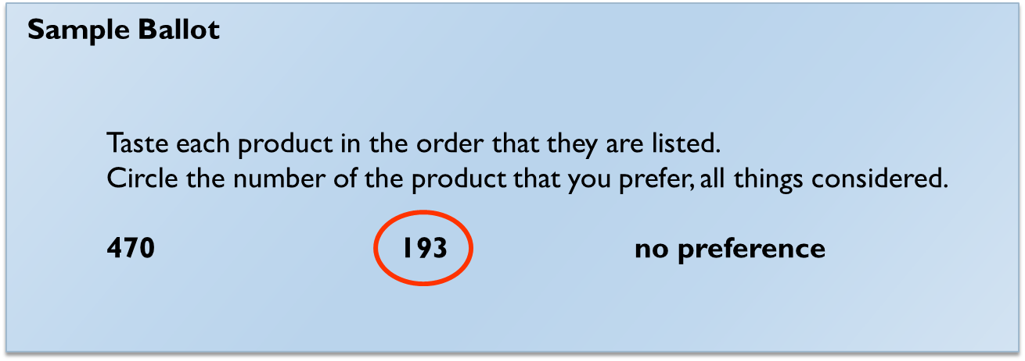
Affective / Hedonic Tests: Consumer Acceptance Tests
Preference Tests
The “Pepsi Challenge” type of test that is widely used in marketing research
Used to determine which product is preferred, although people have the option to choose “no preference”

Slide 25
Steps / Processes in Carrying Out Sensory Evaluation

Slide 26
Good Practices in Sensory Evaluation
Facilities should be well designed
White or off-white colour
Lighting should be controlled
There should be good ventilation

Slide 27
Good Practices in Sensory Evaluation

Slide 28
Good Practices in Sensory Evaluation
Samples should be prepared properly
Temperature should be controlled and the same for all samples
Volume served should be equal for all samples
Samples should be served at equivalent shelf-life or time since cooking/preparation

Slide 29
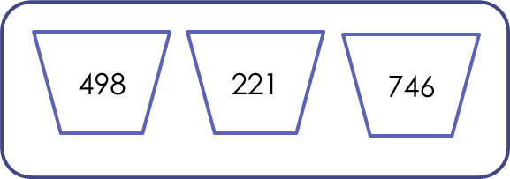
Good Practices in Sensory Evaluation
Experimental Design Considerations
Samples should be labelled with random 3-digit codes to avoid bias
Samples should be served in random or counterbalanced order
Counterbalanced order means that if 2 samples are served, half of the subjects receive one sample first and the other half receive the other sample first
Counterbalancing takes into account order effects

Slide 30
Good Practices in Sensory Evaluation
Carrier
Usually refer to materials that form a base or vehicle for the food being tested, but may more broadly be considered as any other food that accompanies the one being tested so that they are ingested and / tasted together.
Example of carriers Food being tested Rice Curry sauce Bread Butter Cracker Cheese

Slide 31
Good Practices in Sensory Evaluation
Palate cleanser
The goal of palate cleansers should be to aid in the removal of residual materials from previous samples
Examples of palate cleansers are chocolate, pectin solution, water biscuits, warm water, water and whole milk

Slide 32
Good Practices in Sensory Evaluation
Swallow or expectorated?
In most analytical sensory tests, swallowing is avoided and samples are expectorated. This is assumed to provide less carry-over or unwanted influence of one product to the next.
In consumer testing where acceptability is being measured, swallowing and post-ingestion effects can affect consumers’ opinions on the products.

Slide 33
Good Practices in Sensory Evaluation
Items placed on a tray for panellists:
Food samples
Evaluation ballot
Pen / pencil
Eating utensils
Napkins
Carrier
Palate cleanser

Slide 34
Steps in Carrying Out Sensory Evaluation
Determine the purpose of sensory evaluation, and select the appropriate test.
Assign three-digit random code numbers for each sample.
Prepare an evaluation ballot for the panellist to fill in.
Prepare samples.
Serve samples to panellists for evaluation.
Analyse the data.

Slide 35
References
Fehners, V., Simpson, M., & Monks, B. (2011). Food technology. London: Hodder Education.
Lawless, H. T., & Heymann, H. (2010). Sensory evaluation of food: principles and practices. New York: Springer.
Rigewell, J. (2009). Examining Food and Nutrition for Gcse. Gardners Books.
Stone, H., & Sidel, J. L. (2004). Introduction to Sensory Evaluation. Sensory Evaluation Practices, 1–19. doi: 10.1016/b978-012672690-9/50005-6
Tull, A. (2000). Food technology to Gcse. Oxford: Oxford University Press.
Woods, L. (2005). Food Technology: Gcse design & technology for Aqa. Place of publication not identified: Heinemann.

