Slide 1
Technology & living
Textile Technology
S1.2.3 Types, Uses and Care of Fabrics
Cotton and Linen

Slide 2
Types and Uses of Cotton
Cotton fibres are first spun into cotton yarns. The yarn can then be made into cotton fabric.
Instead of classified by woven, knitted and non-woven. Weight and density are key factors affecting the uses of fabric.

Slide 3
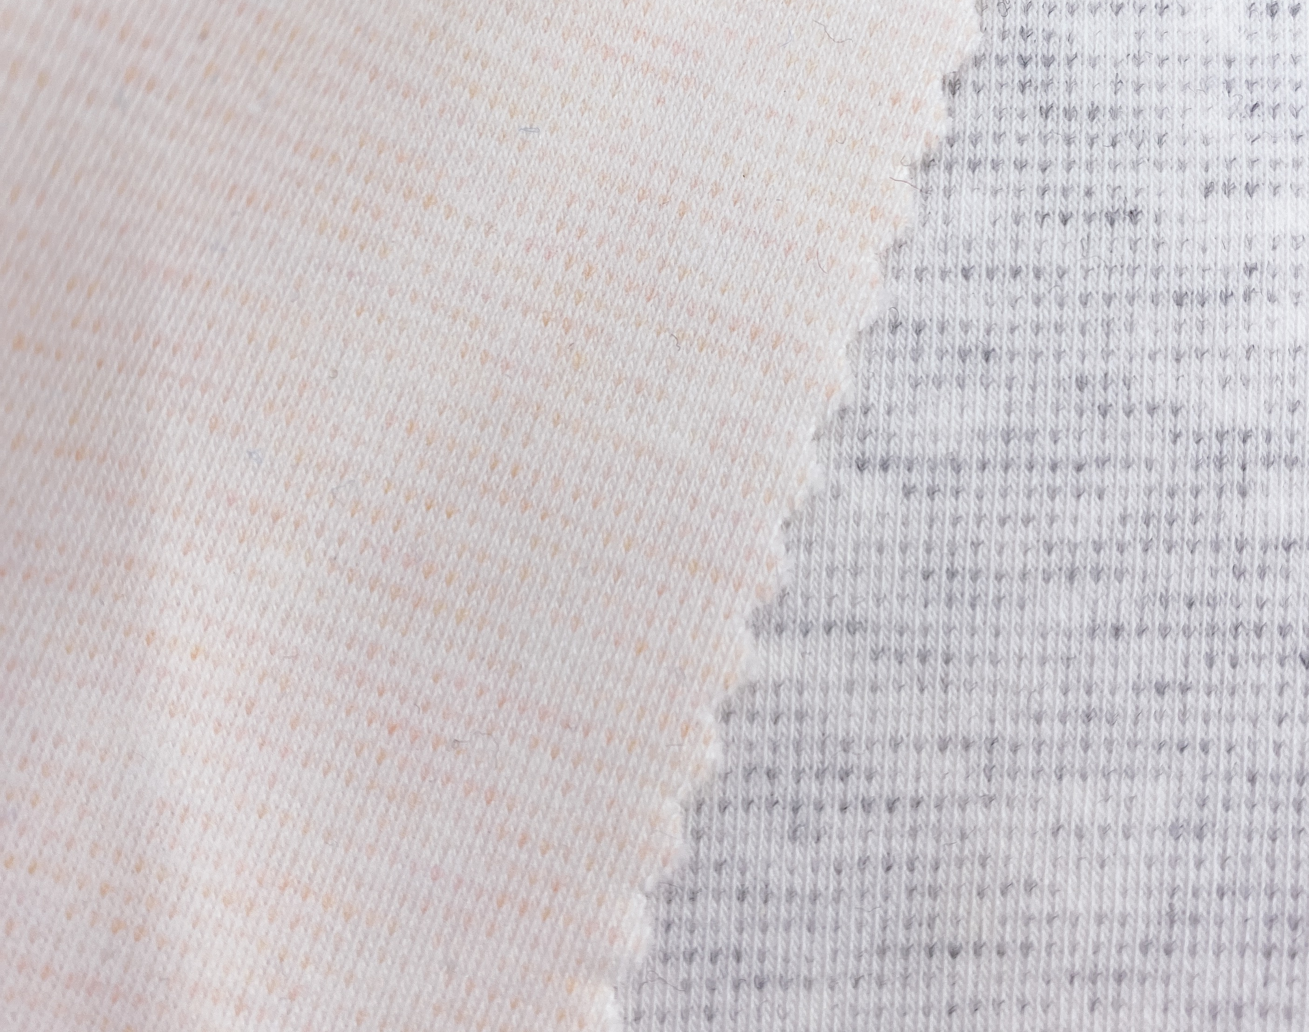
Types and Uses of Cotton
Lightweight Cotton
e.g. lawn, muslin, cotton jersey
Application: Blouses, shirts, tops, underwear, sportswear *Medical use: medical muslin, gauze, bandages, robes, etc.
cotton jersey fabric
Photo(s) is / are owned and provided by HKDI

Slide 4
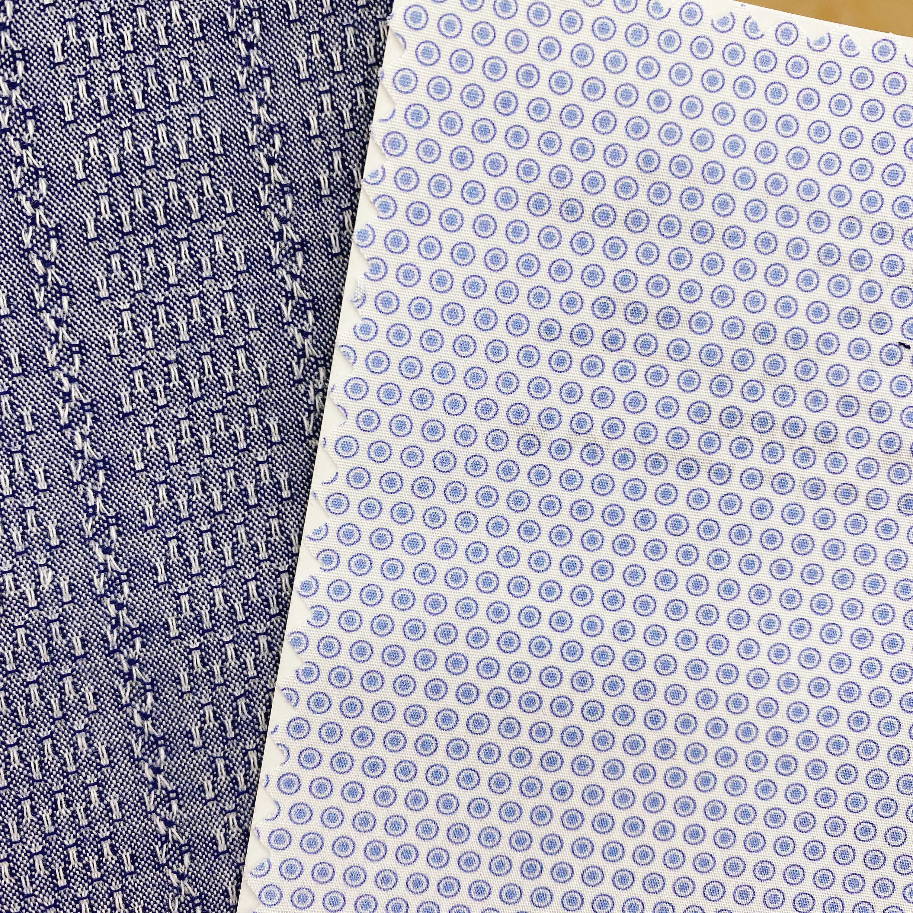
Types and Uses of Cotton
Mediumweight Cotton
e.g. cotton drill, corduroy, seersucker, poplin, denim, calico
Application: Pants, shirts, dresses
Seersucker (left), poplin (middle), corduroy (right: orange & purple) fabric
Photo(s) is / are owned and provided by HKDI

Slide 5
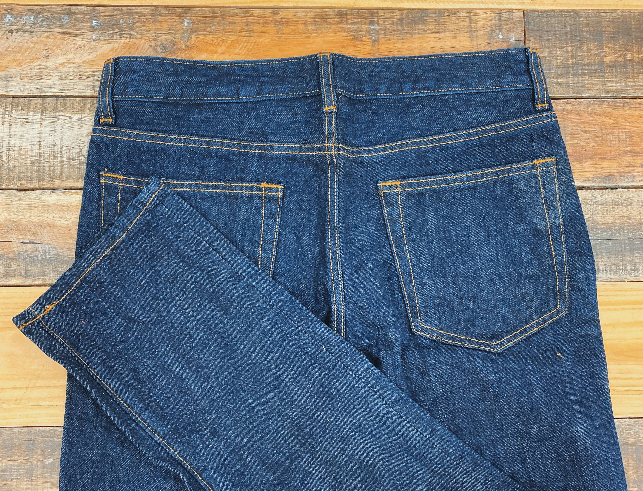
Types and Uses of Cotton
Heavyweight Cotton
e.g. terry toweling, flannelette, denim
Application: Outerwear, coats, bathrobes
Jeans
Photo(s) is / are owned and provided by HKDI

Slide 6
Care of Cotton Fabric
Hand or machine wash
In cold, warm or hot water
Bleach if necessary
Add fabric conditioner to keep its softness
Iron with a dry iron
Use sprinkler to spray water onto the cotton fabric before ironing
Store in cool and dry place

Slide 7
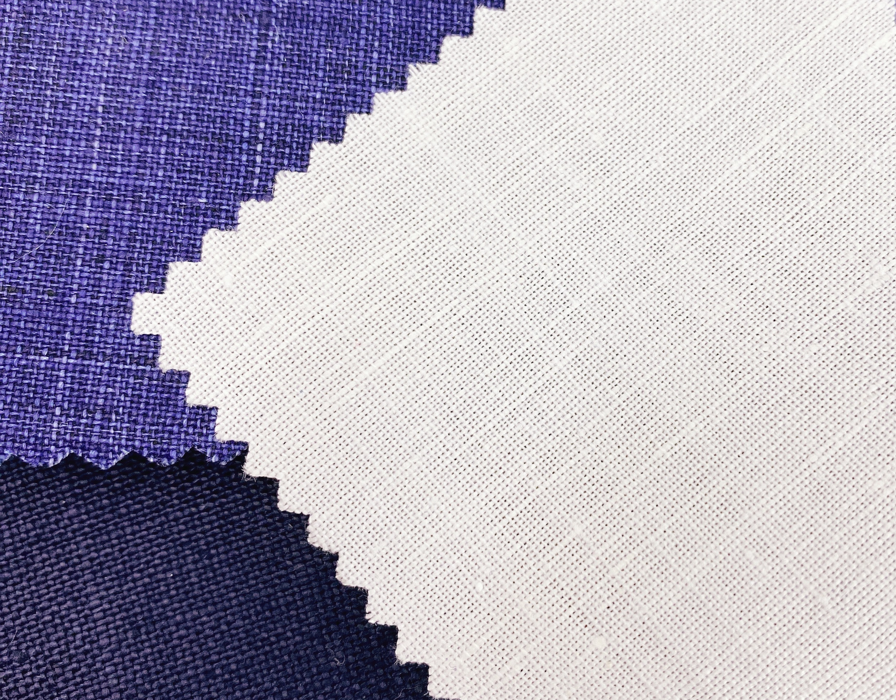
Types and Uses of Linen
Linen fibres are first spun into linen yarns. The yarn can then be made into linen fabric.
Different thickness and fabric construction of Linen
e.g. thick linen, fine linen, Oxford, Blended fabric to improve properties
Application: Dresses, trousers, shirts, blouses, suit, household items
Linen fabric
Photo(s) is / are owned and provided by HKDI

Slide 8
Care of Linen Fabric
Hand or machine wash
In warm or hot water
Rinse in cold water, to minimise shrinkage
Bleach if necessary
Iron on the wrong side of garment to retain the lustre of linen
Iron the garment when nearly dry
Store in cool and dry place

