Slide 1
Bags
(Construction)

Slide 2
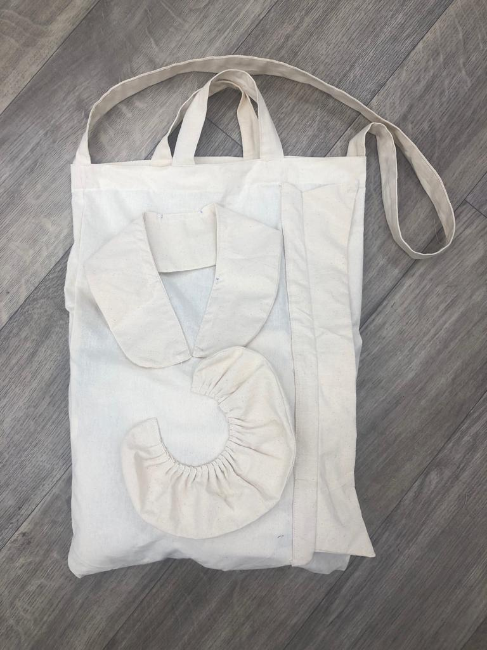
Tote bag
Photo(s) is/are owned and provided by HKDI

Slide 3
Tote bag
- patterns with seam allowance
95cm
8cm
Shoulder strap
8cm
Handle X 2
31cm
112 cm
38 cm
Bag

Slide 4
Demonstration video
Construction of a tote bag
Photo(s) is/are owned and provided by HKDI

Slide 5
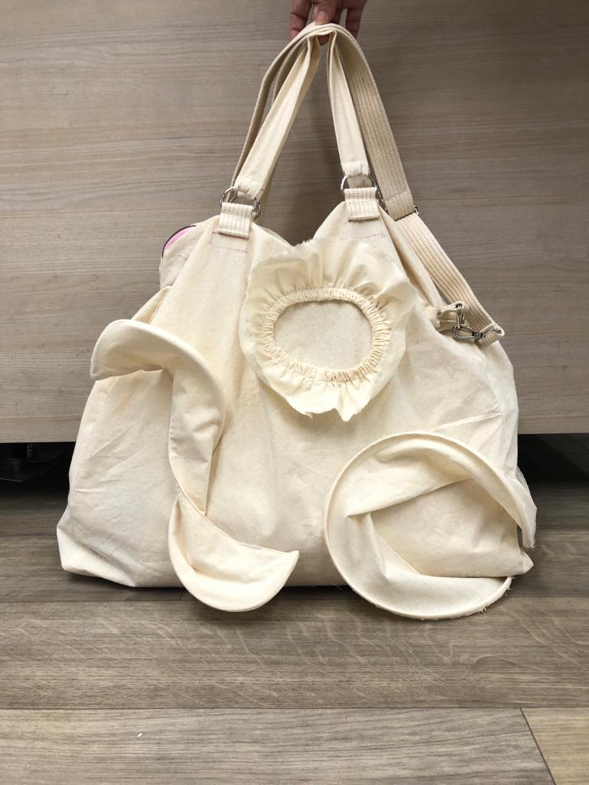
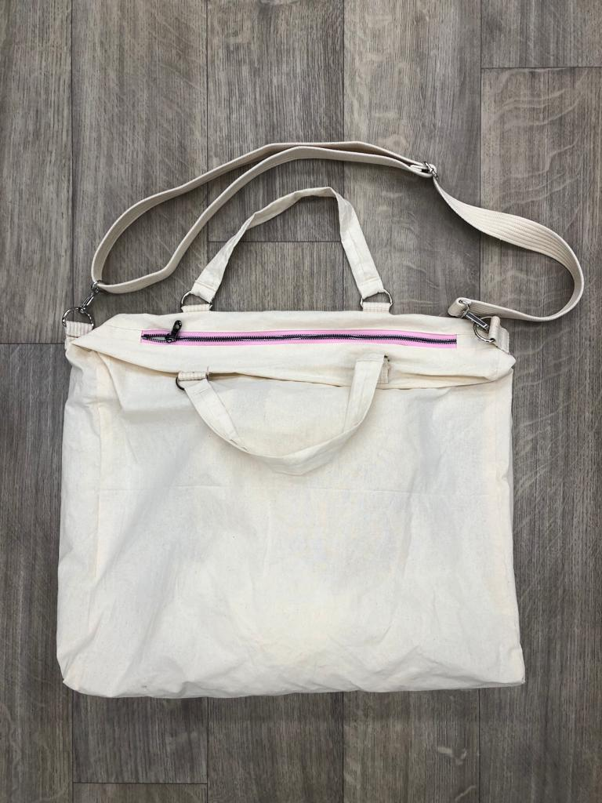
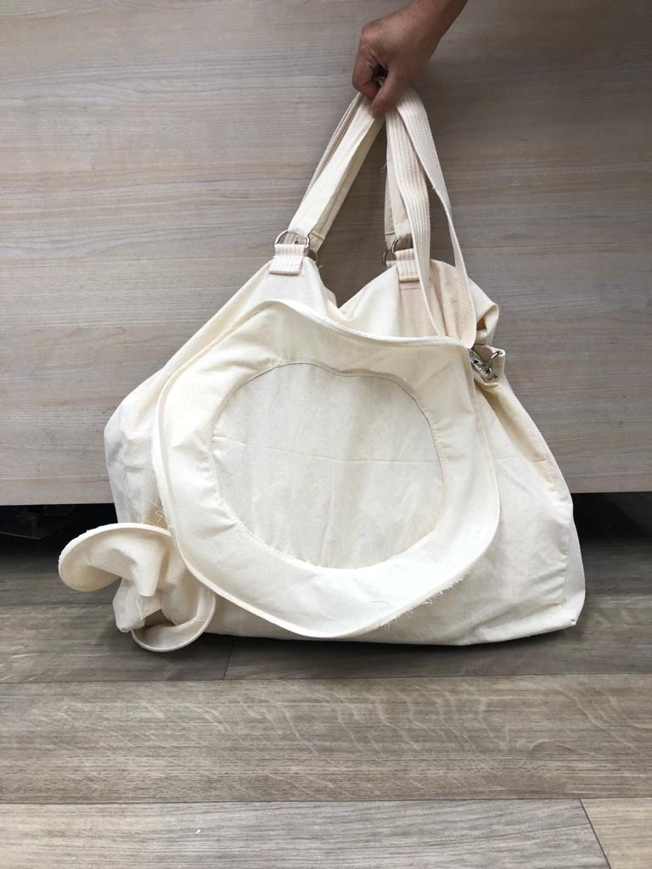
3D Tote bag
Photo(s) is/are owned and provided by HKDI

Slide 6
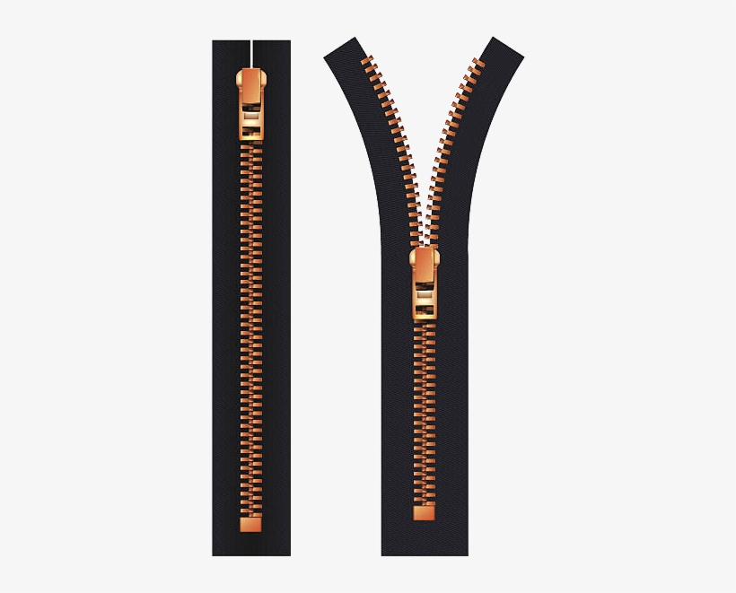
3D Tote bag
- patterns with seam allowance
40cm
zipper
43cm
9cm
Panel for closing
zipper ends
X 2
Side panel X 2
4cm
13cm
95cm
3.2cm
Shoulder strap
3.2cm
Handle X 2
104 cm
31cm
Ear loop X6
Bag
53 cm
3.2cm
9cm
Photo(s) is/are owned and provided by HKDI

Slide 7
Demonstration
Videos
Construction of a 3D tote bag
Attachment of adjustable strap
Attachment of ear loops for adjustable strap
Attachment of handle
Photo(s) is/are owned and provided by HKDI

Slide 8
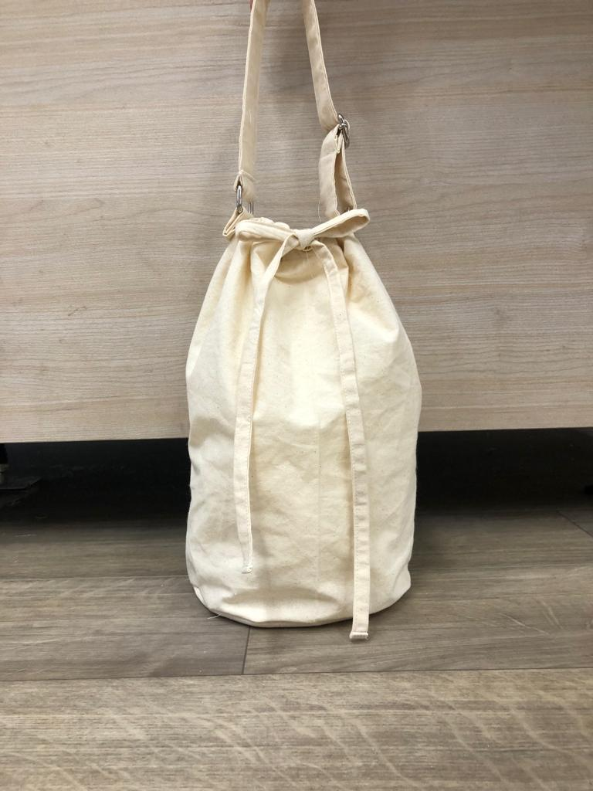
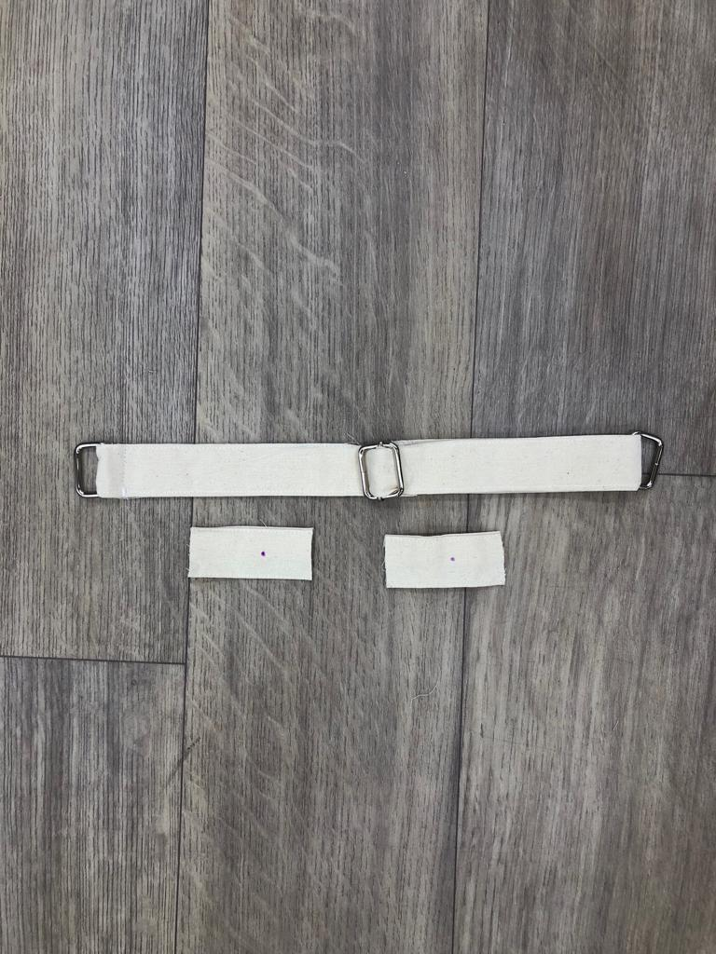
Bucket bag
Photo(s) is/are owned and provided by HKDI

Slide 9
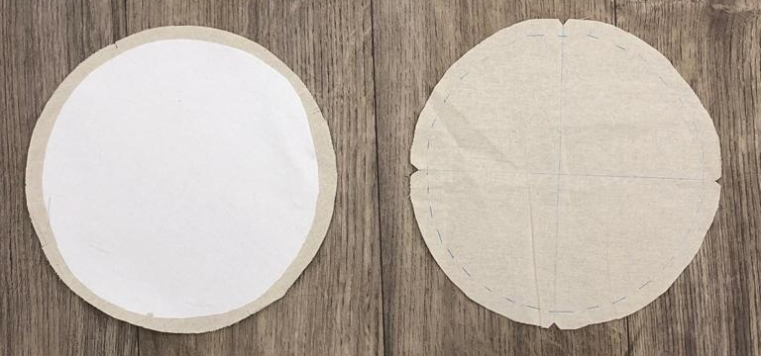
Bucket bag
- Patterns with seam
allowance
18cm
20cm
Base with
Interlining
(no seam allowance)
Base
Ear loop X 2
Drawstring X 2
56 cm
4cm
3.2cm
Handle
3.2cm
56cm
8cm
60 cm
Bag
39 cm

Slide 10
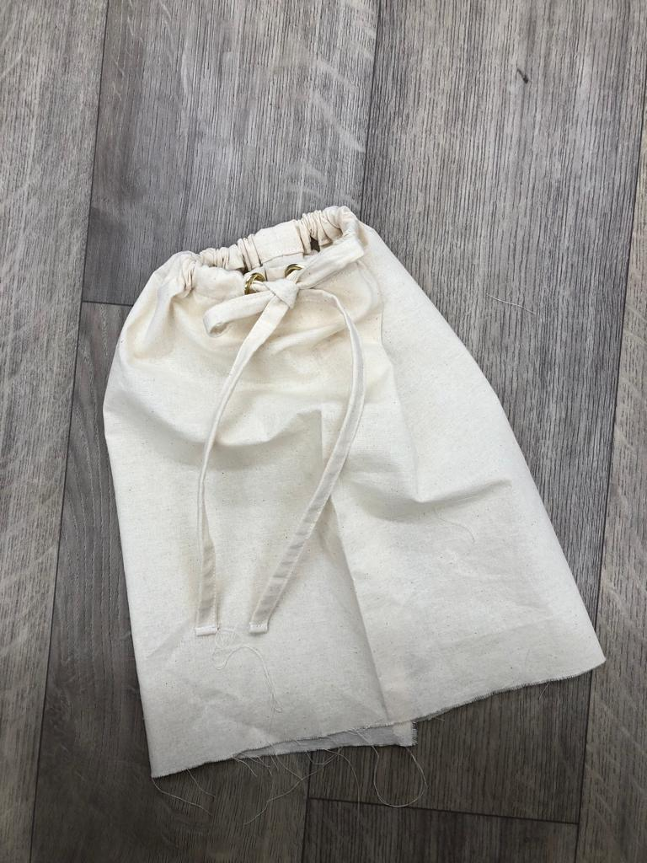
Bucket bag
+
20cm
18cm
Base with
Interlining
(no seam allowance)
Base

Slide 11
Demonstration
Videos
Join the bag with base
Attaching rivet
Photo(s) is/are owned and provided by HKDI

Slide 12
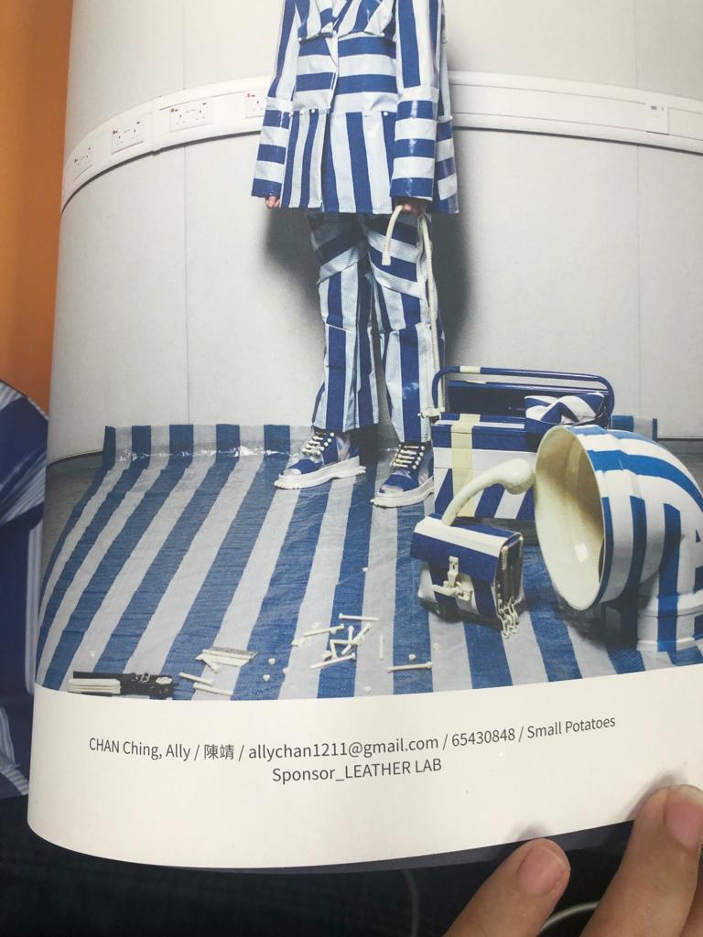
Chapter Activity
Use calico to construct your bag
Photo(s) is/are owned and provided by HKDI
Collection by CHAN Ching, Ally, HD in Fashion Design, Hong Kong Design Institute

