Slide 1
Bags
(patterns)

Slide 2
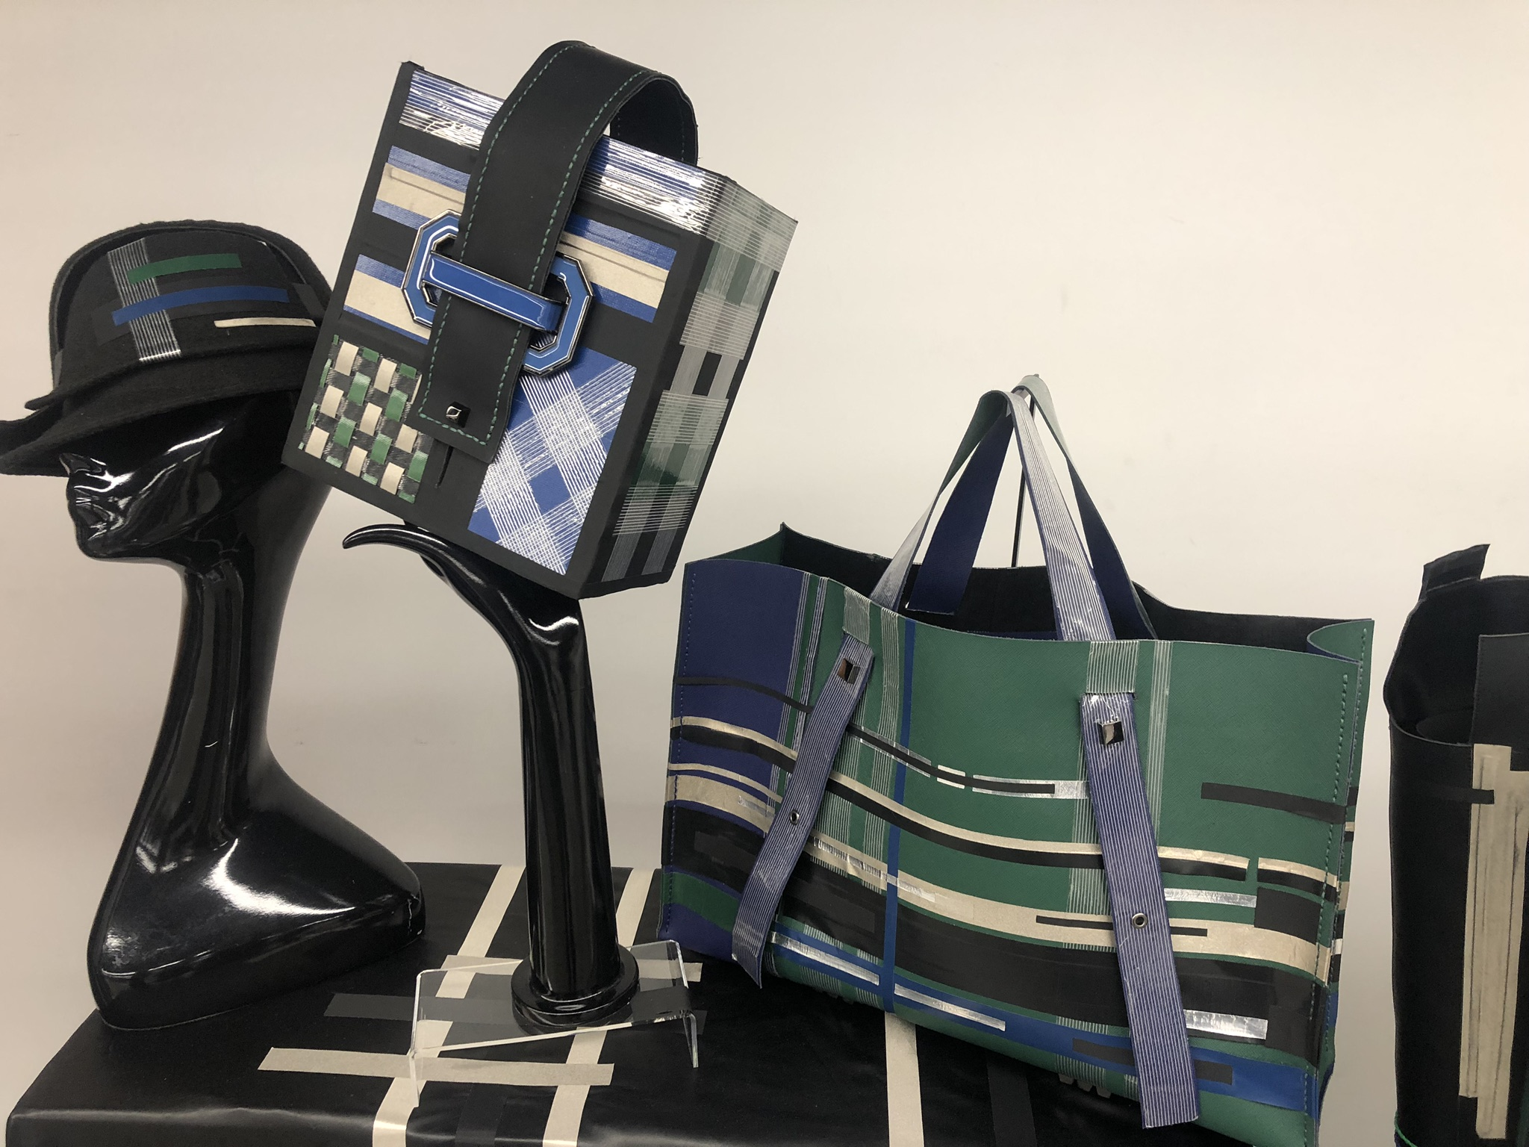
Photo(s) is/are owned and provided by HKDI
Photo(s) is/are provided by HKDI
Collection by SO Yuen Ting, HD in Fashion Design, Hong Kong Design Institute

Slide 3
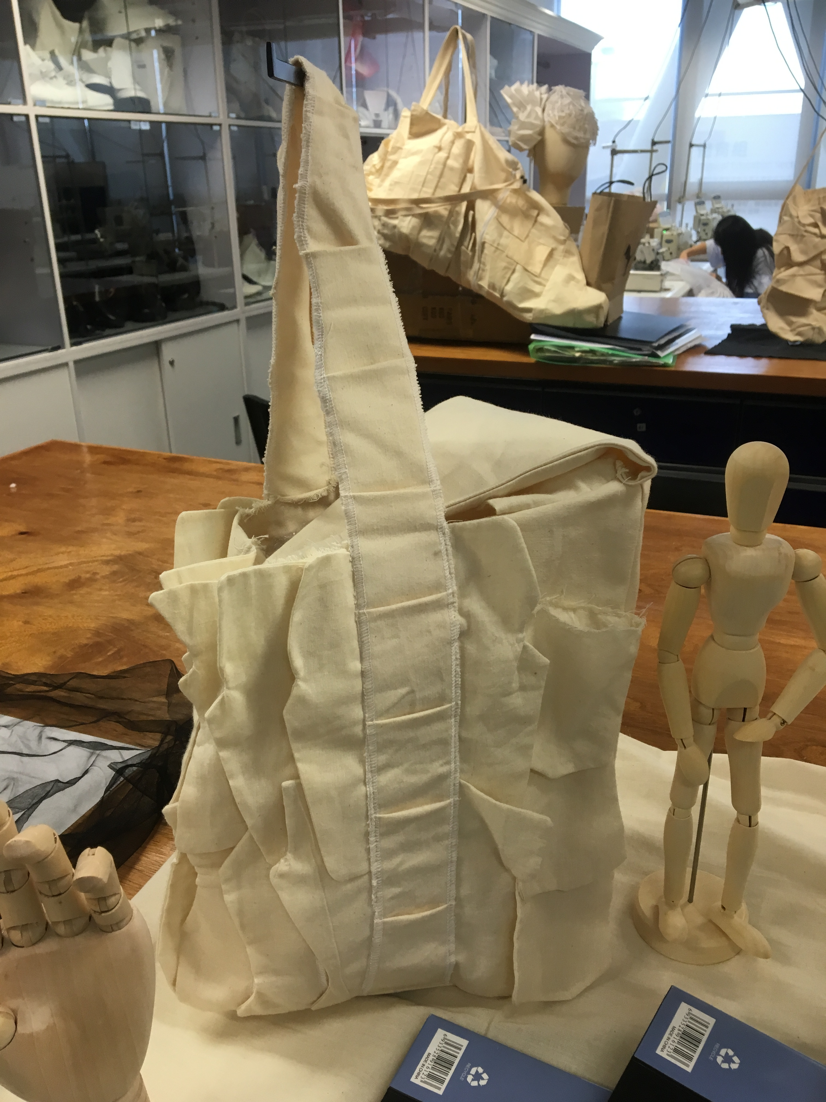
Basic structure of a bag
Handle or Shoulder Strap
Front & Back
Bottom
Side Panel
Handle or Shoulder Strap
Side Panel
Front & Back
Bottom
Photo(s) is/are provided by HKDI

Slide 4
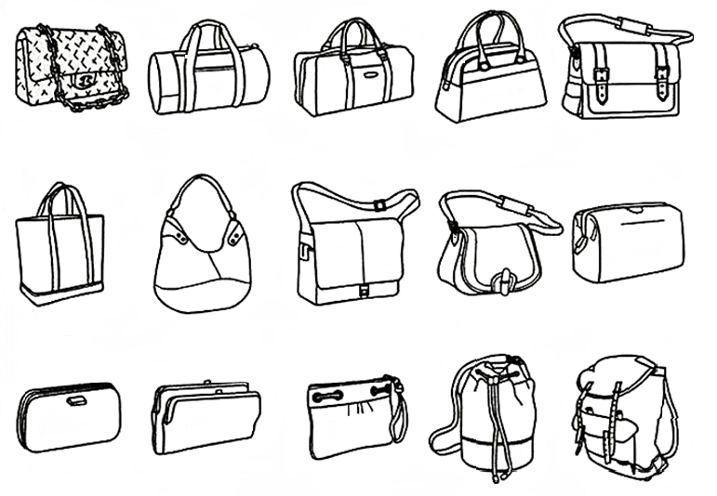
Bag styles
Source from royalty free photo from Pinterest.

Slide 5
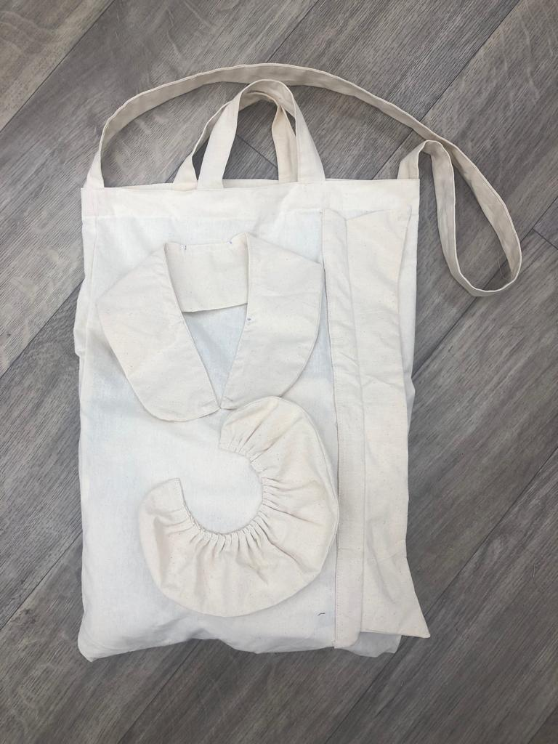
Tote bag
Photo(s) is/are provided by HKDI

Slide 6
Tote bag
- patterns with seam allowance
95cm
8cm
Shoulder strap
8cm
Handle X 2
31cm
112 cm
38 cm
Bag

Slide 7
demonstration video
Drafting patterns for tote bag

Slide 8
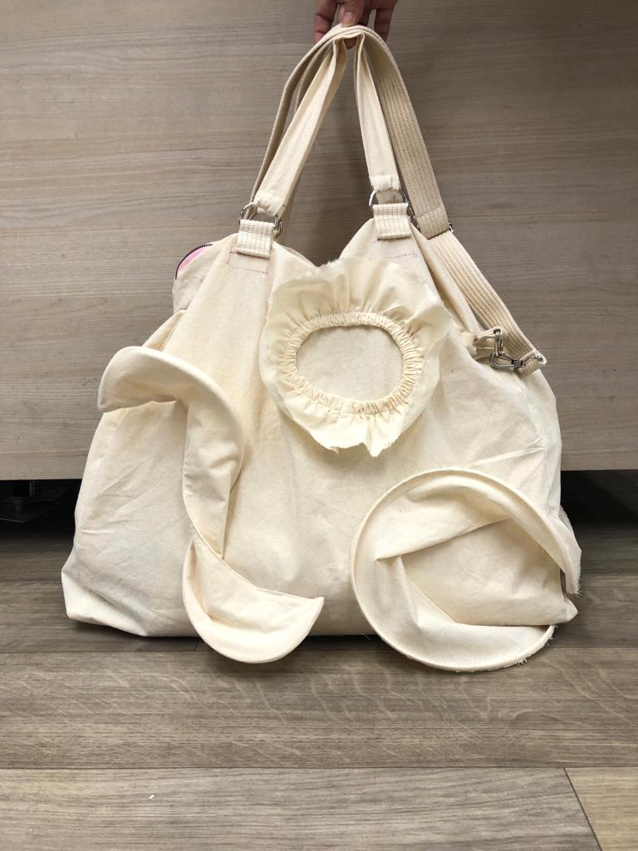
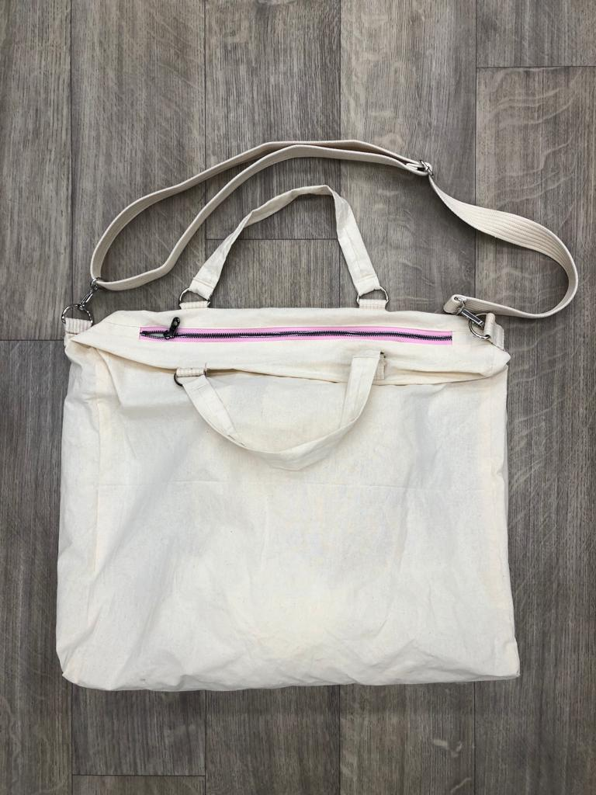
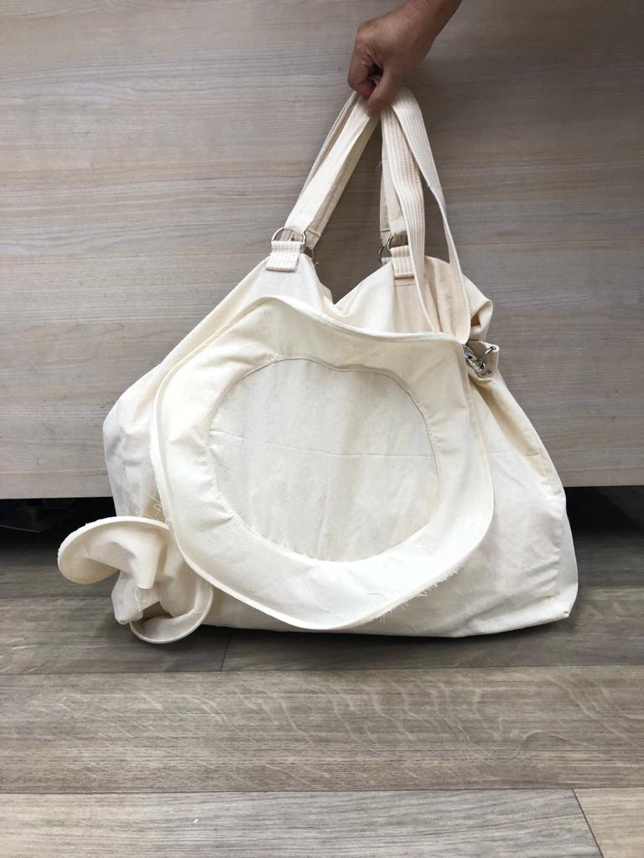
3D Tote bag
Photo(s) is/are provided by HKDI

Slide 9
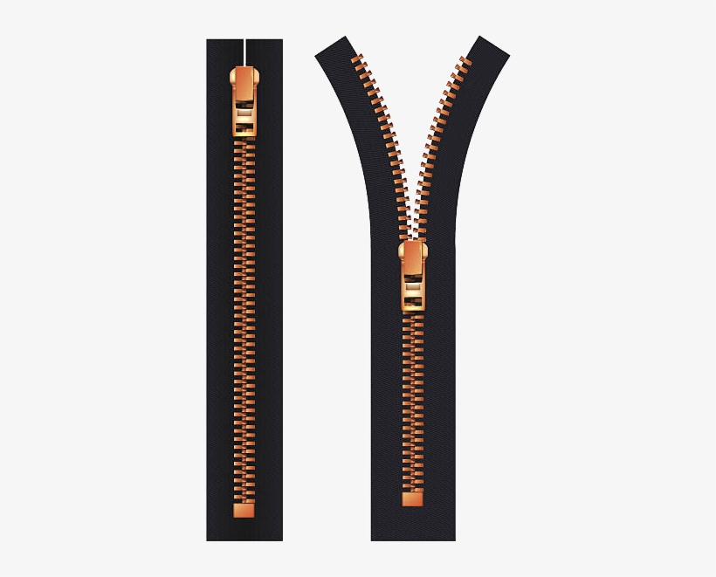
3D Tote bag
- patterns with seam allowance
40cm
zipper
43cm
9cm
Panel for closing
zipper ends
X 2
Side panel X 2
4cm
13cm
95cm
3.2cm
Shoulder strap
3.2cm
Handle X 2
104 cm
31cm
Ear loop X6
Bag
53 cm
3.2cm
9cm
Photo(s) is/are provided by HKDI

Slide 10
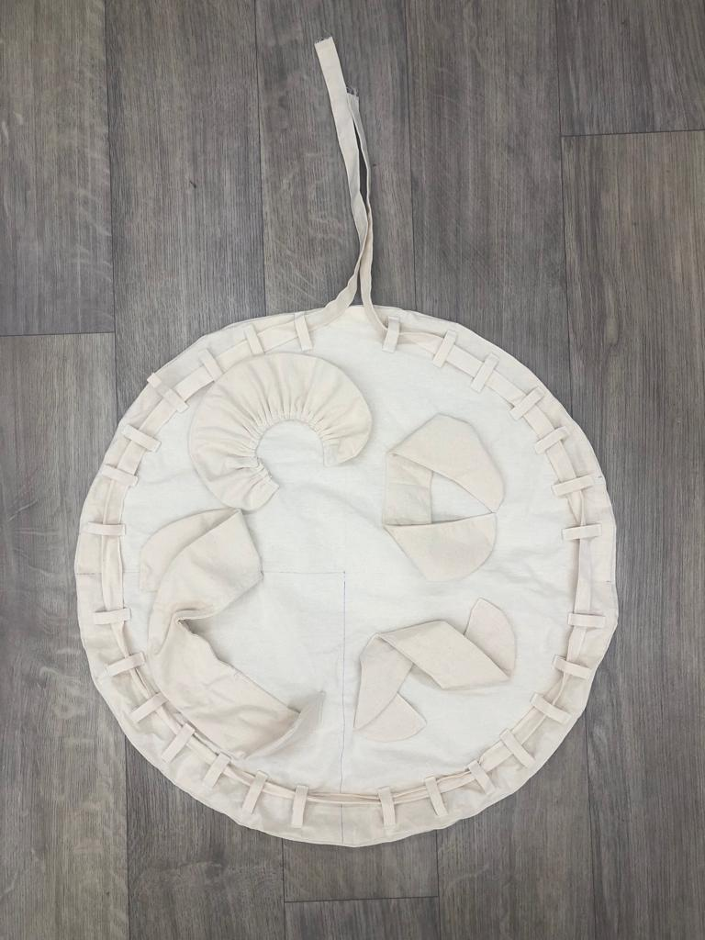
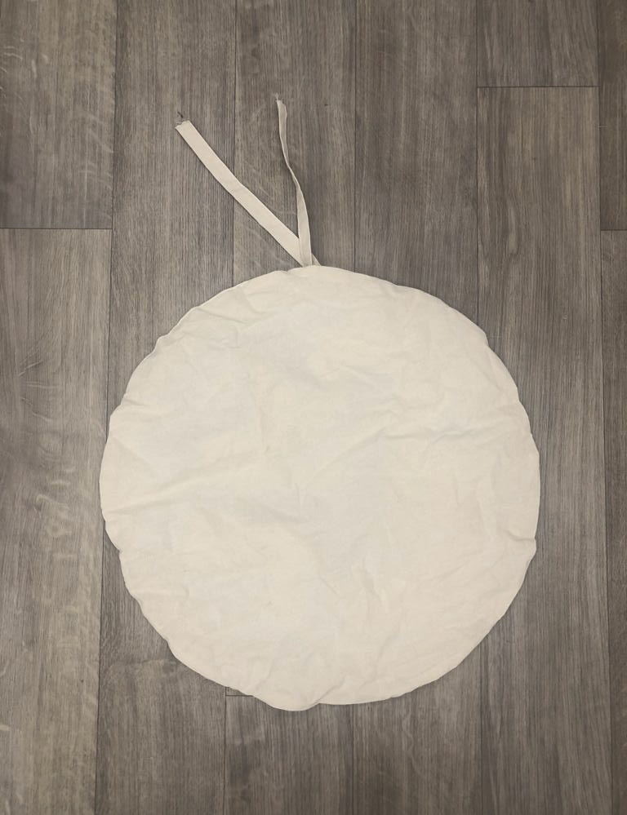
Circular bag
(with draw string)
Photo(s) is/are provided by HKDI

Slide 11
Circular bag
(with draw string)
- patterns with seam allowance
60cm
Bag
X 2
Ear loops
(divided into 28 pieces)
168 cm
4cm
182 cm
Draw String
3 cm
230 cm
6.5cm
Strap

Slide 12
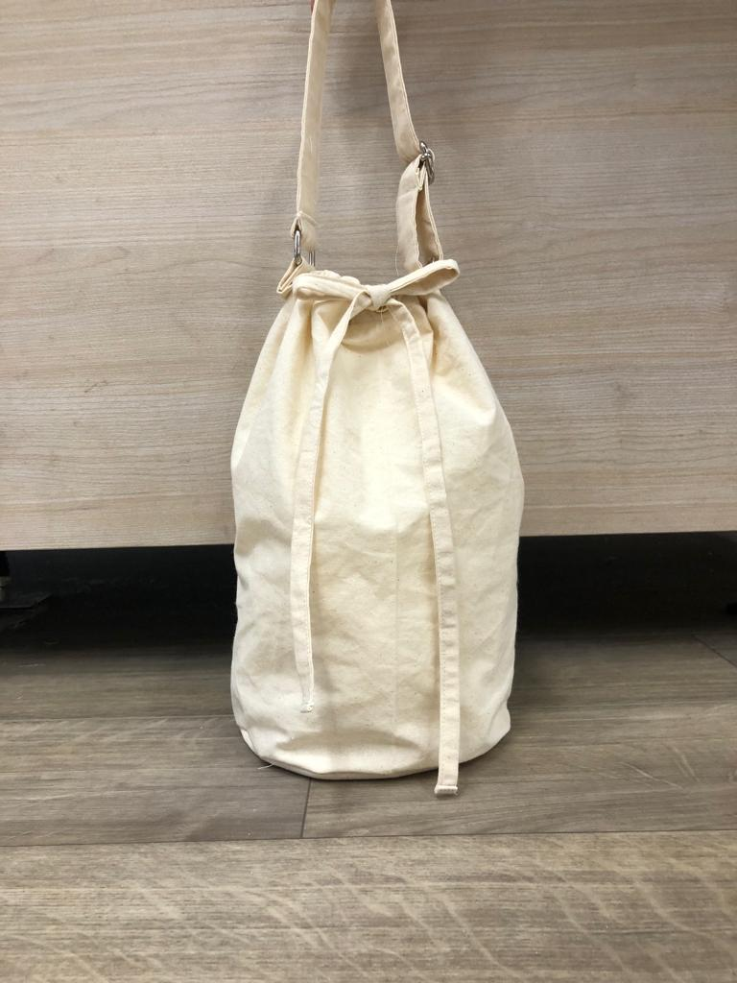
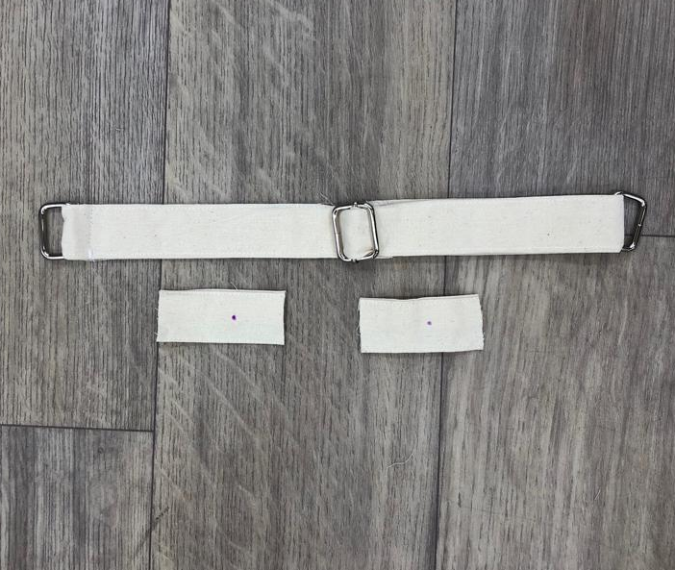
Bucket bag
(With adjustable handle)
Photo(s) is/are provided by HKDI

Slide 13
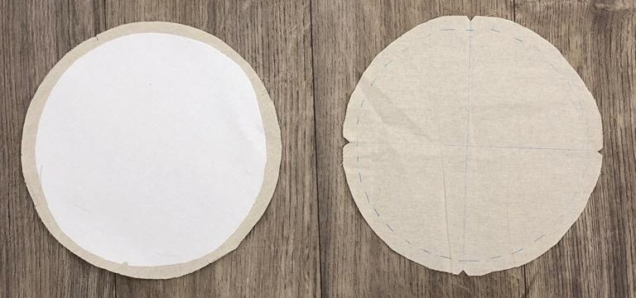
Bucket bag
- Patterns with seam
allowance
18cm
20cm
Base with
Interlining
(no seam allowance)
Base
Ear loop X 2
Drawstring X 2
56 cm
4cm
3.2cm
Handle
3.2cm
56cm
8cm
60 cm
Bag
39 cm

Slide 14
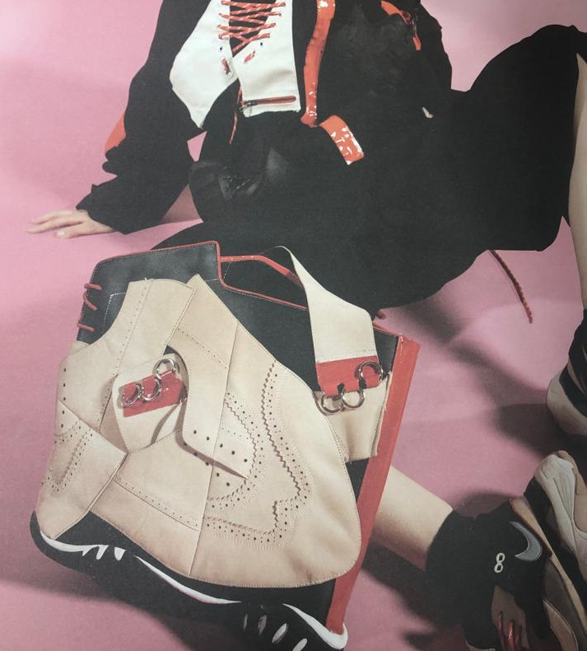
Chapter Activity
Bag pattern drafting
Please create ONE set of patterns of your designed bag.
Photo(s) is/are provided by HKDI
Collection by WANG Guolin,Naomi, HD in Fashion Design, Hong Kong Design Institute

