Slide 1
basic block OF Bodice

Slide 2
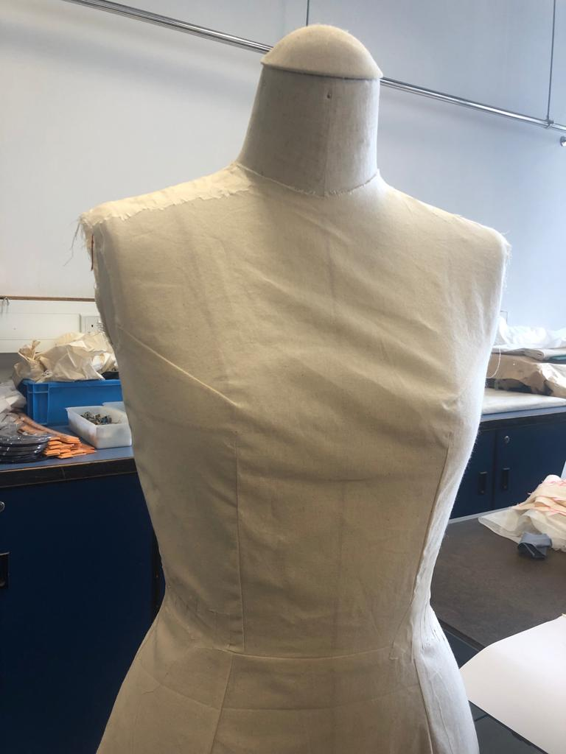
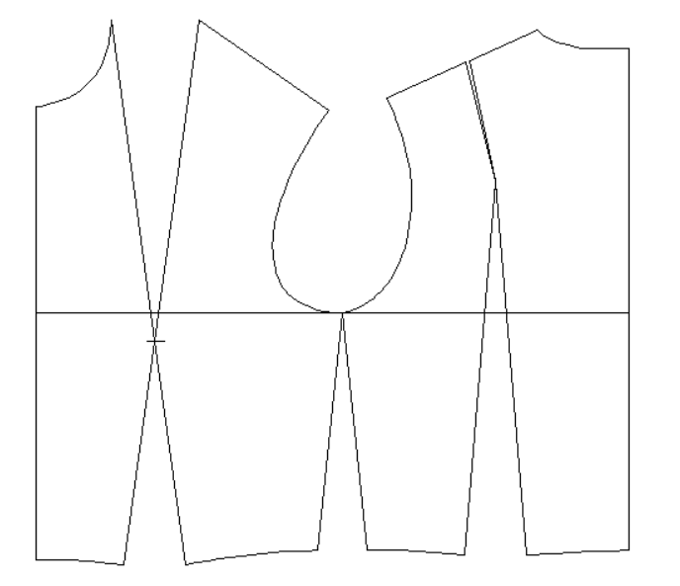
Ladies
Bodice
Photo(s) is/are provided by HKDI

Slide 3
Basic block for ladies bodice
Bust/Chest | 87cm
Waist | 64cm
Scye Depth | 21.4cm
Nape to Waist | 40.3cm
Scye Width | 11.2cm
Half Back | 17.6cm
Back Neck Width | 7.4cm
Front Neck Point Height | 2.3cm
Front Neck Width | 6.1cm
Front Neck Depth | 7cm
Neck to Bust | 26cm

Slide 4
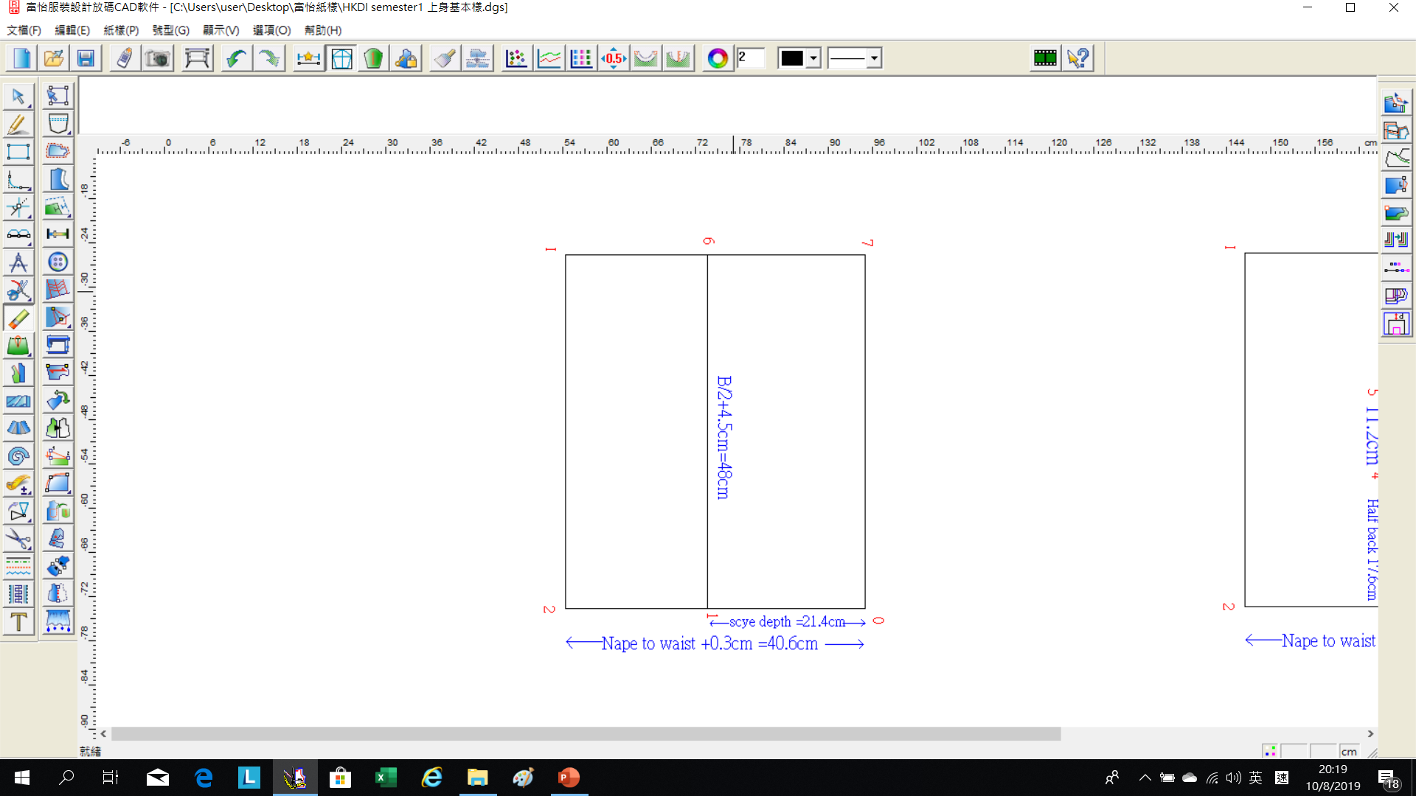
From (1) to (0)
= Scye Depth (21.4cm)
From (2) to (0)
= Nape to Waist + 0.3cm
(40.6cm)
From (6) to (1)
= Half Bust +4.5cm (48cm)
Square up and down from (6) to (7) & (I).

Slide 5
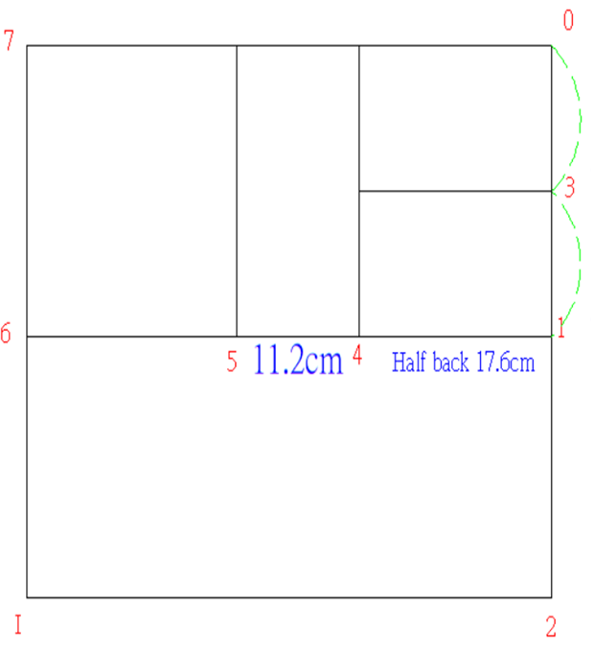
(3) is midway (0)-(1).
Square from (1)-(2)-(3)
From (4)to(1)
= Half Back (17.6cm)
From (5) to (4)
= Scye Width (11.2cm)

Slide 6
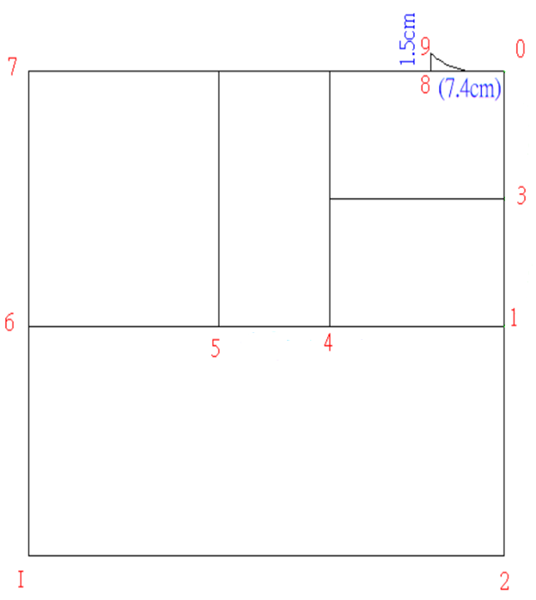
From (8) to (0)
= Back Neck Width (7.4cm)
Square up 1.5cm for all sizes to (9).
Draw the back neck in curve line.

Slide 7
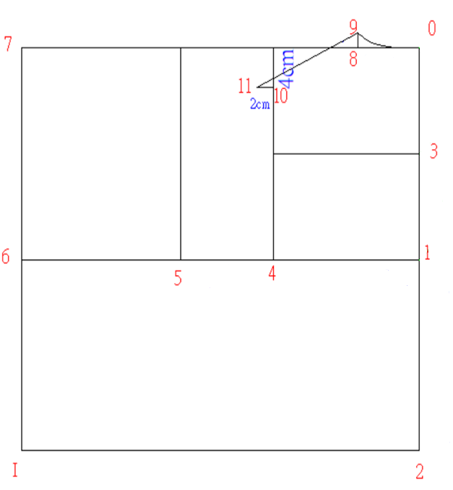
(10) is 4cm below line (0)-(7) for all sizes.
Square out 2 cm to (11).
Draw the shoulder (9)-(11).

Slide 8
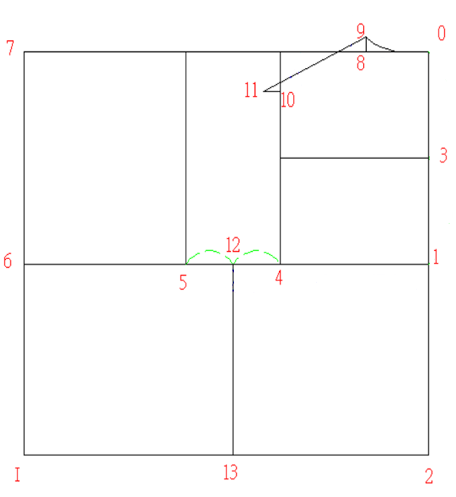
(12) is midway of (4) & (5).
Square down to (13).

Slide 9
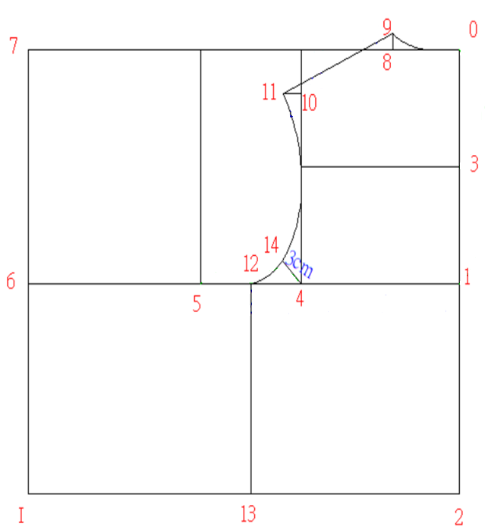
(14)is approximately
3cm from (4).
Draw the back scye (11)-(14)-(12) with a curve line.
Right angle

Slide 10
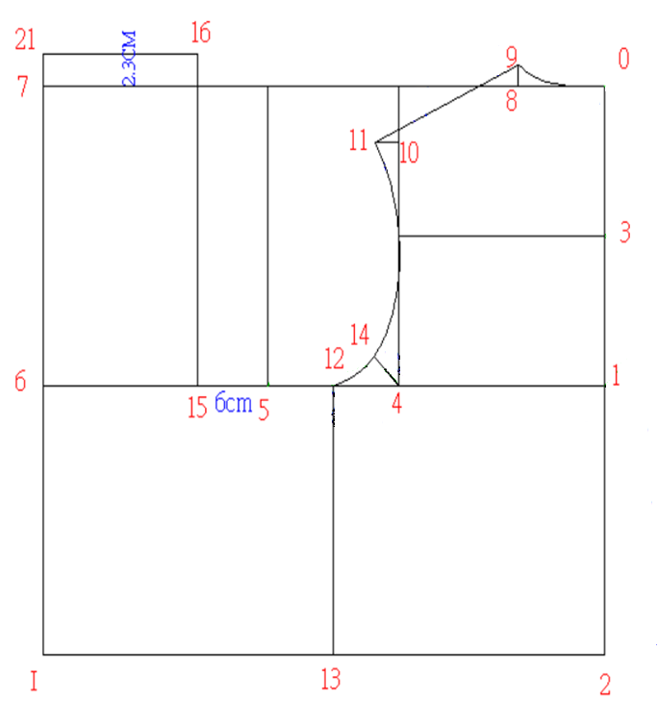
From (15) to (5)
=6cm for all size.
Square up from (15) to (16).
(16) above nape line
(0)-(7)=Front Neck Point Height (2.3cm)
From (21) to (7)
=Front Neck Point Height (2.3cm)
Square across from (21).

Slide 11
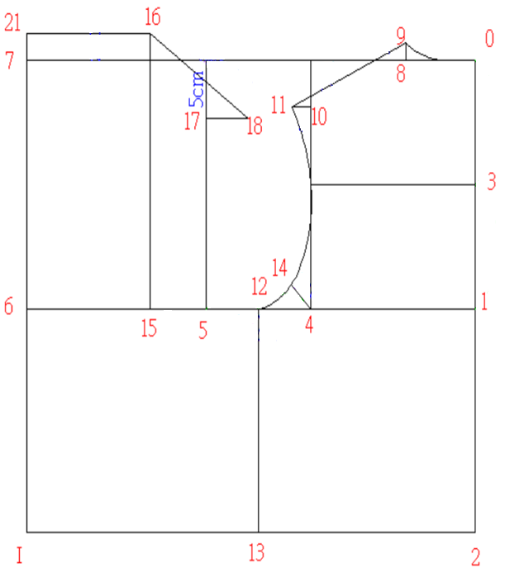
(17) is 5cm below line (0)-(7).
From (18) to (16)
=(9) to (11) minus 0.3cm, measure from pitch (front shoulder line)

Slide 12
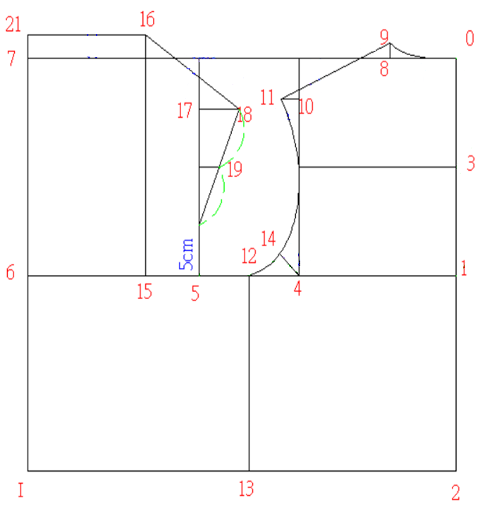
Front pitch is 5cm for all size.
Connect (18) to front pitch.
(19) is midway between (18) and front pitch.

Slide 13
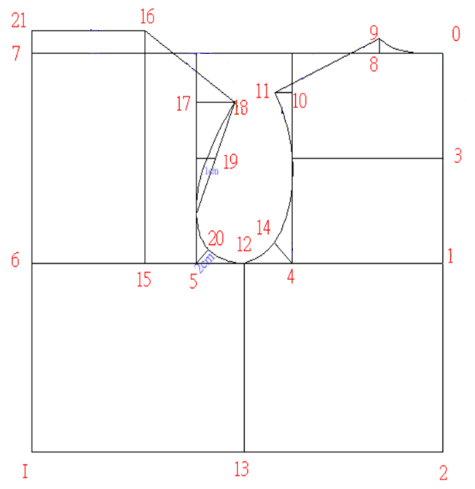
(20) is approximately
2 cm from (5).
Hollowing 1 cm at (19),
Draw the front scye
(18)-(20)-(12),
Right angle

Slide 14
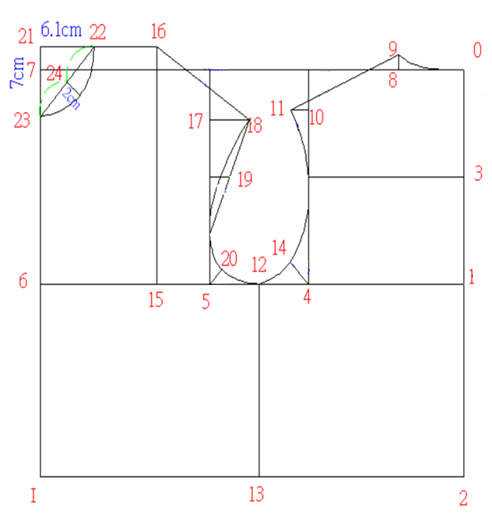
From (22) to (21)
= Front Neck Width (6.1cm)
From (23) to (21)
=Front Neck Depth
(7cm), connect (22)-(23).
Hollowing approximately 2cm at (24)
.
Draw the front neck
(22)-(23) in a curve line.

Slide 15
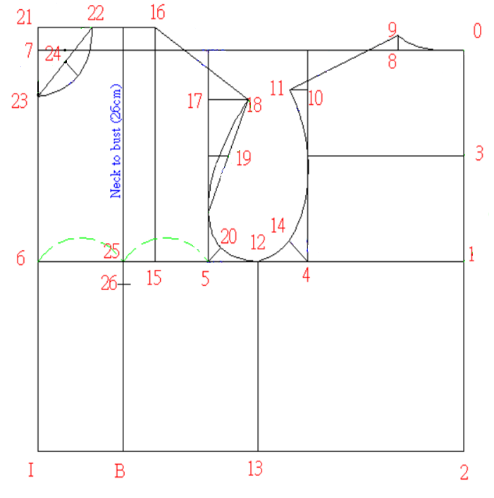
(25) is midway between (5)-(6), square down from (25) to (B).
From (26) to (22)
=Neck to bust measure from (22), on to line (25)-(B).

Slide 16
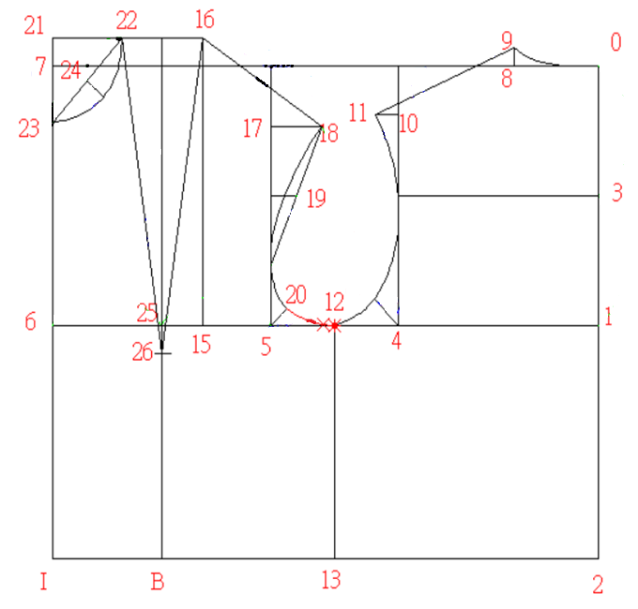
Join the front bust dart.

Slide 17
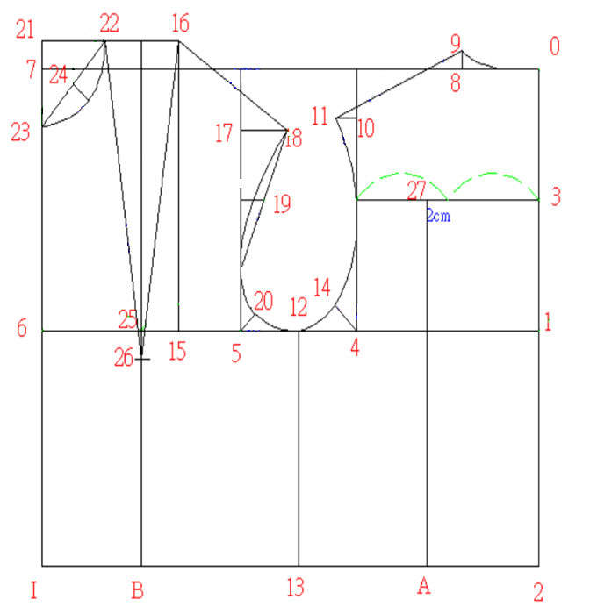
Find the midway point of the half back line (3). (27) is 2 cm toward the scye.
Square down from (27) to (A).

Slide 18
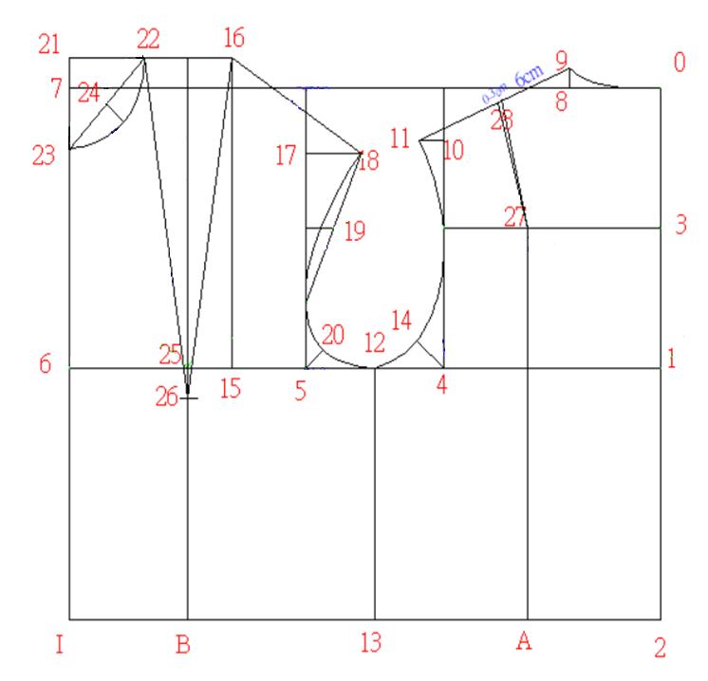
From (28) to (9)
=Approximately 6cm.
From (28), make a small dart of 0.3CM.
Connect the dart at (27).

Slide 19
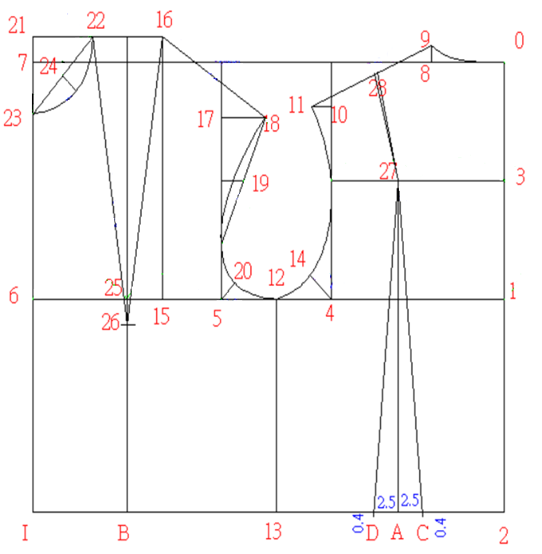
Mark 2.5cm at each side of (A), and draw 2 vertical lines.
(C) & (D) are 0.4cm below waistline.
Connect (C) & (D) to (27).

Slide 20
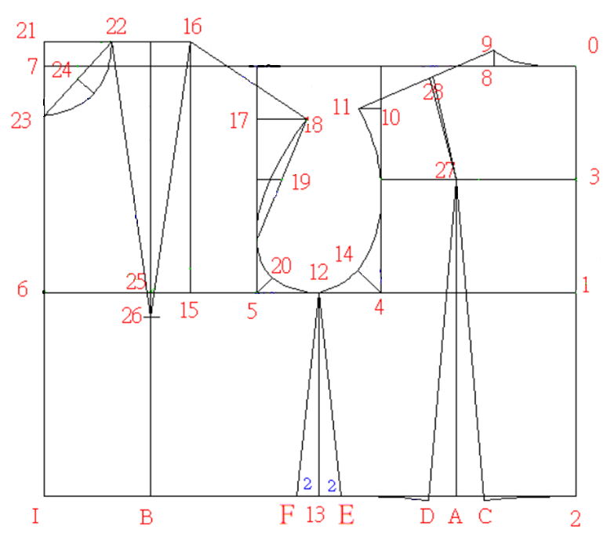
Mark 2 cm each side of (13).
Draw back waist
(2)-(C) and (D)-(E), hollowing slightly.

Slide 21
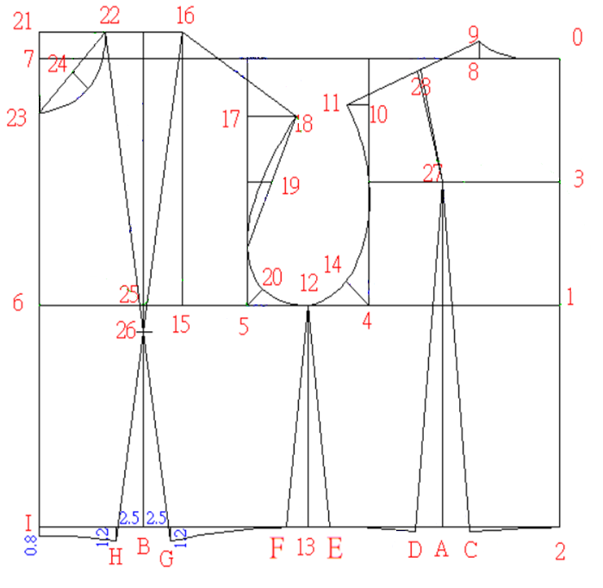
Mark 2.5cm at each side of (B) and draw 2 vertical lines.
(G) & (H) are 1.2cm below waistline. Connect (G) & (H) to (26).
Draw the side seams
(E) to (12) & (F) to (12).
Draw waistline (F)-(G) with a slight curve.
(I) is 0.8 cm below waistline.
Connect (I) & (H) with a slight curve.

Slide 22
Finished the Ladies Bodice Tops ( front and back )

Slide 23
Demonstration Videos
Basic block for ladies bodice - Part 1
Basic block for ladies bodice - Part 2

Slide 24
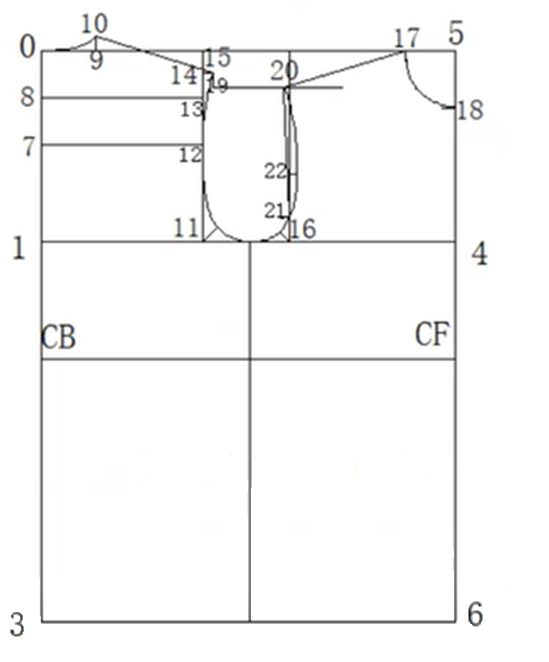
Men’s
bodice

Slide 25
Basic block for
Men’s bodice
Chest | 100cm
Scye Depth | 24.4cm
Neck Size | 40cm
Half Back | 20cm
Natural Waist Length | 42.2cm
Shirt length | 80cm

Slide 26
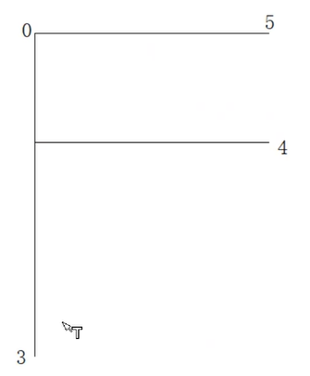
58 cm
Square both ways from (0).
(0)-(5) = (1)-(4) → ½ chest plus 8cm (58cm)
(0)-(3) = Shirt Length plus 1cm.
26.9cm
1
80cm

Slide 27
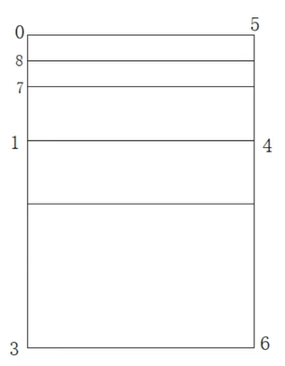
(0)-(2)= Natural Waist Length plus 1cm (43.2cm); square across
(0)-(7)= ½ Scye Depth plus 1cm (13.2cm); square out
(0)-(8)= ½ measurement of (0)-(7) (6.6cm); square out
2

Slide 28

5
(1)-(11) = half back plus 2.5cm (22.5cm); square up to (12) and (13)
11
2

Slide 29
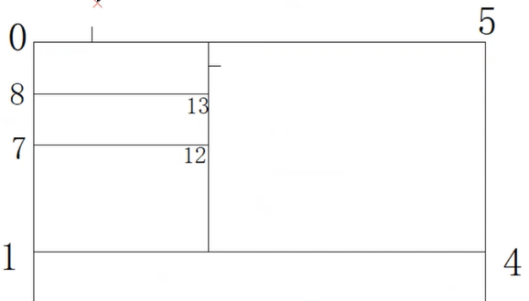
10
5
(0)-(9) = 1/5 Neck Size minus 0.5cm (7.5cm); square up
(9)-(10) = 2cm
9
11

Slide 30
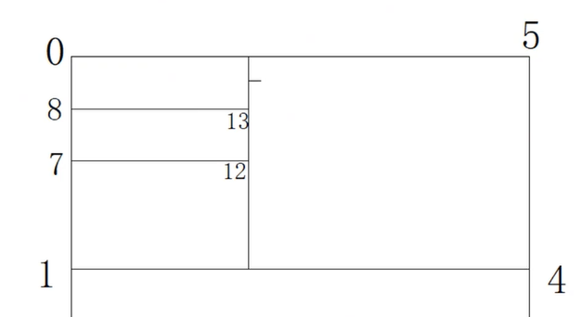
5
(13)-(14) = 3.5cm; square out
(14)-(15) = 1.5cm
14
15
11

Slide 31
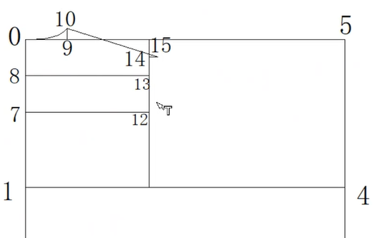
5
Join (10)-(15)
(0)-(10): draw in neck curve
11

Slide 32
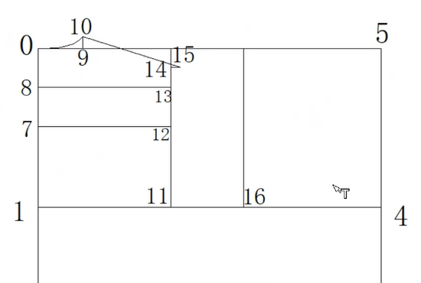
5
(1)-(16) = 1/3 Chest plus 1.5cm (34.8cm)

Slide 33
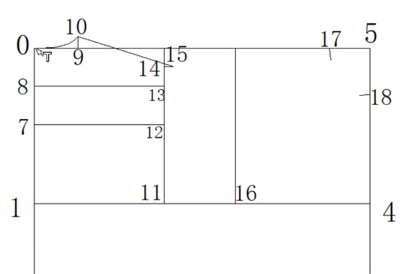
5
(5)-(17) = 1/5 Neck Size minus 1cm (7cm)
(5)-(18) = 1/5 Neck Size (8cm)

Slide 34
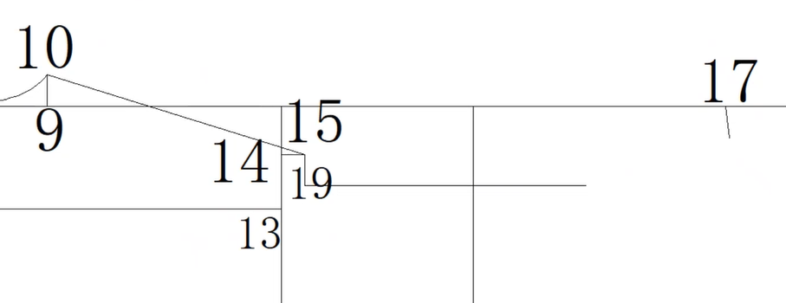
5
(15)-(19) = 2cm; square out

Slide 35
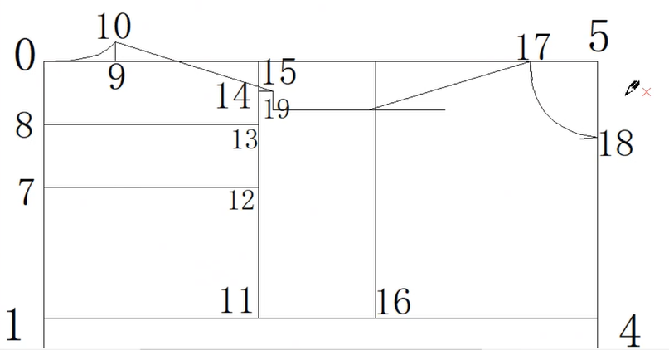
5
(17)-(20) = the measurement (10)-(15) plus 0.5cm (17.8cm)
20

Slide 36
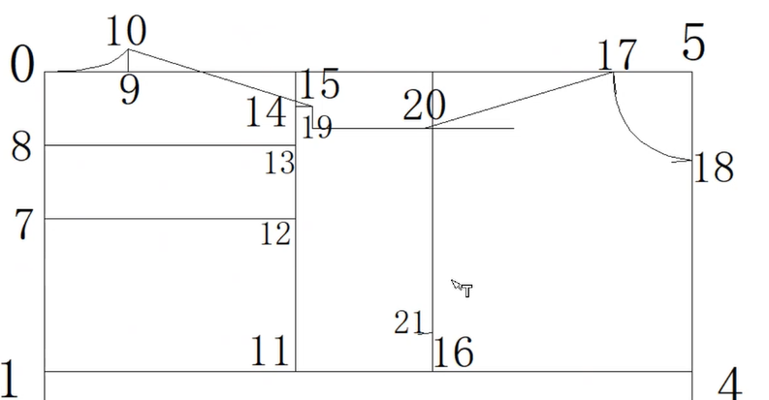
5
(16)-(21): square up 3.5cm from (16)

Slide 37
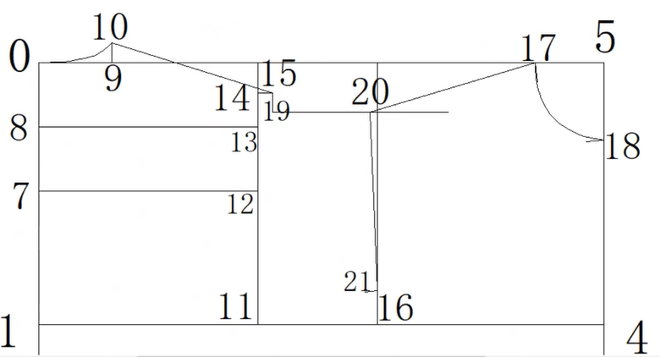
5
Join (20)-(21)

Slide 38
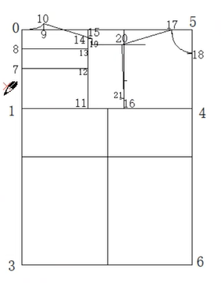
5
(21)-(22) = 1/3 measurement of
(20)-(21)
(16)-(23) = ½ measurement of (11)-(16) minus 0.5cm (5.6cm)
Square sown to hem line
23
2

Slide 39
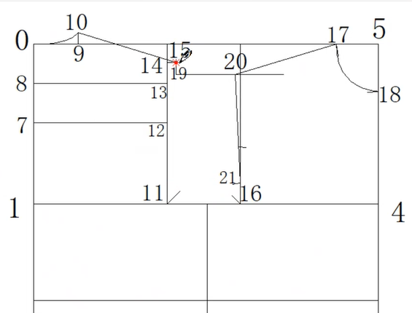
5
(11): Mark a line 3cm at 45 degree
(16): Mark a line 2cmat 45 degree

Slide 40
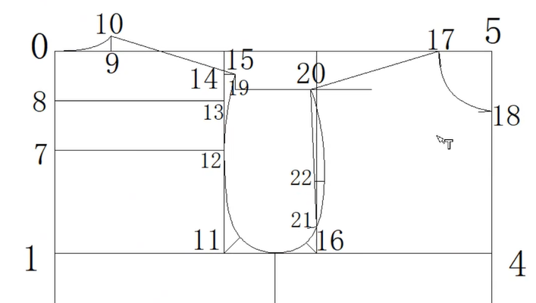
5
(22): Curve inwards 1.25cm
Join the armhole

Slide 41
5

Slide 42
Demonstration Video
Basic block for men’s bodice

Slide 43
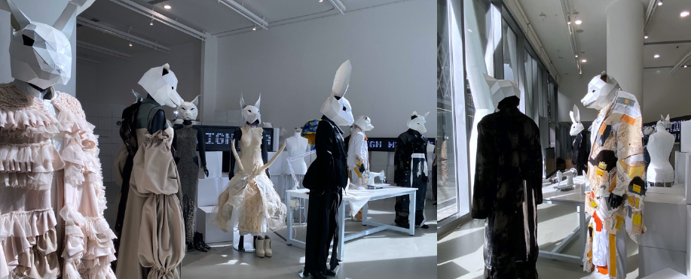
Royalty-free photo sourced from www.pexels.com
Photo(s) is/are provided by HKDI
Chapter Activity
Construct basic block of the ladies or men’s bodice

