Slide 1
Basic block of bodice (pattern styling)

Slide 2
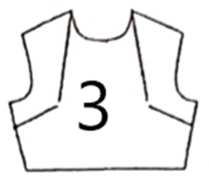
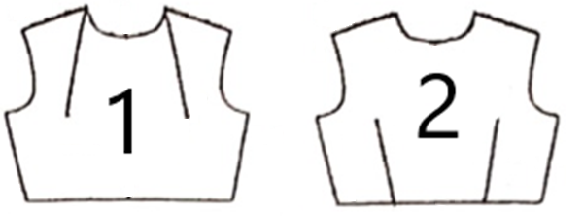

Slide 3
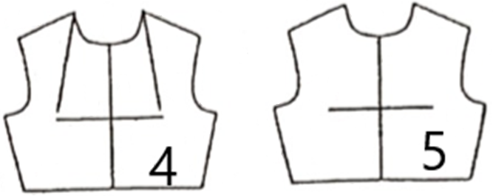

Slide 5
Demonstration Videos
Bodice Style 1-3
Bodice Style 4-5
Bodice Style 6-8

Slide 6
Chapter Activity
Practice the pattern adaptation of bodice

