Slide 1
Pockets
(Sewing Techniques)

Slide 2
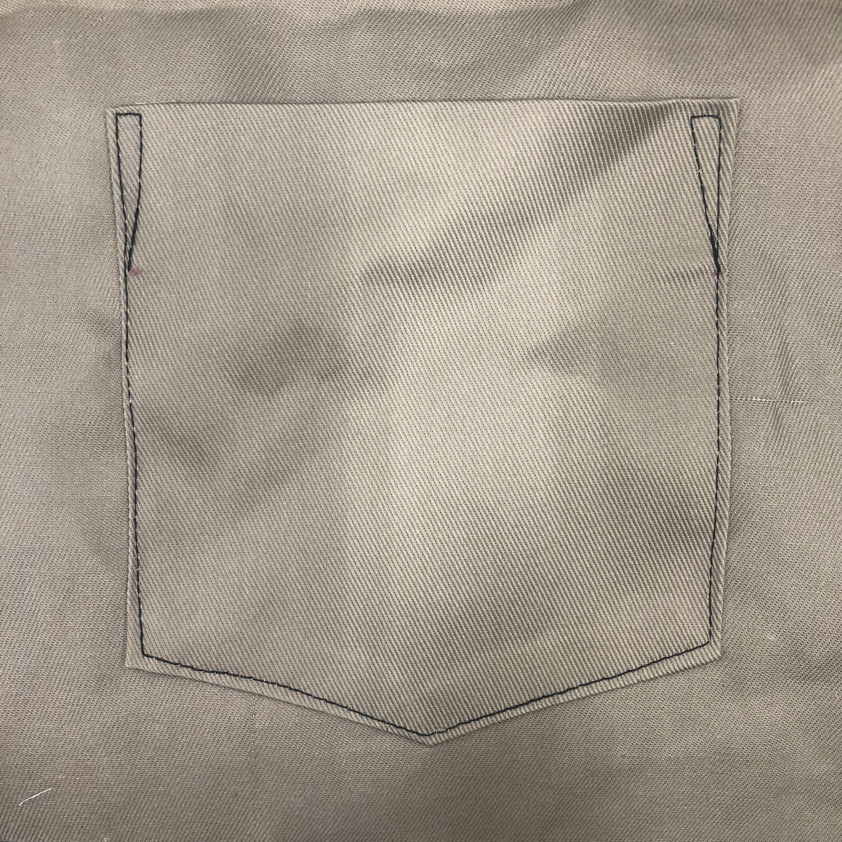
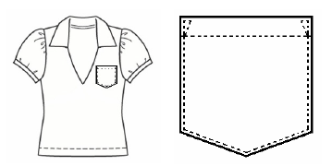
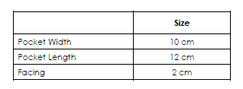
01. Pointed Patch Pocket

Slide 3
Pointed Patch Pocket
Draw vertical line
0 | Mark (0) at starting point | 2cm
1 | (1)- (0) = Pocket Length | 12cm
2 | (2) From (1) = Pocket Width | 10cm
3 | (2) Square up to (0) form a rectangle | 13cm
4 | (4) From (1) = (1)-(2) ÷ 2 | 7cm
5 | (5) From (1) = 2cm | 14cm
6 | (6) From (2) = 2cm

Slide 4
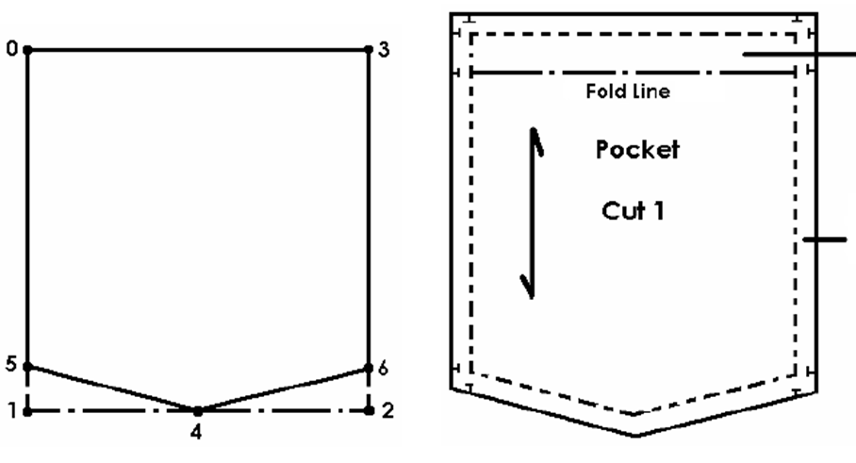
2cm
1cm seam allowance

Slide 5
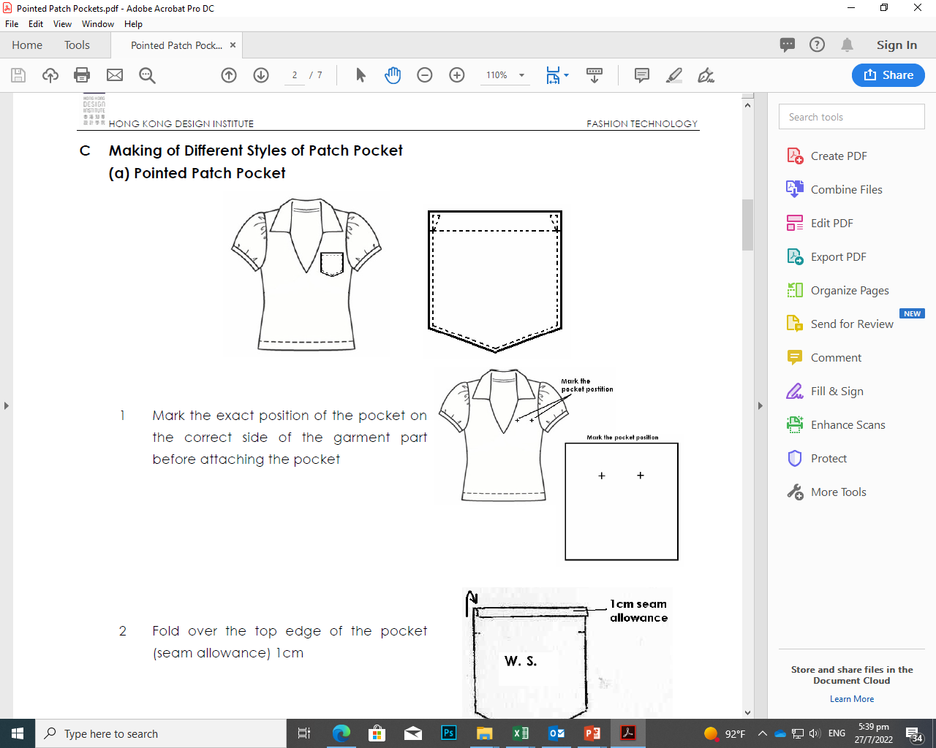
Attaching pointed patch pocket
Mark the exact position of the pocket on the right side of the garment before attaching the pocket.

Slide 6
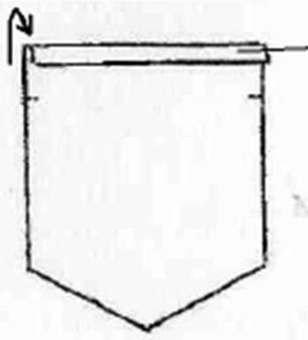
Attaching pointed patch pocket
Fold over the top edge of the pocket (1cm seam allowance).
1cm seam allowance
W.S.
** W.S. – wrong side

Slide 7
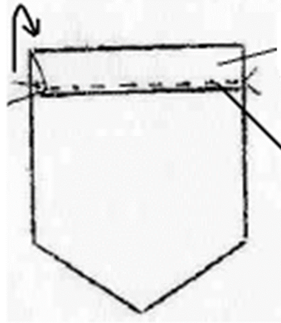
Attaching pointed patch pocket
2cm
Turn 2cm along the fold line to the wrong side (W.S.) and topstitch.
top stitch
W.S.

Slide 8
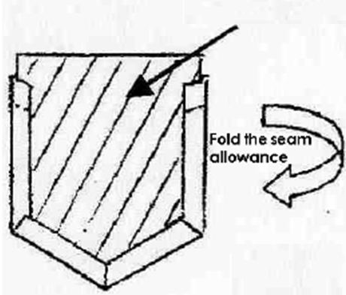
Attaching pointed patch pocket
Fold the seam allowance to the wrong side (W.S.).
template

Slide 9
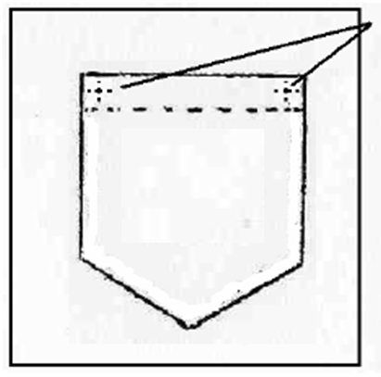
Attaching pointed patch pocket
Place the pocket over the marks
Lay the pocket at the desired pocket location.
R.S.
** R.S. – right side

Slide 10
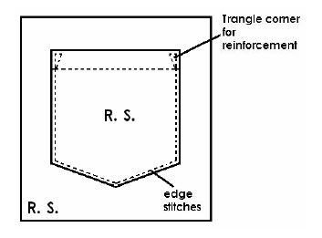
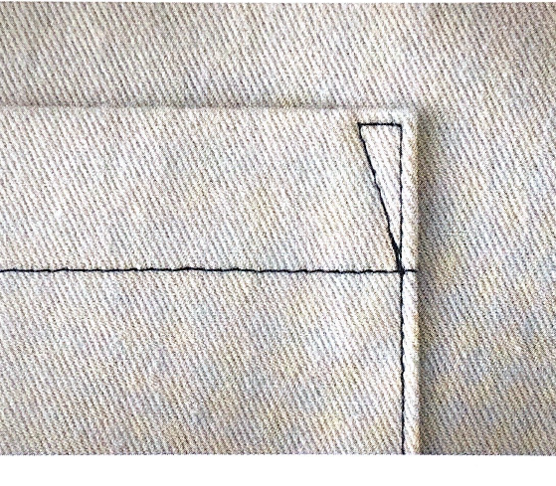
Attaching pointed patch pocket
a small triangle for reinforcement
Edge stitch the pocket to the desired location. Stitch a small triangle at the corner of the pocket opening for reinforcement.
edge
stitching

Slide 11
Attaching pointed patch pocket
a small triangle for reinforcement
edge
stitching

Slide 12
Demonstration Video
Attachment of pointed patch pocket

Slide 13
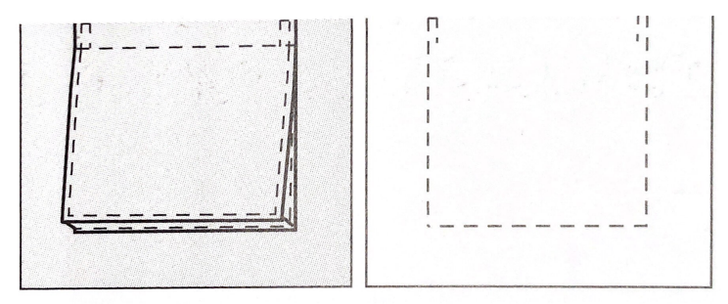
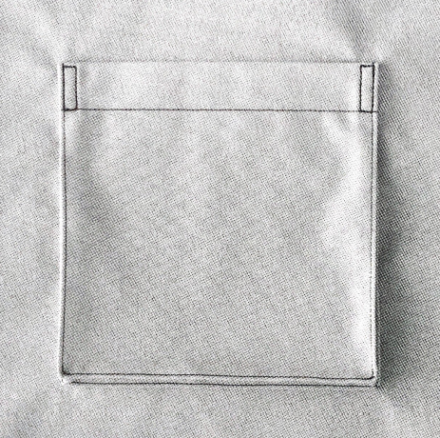
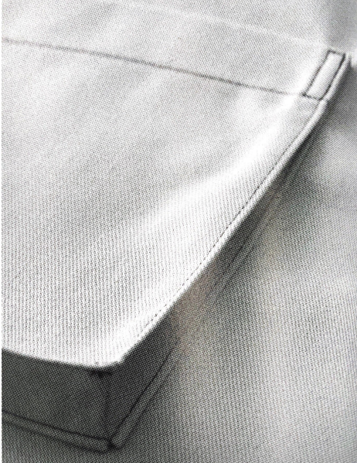
02. Bellow Pocket

Slide 14
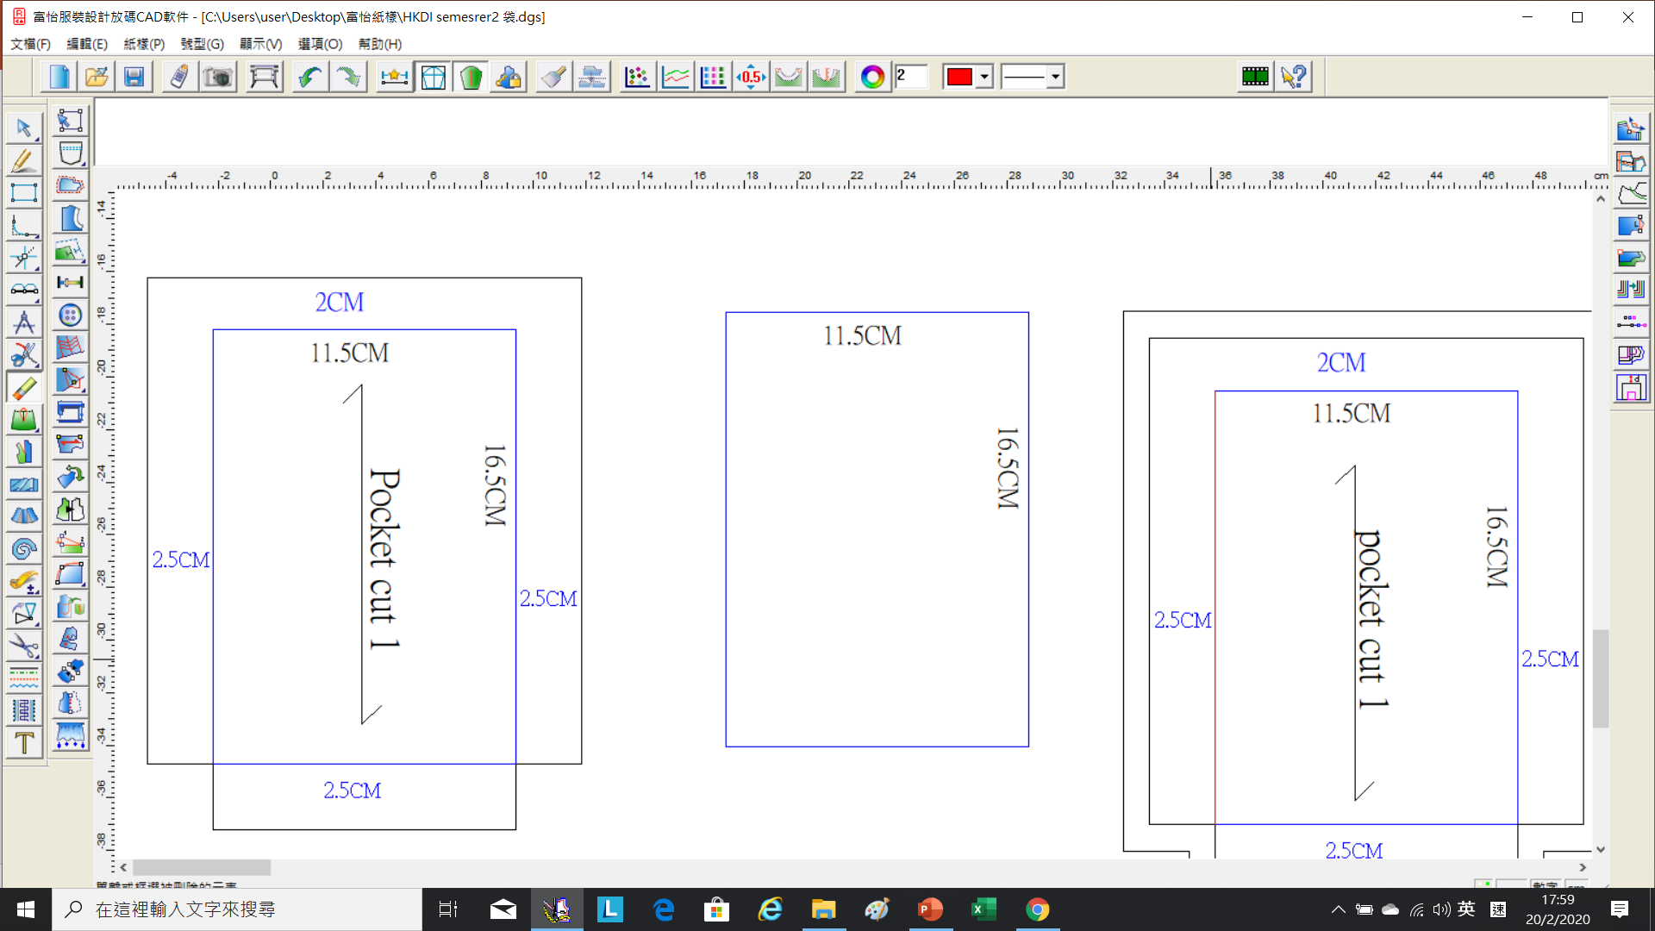
Pocket Width: 11.5cm
Pocket Length: 16.5cm
Bellow Pocket

Slide 15
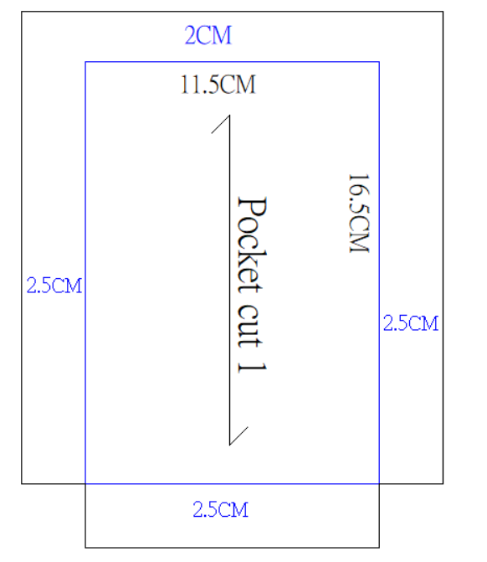
Bellow Pocket

Slide 16
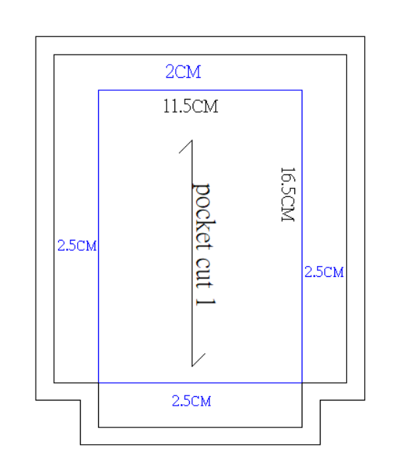
Add 1cm seam allowance.

Slide 17
Attaching Bellow Pocket
Mark the exact position of the pocket on the right side of the garment before attaching the pocket.

Slide 18
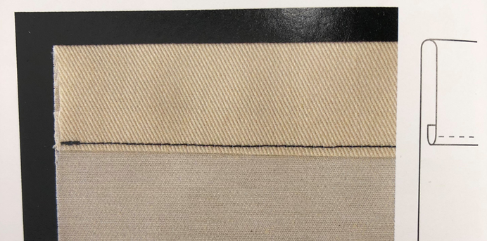
Attaching Bellow Pocket
Fold over the top edge of pocket (1cm seam allowance).
Turn 2cm along the fold line to the wrong side (W.S.) and topstitch.
W.S.

Slide 19
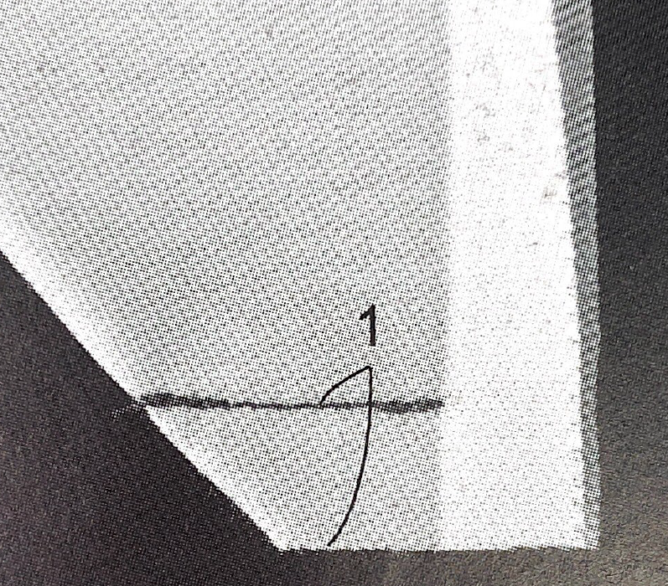
Attaching Bellow Pocket
Fold the turning at the corner and stitch (1cm seam allowance).
1cm

Slide 20
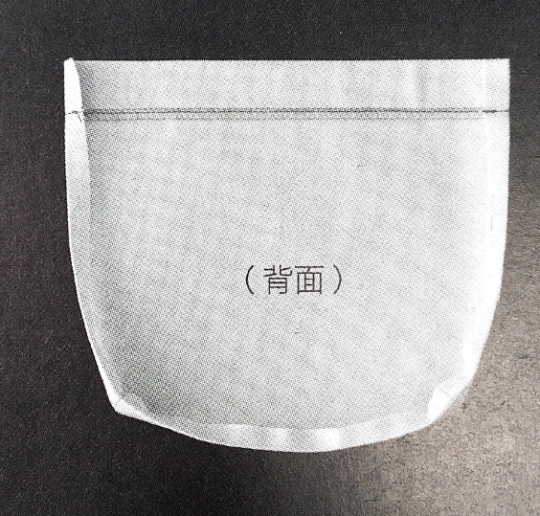
Attaching Bellow Pocket
Fold the seam allowance (1cm allowance) to the wrong side.
Wrong Side

Slide 21
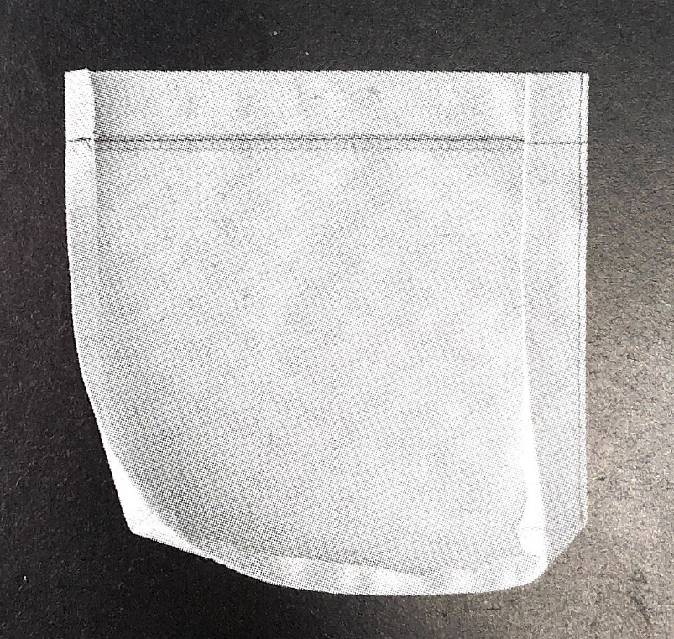
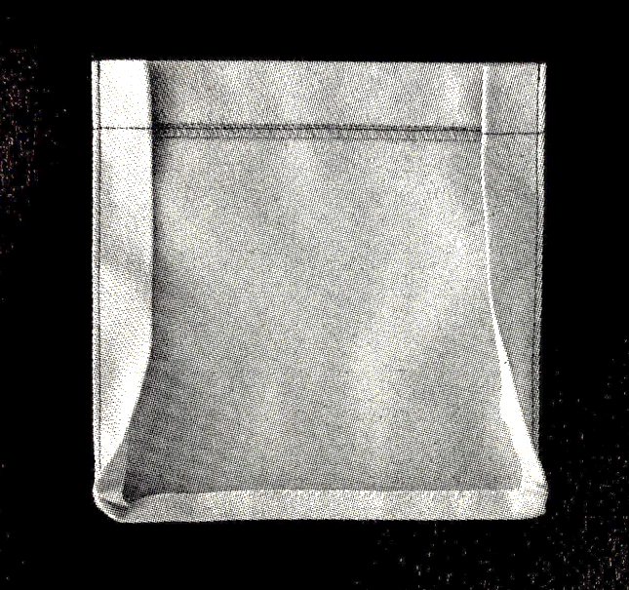
Attaching Bellow Pocket
Edge stitch for keeping the shape of the pocket.
Edge stitching

Slide 22
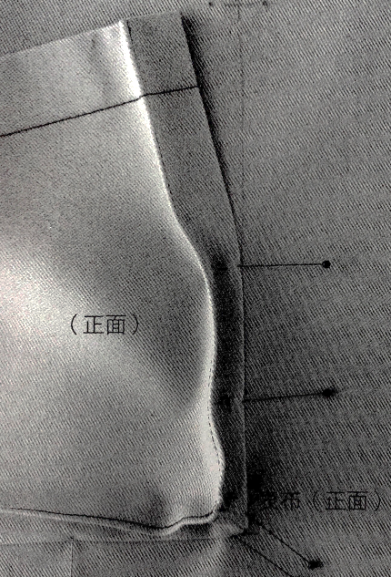
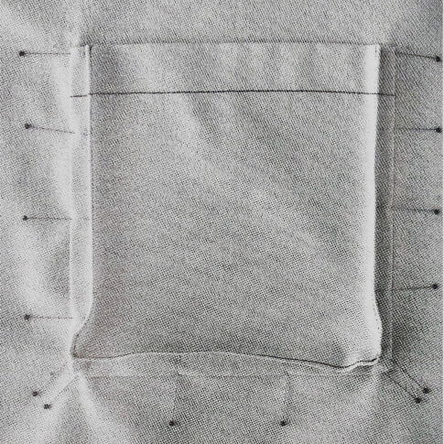
Attaching Bellow Pocket
Use pins to secure the position of the bellow pocket.
R.S.
R.S.

Slide 23
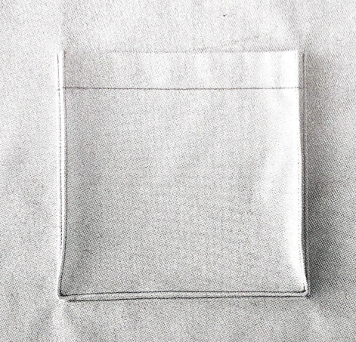
Attaching Bellow Pocket
Edge stitch along the edge of the pocket.
Edge stitching

Slide 24
Attaching Bellow Pocket
Stitch a small rectangle at the corner of the pocket opening for reinforcement.

Slide 25
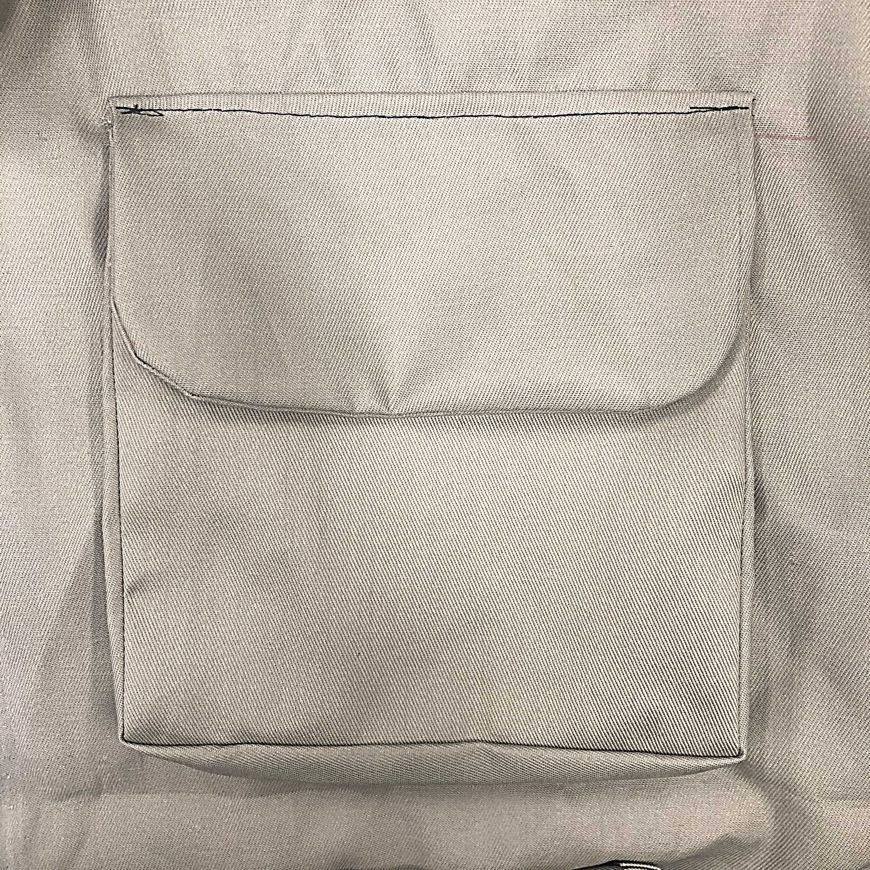
03. Bellow Pocket with flap

Slide 26
Demonstration Video
Attachment of bellow pocket with flap

Slide 27
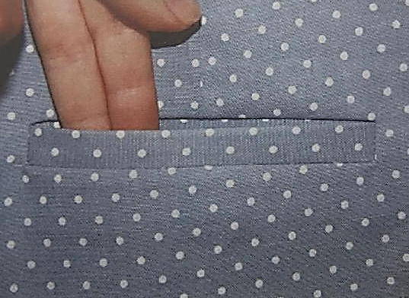
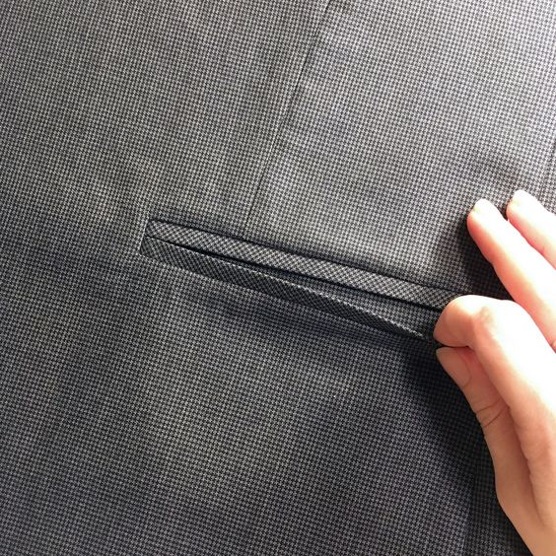
04. bound Pocket
Source from royalty free photo from Pexels

Slide 28
Demonstration Videos
Preparation of bound pocket
Attaching single jet bound pocket
Attaching double jet bound pocket
Overlocking raw edge of pocket

Slide 29
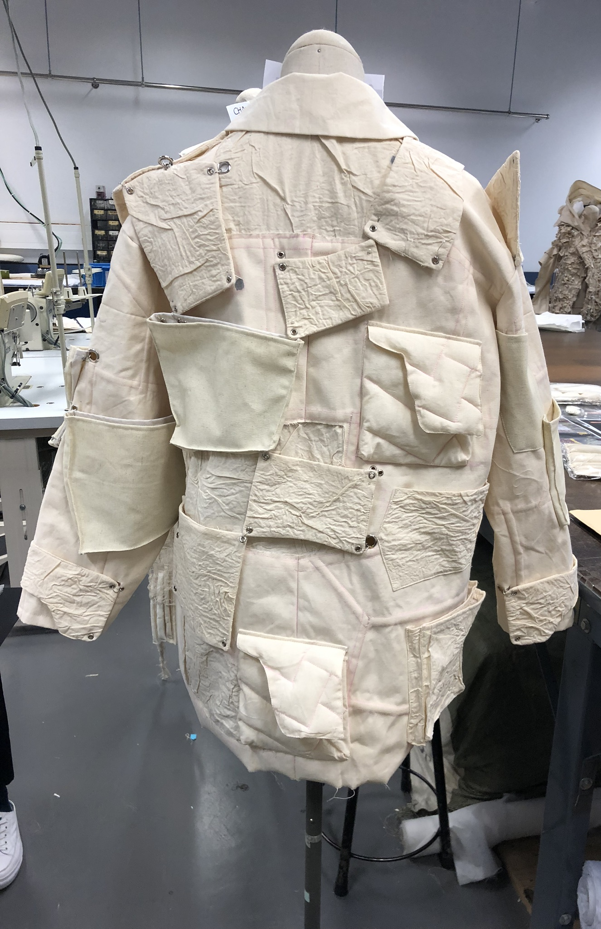
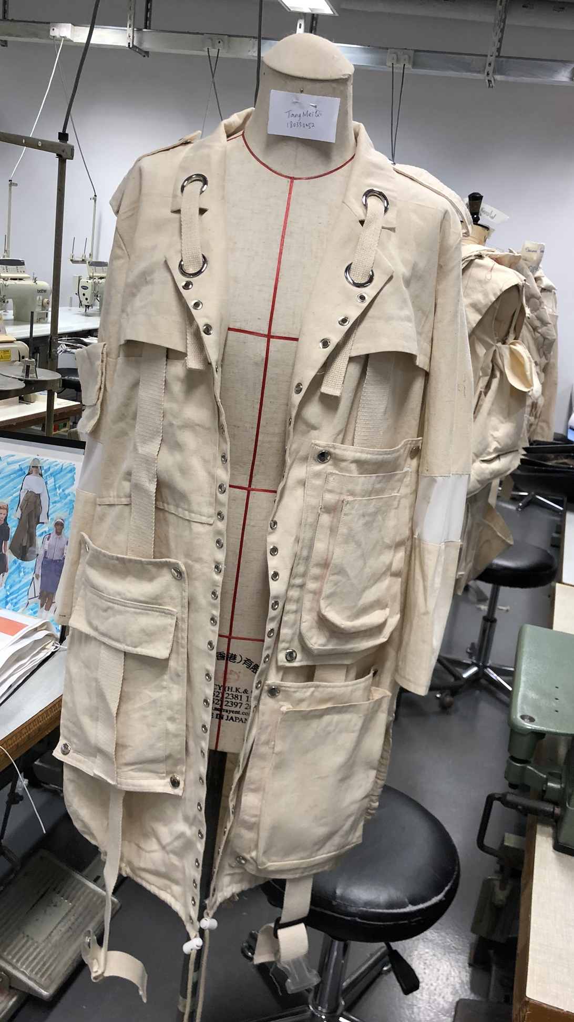
chapter activity
ATTACHING POCKETS
You have already prepared a set of pattern in Chapter 3.
(Now is the time to make the pocket with Calico !
Collection by Chu Hei Lam, HD in Fashion Design, Hong Kong Design Institute
Collection by Tang Meiqi, HD in Fashion Design, Hong Kong Design Institute
Photo(s) is/are provided by HKDI

