Slide 1
Advanced Sewing Techniques

Slide 2
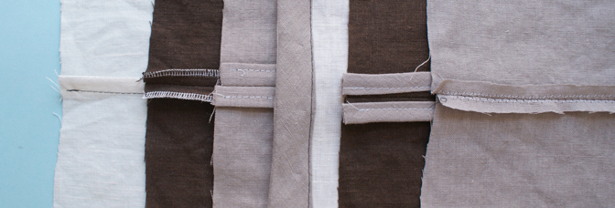
Open seam - Seam neatening
Photo(s) is/are provided by HKDI

Slide 3
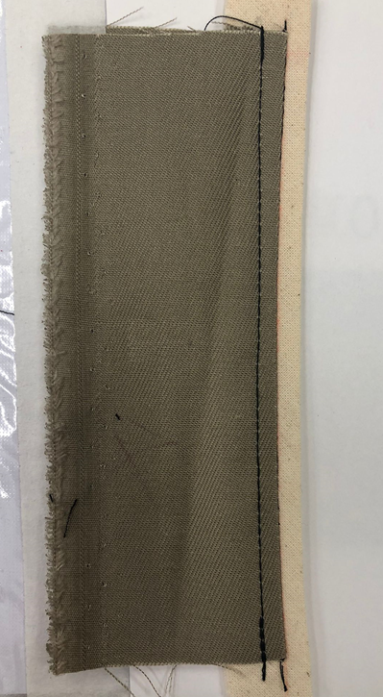
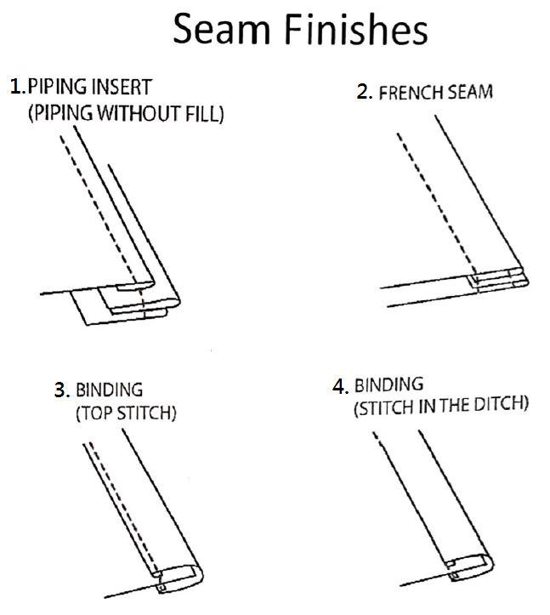
01. Piping
(without fill)
Photo(s) is/are provided by HKDI

Slide 4
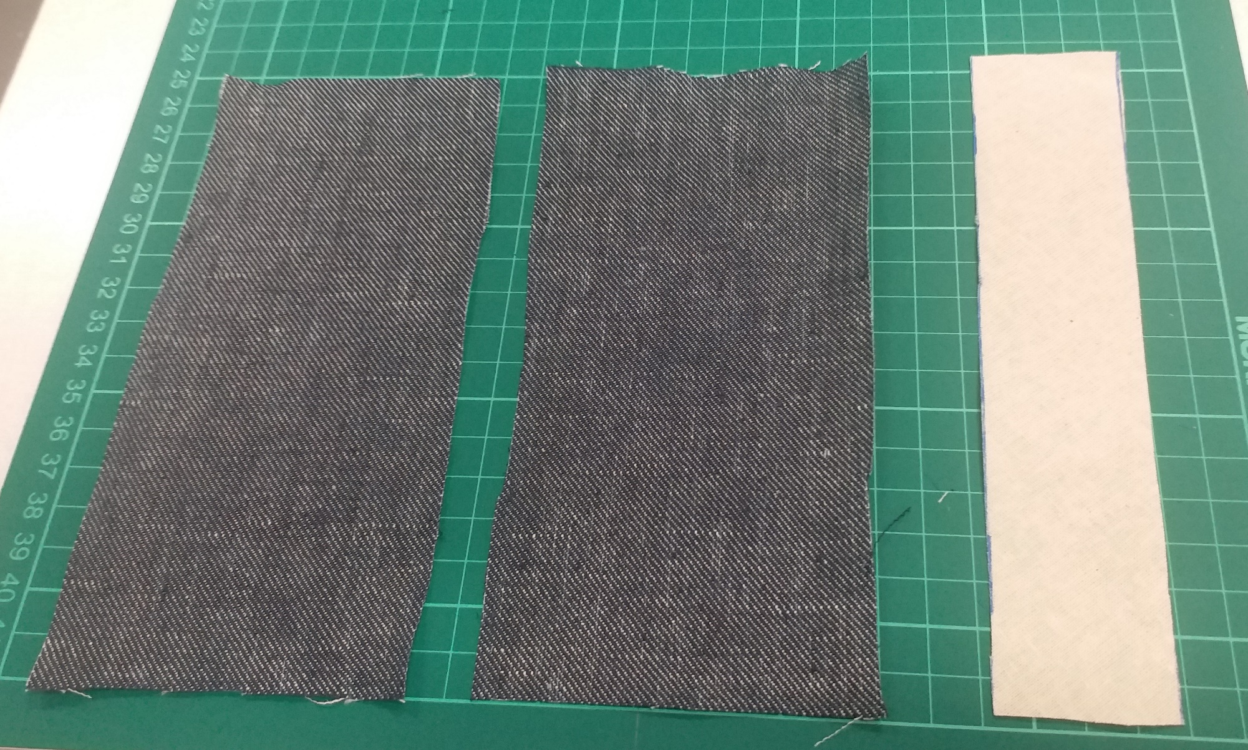
01. Piping
(without fill)
Bias cut
15cm
15cm
7cm
7cm
4cm
Photo(s) is/are provided by HKDI

Slide 5
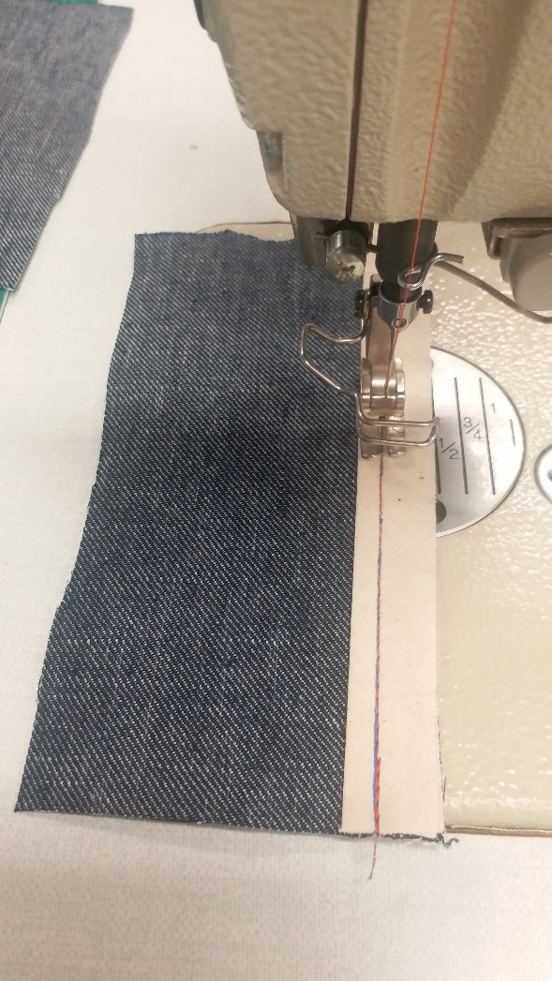
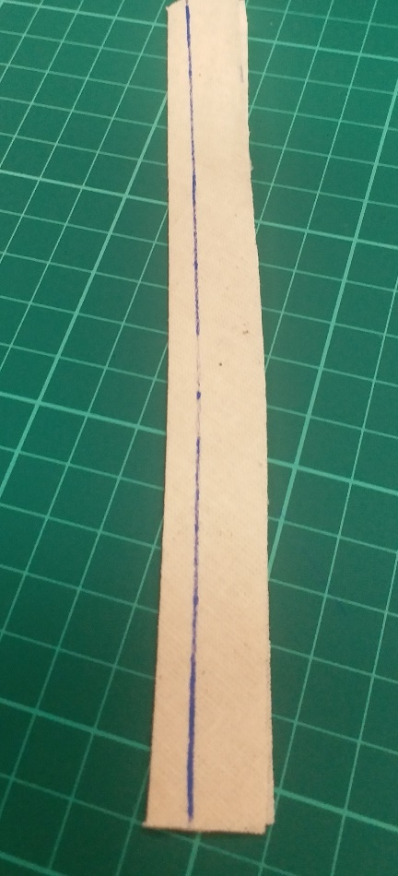
01. Piping
(without fill)
Stitch the binding with 0.5cm seam allowance on the fabric (right side).
Mark a line from the folded edge.
7cm
7cm
Photo(s) is/are provided by HKDI

Slide 6
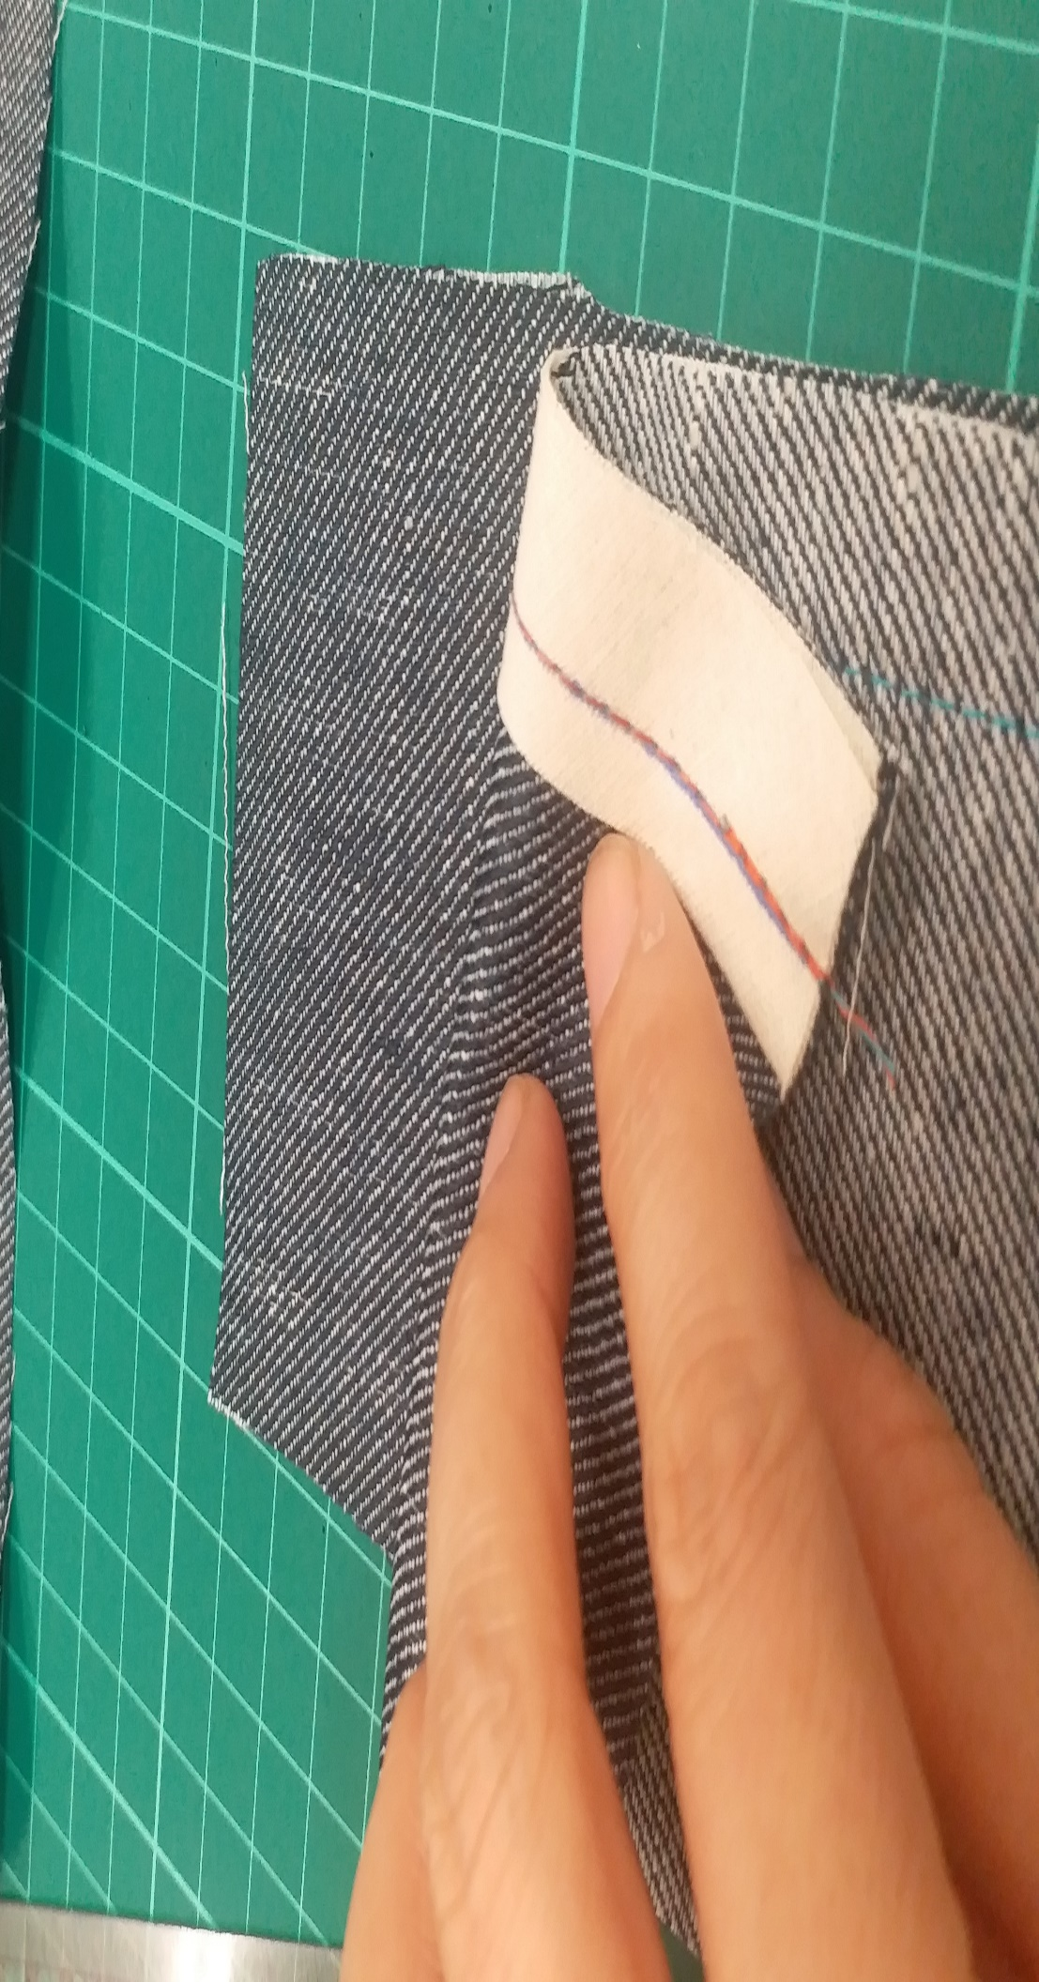
01. Piping
(without fill)
Stitch the two pieces of fabric together (right side facing right side).
7cm
7cm
Photo(s) is/are provided by HKDI

Slide 7
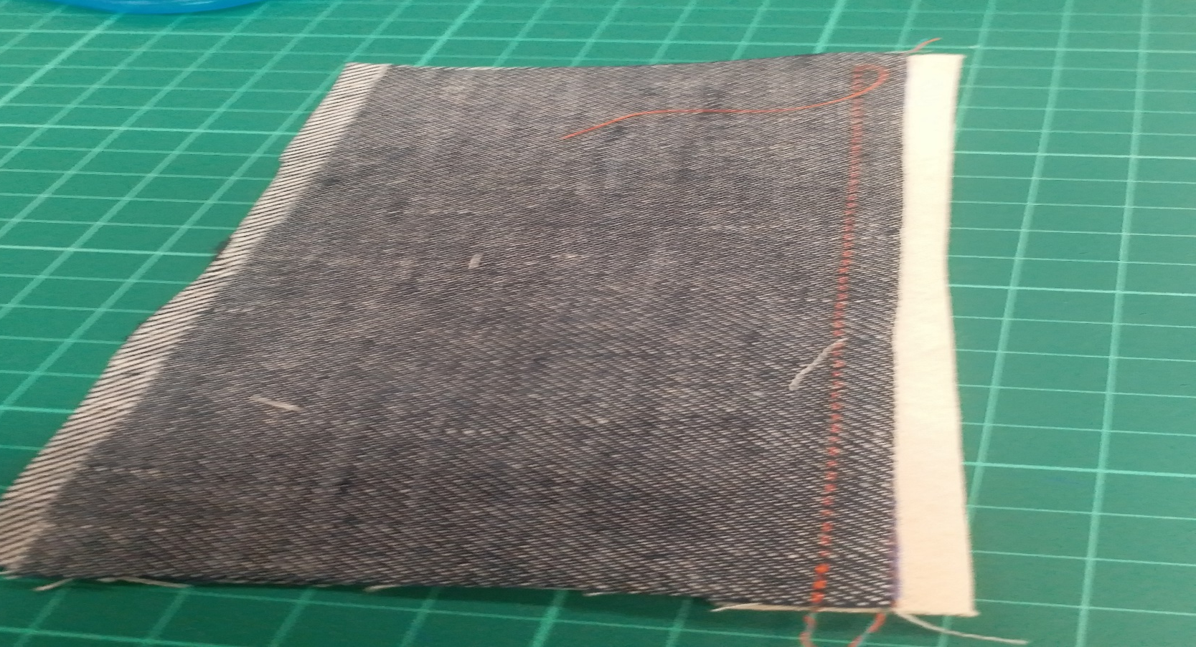
01. Piping
(without fill)
Turn it inside out and top stitching 0.5cm from the folded edge.
7cm
7cm
Photo(s) is/are provided by HKDI

Slide 8
01. Piping
(without fill)
Photo(s) is/are provided by HKDI

Slide 9
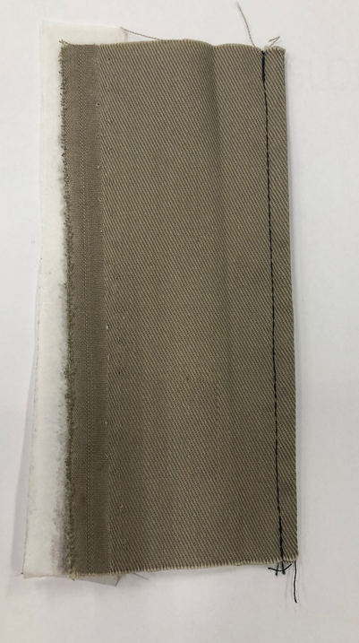
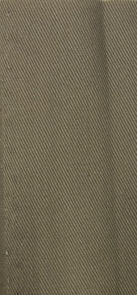
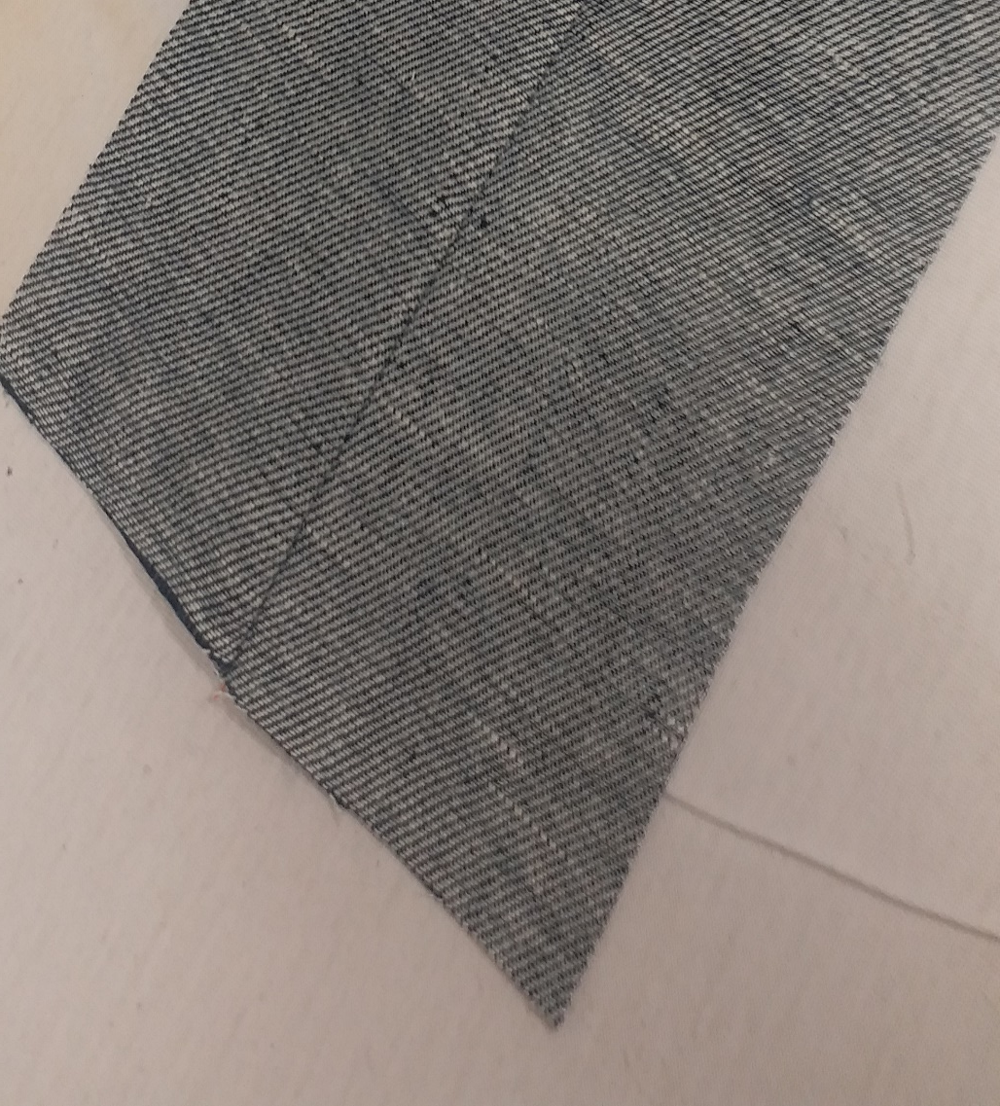

02. French seam
Right Side
Wrong Side
Photo(s) is/are provided by HKDI

Slide 10
02. French seam
15cm
7cm
7cm
Photo(s) is/are provided by HKDI

Slide 11
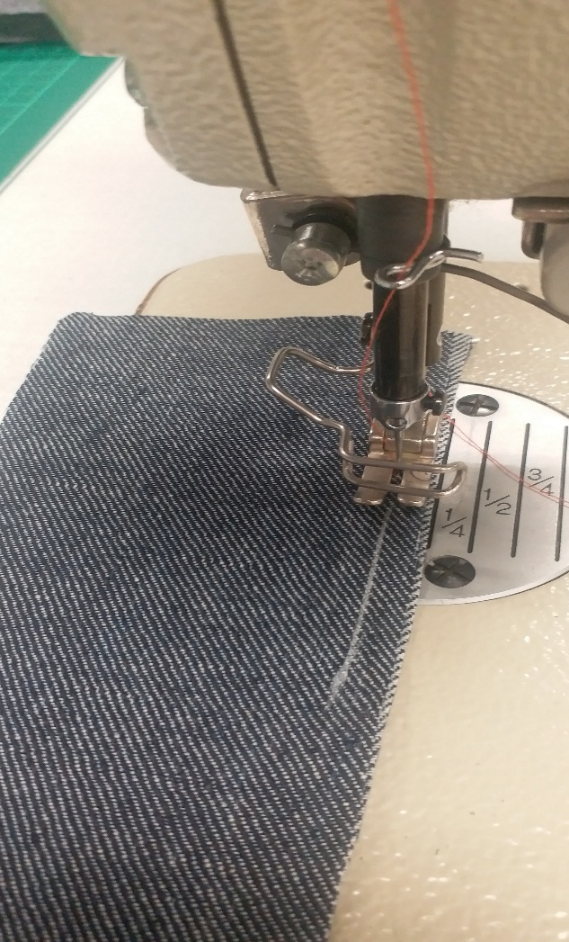
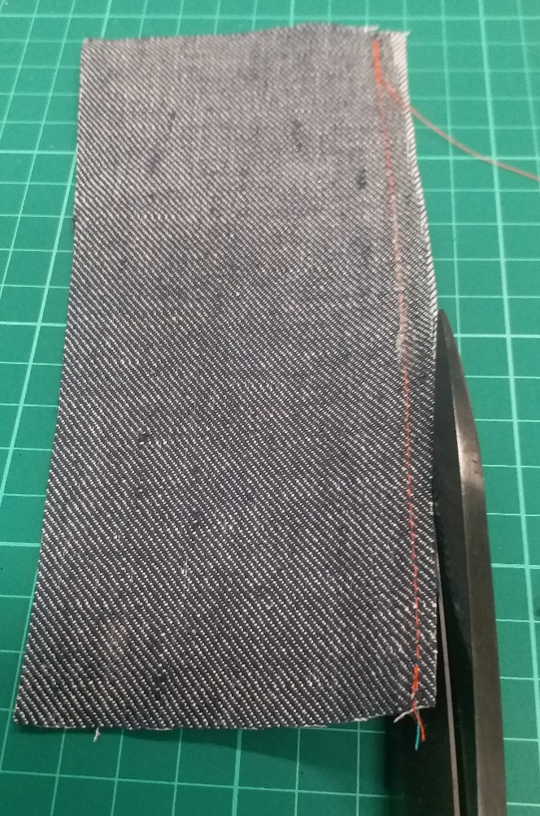
02. French seam
Stitch the two pieces of fabric together (wrong side facing wrong side) with 0.5cm seam allowance.
Trim the seam allowance to 0.3cm.
Photo(s) is/are provided by HKDI

Slide 12
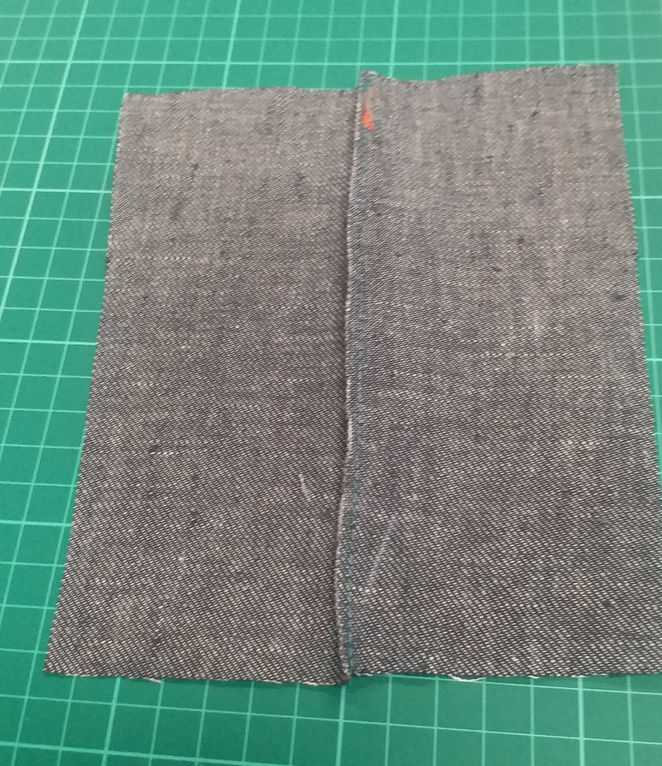
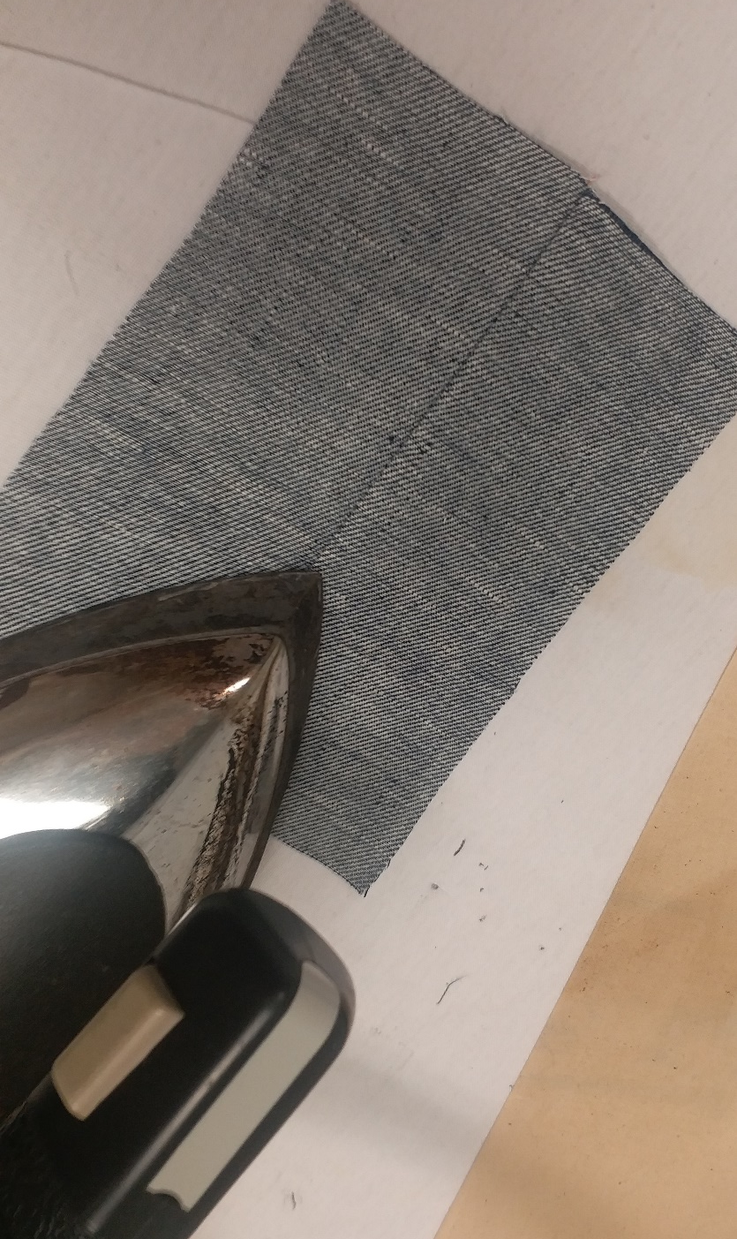
02. French seam
Press the seam open.
Photo(s) is/are provided by HKDI

Slide 13
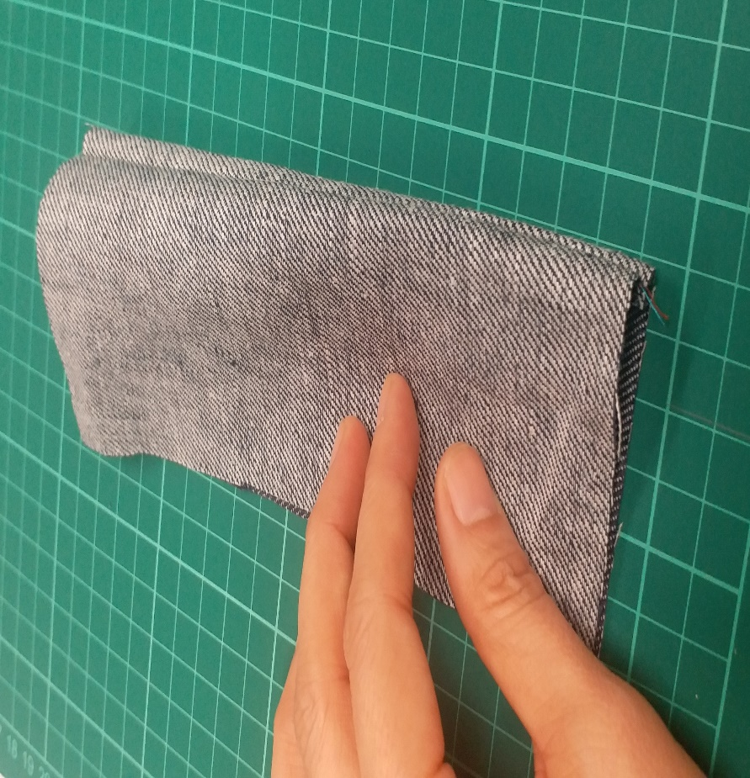
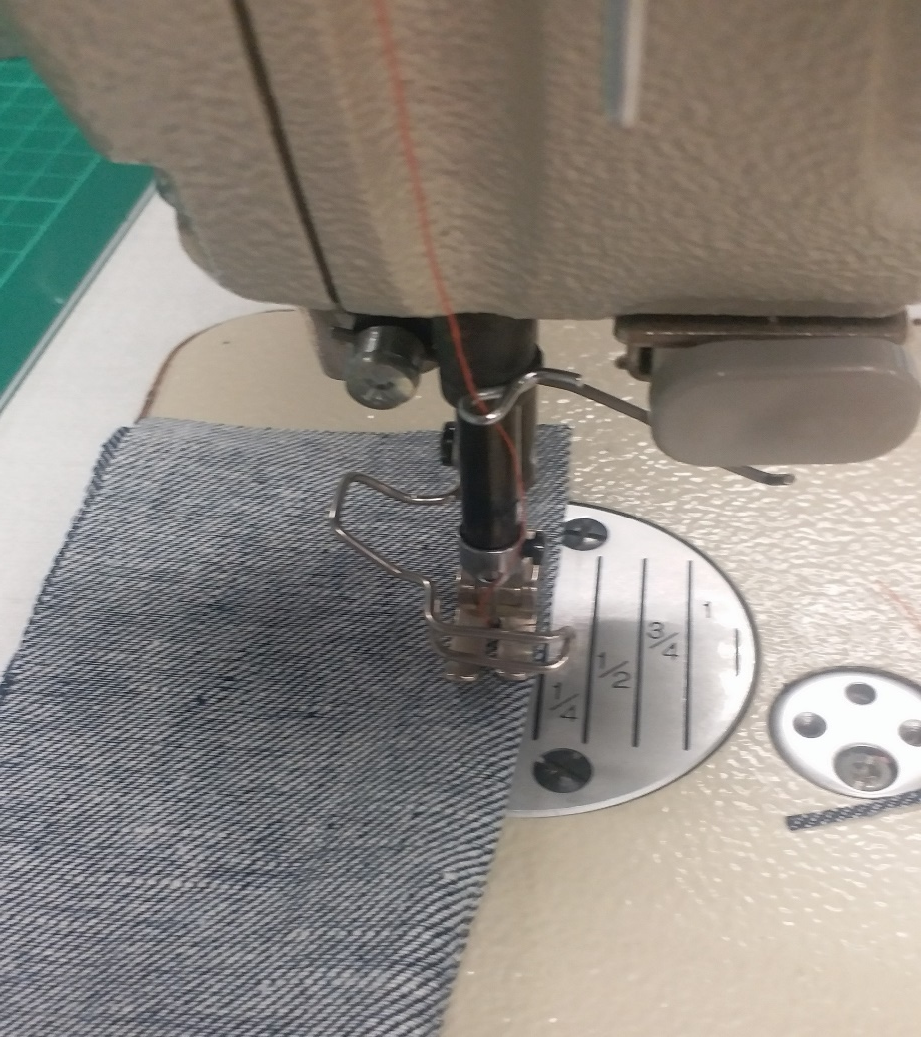
02. French seam
Fold and stitch with 0.5cm seam allowance
(right side facing right side).
Photo(s) is/are provided by HKDI

Slide 14
02. French seam
Right Side
Wrong Side
Photo(s) is/are provided by HKDI

Slide 15
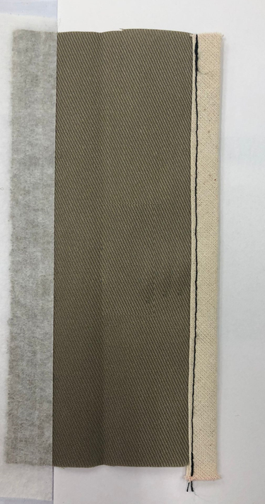
03. Binding
(top stitching)
Photo(s) is/are provided by HKDI

Slide 16
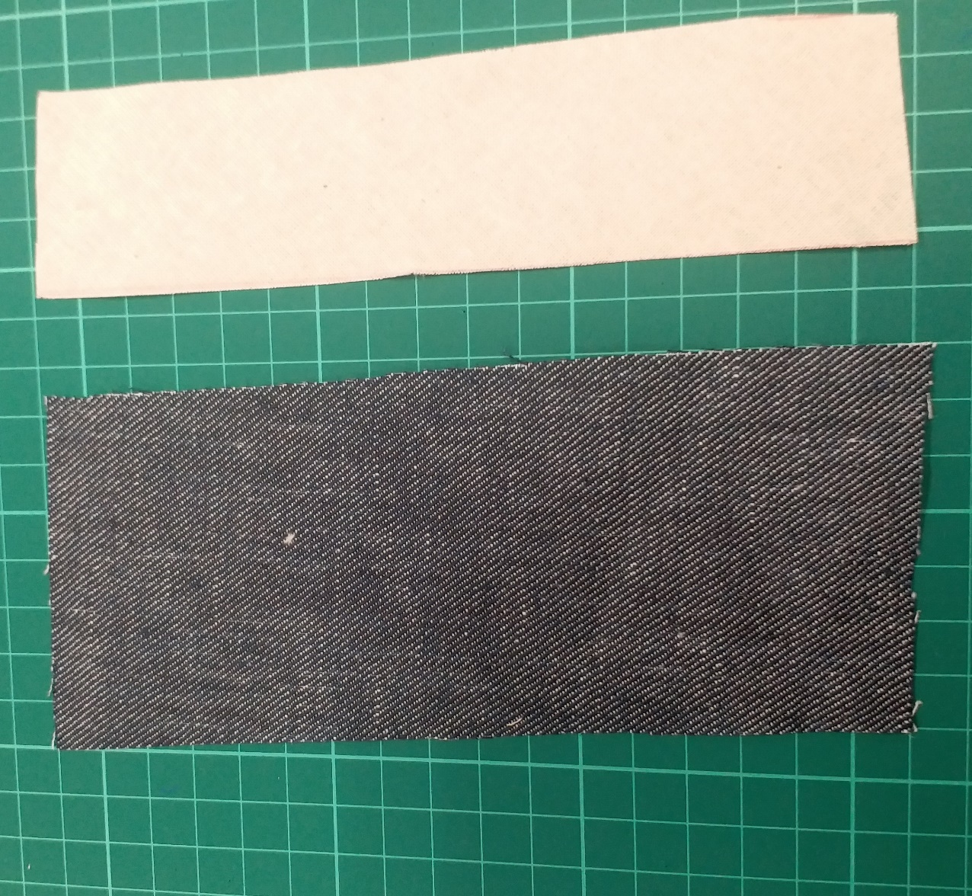
03. Binding
(top stitching)
Bias cut
15cm
15cm
7cm
4cm
Photo(s) is/are provided by HKDI

Slide 17
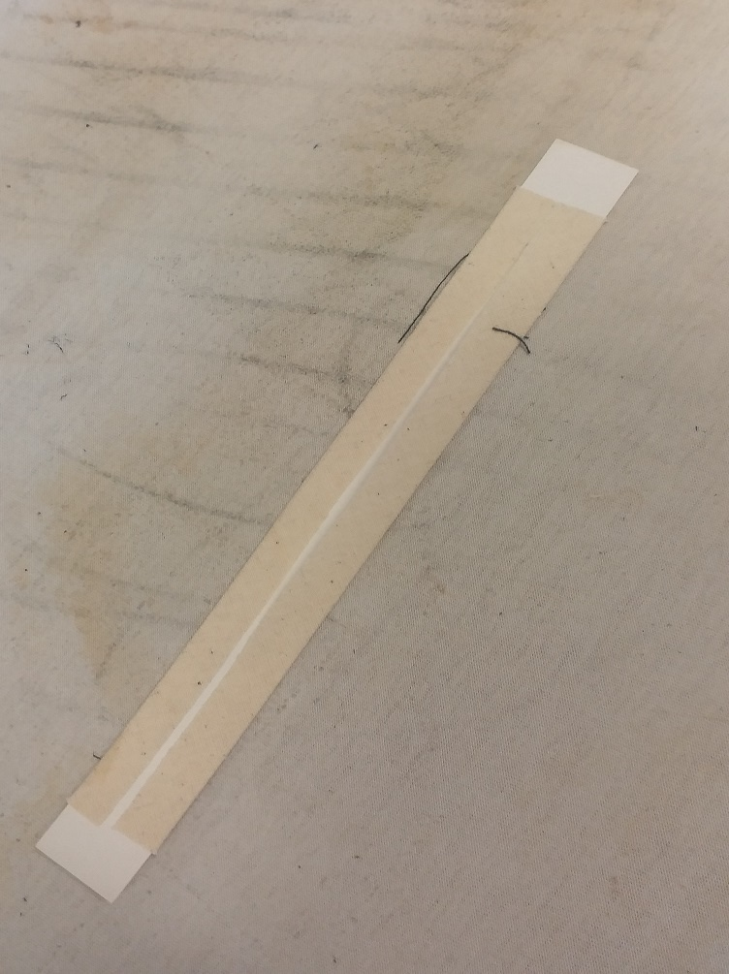
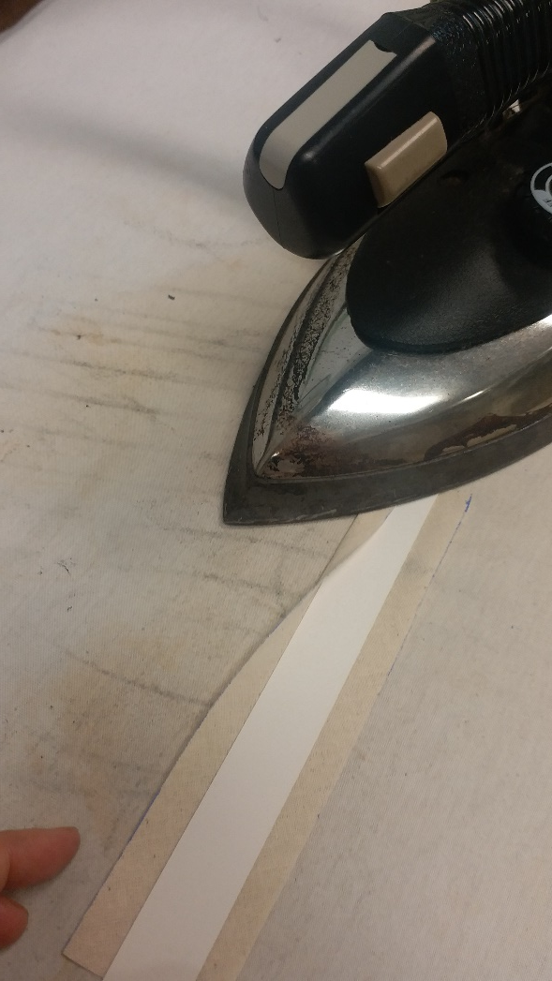
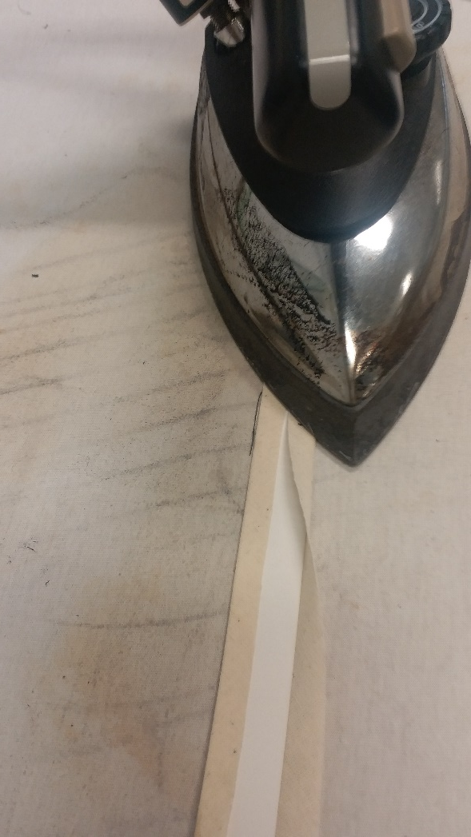
03. Binding
(top stitching)
Press the seam allowance (1 cm) to the wrong side of the binding.
Photo(s) is/are provided by HKDI

Slide 18
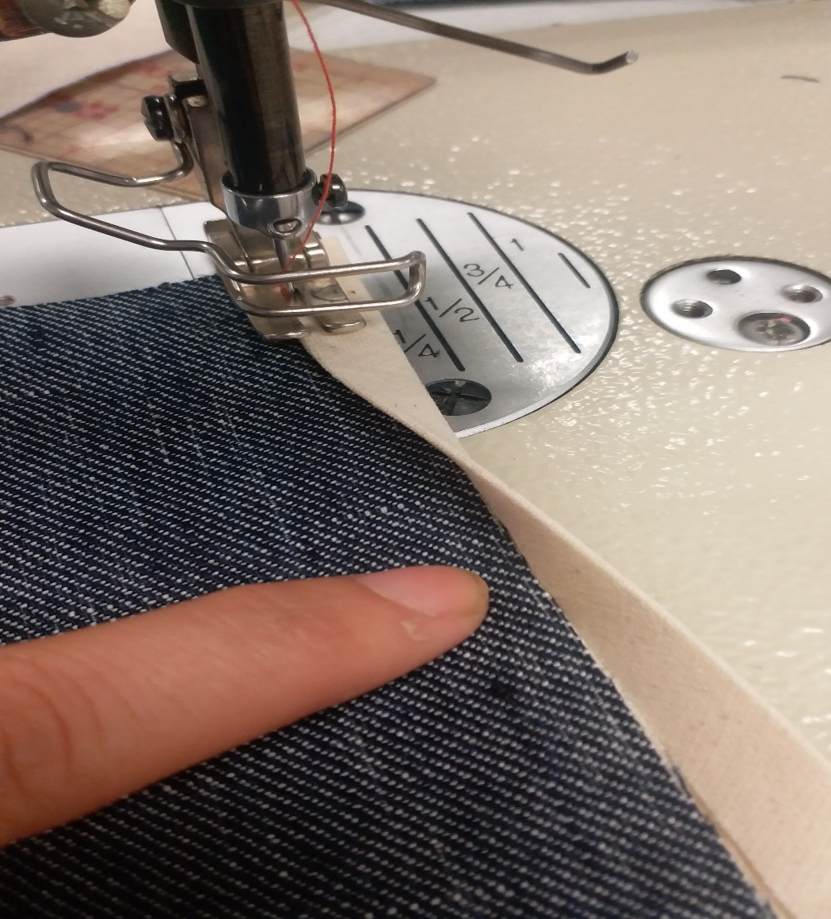
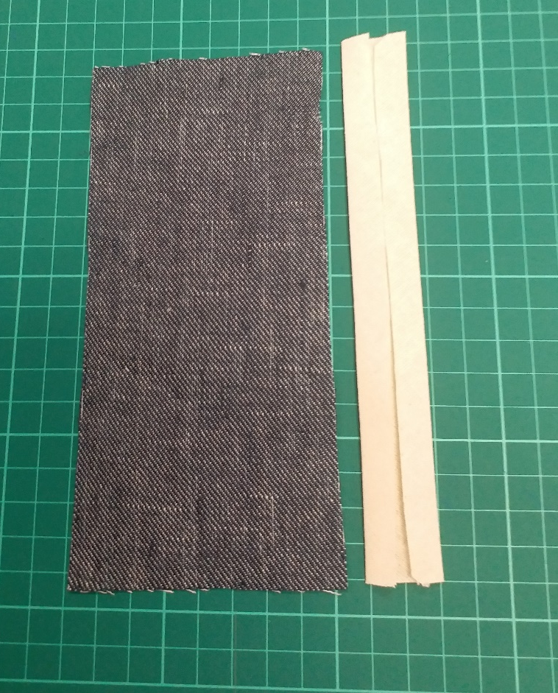
03. Binding
(top stitching)
Attached the binding to the fabric, top stich along the folded edge.
Photo(s) is/are provided by HKDI

Slide 19
03. Binding
(top stitching)
Photo(s) is/are provided by HKDI

Slide 20
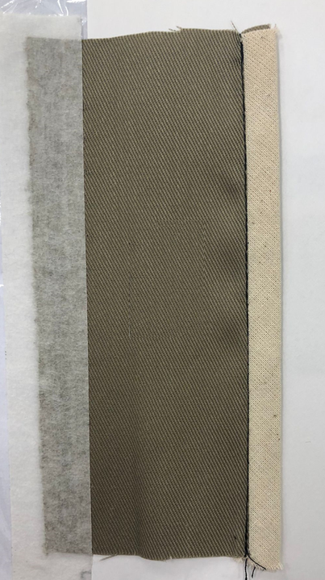
04. binding
(stitch in the ditch)
Photo(s) is/are provided by HKDI

Slide 21
04. binding
(stitch in the ditch)
Bias cut
15cm
15cm
7cm
4cm
7cm
Photo(s) is/are provided by HKDI

Slide 22
04. binding
(stitch in the ditch)
Press the seam allowance (1 cm) to the wrong side of the binding.
Photo(s) is/are provided by HKDI

Slide 23
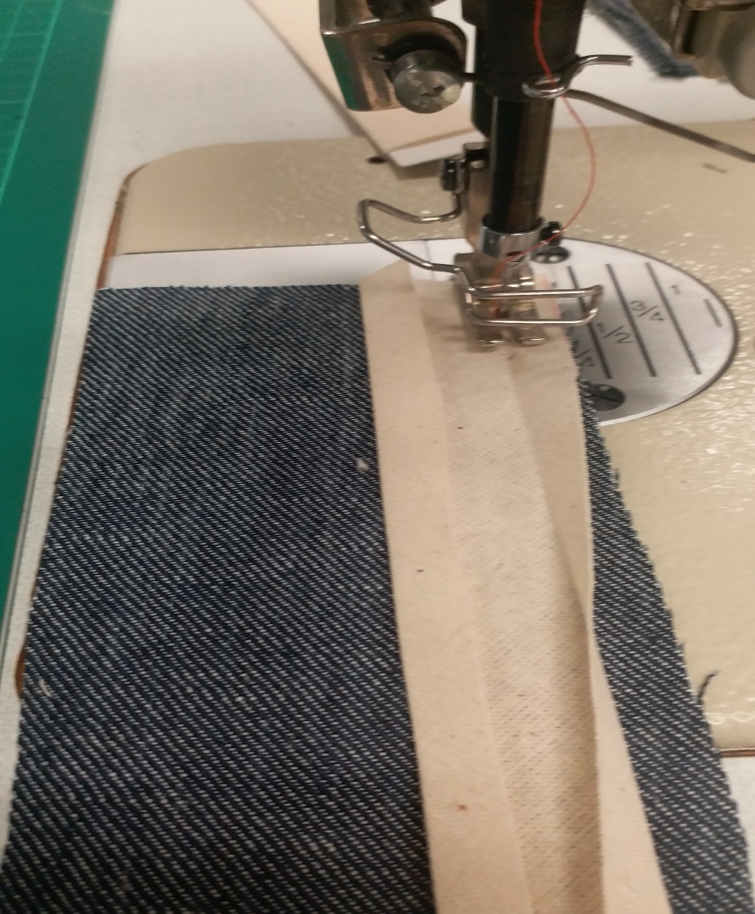
04. binding
(stitch in the ditch)
Attached the binding to the fabric with 1cm seam allowance.
Photo(s) is/are provided by HKDI

Slide 24
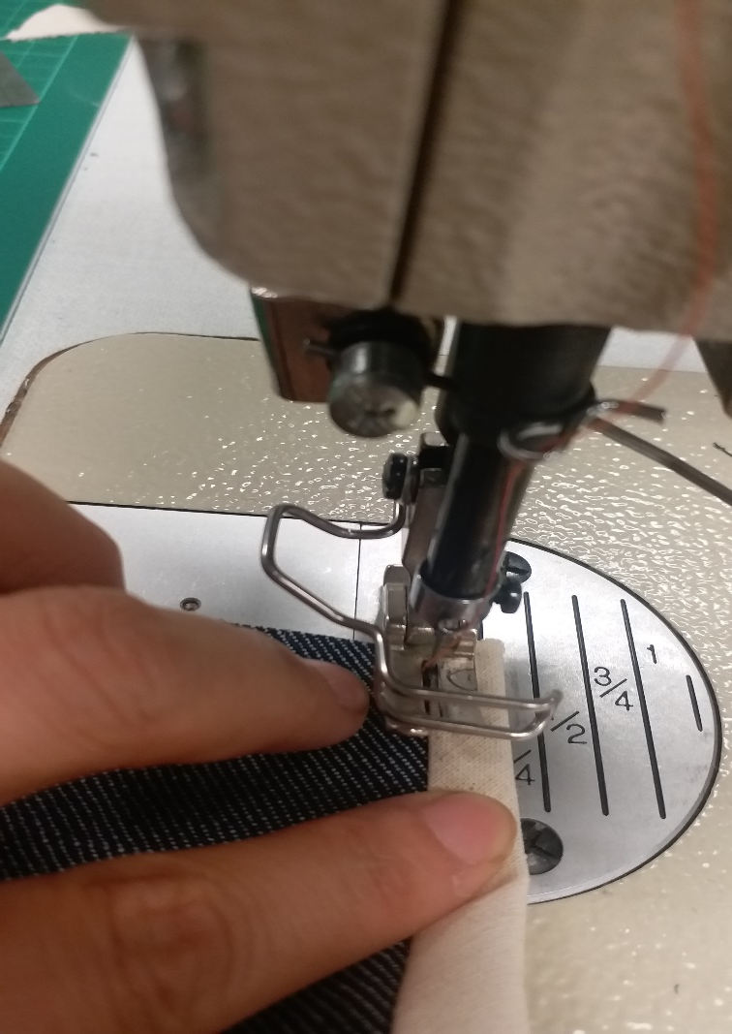
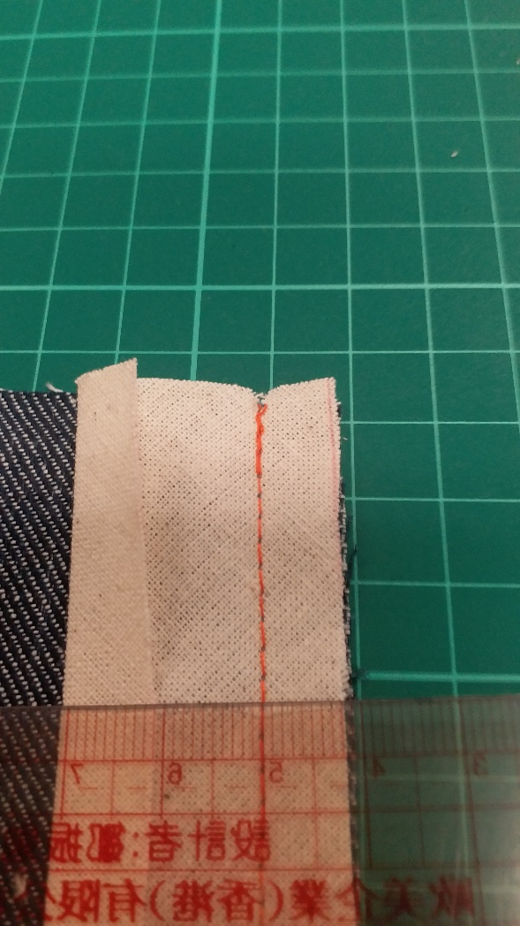
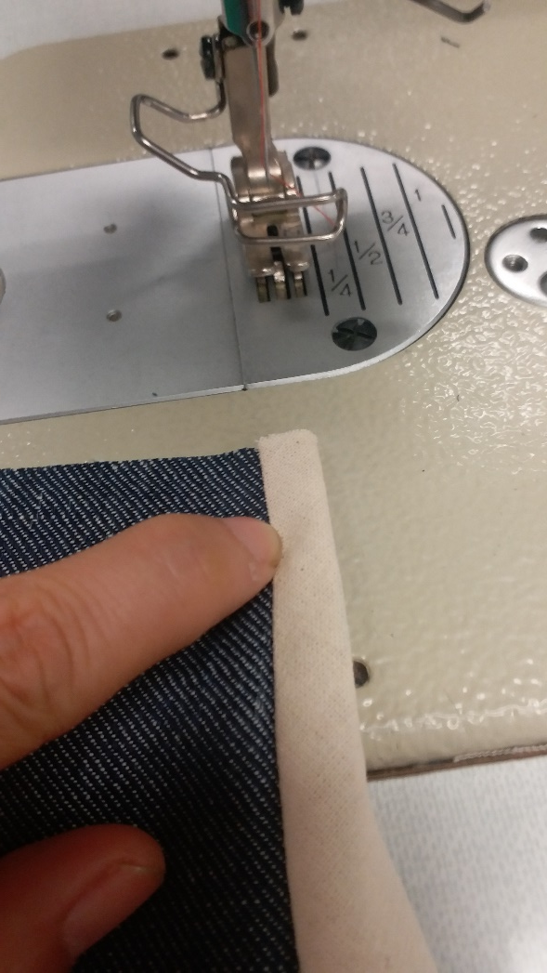
04. binding
(stitch in the ditch)
Trim the seam allowance to 0.9cm.
Fold and top stitch along the ditch.
Photo(s) is/are provided by HKDI

Slide 25
04. binding
(stitch in the ditch)
Photo(s) is/are provided by HKDI

Slide 26
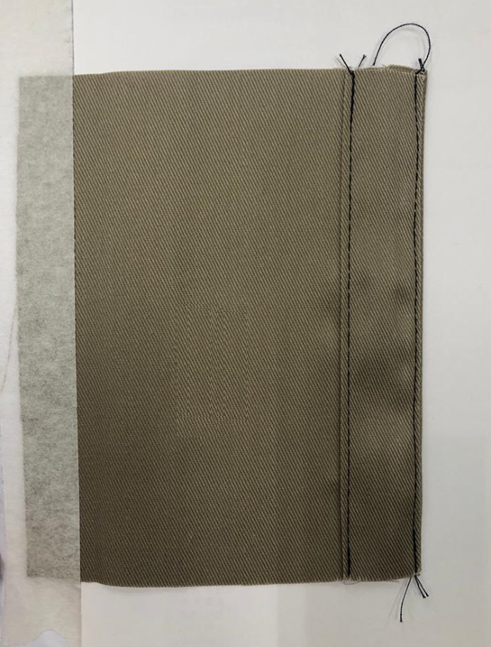
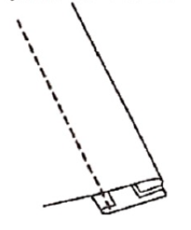
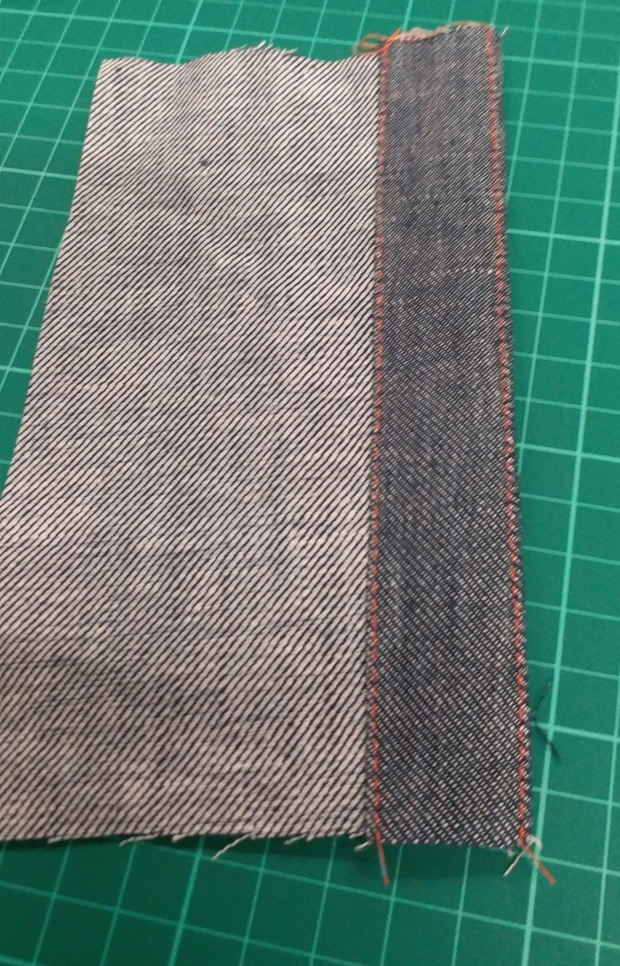
05. facing
Wong Side
Right Side
Photo(s) is/are provided by HKDI

Slide 27
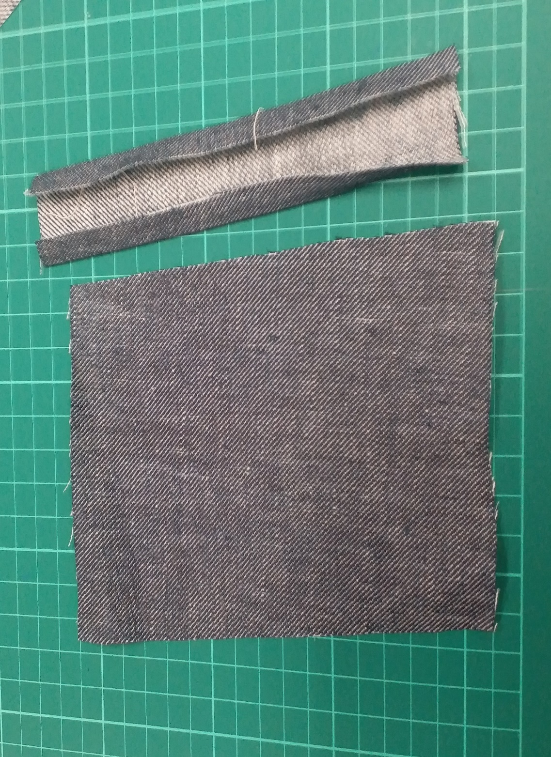
05. facing
13 cm
15cm
15cm
4.5cm
Photo(s) is/are provided by HKDI

Slide 28
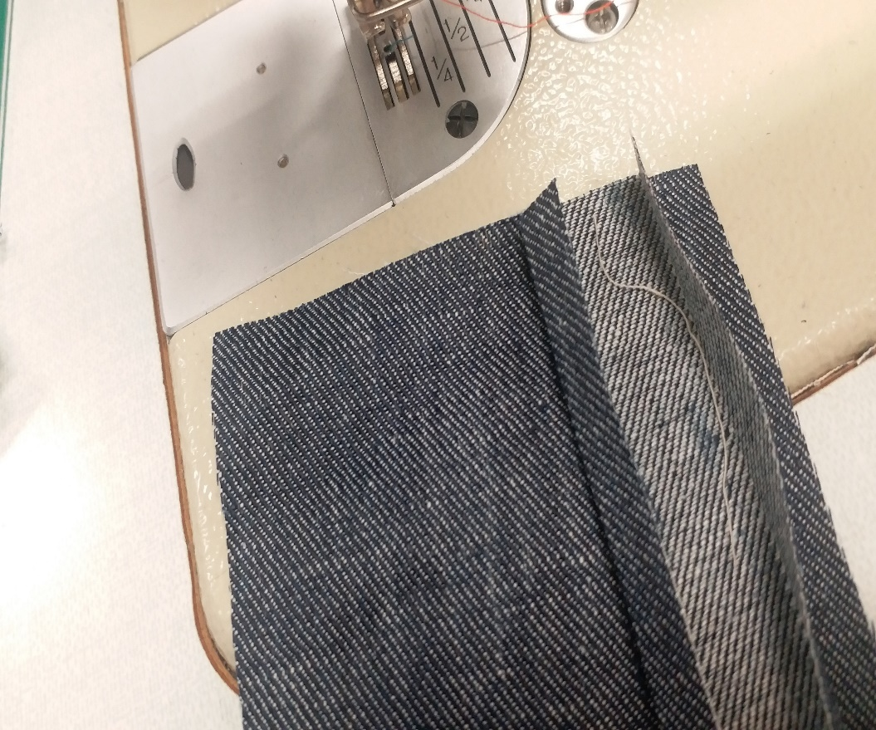
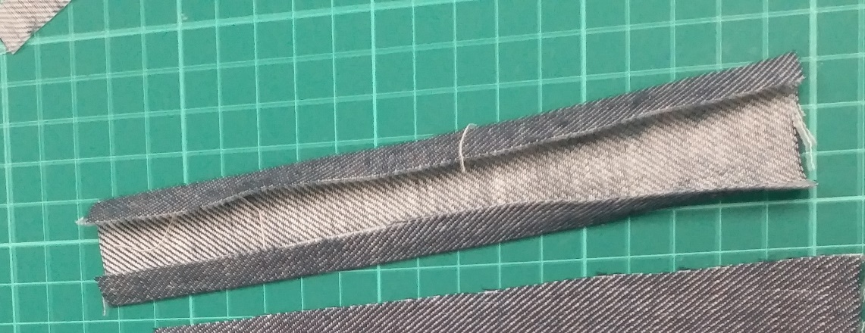
05. facing
Press the seam allowance (1cm) to the wrong side of the facing.
Place the facing on the right side of fabric (right side facing right side).
Stitch along the folded line.
Photo(s) is/are provided by HKDI

Slide 29
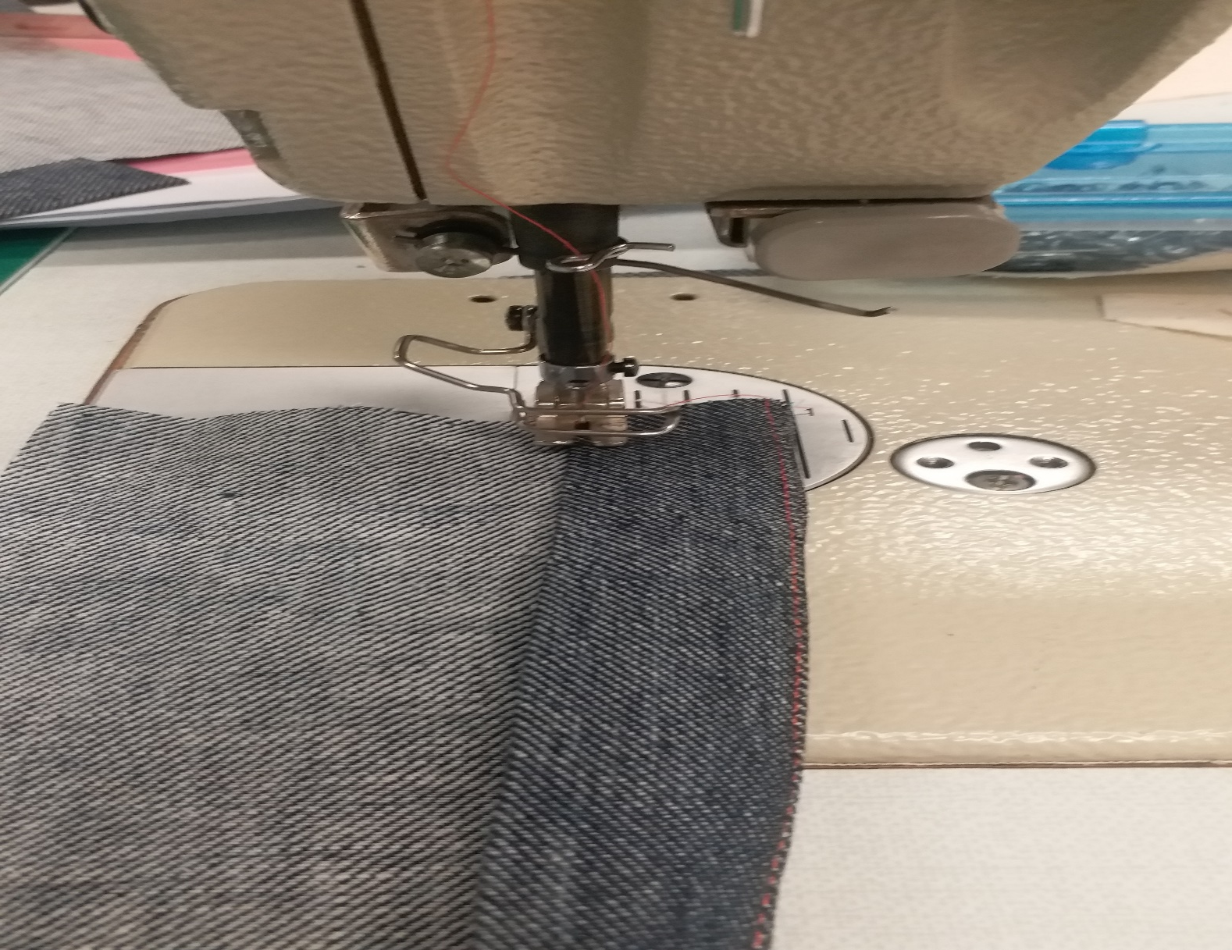
05. facing
Turn the facing to the wrong side of the fabric.
Top stitch on both edges of the facing.
Photo(s) is/are provided by HKDI

Slide 30
05. facing
Wong Side
Right Side
Photo(s) is/are provided by HKDI

Slide 31
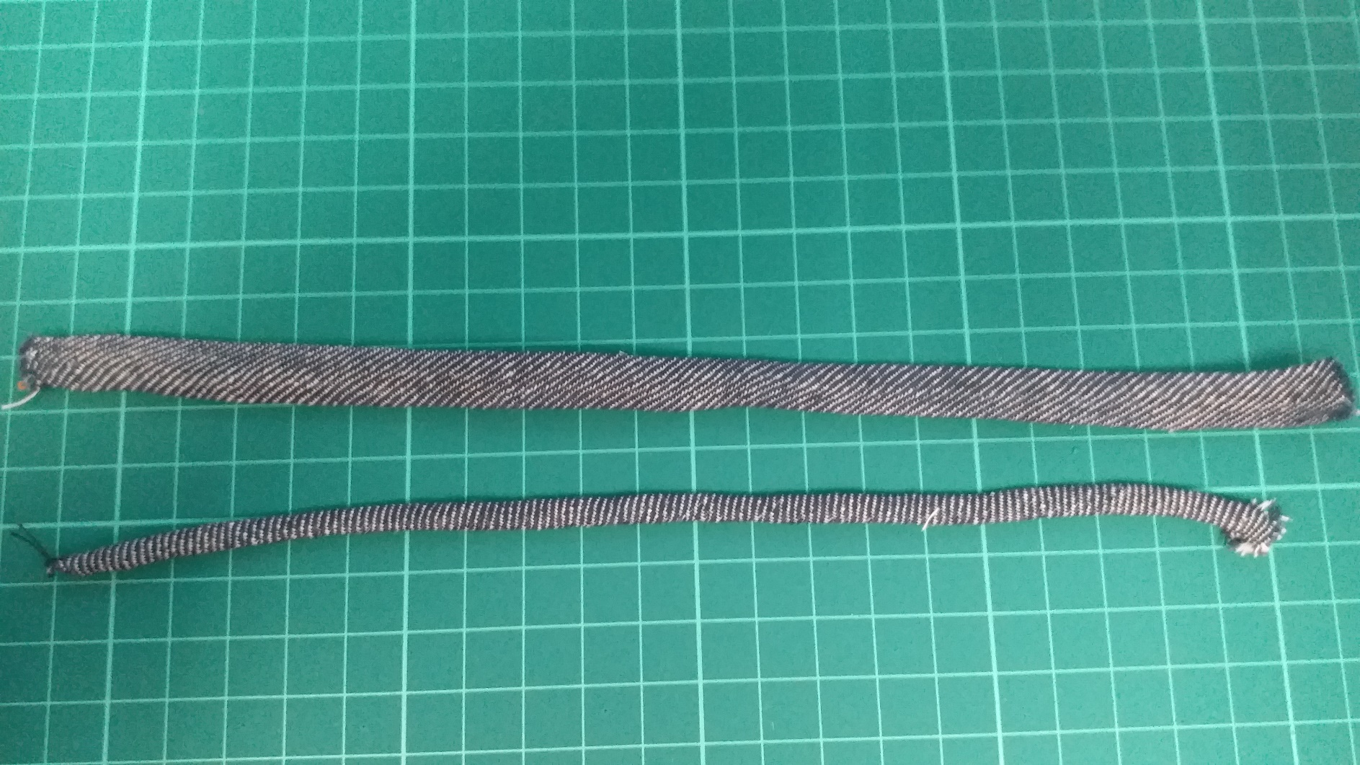

06. Belt loop
Photo(s) is/are provided by HKDI

Slide 32
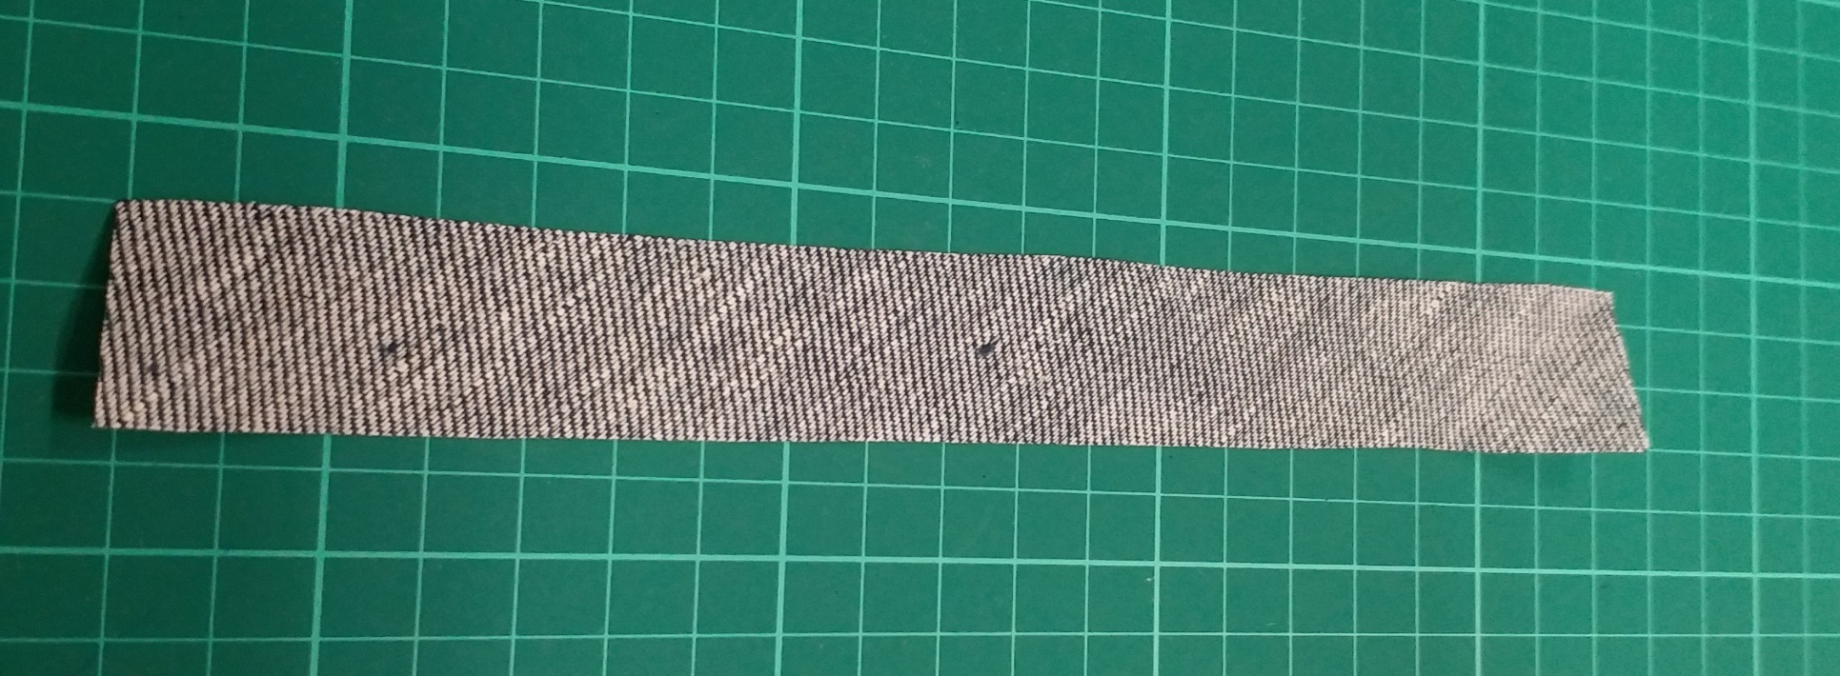
06. Belt loop
Bias cut
3cm
20cm
Photo(s) is/are provided by HKDI

Slide 33
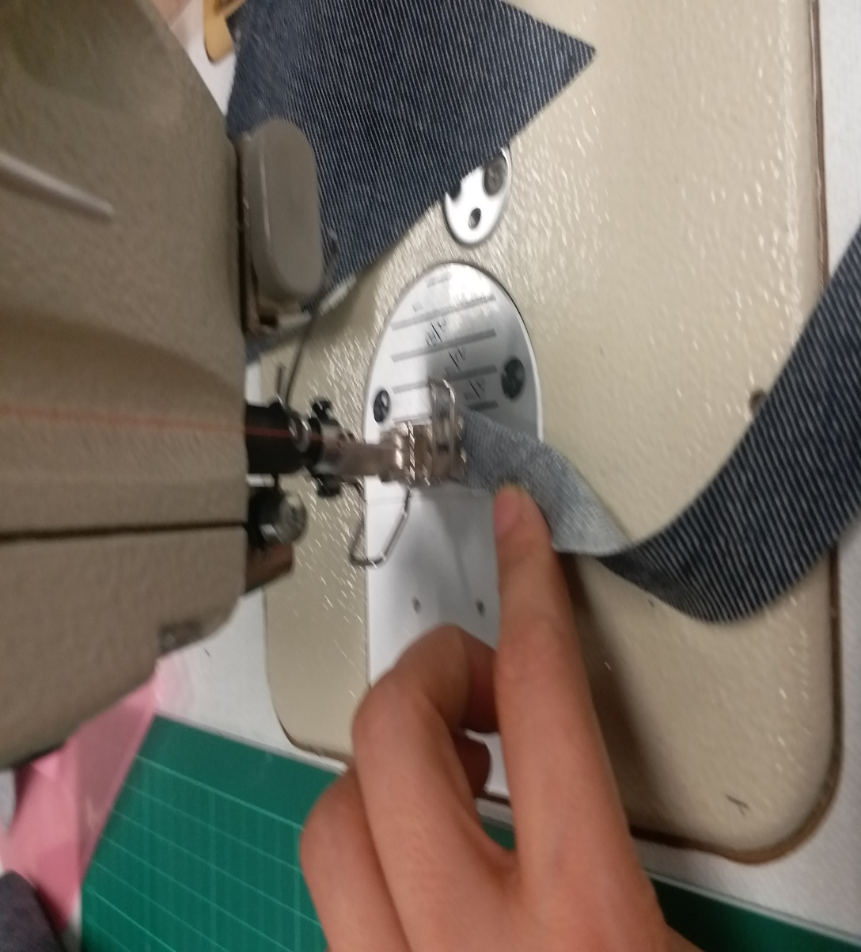
06. Belt loop
Fold the tape (right side facing right side).
Stitch with 0.5cm seam allowance.
Photo(s) is/are provided by HKDI

Slide 34
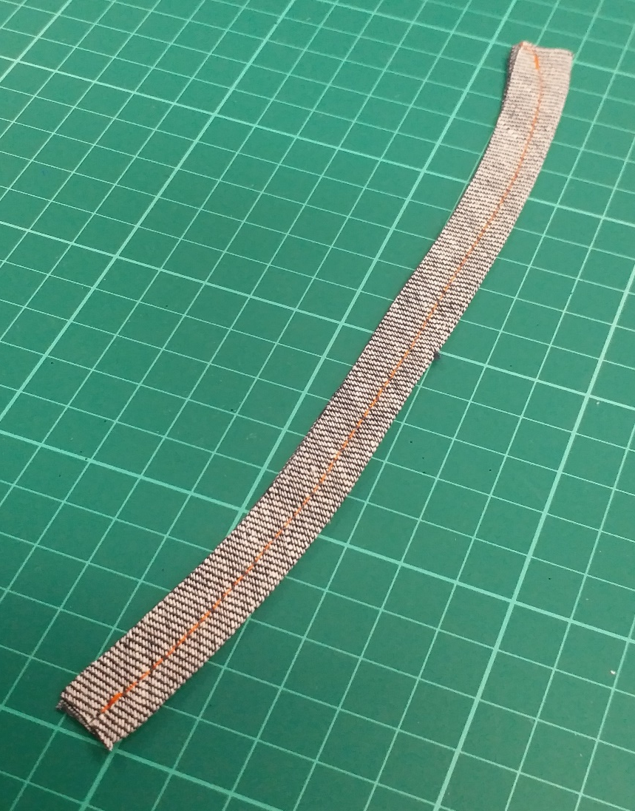
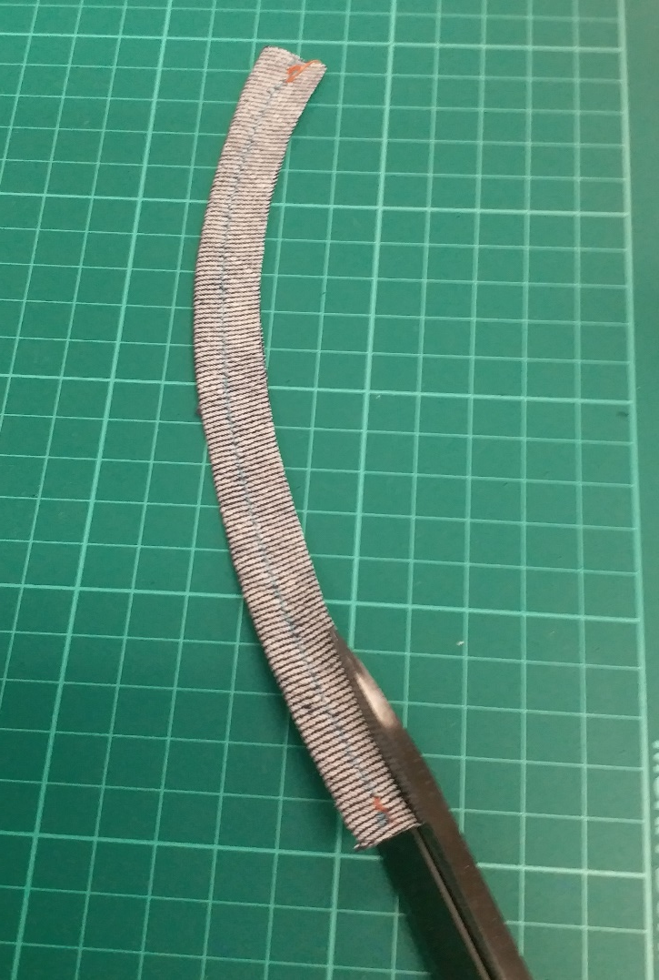
06. Belt loop
Trim the seam allowance to 0.3cm.
Photo(s) is/are provided by HKDI

Slide 35
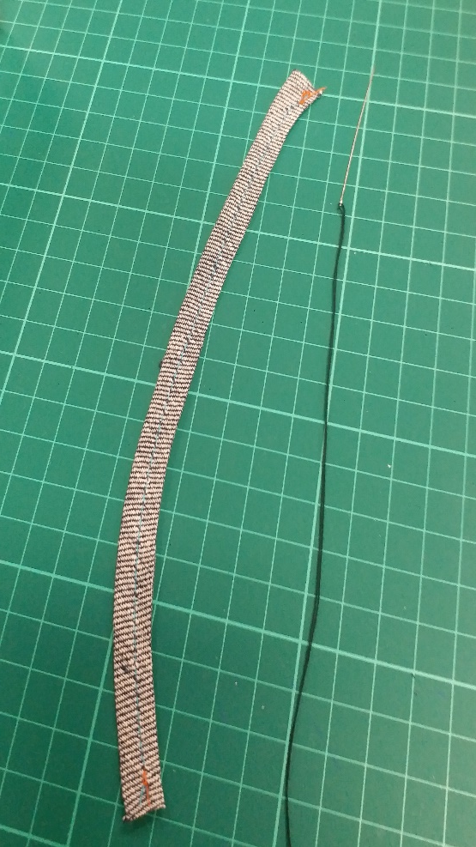
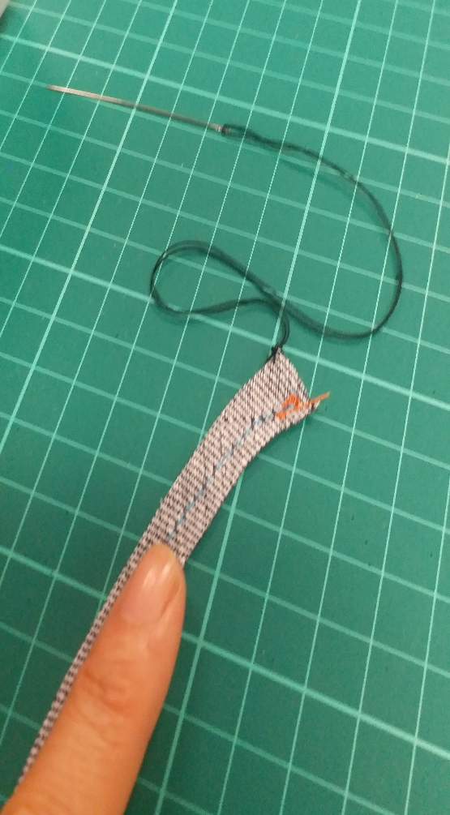
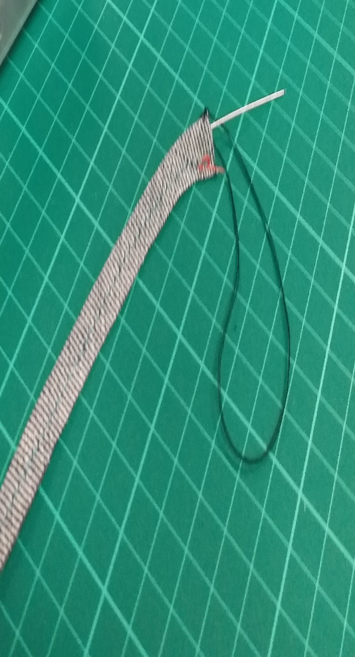
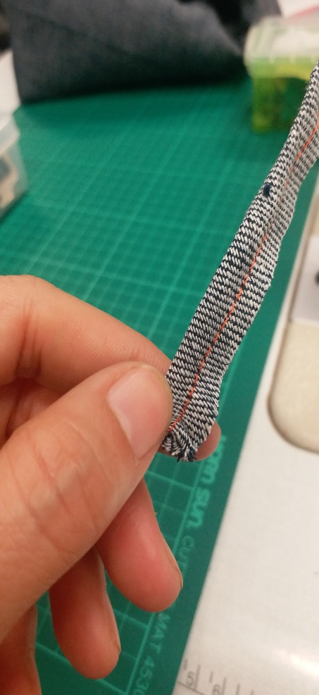
06. Belt loop
Turn the belt loop.
Photo(s) is/are provided by HKDI

Slide 36
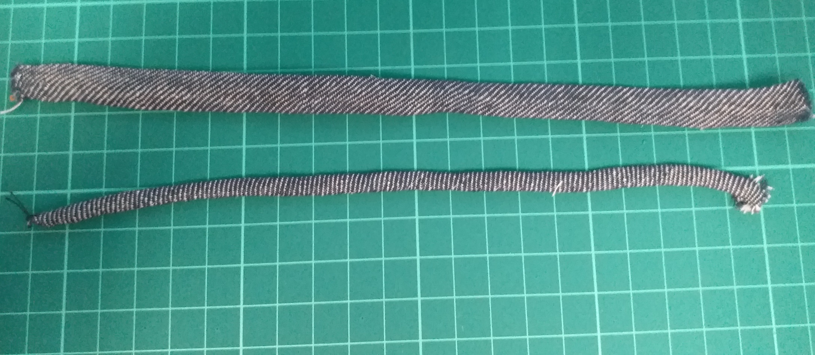
06. Belt loop
Press the belt loop.
Photo(s) is/are provided by HKDI

Slide 37
Demonstration Videos
Piping (without fill)
French seam
Binding (top stitching)
Binding (stitch in the ditch)
Facing
Belt loop

Slide 38
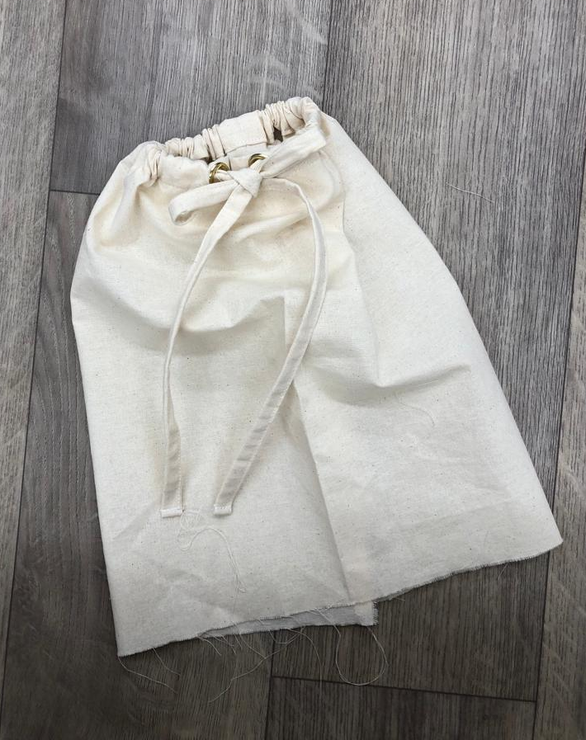
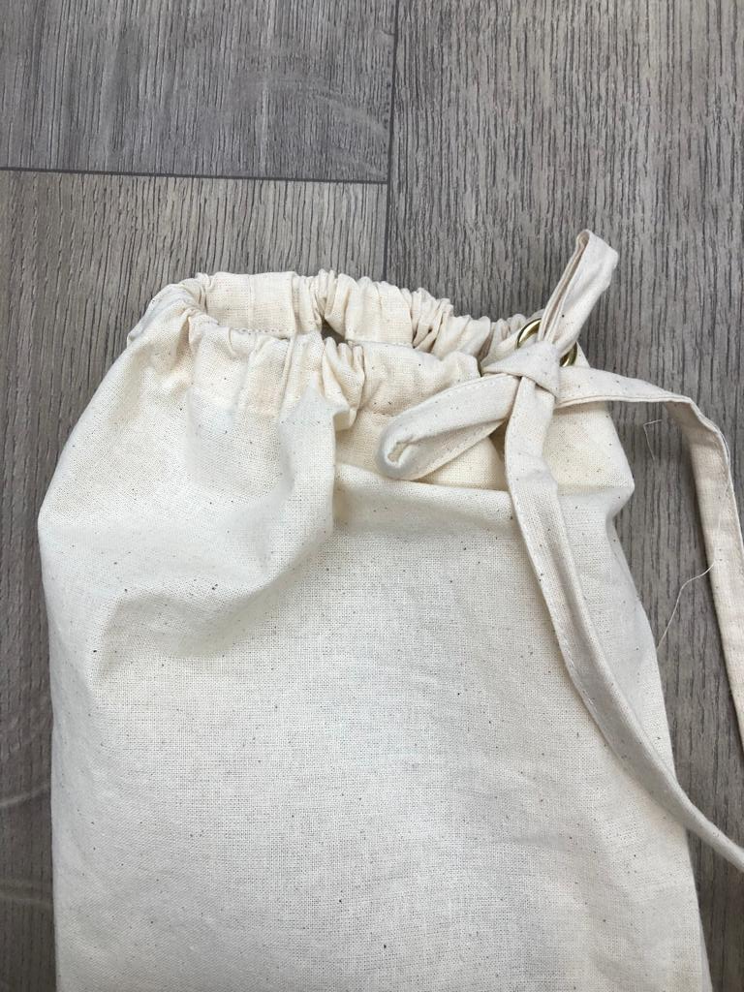
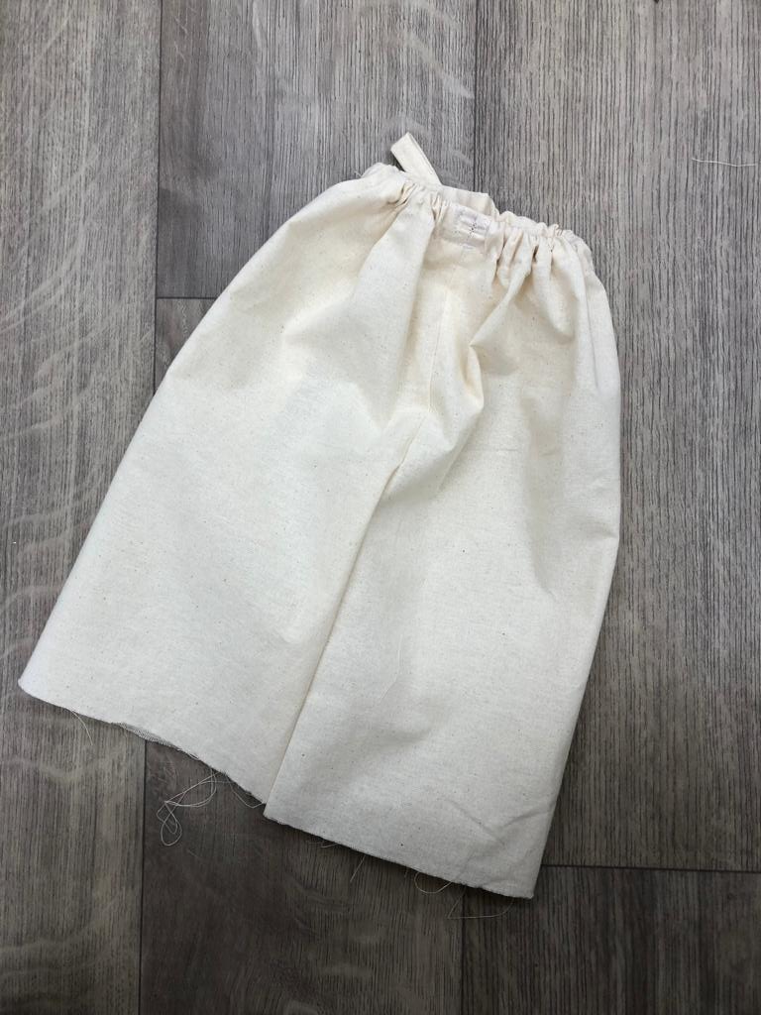
07. Casing for drawstring
Photo(s) is/are provided by HKDI

Slide 39
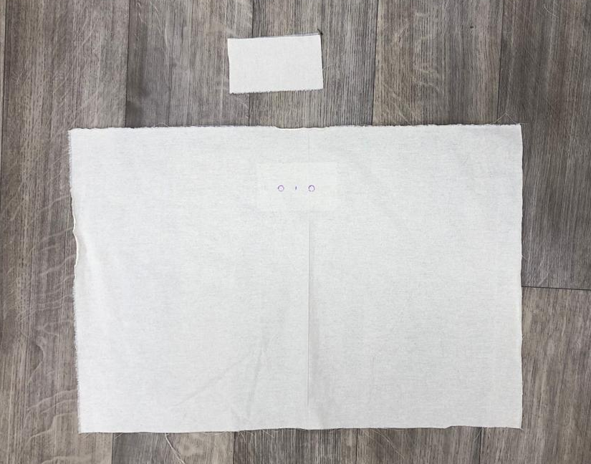

08. Eyelets
Photo(s) is/are provided by HKDI

Slide 40
Demonstration Videos
Casing for drawstring
Eyelets

Slide 41

09. Attaching fishbone
Photo(s) is/are provided by HKDI

Slide 42



09. Attaching fishbone
Style 2
Style 1
Photo(s) is/are provided by HKDI

Slide 43
Demonstration Videos
Attachment of fish bone - style 1
Attachment of fish bone – style 2

Slide 44


10. Invisible Zipper
Photo(s) is/are provided by HKDI

Slide 45


10. Invisible Zipper
Neaten raw edges.
Photo(s) is/are provided by HKDI

Slide 46

10. Invisible Zipper
Machine along the fitting line from hip to hem with 1cm seam allowance.
Zipper end + 2.5cm
Photo(s) is/are provided by HKDI

Slide 47

10. Invisible Zipper
Zipper end
Press the seam open.
Photo(s) is/are provided by HKDI

Slide 48


10. Invisible Zipper
Use invisible presser foot
Or
Single feet pressure foot
OR
Invisible zipper pressure foot
Single feet pressure foot
Photo(s) is/are provided by HKDI

Slide 49

10. Invisible Zipper
Unzip the zipper, place the zipper to the fabric (right side facing right side).
Photo(s) is/are provided by HKDI

Slide 50


10. Invisible Zipper
Attach invisible zipper to the fabric.
Photo(s) is/are provided by HKDI

Slide 51


10. Invisible Zipper
Attach invisible zipper to the other side of the fabric.
Photo(s) is/are provided by HKDI

Slide 52
10. Invisible Zipper
Photo(s) is/are provided by HKDI

Slide 53
Demonstration Video
Invisible zipper

Slide 54


11. SEMI concealed
Zipper
This method is used for the
side seam or center back opening.
Source from royalty free photo from Pexels.

Slide 55
11. SEMI concealed Zipper
Neaten raw edges.
Photo(s) is/are provided by HKDI

Slide 56


11. SEMI concealed Zipper
Machine along the fitting line from hip to hem with 1cm seam allowance.
Press the seam open.
Zipper length
+0.5cm
(not stitching)
Photo(s) is/are provided by HKDI

Slide 57

11. SEMI concealed Zipper
Stitch the zipper together with the fabric on the right side.
Photo(s) is/are provided by HKDI

Slide 58
11. SEMI concealed Zipper
Source from royalty free photo from Pexels.

Slide 59
Demonstration Video
Semi concealed zipper

Slide 60

chapter activity
SEWING PRACTICE
Piping
French seam
Binding (top stitch)
Binding (stitch in the ditch)
Facing
Belt loop
Casing for drawstring
Attaching fish bone
Invisible zipper
Semi concealed zipper
Photo(s) is/are provided by HKDI

