Slide 1
basic block OF Skirt

Slide 2
Basic block of skirt
Basic Block of Skirt
Skirt length | 65cm
Waist | 60cm
Hip | 96cm
Waist to Hip | 20cm
Hem | 108cm
Waistband Height | 3cm
Zipper Length | 18cm

Slide 3
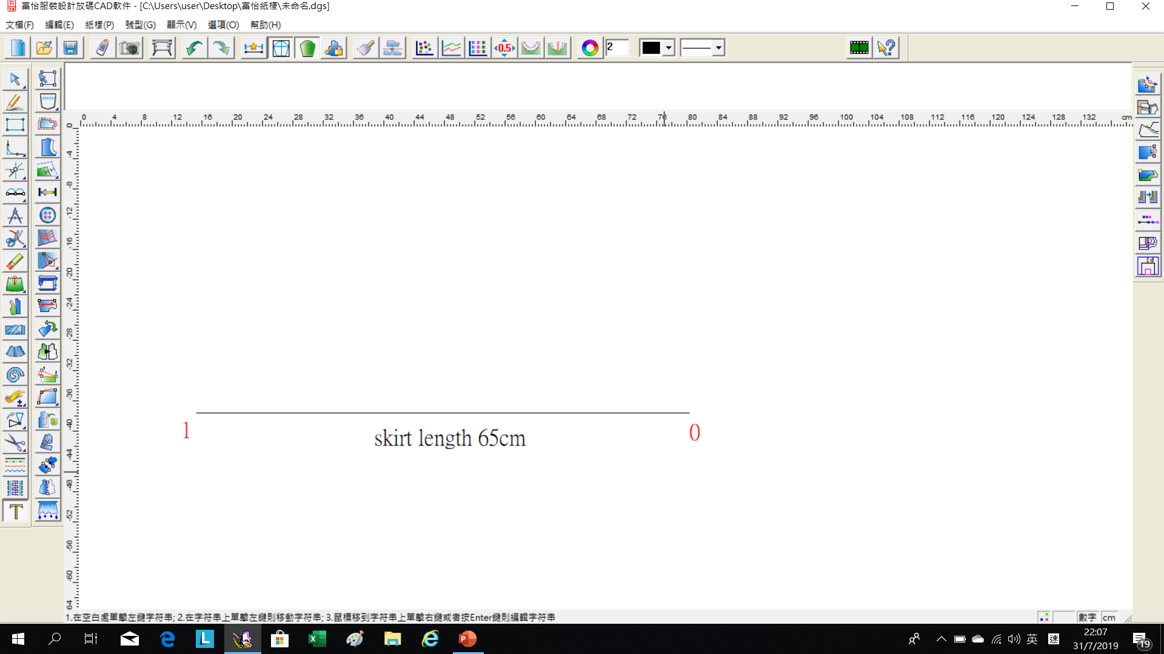
(0)-(1) :Skirt length (65cm)

Slide 4
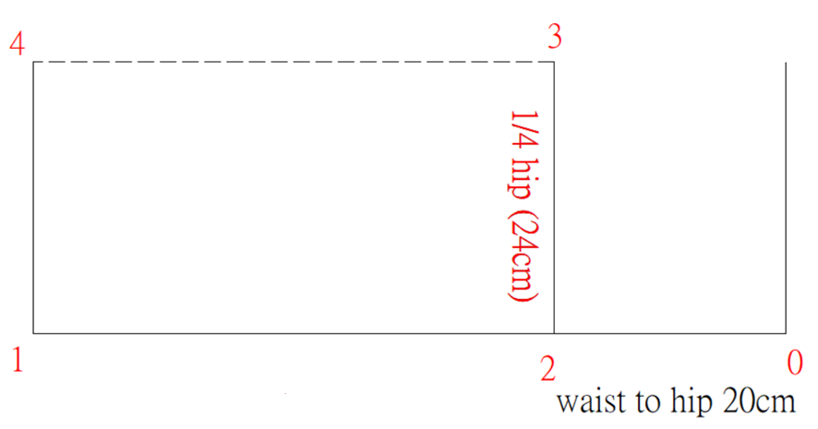
(0)-(2): Waist to Hip (20cm)
(2)-(3): ¼Hip(24cm), square down to the hem, mark point (4)
skirt length 65cm

Slide 5
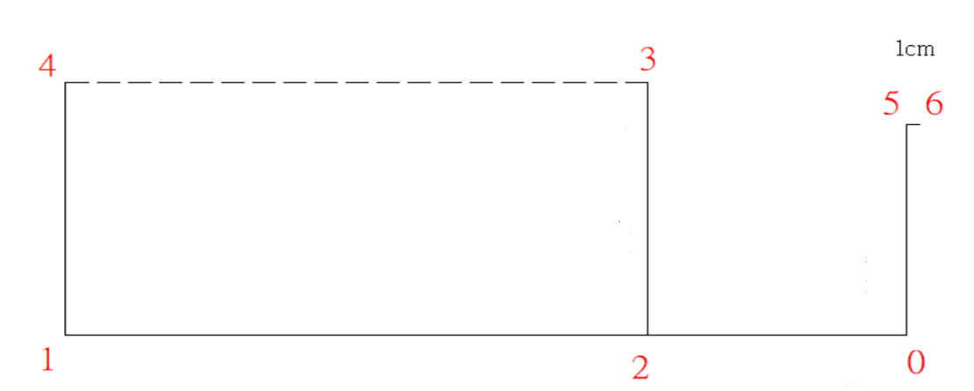
(0)-(5):1/4 Waist + 2.5cm + 2.5cm(dart)=20cm
(5)-(6):Square up 1cm to make point (6)

Slide 6
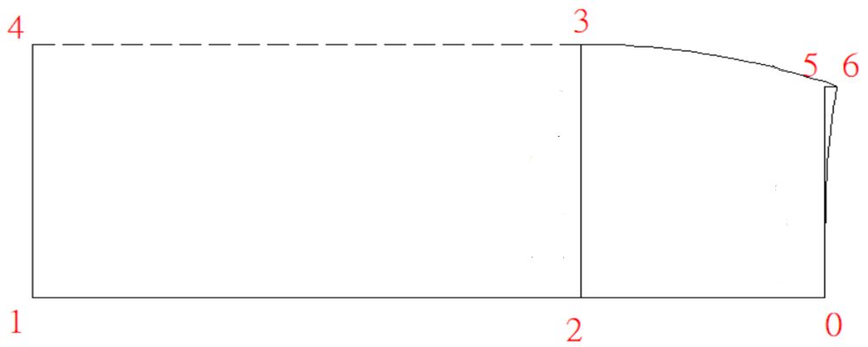
Join (3)-(6) in a curve line and join(0)-(6) in a curve line

Slide 7
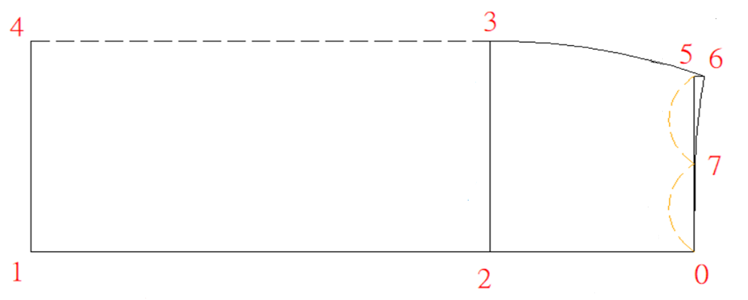
(0)-(7):Midpoint of (0)-(6)

Slide 8
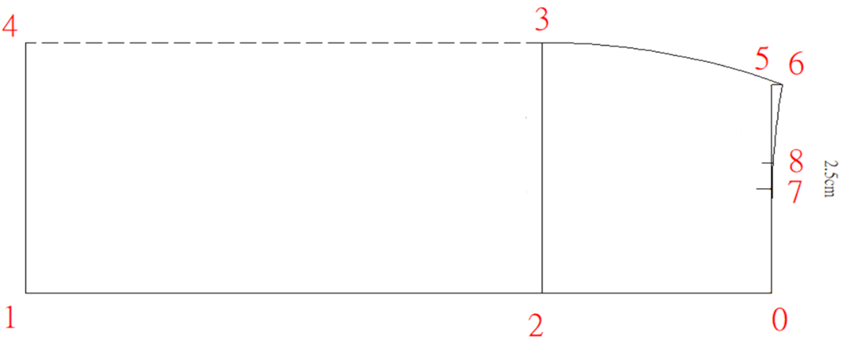
(7)-(8) :Front dart (2.5cm)

Slide 9
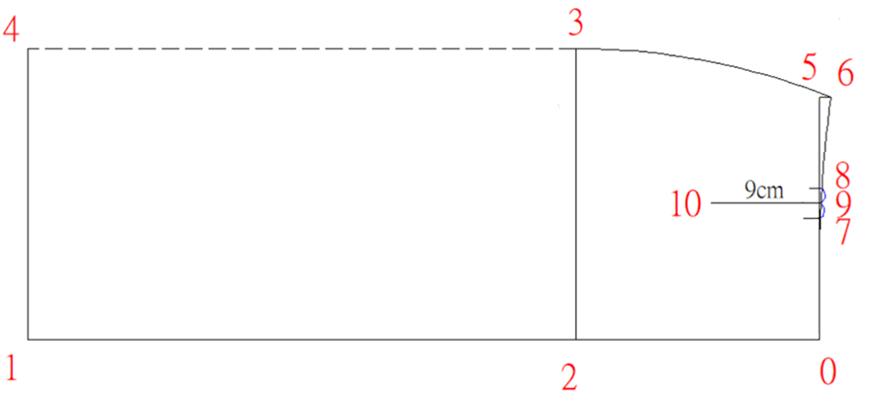
(9) : Midpoint of (7)-(8), square down to point (10)
(9)-(10): 9cm (dart length)

Slide 10
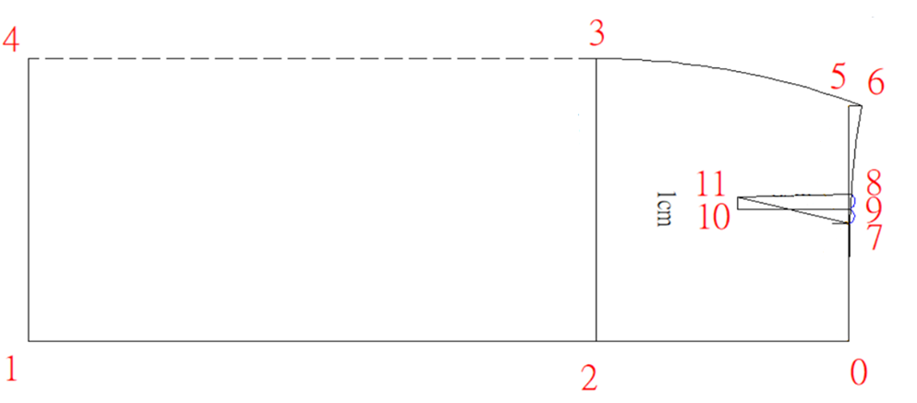
(10)-(11) :1cm

Slide 11
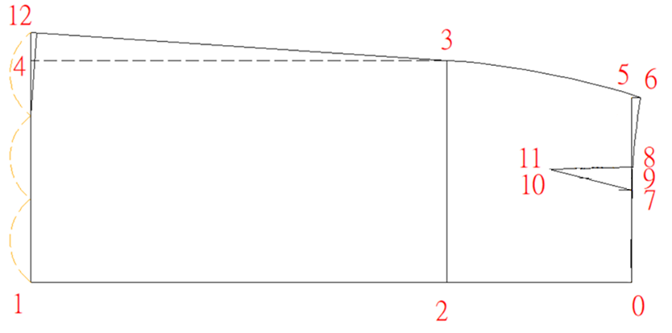
(4)-(12) : 3 cm
Divide (1)-(12) into three equal portions, and (12) at a right angle
3 cm

Slide 12
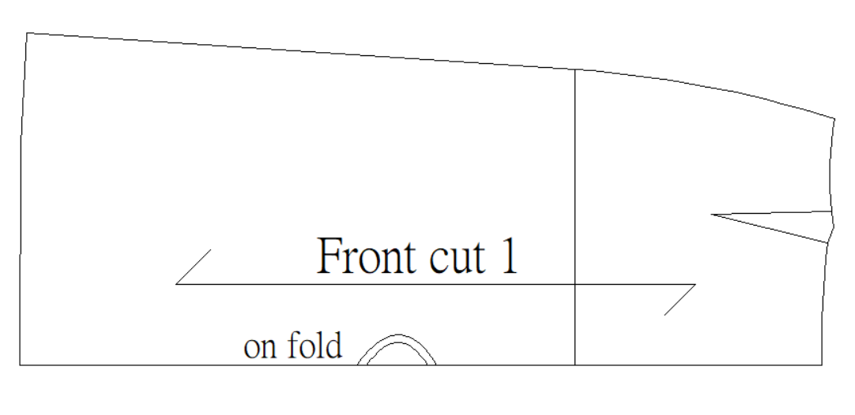
Fold the dart, draw the waist line again

Slide 13
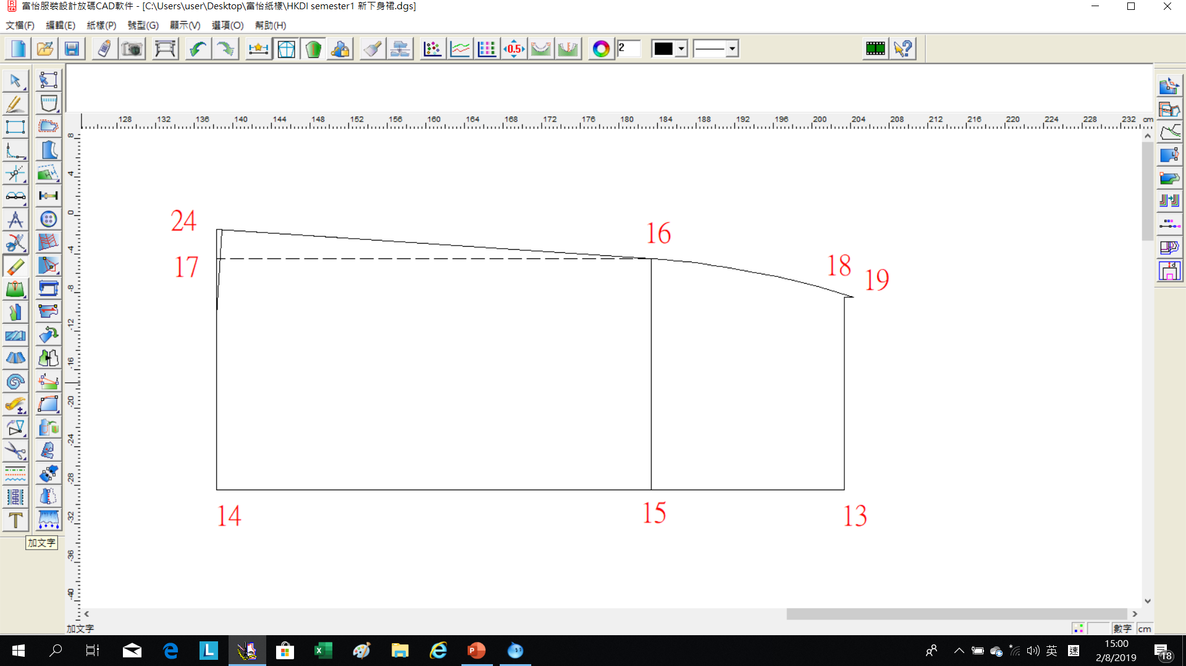
Back
(13)-(14): Skirt length (65cm)
(13)-(15): Waist to Hip (20cm)
(15)-(16): 1/4 Hip (24cm)
(13)-(18): ¼ waist less 1.25cm+5cm (two dart) =20cm

Slide 14
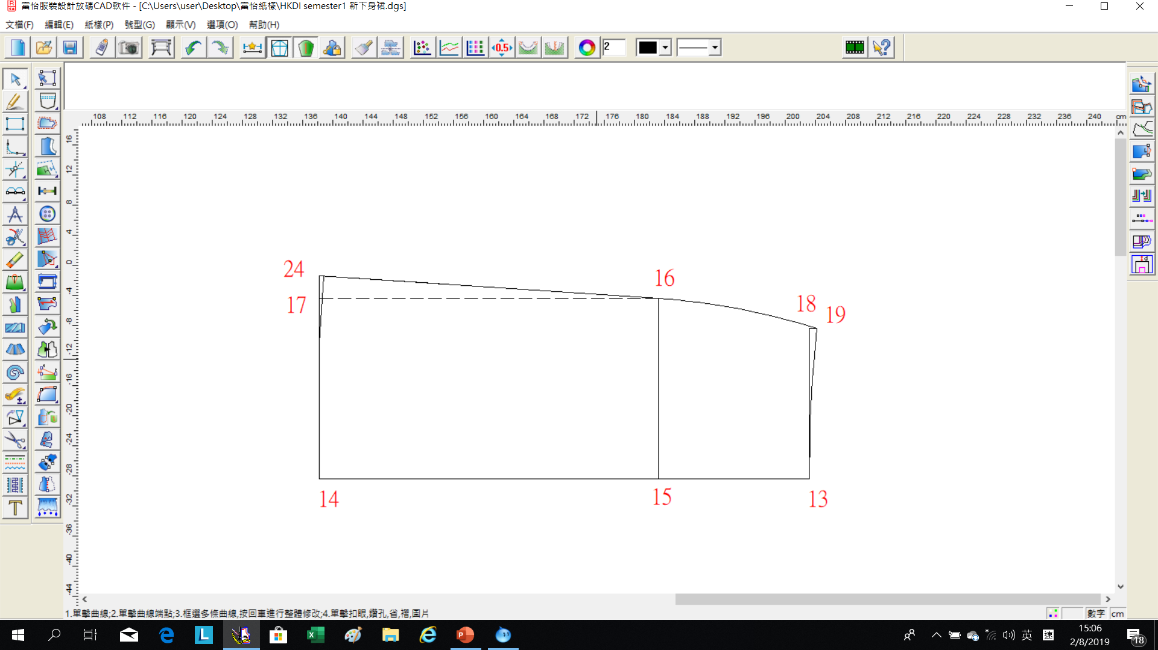
(18)-(19): Square up 1cm from (18), join (19)-(16) in a curve line
(13)-(19): Join in a curve line, (19) at a right angle

Slide 15
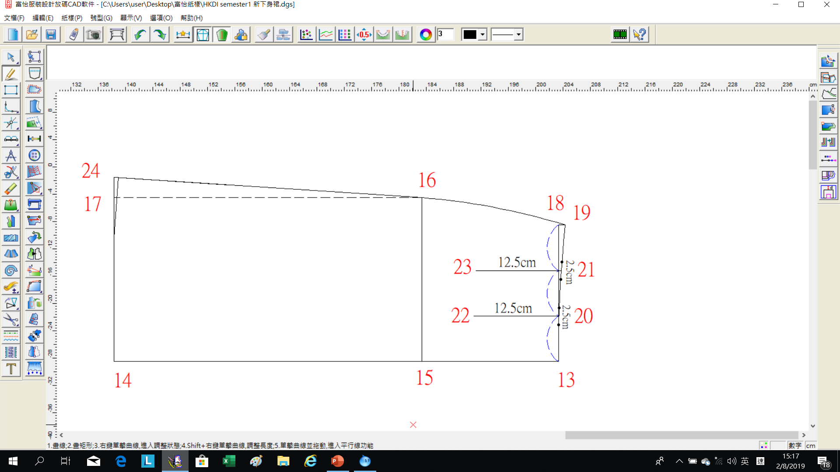
Divide (13)-(19) into three equal portions, square down 12.5cm to make (20) and (21).
Dart (a):2.5cm and dart (b):2.5cm

Slide 16
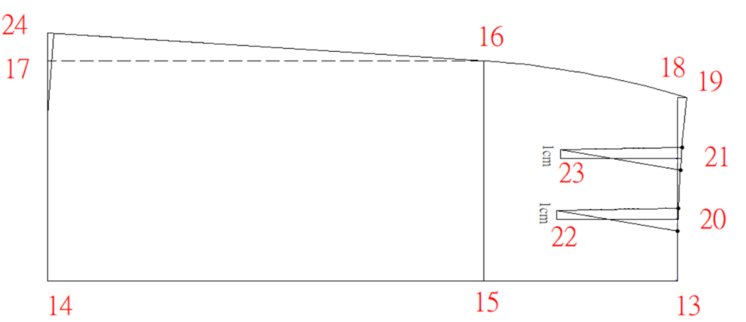
(22)/(23) :1cm

Slide 17
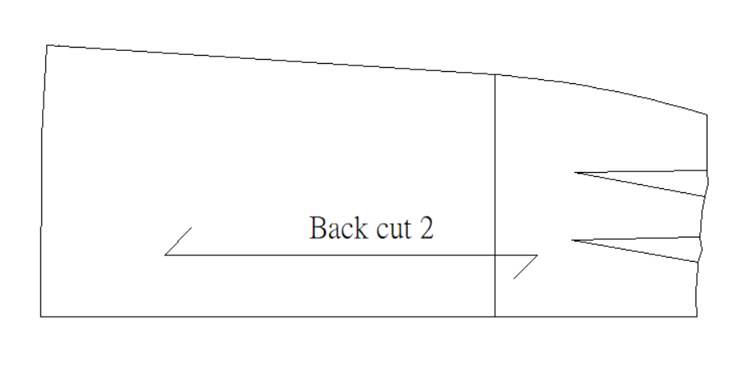
Fold the dart, draw the waist line again

Slide 18
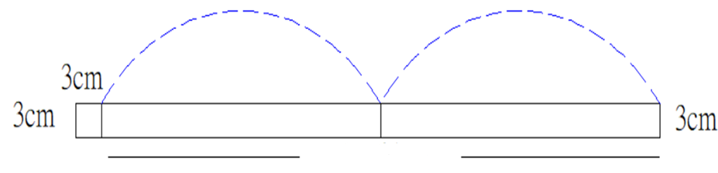
Waistband
- with 3cm button stand
waist 60cm

Slide 19
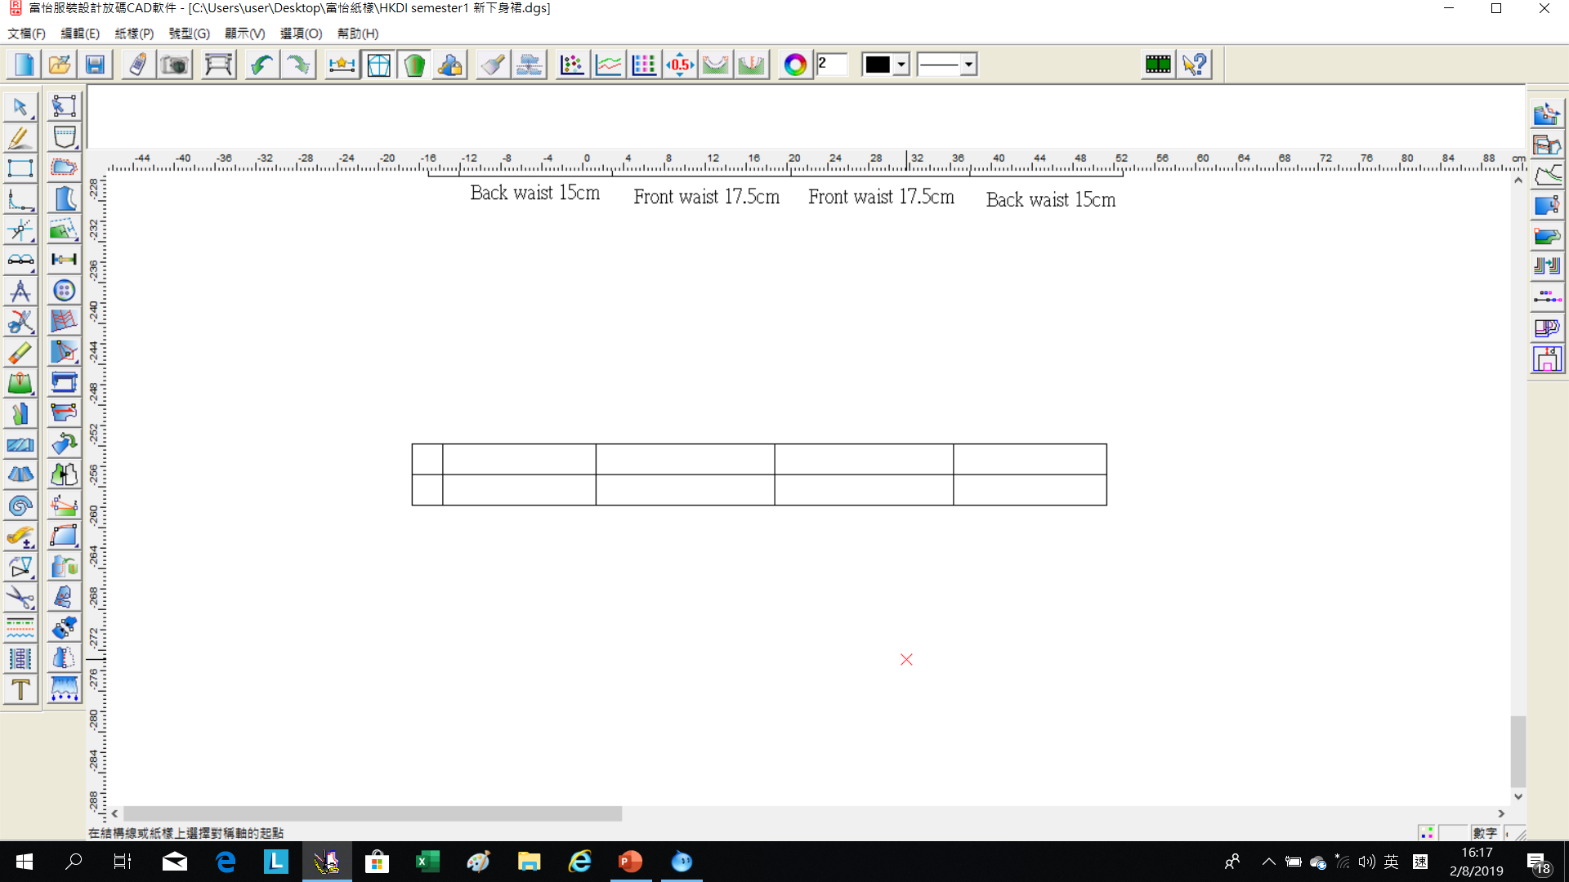
Waistband
6cm

Slide 20
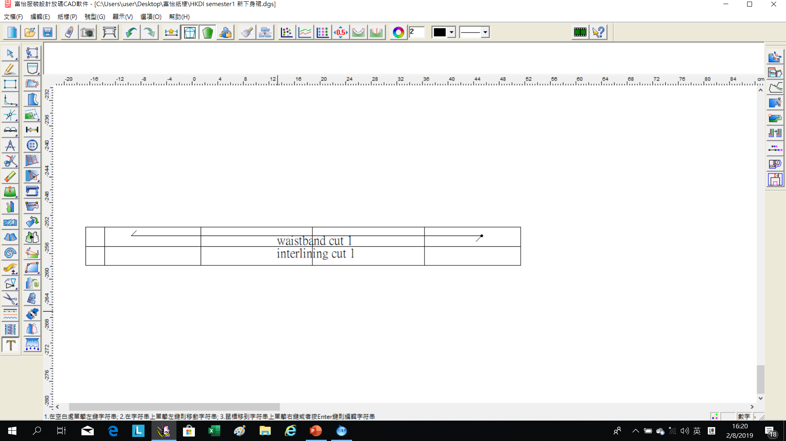
Waistband
6cm
60cm

Slide 21
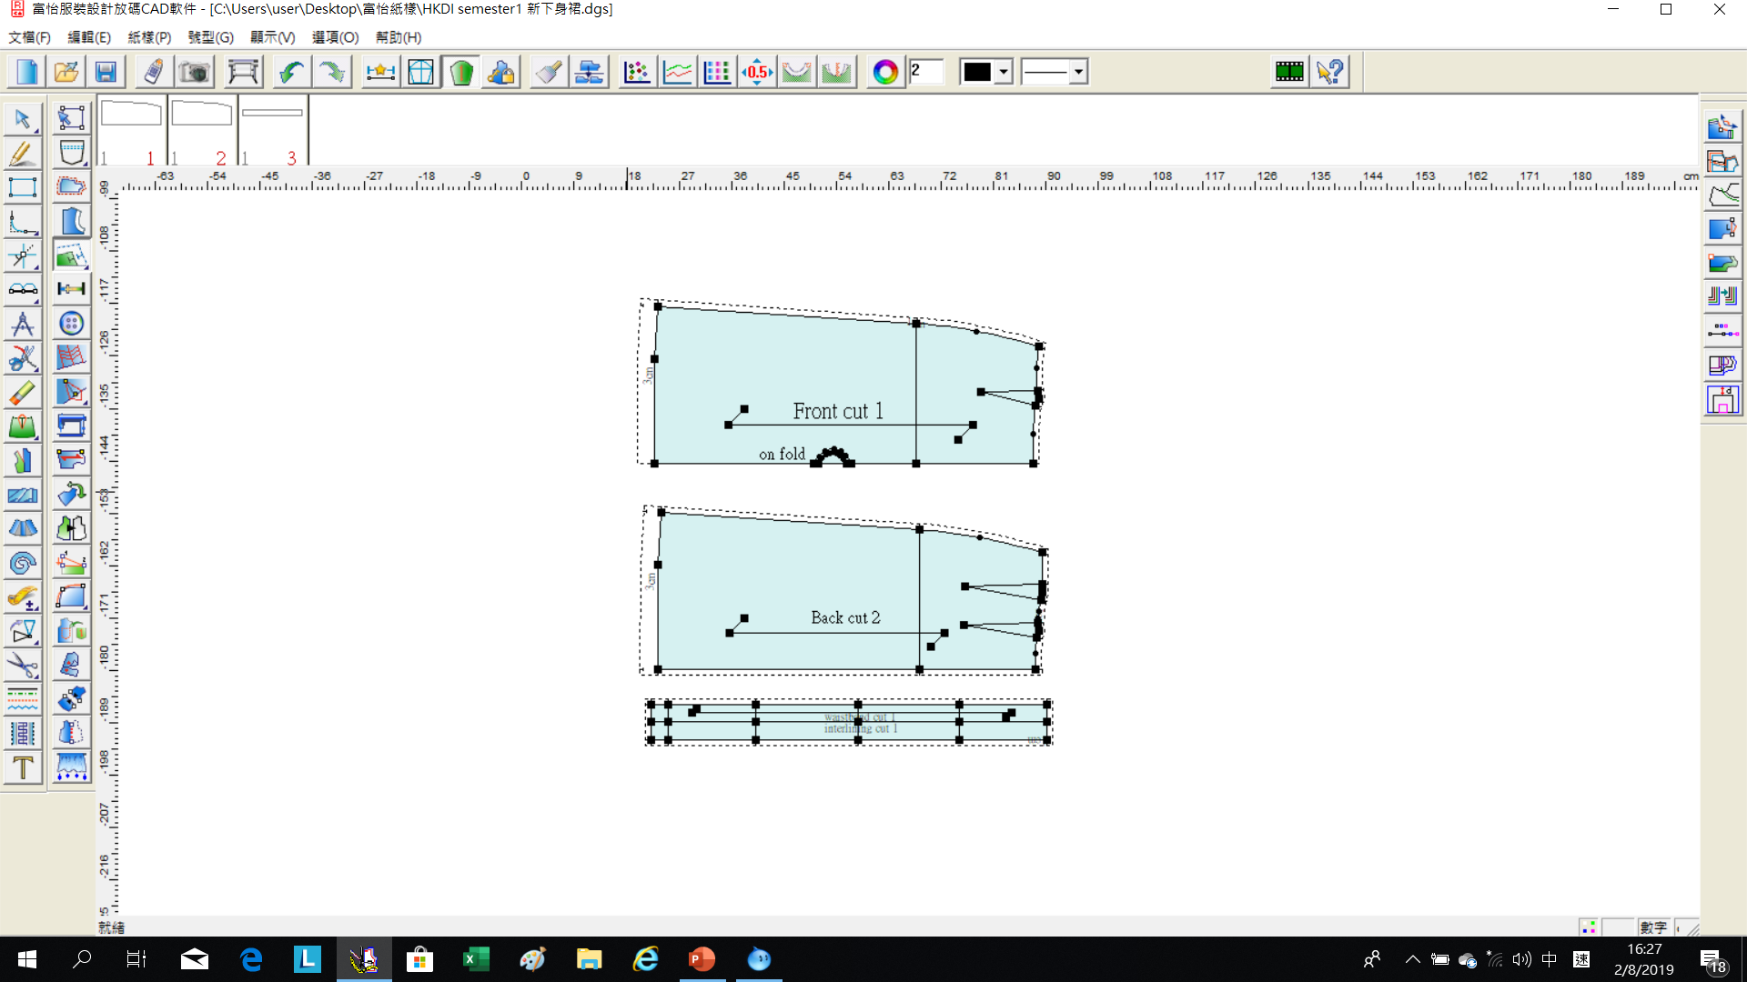
Seam allowance
Waist | 1cm
Center back | 1.5cm
Side seam | 1.5cm
Hem | 3 cm
Waistband | 1cm

Slide 22
Demonstration Videos
Basic Block of Skirt – Front
Basic Block of Skirt – Back
Adding Seam Allowance
Waistband

Slide 23
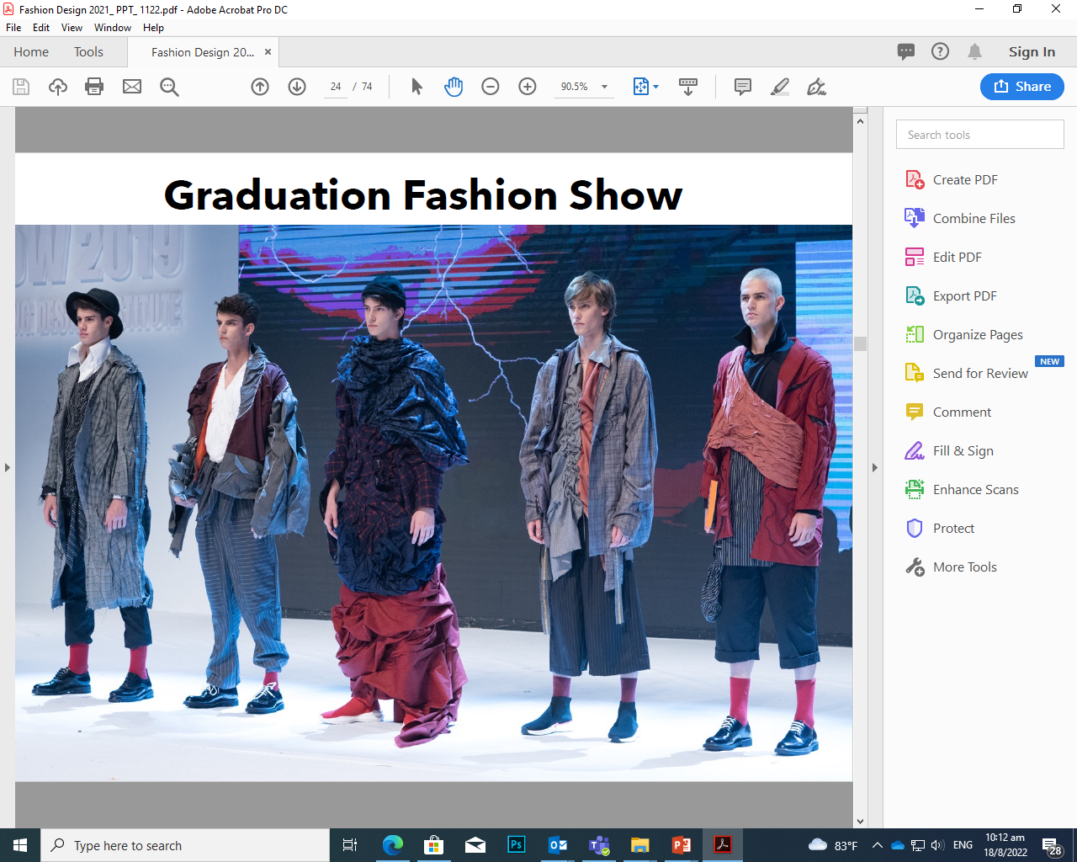
Photo(s) is/are provided by HKDI
Chapter Activity
Construct
basic block OF Skirt

