Slide 1
Sleeves
(patterns)

Slide 2
Kimono/Magyar/Grown-on SLEEVE
Collar | 15.4cm
Shoulder | 38cm
Bust/Chest | 102cm
Centre Back Length | 56cm
Sleeve Length | 97cm
Sleeve Width | 34cm
Back Waist Length | 39.5cm
Neck Width | 7.7cn

Slide 3
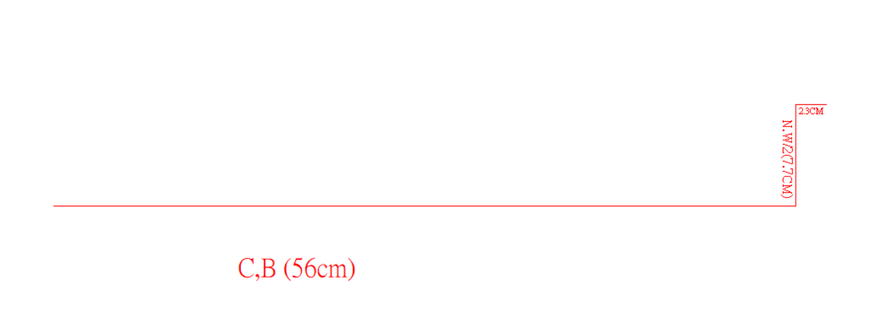
Kimono/Magyar/Grown-on SLEEVE
2.3cm
7.7cm
C.B (56cm)

Slide 4
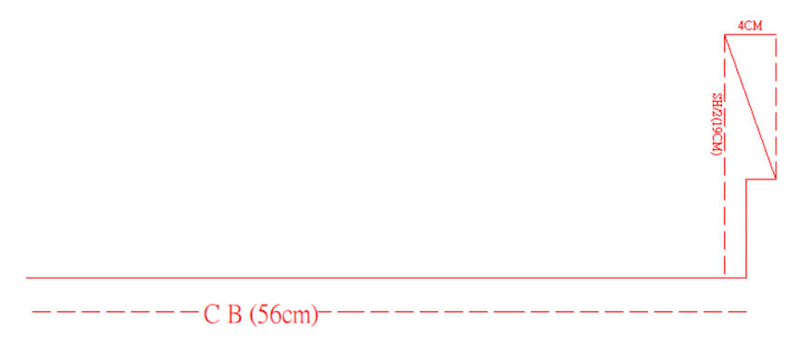
Kimono/Magyar/Grown-on SLEEVE
4cm
19cm

Slide 5
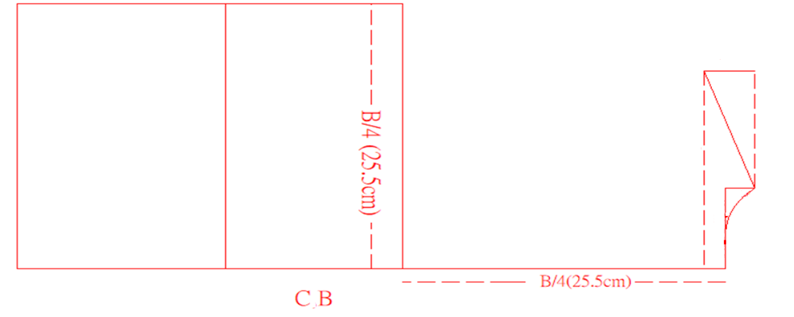
Kimono/Magyar/Grown-on SLEEVE
25.5cm

Slide 6
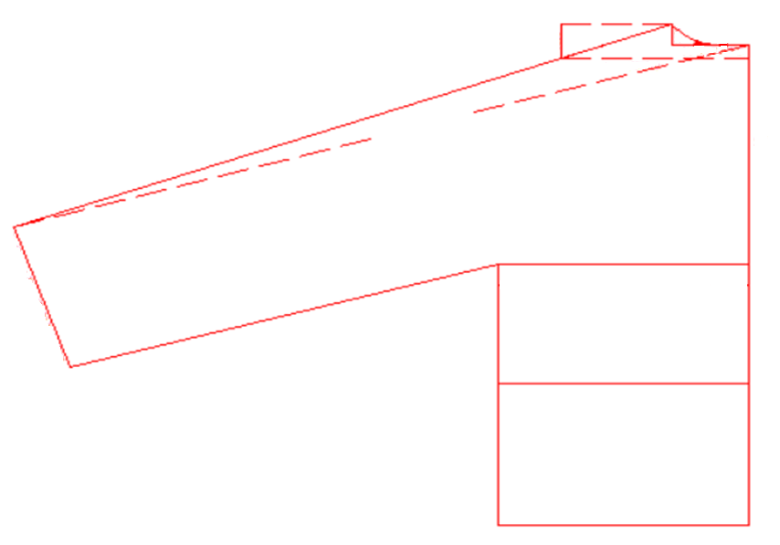
Kimono/Magyar/
Grown-on SLEEVE
78cm
C B
17.25cm

Slide 7
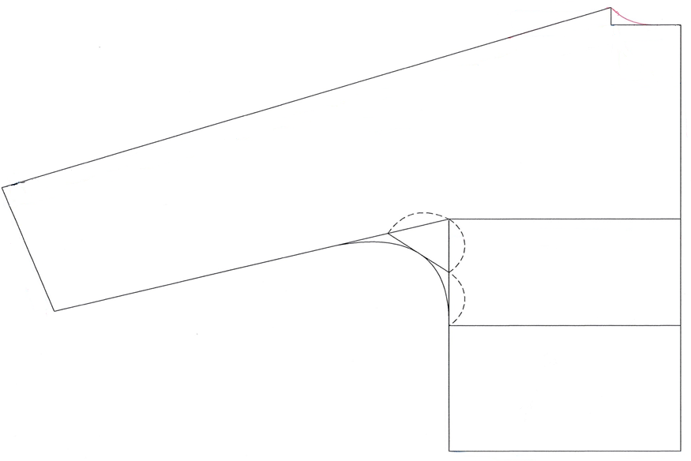
Kimono/Magyar/
Grown-on SLEEVE
C B

Slide 8
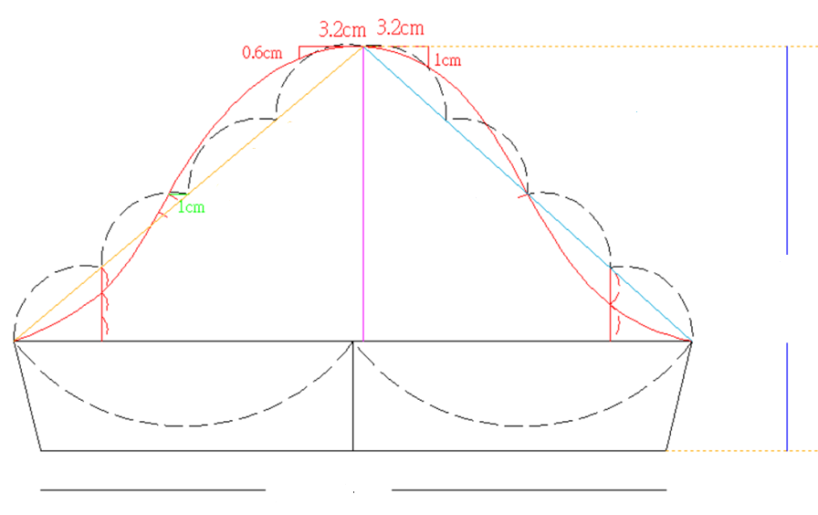
Set-in Sleeve
Back Armhole | 23.3cm
Front Armhole | 22.8cm
Sleeve Crown | 14.6cm
Sleeve Length | 20cm
Sleeve Width | 31cm
Back Armhole
Front Armhole
Sleeve Crown
Sleeve Length
Sleeve Width

Slide 9
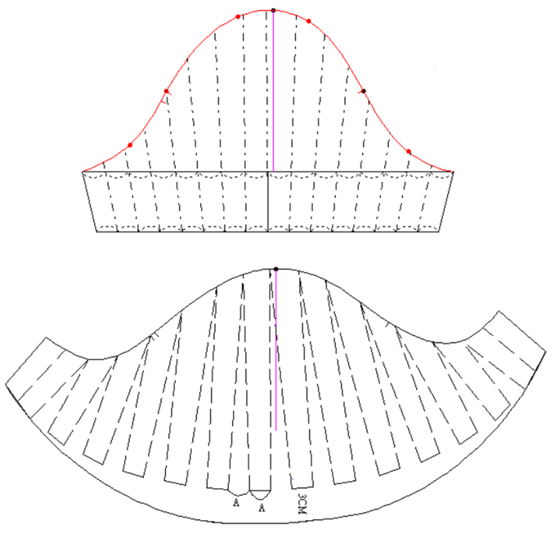
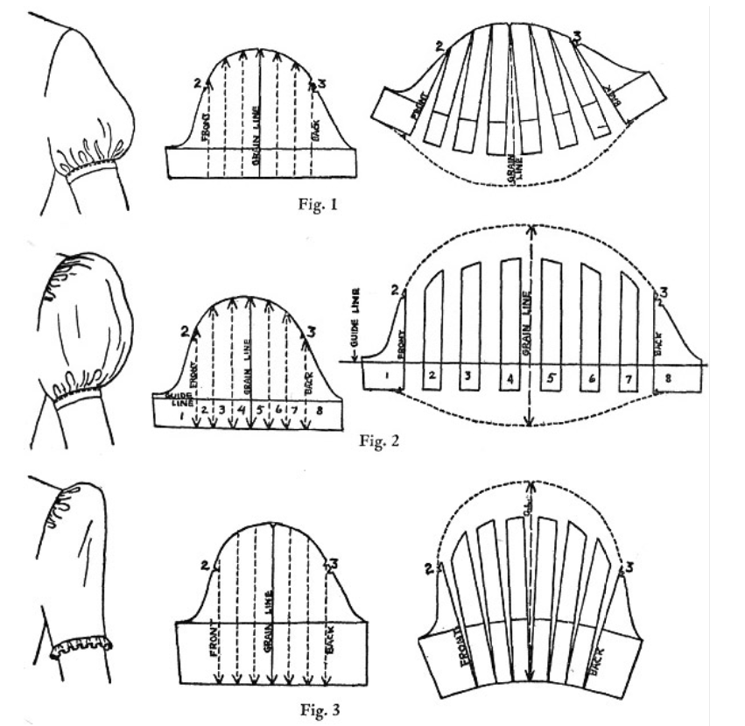
Puff sleeve
Divide into 16 parts
Every part is 3cm apart from each other

Slide 10
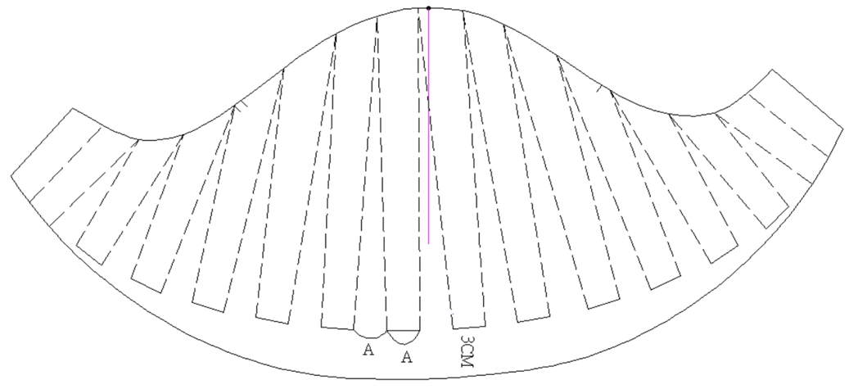
Puff sleeve
Make a smooth curve line

Slide 11
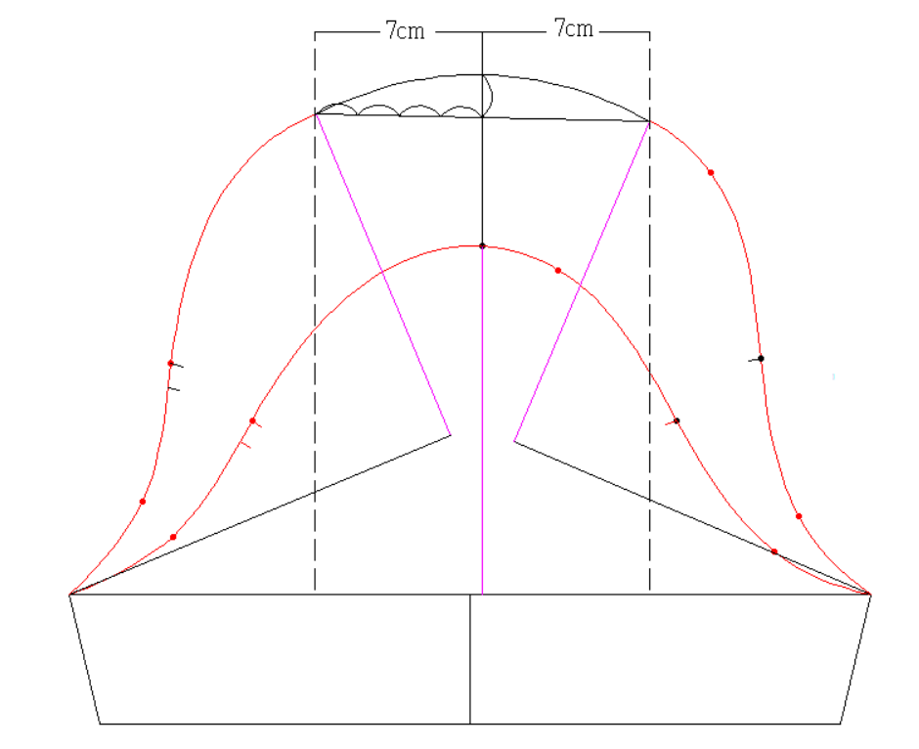
Princess sleeve
Slash at the middle of the sleeve
crown, insert 7cm at each side

Slide 12
Demonstration Video
Kimono / Magyar / Grown-on sleeve
Set-in sleeve
Puff sleeve and princess sleeve

Slide 13
chapter activity
Pattern drafting for sleeve
Collection by LAI Ho Man, HD in Fashion Design, Hong Kong Design Institute
Photo(s) is/are provided by HKDI

