Slide 1

Consumer Behaviour in Clothing Choices and Implications
Factors that Influence Consumer Buying Behaviours

Slide 2
Cultural
Psychological
Factors Influencing Consumer Behaviour
Social
Personal
Economic

Slide 3
Cultural factors come from the different components related to culture or cultural environment from which the consumer belongs.
A brand will take into account the cultural factors inherent to each market or to each situation in order to adapt its product and its marketing strategy. As these will play a role in the perception, habits, behaviour or expectations of consumers.
Cultural Factors

Slide 4
Culture is crucial when it comes to the understanding of the needs and behaviours of an individual.
A person will be influenced by his / her family, friends, cultural environment or society that will “teach” him / her values, preferences as well as common behaviours to his / her own culture.
Culture is the fundamental determinant of person’s wants and behaviour.
What is a Culture?

Slide 5
Cultural environment includes the influence of religion, family, education, and social system on the markets.
Marketers will closely attend to cultural values in different places to understand how to best market their existing products and find opportunities for new products.
Cultural Environment

Slide 6
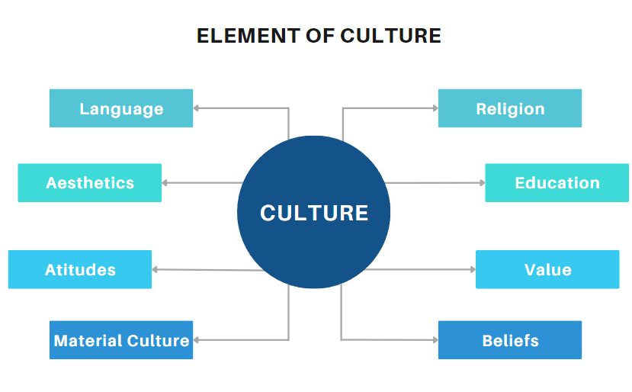

Slide 7
A Theoretical Model of Culture’s Influence on Behaviour
Cognitive Beliefs
Personality Traits
Attitude
Subjective Culture:
Regional
Ethnic
Religious
Linguistic
National
Professional
Organisational
Behaviour
Behaviour
Intention
Practices
Social
Norms
Values

Slide 8
Relationship between Culture and Consumer Behaviour
Culture satisfy buying needs
Culture is learned
Culture offers order, direction and guidance in all phases of human problem solving processes, including buying decisions.
Acculturation
Culture provides standards and rules about when to wear, what to wear for festival or culture event.

Slide 9
Impact of Culture on Consumption Patterns
Norms – ranges of appropriate behaviour
Consumption
Patterns
Cultural Values
Sanctions – penalties for violating social norms

Slide 10
Self-Oriented Values
Active / Passive
Material / Nonmaterial
Hard work / Leisure
Postponed gratification / Immediate gratification
Sensual gratification / Abstinence
Religious / Secular
Cultural Values of Relevance to Consumer Behaviour
Notes:
Active / Passive
Is a physically active approach to life valued more that a less active orientation?
Material / Nonmaterial
How much importance is attached to the acquisition of material wealth?
Hard work / Leisure.
Is a person who works harder than economically necessary admired more than one who does not?
Postponed gratification / Immediate gratification
Are people encouraged to “save for a rainy day” or to “live for today”?
Religious / Secular. To what extent are behaviours and attitudes based on rules specified by religious doctrine.
Sensual gratification / Abstinence. To what extent is it acceptable to enjoy sensual pleasures such as food, drink, and sex?

Slide 11
Cultural Factors Affecting Consumer Behaviour
Social class
Subculture
Culture
01
Learned values, perception, wants and behaviour from family and other important institutions.
01
02
Groups of people within a culture with shared value systems based on common life experiences and situations.
02
03
Society’s relatively permanent and ordered divisions whose members share similar values, interests and behaviours.
03

Slide 12
Subcultures are groups of people within a culture with shared value systems based on common life experiences and situations.
It provides more specific identification and socialisation for the members.
It includes nationalities, religion, racial groups and geographic regions.
Consumers are usually more receptive to products and marketing strategies that specifically targeting at them.
What is subculture?

Slide 13

Social Class
People within a social class tend to exhibit similar buying behaviour.
For example:
Occupation
Income
Education
Wealth

Slide 14
Social classes are defined as groups forming a social hierarchy
People from different social classes tend to have different desires and consumption patterns.
Some studies have also suggested that the social perception of a brand or a retailer is playing a role in the behaviour and purchasing decision of consumers.
Social Class

Slide 15




Psychological factors
Motivation
Maslow’s hierarchy of needs
Perception
Selective attention,
distortion , and retention
Beliefs and Attitudes
Descriptive thoughts vs
consistency
Learning
Drive, stimuli, cues,
responses, reinforcement

Slide 16





Maslow’s Hierarchy of Needs
Esteem
Love / Belonging
Safety
Physiological
Creativity,
Spontaneity,
Problem Solving,
Acceptance of Facts
Self-
Actualisation
Self-Esteem, Confidence,
Achievement,
Respect of Others,
Respect by Others
Friendship, Family
Body, Employment, Resources, Family,
Health, Property
Breathing, Food,
Water, Sleep,
Excretion

Slide 17
Social Factors
Reference Groups
Groups that have a direct and indirect influence on consumers’ attitudes or behaviour
Expose individual to new behaviour and lifestyle, influence attitudes, create pressures for conformity
Family
Family of orientation: parents and siblings
Roles and Status
Role consists of the activities a person is expected to perform
Affect product and brand choice
Family of procreation: spouse and children
Each role carries a status
People choose products that reflect and communicate with their role and status

Slide 18






Age and Life-cycle Stage
Tastes and preferences change majority in different stages of life
Occupation
Affects the goods and services bought by consumers
Lifestyle
Consumer’s AIOs (activities, interests, and opinions)
Personality and Self-concept
Unique psychological characteristics and how the consumers perceive themselves
Financial Condition
Include trends in personal income and savings
Personal
Factors

Slide 19
Economic Factors
Personal income
Family income
Income expectation
Consumer credit
Liquid assets
Savings

Slide 20
Economic Factors
Personal Income:
The disposable personal income is the income left in hand after all the taxes, and other necessary payments have been made.
The discretionary personal income is the income left after meeting all the basic necessities of life and is used for purchase of extra shopping goods, luxuries, durable goods, etc.

Slide 21
Economic Factors
Family Income
The family income refers to the aggregate of the sum of the income of all the family members.

Slide 22
Economic Factors
Income Expectation
An Individual’s expectation with respect to his / her income level in the future influences his / her buying behaviour today.

Slide 23
Economic Factors
Consumer Credit
The credit facility available to the consumer also influences his / her buying behaviour.
This credit is offered by the seller either directly or indirectly through the banks and other financial institutions.

Slide 24
Economic Factors
Liquid Assets
The liquid assets are the asset that are readily convertible into the cash.

Slide 25
Economic Factors
Savings
The amount of savings out of the personal income also influences the consumer buying behaviour.

Slide 26
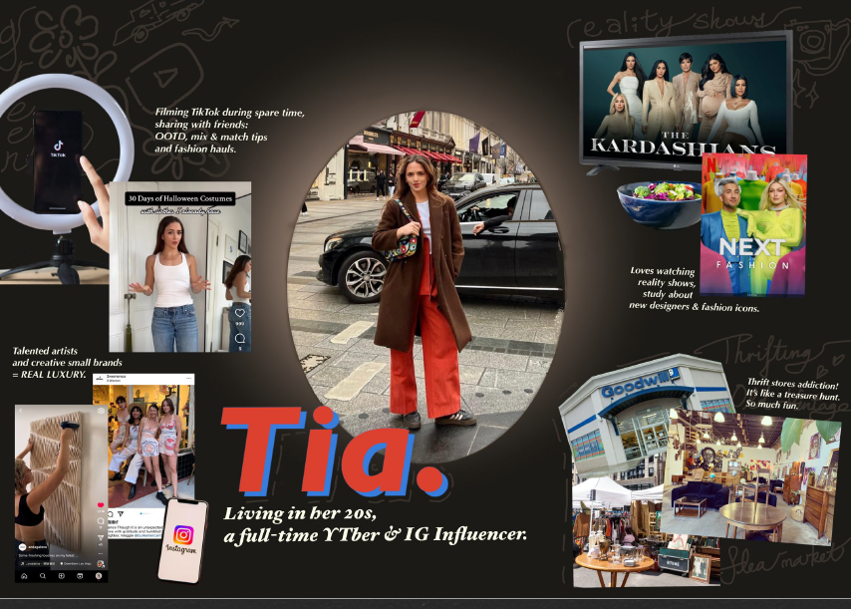
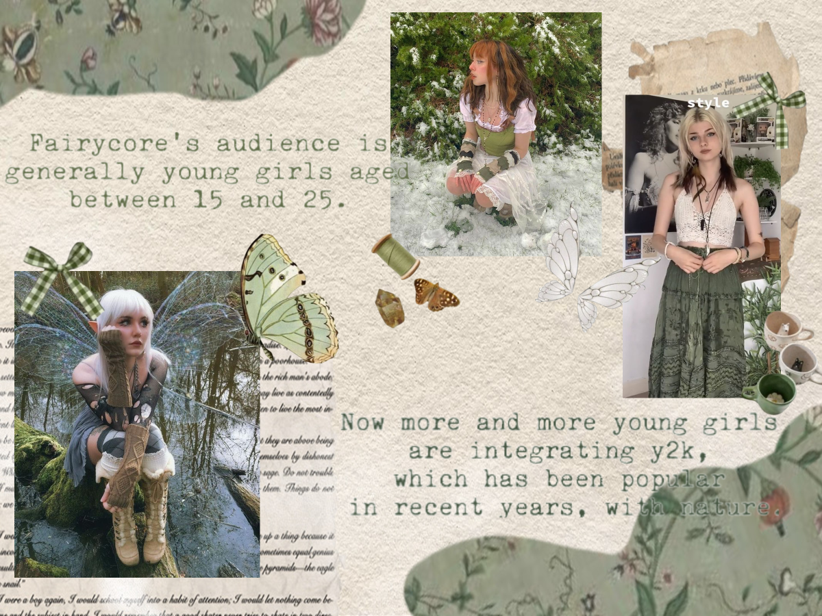
Example: Application of the Maslow’s Hierarchy of Needs
Works prepared by student in FHDFASH Higher Diploma in
Digital Fashion Creation, Hong Kong Metropolitan University
Photo(s) is/are provided by the Clothing Industry Training Authority

Slide 27
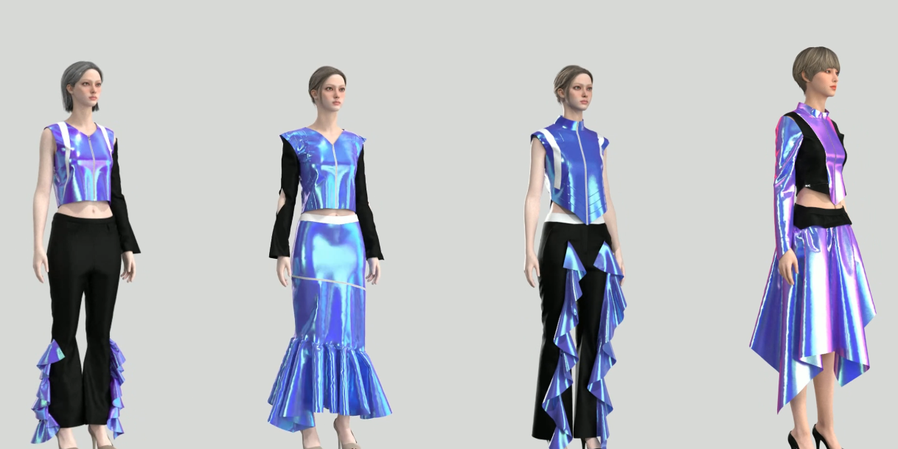
Works prepared by student in FHDFASH Higher Diploma in
Digital Fashion Creation, Hong Kong Metropolitan University
Example: Application of the Maslow’s Hierarchy of Needs
IoT
Real-time monitoring
Health monitoring
AR/VR
Product development
Product experience
Blockchain
Supply Chain
Circular economy
Photo(s) is/are provided by the Clothing Industry Training Authority

