Slide 1
CHAPTER 7
STYLING REALISATION

Slide 2
CONCEPT OF TOTAL LOOK
Royalty-free photo sourced from Pexels

Slide 3
CONCEPT OF TOTAL LOOK
Total look is an outfit worn by someone who styles him/ herself with “looking good” coordination and mix-and-match of clothing and accessories items.
Outfit ideas are fun, full of variations and personalities.
It is more than just applying a single colour or pattern to an outfit, but a creation of look to mix and match styles, items, colour and brands.
Royalty-free photo sourced from Pexels

Slide 4
Most people can’t or won’t be categorised themselves into a single iconic look
Personal style is fun and full of variations
It is about being creative and mix up, e.g. worker style mix with street style, American classic mix with sports style, rock and roll mix with feminine style
WHAT is MIX & MATCH
Royalty-free photo sourced from Pexels.

Slide 5
Fashion accessories and their effects on the total look
Royalty-free photo sourced from Pexels

Slide 6
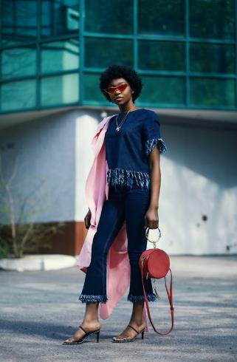
THE IMPORTANCE OF ACCESSORIES
Always a delicate balance of good and bad taste; stylish or not stylish
Critical accessories such as bag and footwear might enhance or ruin the total look
Accessories include: bag, footwear, scarf, belt, glasses, headwear, socks
Could be classified into 2 types, namely: basics (essential) and trendy (non-essential)
THE
Royalty-free photo sourced from Pexels

Slide 7
BAGS
Different kinds of bags for females and males
Formal or casual
Hangbag, tote, backpack, briefcase, shoulder bag, clutches etc.
Essential handbags are bags that are necessary to carry all essential items daily, it could match with your daily outfit easily and add a finishing touch to your daily look
Briefcase
Tote
Clutch
Waistbag
Handbag
Backpack
Royalty-free photo sourced from Pexels.

Slide 8
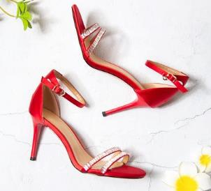
Running shoes
Derby shoes
Ankle boots
High heels
FOOTWEAR
Formal or casual, for different occasions and purposes
Formal shoes: men’s leather shoes, women’s high heels, leather boots
Casual shoes: running shoes, canvas sneakers, trainers, sandals (flipflops), outdoor boots
Canvas
sneakers
Trainers
Sandals
Outdoor boots
Royalty-free photo sourced from Pexels

Slide 9
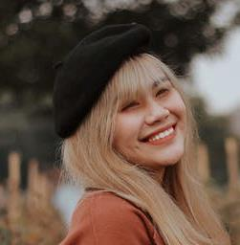
Beanie
Gentleman
hat
Straw hat
Beret hat
Bandana
HEADWEAR
Cap
Newsboy
cap
Formal or casual
Stylish touch adding on the total look
Variety of colours patterns and materials
Bandana, typical headwear item besides hat
Headwear presents a sense of personal style and characters
Royalty-free photo sourced from Pexels

Slide 10
OTHER
ACCESSORIES
Belts
Socks
Scarves
Glasses
Sunglasses
Watches
Bracelets
Rings/ earrings
Royalty-free photo sourced from Pexels.

