Slide 1


GIFTED EDUCATION SECTION, CDI, EDB
Learning and teaching
resources for
junior secondary
levels
(English language)

Slide 2
Topic: | Health and hygiene
Learning Objectives: | To identify good habits and ways to help people stay healthy during the COVID-19 pandemic; To develop reading and writing skills; and To write leaflets to inform different stakeholders in the neighbourhood of ways to stay healthy during the COVID-19 pandemic.
Language Focuses: | To understand the features of a leaflet To understand the use of imperatives to give advice

Slide 3
Part 1: Getting started
List FIVE things you do every day to help you stay healthy and hygienic. Explain why you do so and how these habits/things you do keep you healthy and clean.
 | Things you do daily | Reasons
1
2
3
4
5

Slide 4
Part 2: Reading - Learning about the needs/problems faced by different stakeholders in the society
Your friends have told you about an online discussion forum about COVID-19. Read the posts on the discussion forum in the worksheet and answer questions 1 – 8 on slides 4 – 6.
Why doesn’t Tony clean his room?
What is Tony’s tone in his post?
A. depressed
B. critical
C. enthusiastic
D. sympathetic

Slide 5
Find words in Linda’s post that mean the same as the following:
Why do you think Linda suggest Tony to help take up some chores at home?
Why do you think Peter and his colleagues bring their lunchboxes instead of having lunch at the restaurant?
What does “our” (line 30) refer to?
What is the purpose of the last paragraph in Peter’s post?
(i) | outbreak
(ii) | nourishing
(iii) | complimented

Slide 6
8. Complete the table with information from the online discussion forum.
Person | Problem (with elaboration) | Possible Solution
Tony Wong | He has poor ______ ______. his bedroom is dirty. he has terrible body odour. | He should ____________ __________________________________________.
Linda Chan’s daughter | She ________ _________ to her smartphone. she stays in her room playing with her smartphone all the time. | Her mother ___________ __________________________________________.
Peter Cheung | He almost fell when the bus stopped suddenly. he ________________ ________________. | He should ____________ __________________________________________.

Slide 7
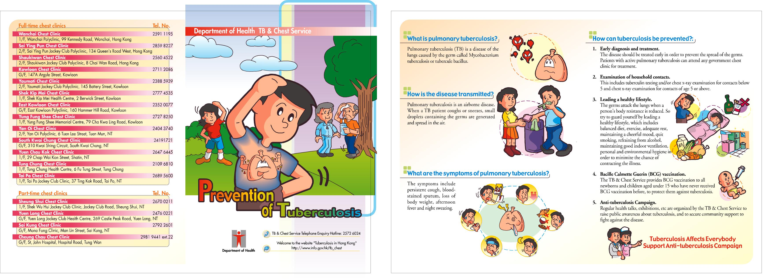
Part 3: Understanding the Text Type: Leaflet
Read the information leaflets from Department of Health. Can you identify some key features of a leaflet? Complete the table on slide 9.
Heading
Sub-heading
Eye-catching Title
Reference:
https://www.info.gov.hk/tb_chest/doc/prevent_eng.jpg

Slide 8

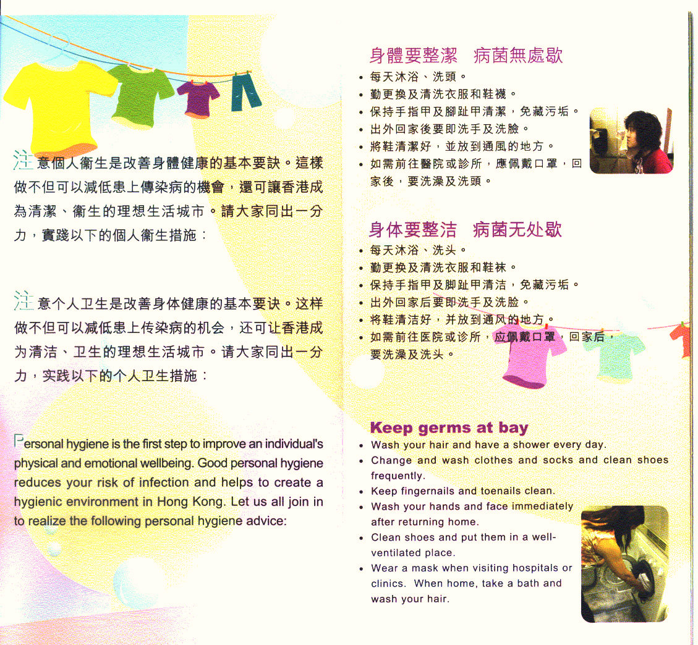

Heading
Language
- use of imperatives
Click HERE to learn more about Imperatives!
Reference: https://www.chp.gov.hk/en/resources/e_health_topics/pdfwav_2959.html?page=2

Slide 9
Features (What?) | Purpose (Why?)
Title bigger font size key message of the leaflet shown to readers
Headings/ sub-headings short and precise
Language - use of imperatives
Next

Slide 10
What are imperatives?
Compare these two sentences:
(1) Could you open the windows?
(2) Open the windows.
You probably think that the first sentence is more polite and the second sentence sounds like an order/instruction.
FORM
In sentences like (2), the verb forms are called ‘imperatives’. Read the following sentences and circle the imperatives:
(a) Come here.
(b) Be quiet.
(c) Have a drink!
(d) Don’t worry.
Affirmative imperatives : Verb (infinitive form)
Negative imperatives : Do not + Verb (infinitive form)

Slide 11
USAGE
Imperatives are used:
(a) to tell or ask people to do things | e.g. Check your homework carefully before submission./Don’t shout in the classroom.
(b) to make suggestions | e.g. Wash your hand thoroughly.
(c) to give advice or instructions | e.g. Pour the hot water into the cup and add some milk.
(d) to encourage and offer | e.g. Have some more tea.
(e) to express wishes for people’s welfare | e.g. Enjoy your holiday.
* as shown in the information leaflet on slide 8

Slide 12
Extended activity
Part A: Put a tick next to the sentences that contain imperatives.
 | 1. Mix the yeast with the flour in the mixing bowl.
 | 2. Would you close the door on your way out?
 | 3. I want you to look both ways before you cross the road.
 | 4. Be careful with that box. There’s a glass lamp in it.
 | 5. Can you please pick me up at 6 p.m.?
 | 6. Pass the salt, please.
 | 7. Don’t forget to bring your hand sanitiser before you leave.
 | 8. I don’t want you to clean the clothes.
 | 9. Stop yelling!
 | 10. You need to stay vigilant during the pandemic.

Slide 13
Extended activity
Part B: Rewrite the sentences without the use of imperatives in
Part A as imperatives.
1.
2.
3.
4.
5.
Back to Part 3

Slide 14
Part 4 : Writing Task (A leaflet)
You are a member of the Social Services Club at your school. You and the other club members decide to write a leaflet to raise concern over the issue of COVID-19 in your neighbourhood. Useful tips to stay healthy and hygienic will be given to your readers.
Your teachers prepare a choice board for you. Include some areas from the choice board below in your leaflet.
Getting around Hong Kong | Diet | Living environment
Personal Hygiene | ? (your own idea) | Sleep
Exercises | Leisure activities | Habits

Slide 15
You may work on any ONE of the topics below.
(a) Brainy Beginner
Write a leaflet to be sent to your classmates. Give them ideas on how to stay healthy and hygienic on any one or two area(s) from the choice board.
(b) Logical Learner
Write a leaflet to be sent to all students in your school. Give them ideas on how to stay healthy and hygienic on any three areas from the choice board.
(c) Creative Challenger
Write a leaflet to be sent to all students and their parents in your school. Give them ideas on how to stay healthy and hygienic on any four areas from the choice board.

Slide 16
Self-evaluation
Use the checklist below to evaluate your work. Put a tick in the appropriate boxes.
CONTENT
□ My ideas are varied and well supported with elaboration. □ My advice addresses the need and concern of the target readers (there is a high awareness of audience).
LANGUAGE
□ I use imperatives to give advice. □ The meaning of each sentence is clear. □ I have used the sentence structures and tenses I have learnt. □ I use new vocabulary and I have checked my spelling carefully.
ORGANISATION
□ I give my leaflet an eye-catching title. □ I use headings and sub-headings to help organise my ideas. □ I put relevant ideas together under the same headings/ sub-headings. □ I use appropriate connectives to link my ideas.

Slide 17
For more information on combatting COVID-19, please visit the website of the Centre for Health Protection, Department of Health:
https://www.chp.gov.hk/en/index.html

Slide 18
WORD WHIZ
Visit the following dictionary web sites (in alphabetical order) to learn more about the pronunciation, definition and usage of words:
1. Cambridge Dictionary
https://dictionary.cambridge.org/
2. Oxford Learner’s Dictionaries
https://www.oxfordlearnersdictionaries.com/

Slide 19
Suggested Answers
Part 2: Reading
1. He stays up late to play online games with his friends so he is tired.
2. A
3. (i) pandemic
(ii) nutritious
(iii) praised
She wants Tony to spend less time on online games and bond with his parents.
Peter can wear a protective mask/ avoid holding or touching the handrails// poles (other possible answers are also accepted)
Peter and his colleagues’
To encourage readers’ to stay positive// optimistic and not to be afraid of the pandemic/ to tell readers’ that they should fight against the virus together.

Slide 20
8.
Suggested Answers
Person | Problem (with elaboration) | Possible Solution
Tony Wong | He has poor personal hygiene. his bedroom is dirty. he has terrible body odour. | He should clean his room, change his clothes and wash them regularly.
Linda Chan’s daughter | She is addicted to her smartphone. she stays in her room playing with her smartphone all the time. | Her mother invited her to cook and the family praised her cooking/ cleans the home and cooks with her every day/ spends time getting to know her more.
Peter Cheung | He almost fell when the bus stopped suddenly. He does not want to/ dare not touch the handles/ poles. | He should clean his hands with alcohol-based handrub after touching the handles or poles on public transport.

Slide 21
Suggested Answers
Part 3: Understanding the Text Type: Leaflet
Features (What?) | Purpose (Why?)
Title bigger font size key message of the leaflet shown to readers | To capture readers’ attention To clearly communicate the key message
Headings/ sub-headings short and precise | To guide the readers through each section – some information is organised with numbers and bullet points To serve as signposts to important information in the leaflet. Key words and phrases are picked out to get the readers’ attention
Language - use of imperatives | To make the message direct and persuasive

Slide 22
What are imperatives? Part A (The imperatives are circled for reference)
Suggested Answers
✓ | 1. Mix the yeast with the flour in the mixing bowl.
 | 2. Would you close the door on your way out?
 | 3. I want you to look both ways before you cross the road.
✓ | 4. Be careful with that box. There’s a glass lamp in it.
 | 5. Can you please pick me up at 6 p.m.?
✓ | 6. Pass the salt, please.
✓ | 7. Don’t forget to bring your hand sanitiser before you leave.
 | 8. I don’t want you to clean the clothes.
✓ | 9. Stop yelling!
 | 10. You need to stay vigilant during the pandemic.

Slide 23
Suggested Answers
What are imperatives? Part B
1. | Close the door on your way out.
2. | Look both ways before you cross the road.
3. | Please pick me up at 6 p.m.
4. | Don’t clean the clothes.
5. | Stay/Be vigilant during the pandemic.

Slide 24
Stay Positive and Be Proactive!
Together, We Fight the Virus!

