Slide 1
General Studies for Primary Schools
Learning Strand – Health and Living
General Studies for Primary Schools Additional Resources
Health and Living Series
Primary Four to Six
(Teachers’ Copy)

Slide 2

Learning and Teaching Resources CD for Primary General Studies
“Our Wonderful Body”
(Includes learning activities of “communicable diseases”)
Theme | Learning Activities
Structure of our body | Sensory organs(Key Stage 1) Main parts and functions of digestive system (Key Stage 1) Bones and muscles (Key Stage 1) Our respiratory system (Key Stage 1) Importance of circulatory system (Key Stage 1) Functions of the nervous system (Key Stage 2)
Healthy living | 1. Healthy eating (Key Stage 1) 2. Common diseases (Key Stages 1 and 2)
Website:
https://www.edb.gov.hk/attachment/en/curriculum-development/kla/general-studies-for-primary/learning-and-teaching_resource_cd_st/Healthy_life_en_2.zip

Slide 3
General Studies for Primary Schools
Learning elements related to Common Diseases and Be a Responsible Citizen
Causes, effects and preventive measures of common diseases, e.g. infectious diseases and non-infectious diseases
Healthy lifestyles
Maintenance of community health

Slide 4
General Studies for Primary Schools
Common Diseases and Be a Responsible Citizen
Suggested Learning Activities
Watch the ETV programme 「預防呼吸道感染」、「細菌和病毒」 and take notes
Design slogans/ poster or write an e-mail to relatives who live overseas to suggest some preventive measures
Research on information disseminated by Department of Health about COVID-19 and learn related health guidelines
Practise the proper way to clean hands
Practise the proper way to dispose a used mask
Discuss the responsibilities of a citizen, e.g. keep personal and home hygiene, proper way to handle waste, be aware of environmental hygiene
Show care to family members and relatives by phone

Slide 5

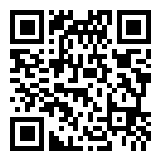
ETV, EDB
Preventing respiratory tract infections
There are three parts in this programme:
Part 1: To introduce the causative agent of respiratory tract diseases and identify the differences in symptoms between influenza and atypical pneumonia
Part 2: To demonstrate how to wear a mask properly and explain the functions of a mask, how to choose and dispose a mask etc. by healthcare professionals
Part 3: To tell how to keep personal, environmental and food hygiene in order to strengthen our immune system, so to prevent respiratory tract diseases and other infectious diseases
https://www.hkedcity.net/etv/resource/1836614955

Slide 6
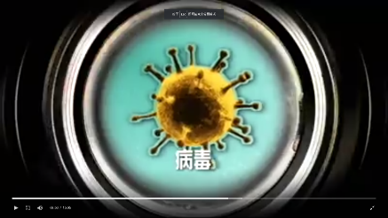
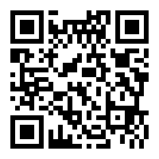
ETV, EDB
Bacteria and Viruses
To point out the invisibility of microorganisms to naked eye, including bacteria and viruses by parents working in hospital
To highlight the morphology of bacteria and viruses, the living environment, reproduction, and relationships with humans and recommend preventive measures and treatment of diseases caused by bacteria and viruses
https://www.hkedcity.net/etv/resource/239963568

Slide 7
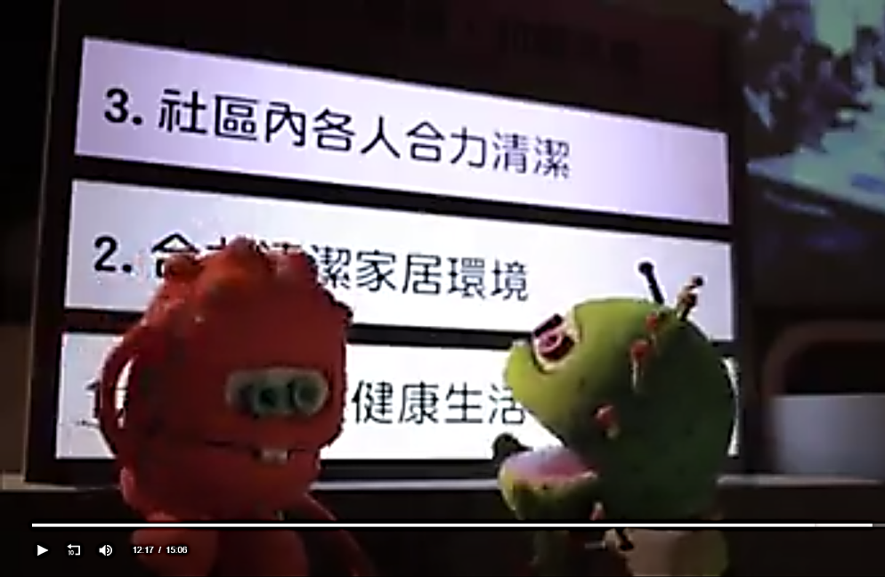
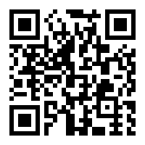
ETV, EDB
Healthy Community
The protagonist is originally a child who doesn’t pay much attention to personal health, and is the target of the “illness family” waiting to be attacked. His family takes him to visit Mr. Kwan, a stroke patient.
After listening to Mr. Kwan, the protagonist begins to make changes. He not only begins to practise his personal healthy lifestyle, but also knows how to care for everyone around him, live in harmony with others, and build a healthy community.
https://www.hkedcity.net/etv/resource/1614033468

Slide 8
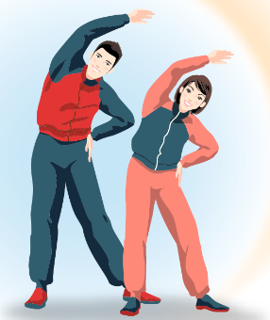
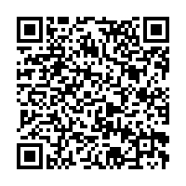
CHP, Department of Health
A Guide to Personal, Home and Environmental Hygiene (pdf format)
Website:
https://www.chp.gov.hk/files/pdf/a_guide_to_personal_home_and_environmental_hygiene_keep_clean_be_healthy_booklet.pdf

Slide 9

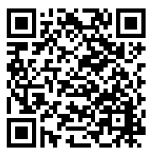
Introduction of the webpage of COVID-19, CHP, Department of Health
https://www.chp.gov.hk/en/healthtopics/content/24/102466.html

Slide 10
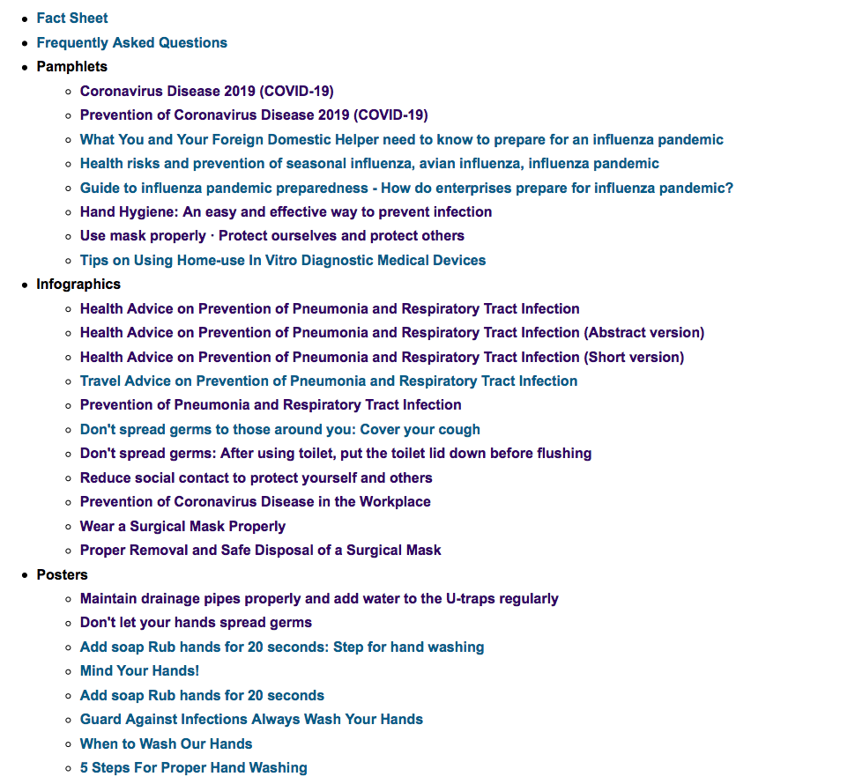

Slide 11
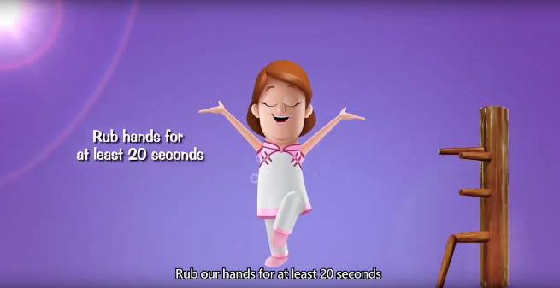
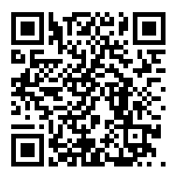
CHP, Department of Health
“How to clean our hands properly” (video)
Website:
https://www.youtube.com/watch?v=sKFUOlyTJVg&feature=youtube

Slide 12
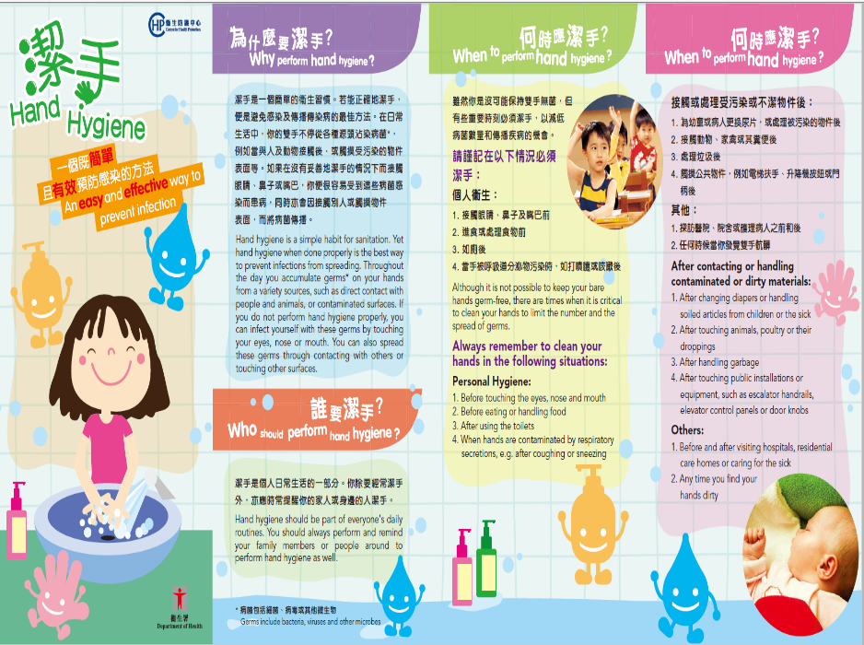

Slide 13
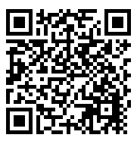
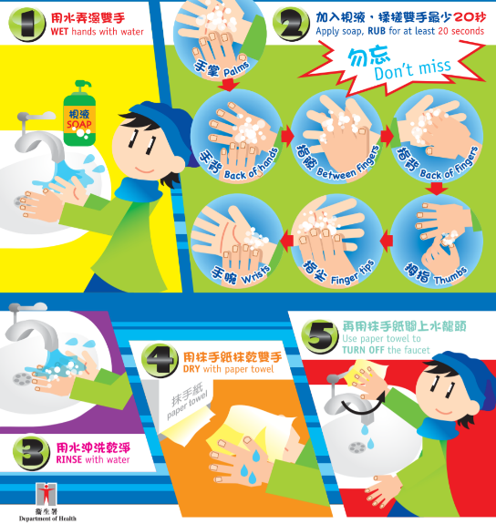
CHP, Department of Health
5 Steps for Proper Hand Washing (Poster)
Website:
https://www.chp.gov.hk/files/pdf/5_steps_for_proper_hand_washing.pdf

Slide 14
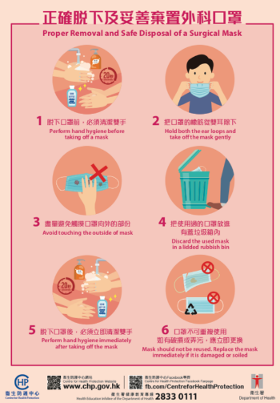
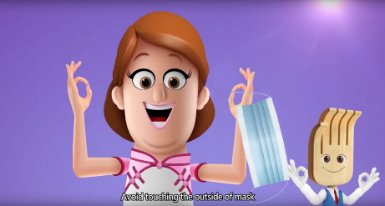
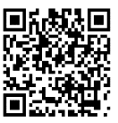
CHP, Department of Health
How to take off a surgical mask properly (Video) and safe disposal of a surgical mask
Website:
https://www.youtube.com/watch?v=D9M57hycc7A&feature=youtube

Slide 15


Suggested Learning Activity
Show your care to your relatives/ friends/ elderly
Give a call with your family members to show your care to relatives/ friends/ elderly, and share with them the measures that you have learned, e.g. how to clean hands and wear a mask properly to prevent the virus transmission.
Make greeting cards
  Design greeting cards (take photos of the cards) to encourage healthcare professionals, cleaners or epidemic precaution personnel who you know and appreciate their contribution. Then ask your parents to send the cards to them through e-mails, social platforms or media.

Slide 16
Suggested Learning Activity
Design a poster/ video
  “Maintaining good personal hygiene/ Prevention of infectious diseases” as the theme, design:
  (i) a poster or
    (ii) a one-minute video

Slide 17
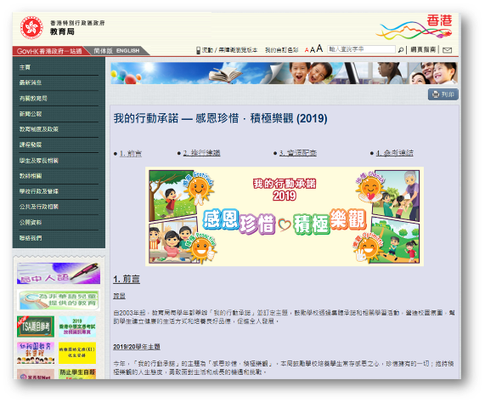
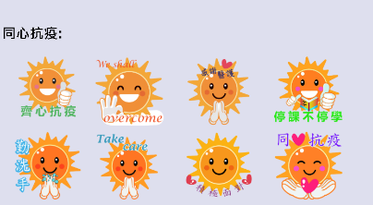

Resources on web
Instant messaging stickers can be added to the greeting cards and downloaded from the EDB website

Slide 18




To fight the virus positively
To keep good personal hygiene to protect yourself and others

Slide 19



To show your care
To thank and appreciate the effort of healthcare professionals and other epidemic precaution personnel

Slide 20
Suggested Learning Activity
Read the webpage of CHP, Department of Health to understand the health advice on how to prevent COVID-19 and the process of transmission

Slide 21
Worksheets (Teachers’ Version)
Understanding COVID-19
Self-learning Worksheet（Together, we fight the virus）Worksheet 1: Understanding infectious diseases
Self-learning Worksheet（Together, we fight the virus）Worksheet 2: Maintaining hygiene to prevent diseases
Self-learning Worksheet （Together, we fight the virus）Worksheet 3: Extended activity – Care for others

Slide 22
Wish You Good Health!

