Slide 1
Learning and Teaching Resources on “Coronavirus Disease 2019
(COVID-19)”
Liberal Studies Section,
Curriculum Development Institute,
Education Bureau

Slide 2
Introduction of the Learning and Teaching Resources
Key stage / grade | Topic | Relevant curriculum content / learning focus | Teaching resources (PPT)
Senior secondary | Analysing the behaviours and values related to the epidemic | Liberal Studies: Module 5 “Public Health” | PPT

Slide 3
Introduction of the Learning and Teaching Resources
Learning objectives | To guide students to reflect on their behaviours and values during the epidemic, including Maintaining personal hygiene and wearing a surgical mask in public places in order to prevent the spread of the disease Showing empathy and care for others’ needs and feeling
Values / attitudes | Respect for others, Responsibility, Care, Integrity, Solidarity, Cooperation
Learning and teaching strategies | Read the picture and watch the video clip, and then invite students to discuss and answer the questions. Guide students to develop positive values and behaviours, and encourage students to put into practice in daily life, particularly during the epidemic.
References | Websites of Centre for Health Protection (CHP) and News.gov.hk “Life Event” exemplars of Moral, Civic and National Education Section
Remarks | In view of the ongoing development of COVID-19, teachers should remind students of staying alert to the latest epidemic development, and browsing the website of CHP for the latest information. During the lesson, teachers should promote relevant positive values and behaviours , and encourage students to put into practice in daily life.

Slide 4
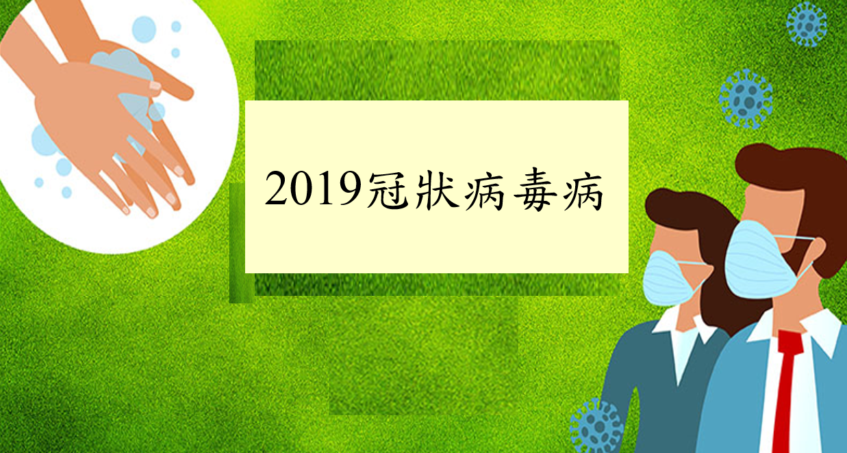
Read the following picture
Coronavirus Disease 2019
(COVID-19)
Adapted from the website of Centre for Health Protection https://www.chp.gov.hk/tc/

Slide 5
Answer the following question
What is “Coronavirus Disease 2019 (COVID-19)”? What are the symptoms of the disease?
Suggested answer
  “Coronavirus Disease 2019 (COVID-19)” refers to the cluster of viral pneumonia cases occurring in Wuhan, Hubei Province, since December 2019. According to investigation by the Mainland health authorities, a novel coronavirus is found to be the causative agent.
  According to the information provided by the Mainland health authorities, symptoms of the cases include fever, malaise, dry cough and shortness of breath. Some cases were in serious condition. People of older age or having underlying disease are at a higher risk of deterioration into serious condition.

Slide 6
Watch the following video clip
“Chief Executive urges the public to fight the virus together
(特首呼籲各界同心抗疫)” [in Chinese],
3 February 2020.
Source: News.gov.hk (Length: 3 minutes 10 seconds)
https://www.news.gov.hk/chi/2020/02/20200203/20200203_182546_833.html?type=ticker

Slide 7
Answer the following questions
What did Chief Executive (CE) Carrie Lam urge the public to fight the virus together in the video clip?
What are the values and behaviours are reflected in the plea made by the CE? Explain your answer.

Slide 8
Suggested answer (the main points of the plea made by the CE)
  Members of the public are strongly advised to avoid the non-essential travel to the areas with active community transmission of COVID-19, including the Mainland.
  Members of the public should cooperate with the CHP and follow their advice.
  People who are suspected or confirmed to contract COVID-19 should inform CHP honestly of their recent travel history as well as the close contacts for the sake of contact tracing. Anyone who provides false information commits an offense. There is strict enforcement of relevant laws and regulations.
  Members of the public are encouraged to stay at home and not to go to crowded places. If it is unavoidable to go out, personal hygiene should be maintained strictly.
  Employers are encouraged to ride out difficult times and adopt considerate attitude when dealing with the work arrangement of employees.

Slide 9
Suggested answer (the values reflected in the plea)
  Cooperation: During the epidemic, members of the public should exercise their civic responsibility, and cooperate with the Government to fight the virus together.
  Integrity and responsibility: Anyone who has contracted COVID-19 should report his/her recent travel history and close contacts honestly. This reflects the virtue of integrity and civic responsibility.
  Care: Employers should be considerate and make flexible work arrangement in order to safeguard public health. This shows the virtue of caring for others.

Slide 10
Brief summary
The ongoing development of COVID-19 threatens public health and safety. To effectively and successfully fight against the virus relies not only on the actions taken by the Government, but also the cooperation among members of the public.
During the epidemic, many people go out less and stay at home in order to protect themselves against infection. This reflects that family members serve the function of being a protection net. Thus, nurturing harmonious atmosphere, caring for family members, and supporting one another are important at all times.
The epidemic adversely affects the vulnerable groups. Members of the society should care for the people in need and offer assistance within their capacity.

Slide 11
Read the following picture again
Coronavirus Disease 2019
(COVID-19)
Adapted from the website of Centre for Health Protection https://www.chp.gov.hk/tc/

Slide 12
Answer the following question
On the top left corner in the picture, an individual is washing hands while two people are wearing surgical masks (on the right bottom corner). How do these behaviours prevent the spread of COVID-19?
Reference answer:
Please refer to the designated website of
“Coronavirus Disease 2019 (COVID-19)” https://www.coronavirus.gov.hk/eng/index.html

Slide 13
Answer the following questions
What are the concerns about public health as reflected from washing hands regularly and wearing a surgical mask? What are the values reflected in wearing a surgical mask when needed?

Slide 14
Suggested answer
  Concern: The public health concern is about the prevention of the spread of the epidemic. It is because maintaining strict personal and environmental hygiene at all times is a key to personal protection against infection and prevention of the spread of infectious diseases in the community.
  Values: Washing hands regularly and wearing a surgical mask when needed show one’s civic-mindedness and empathy. This behaviour, based on one’s hygiene knowledge is also considered as being considerate and is regarded as exercising one’s civic responsibility. Besides, this behavior also protects oneself and other people and reflects one’s responsibility to care for others and cherish one’s own life.

Slide 15
Brief Summary
From the perspective of public health, disease prevention should start from the individual and societal levels. To develop a healthy lifestyle, members of the public are urged to maintain personal hygiene (e.g. washing their hands regularly). Besides, wearing a surgical mask, due to illness or personal needs safeguards personal and public health, reflects the virtues of cherishing one’s life, caring and respecting for others. Therefore, we should not only put the above values into practice during the epidemic, but also maintain them after the epidemic, in turn being part of our daily lives.

Slide 16
Brief Summary
Watch the following video clips to understand more about how to wash hands and wear a surgical mask properly
  Washing hands with liquid soap and water
    https://www.youtube.com/watch?v=pN2C6AJ2_EA&feature=youtu.be
  How to wear a surgical mask properly
    https://www.youtube.com/watch?v=gggtXTuhJek&feature=youtu.be

Slide 17
Recommended Readings [in Chinese]
顏寶倫〈自律自重 保護自己 嚴抗肺炎〉，《信報財經新聞》，2020年1月30日。
歐陽五〈疫病與文明：全球化時代如何同行？〉，《明報》，2020年2月4日。
朱銘泉〈互諒互讓 齊心抗疫〉，《文匯報》，2020年2月4日。
周其森〈疫情防控呼喚三種公衆意識〉，《經濟日報》（北京），2020年2月4日。

Slide 18
End

