Slide 1
Coronavirus disease 2019
(COVID-19)
Transmission and Prevention
Integrated Science(S4-6)

Slide 2
Key Learning Points
  Let students know about the infectious disease - coronavirus disease 2019 (COVID-19)
  Let students know about how to prevent pneumonia and respiratory tract infections ( COVID-19)
  To cultivate a sense of responsibility for community health in students
  To nurture students’ care for patients and elderly

Slide 3
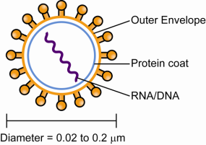
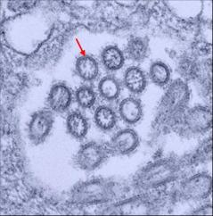
Virus
Virus
Non-living by itself, and cannot reproduce unless inside suitable host cells
Have simple structures. They consist of genetic material (can be DNA or RNA) encased in a protein coat. Some viruses also have an outer envelope
They are very small, about 0.02 to 0.2 μm in diameter
Each type of virus has a specific protein coat, which attaches to particular types of cells (e.g. pneumonia viruses attach to lung cells)
Transmission Electron Micrograph of viruses. (x100000)

Slide 4
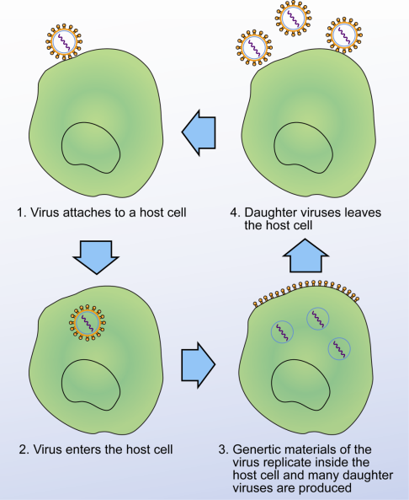
The life cycle of a virus

Slide 5
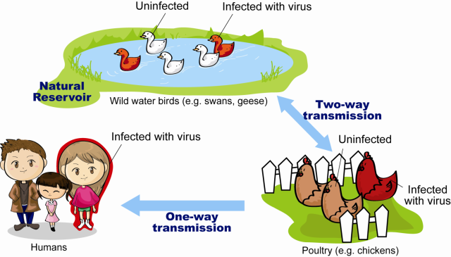
The mechanism of the emergence of novel virus (Avian Influenza as an example)
Some animals are the natural reservoir of the particular microorganism
Under certain circumstances, such as changes in the genetic material of the pathogen (mutation) or environmental changes, the pathogens may be transmitted to humans and cause disease.
Example:
Avian Influenza
Reservoir
Reference: Centre for Health Protection, Department of Health-Avian Influenza https://www.chp.gov.hk/en/healthtopics/content/24/13.html

Slide 6
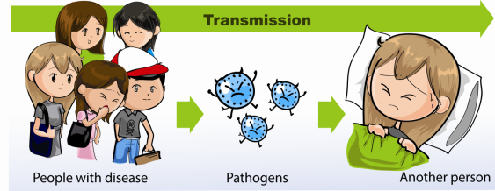
Transmission of pathogens
Infectious diseases are spread from one host to another
The pathogens (i.e. different kinds of disease-causing microorganisms) multiply themselves in the host and the microorganisms reproduced are spread to other individuals
Different microorganisms are transmitted by different modes of transmission

Slide 7

Activity 1: Investigate the mode of transmission of coronavirus disease 2019 (COVID-19 )
Make reference from the website of the Center for Health Protection of the Department of Health (2019 Coronavirus Diseases Page) and fill in the following table:
  https://www.coronavirus.gov.hk/eng/index.html
 | Air borne/ Direct Contact
Examples of diseases | Coronavirus disease 2019 (COVID-19 )
Portal of entry of pathogens into host | Nose, Mouth
Location of growth of pathogens inside the host | Airway, Lungs
Portal of exit of pathogens from the host | Sneezing, Coughing (Some information indicate that the virus can leave the host via faeces)

Slide 8
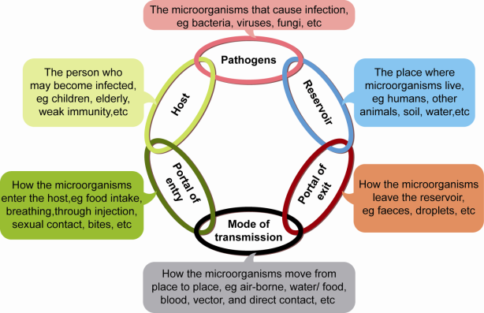
The chain of infection
There are six essential links of transmission of diseases, called the chain of infection
All the components in the chain must be present for an infection to occur
Precautions can be taken to reduce disease transmission by breaking the chain of infection
Removing any one link stops the transmission of the infectious disease

Slide 9

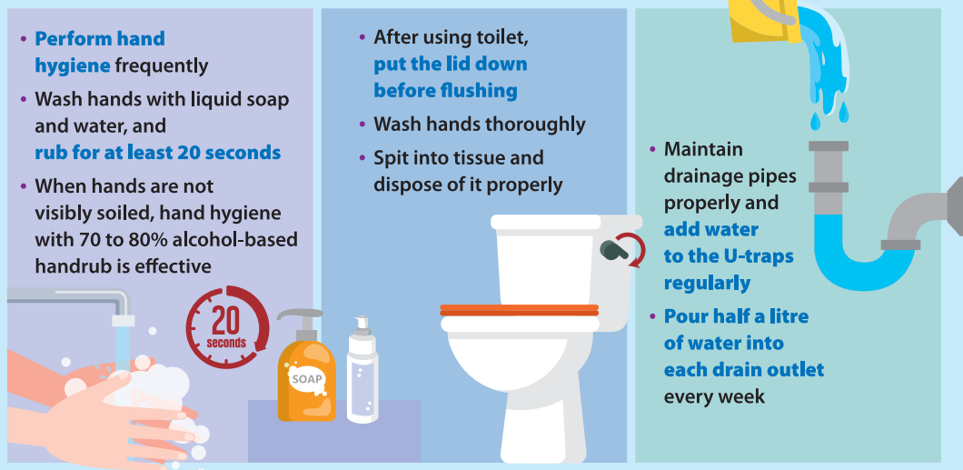
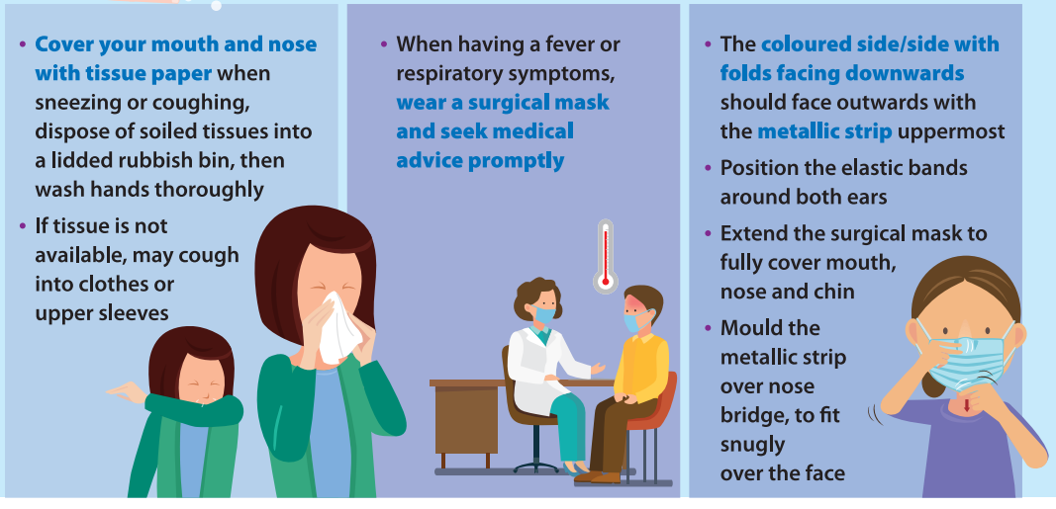
Prevention of coronavirus disease 2019
(COVID-19)
There is no vaccine for this infectious disease at the moment
To maintain at all times strict personal hygiene (e.g. wash hands thoroughly) is key to protection against infection of the coronavirus disease. When travelling outside Hong Kong, avoid touching animals; do not consume game meat; and avoid visiting wet markets, live poultry markets or farms

Slide 10

Activity 2: Group project -
Mode of transmission of infectious diseases
Each group with 3-4 students is responsible for searching information on an infectious disease. The group findings should be presented in class in the form of PowerPoint slides or poster, etc.
Information to be searched by each group:
The pathogen that causes the disease
How the pathogen enters the host , where it grows inside the host , and how it leaves the host
Symptoms
Mode of transmission
Methods to prevent or reduce transmission
Please refer to the Health Protection Center of the Department of Health (Infectious Diseases Page)
https://www.chp.gov.hk/en/healthtopics/24/index.html

Slide 11





Reference websites:
  1. Centre for Health Protection, Department of Health
  https://www.chp.gov.hk/en/index.html
  2. Latest Situation of Coronavirus Disease (COVID-19) in Hong Kong
  https://chp-dashboard.geodata.gov.hk/covid-19/en.html
  3. National Health Commission of the People’s Republic of China
  http://www.nhc.gov.cn/
  4. World Health Organisation – Coronovirus disease (COVID-19) outbreak
  https://www.who.int/emergencies/diseases/novel-coronavirus-2019

Slide 12



Other reference videos：
Prevention of pneumonia and respiratory tract infection
https://www.youtube.com/watch?v=QA_TRNFf5tU&feature=youtu.be
Prevent diseases · Maintain good hygiene
https://www.youtube.com/watch?v=X0OxrsgAP2w

Slide 13
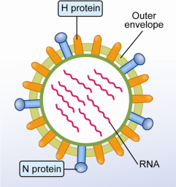
More to know: Influenza
Influenza
caused by the influenza virus
The various forms of influenza viruses have different types of H proteins and N proteins on the outer envelope and they are named accordingly
H protein | N protein | Influenza virus type | Host
Type 1 | Type 1 | H1N1 | Humans, pigs, birds
Type 2 | Type 2 | H2N2 | Humans, pigs, birds
Type 3 | Type 2 | H3N2 | Humans, pigs, birds
Type 5 | Type 1 | H5N1 | Birds (occasionally humans)
Type 7 | Type 7 | H7N7 | Birds (occasionally humans)
Type 9 | Type 2 | H9N2 | Birds (occasionally humans)

