Slide 1
Technology Education Key Learning Area
Information and Communication Technology (Senior Secondary)

Slide 2
Learning Objective
[Module C] Internet and its Applications
  Internet Services and Applications
    Formulate an effective strategy for searching for specific information on the Web by using search engines
      Through searching for reliable sources, develop students' information literacy (including positive values and attitudes)
    Value and appraise the significance of the development of the Internet for various activities in society.

Slide 3


Activity 1: Searching Data
Searching data related to COVID-19 from the DATA.GOV.HK website
https://data.gov.hk/

Slide 4
Activity 1: Searching Data
Besides the data on COVID-19, what kind of data does DATA.GOV.HK provide?
  Medical and health, traffic, education, commerce and economy, environment, leisure and culture, housing, land development and matters relating to people’s livelihood
What kinds of format do these open data stored?
  Machine-readable formats, including JSON, XML and CSV
Historical public data can be found in DATA.GOV.HK. What are the purposes of them?
  Trend analysis and big data analytics applications
Reference: Legislative Council Panel on Information Technology and Broadcasting / Open Data Policy / LC Paper No. CB(4)283/18-19(03)
https://www.legco.gov.hk/yr18-19/english/panels/itb/papers/itb20181210cb4-283-3-e.pdf

Slide 5
Learning Objective
[Module A] Information Processing
  Data Organisation and Data Control
    Identify data, records, fields, files and databases in the hierarchical organization of data.
      Reference to the official data from DATA.GOV.HK and its corresponding formats.
  The Use of Office Automation Software
    Describe and use basic features of spreadsheets to solve problems
    Demonstrate data manipulation techniques in spreadsheets.
    Apply spreadsheets as a data analysis tool by using a pivot table (and pivot chart), and “what if” scenarios.

Slide 6

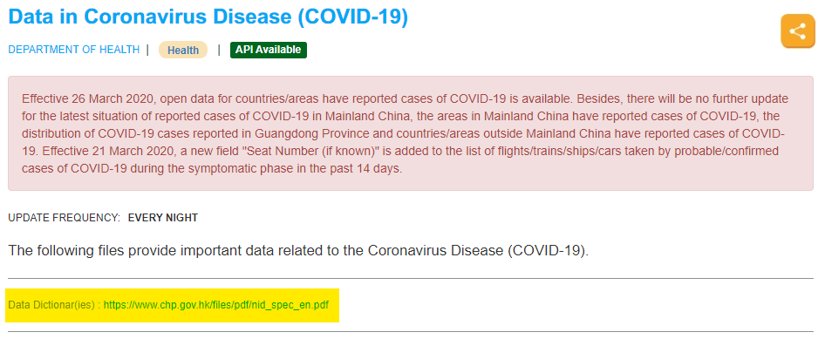
Activity 2: Data Dictionary
Download data related to COVID-19 from DATA.GOV.HK and read its data dictionary
https://www.chp.gov.hk/files/pdf/nid_spec_en.pdf

Slide 7
Activity 2: Data Dictionary
List the names of the fields according to the data dictionary.
  Case no.、Report date、Date of onset、…
What is the data type for Age? Why text format is not used?
  Number
  Number is easier for mathematical comparison and sorting than text

Slide 8

Activity 3: Spreadsheet
Download the data on “Details of probable/confirmed cases of COVID-19 infection in Hong Kong” from DATA.GOV.HK
https://data.gov.hk/en-data/dataset/hk-dh-chpsebcddr-novel-infectious-agent

Slide 9
Activity 3: Spreadsheet
What is the file format of the data?
  CSV / Comma-Separated Values
Convert the file into a spreadsheet format.
  CSV save as XLS or XLSX format (or other spreadsheet formats)

Slide 10
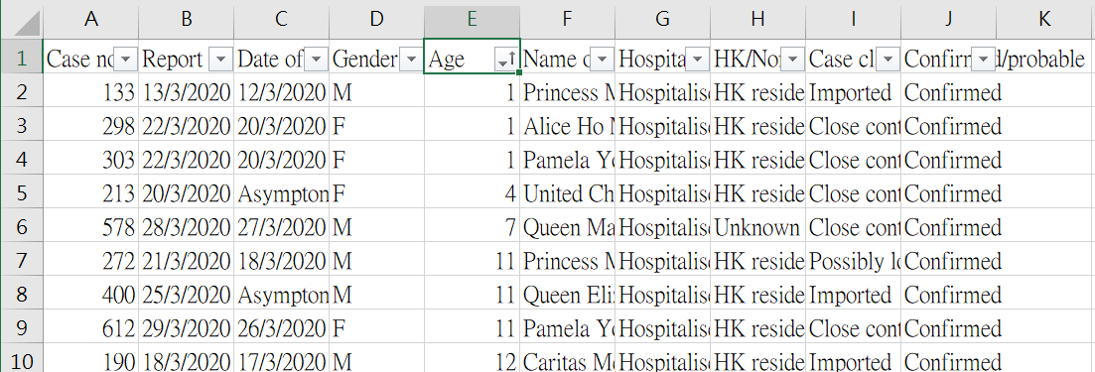
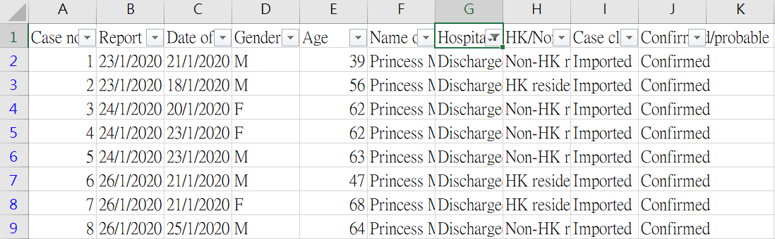

Activity 3: Spreadsheet
Demonstrate data manipulation techniques in spreadsheets
  i) Sort according to Age
    Sort according to the Column “Age”
  ii) Display discharged cases
    Apply filter on the Column “Hospitalised/Discharged/Deceased”

Slide 11
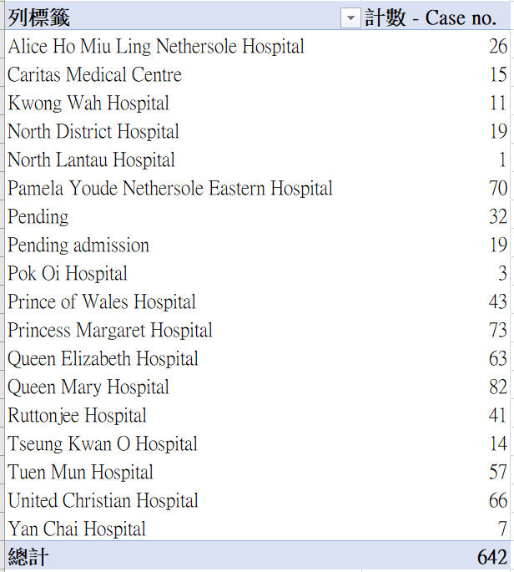
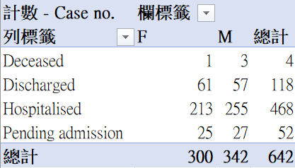
Activity 3: Spreadsheet
Data analysis using pivot tables
  i) Show number of cases by hospital
    Row: Name of hospital admitted
    Values: COUNT - Case no.
  ii) Show number of patients according to gender and hospitalisation status
    Row: Hospitalisation status
    Column: Gender
    Values: COUNT - Case no.

Slide 12
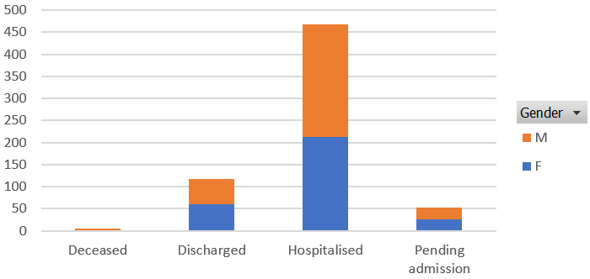
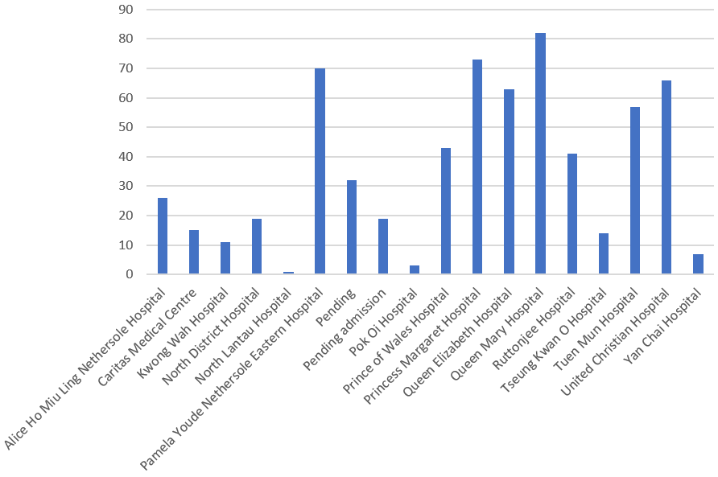
Activity 3: Spreadsheet
Display data using pivot charts
  i) Show number of cases by hospital
  ii) Show number of patients according to gender and hospitalisation status

