Slide 1
Parent Seminars on Admission Arrangements for Nursery (K1) Classes in KGs for the
2019/20 School Year
(Applicable to children who were born on or before 31 December 2016)
1

Slide 2
Background
The Government has implemented the new kindergarten (KG) education scheme (hereafter referred to as “Scheme”) starting from the 2017/18 school year.
K1 Admission Arrangements will continue to be at the discretion of individual KGs to fit into the implementation of the new policy.

Slide 3
2019/20 K1 Admission Arrangements
Objectives
KGs Covered
Measures
Samples of Relevant Registration Documents for KG Admission
“2019/20 K1 Admission Arrangements“ Flowchart
Enhanced Education Support for NCS students

Slide 4
Objectives
To avoid parents queuing up for application forms;
To avoid hoarding of more than one place by a child at any one time to enable KGs to confirm enrolment for manpower planning, and facilitate parents in securing a place for their children in a timely manner; and
To help parents find a place for their children by providing them information on the vacancy situation, etc.

Slide 5
KGs Covered
Applicable to KGs joining the Scheme
Strongly encourage the non-Scheme local KGs to join
        The list of non-Scheme local KGs joining the “2019/20 K1 Admission Arrangements” has been uploaded to the EDB’s website in mid-July 2018.

Slide 6
Measures
(1) Distribution of Application Forms
(2) School-based Admission Mechanism
(3) " Not More Than One Place for Each
Child "Arrangements
(4) Release of Vacancy Information
(5) Referral arrangements for students

Slide 7
Measures
(1) Distribution of Application Forms
Distribution of application forms without quota or via school website to avoid queuing up.
Should not interview the children applicants earlier than November.

Slide 8
Measures
(2) School-based Admission Mechanism
Should introduce a school-based admission mechanism, including the admission procedure and criteria, and the number of candidates to be interviewed, etc.
Must be in compliance with the existing anti-discrimination legislation and other related legislation, including:
Sex Discrimination Ordinance, Disability Discrimination Ordinance, Family Status Discrimination Ordinance, Race Discrimination Ordinance; and
Personal Data (Privacy) Ordinance and/or Prevention of Bribery Ordinance ,etc.
Circulars and guidelines issued by EDB, e.g. the application forms and relevant information provided by KGs must be in both Chinese and English

Slide 9
Measures
(2) School-based Admission Mechanism
Must be fair, just and open
To create a diverse and inclusive school environment, KGs are reminded that equal opportunities in admission to KGs must be provided for all children (regardless of their race, gender and ability). KGs must be careful about the details of admission arrangements on whether they may involve direct or indirect discrimination; when answering enquires from parents; teachers and staff in general should offer assistance as appropriate and avoid misunderstanding.

Slide 10
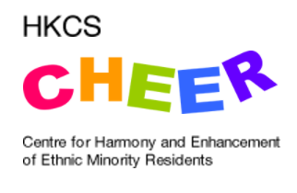
Centre for Harmony and Enhancement of Ethnic Minority Residents (CHEER)
Free-of-charge telephone interpretation service in ethnic minority languages provided by the Home Affairs Department-funded “Centre for Harmony and Enhancement of Ethnic Minority Residents (CHEER)”. The telephone interpretation service hotlines are:
        3755 6811 (Bahasa Indonesian, Tagalog, Thai)
        3755 6822 (Hindi, Nepali)
        3755 6833 (Punjabi, Urdu)
Other interpretation and translation services:
    Schools can choose to attend the briefing sessions on Interpretation and Translation Services” organized by CHEER to gain more understanding on the relevant services if deemed necessary. Please refer to the following webpage for details:
      http://hkcscheer.net/interpretation-and-translation-services

Slide 11
Measures
(2) School-based Admission Mechanism
KG must inform parents in advance of the details of their school-based mechanism through effective channels and upload the relevant information onto the school webpage
        Guidance notes in application forms, admission guidelines/leaflets, school website, etc.
KGs must provide the relevant documents of their K1 admission arrangements in both Chinese and English, e.g. application forms and relevant information. Relevant documents for admission arrangements have been uploaded onto the EDB’s website for reference.
When considering applications for WD/LWD services:
        KGs should give due priority to families in need (e.g. families with working parents, those who need to take care of family member(s) with disability at home ,etc.
        Relevant conditions should be included in the admission criteria announced

Slide 12
Measures
(2) School-based Admission Mechanism
KGs are required to upload the information below to school webpage and/or via different channels to inform parents in advance on or before 20 September 2018 (Thursday).
1
2
3
Information on Admission Application
Ways to distribute application forms
Date and period for distribution of application forms
Application procedure
Application fee (if applicable)
Ways to submit application forms
Date and period for submission of application forms
School-based Admission Mechanism
Number of candidates to be interviewed
Interview format and arrangements
Admission criteria
Registration Procedure
Arrangements on announcement of admission results
“Centralised Registration Dates”
Arrangements on submission of a valid registration document and registration fee (including the amount)
Arrangements on registration for students on waiting list
Arrangements for students changing school after registration

Slide 13
Measures
(3) " Not More Than One Place for Each Child "Arrangements
Premised on the principle that each student should only attend one KG, and for enabling students to have equal opportunities for receiving subsidized KG education as well as making good use of Government resources, regardless of the level, all Scheme-KGs can only admit students with a valid registration document.
        Scheme-KGs can only complete K1 registration for students holding a valid registration document.
        If parents are unable to submit the valid registration document, even if they are willing to pay full school fees, the KG concerned cannot complete K1 registration for their children.

Slide 14
"Registration Certificate for KG Admission"
(Application starts from September)

Slide 15
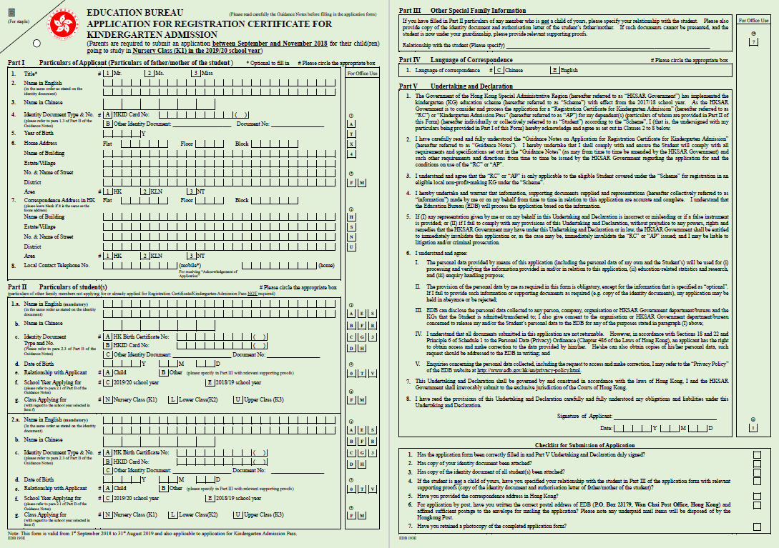
Sample – Application Form of
“Registration Certificate for KG Admission”
[in light green]
School Year Applying for：
C: 2019/20 school year
Class Applying for：
N: Nursery Class (K1)

Slide 16
Checklist for Submission of Application
the application form, undertaking and declaration have been correctly filled in and duly signed
copy of the applicant’s identity document has been attached
copy of the student’s identity document has been attached
if the student is not a child of yours, your relationship with the student has been specified in the application form with relevant supporting proofs (copy of the identity document and authorisation letter of father/mother of the student)
the correspondence address in Hong Kong has been provided
sufficient stamp has been affixed to the envelope for mailing the application (Please note any underpaid mail items will be disposed of by the Hong Kong Post)
a photocopy of the completed application form has been retained

Slide 17
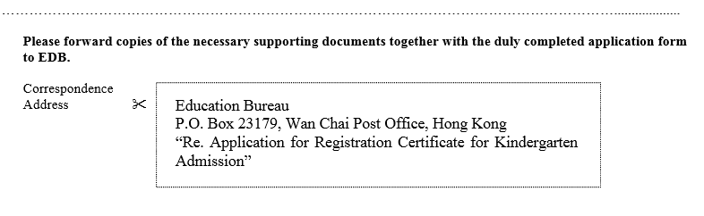
Submission method
“Acknowledgement of Application” will be issued to applicants within 10 working days from the date of receipt of the applications.
If a local mobile phone number is provided: acknowledgement by SMS; Otherwise, acknowledgement will be given in writing by post.
By post:
Guidance Notes on Application for Registration
Certificate for KG Admission – Page 6
Please remember to attach copy of valid supporting documents, provide address and affix sufficient postage on the envelope.
Drop-in box :
14/F, Wu Chung House, 213 Queen’s Road East, Wan Chai, HK
(Working hours: Mondays to Fridays 8:30 a.m. to 1:00 p.m., 2:00 p.m. to 6:00 p.m.,
closed on Saturdays, Sundays and Public holidays).

Slide 18

Measures
(3) " Not More Than One Place for Each Child "Arrangements
Valid registration documents for 2019/20 school year
“Registration Certificate for KG Admission”
（“ RC”）
For students who are eligible for
receiving subsidised KG education
The students must be Hong Kong residents with right of abode, right to land or valid permission to remain without any condition of stay (other than the limit of stay) in Hong Kong
In general, the validity of “RC” is three years (Application for extension of validity will only be considered by the EDB under very special circumstances of individual children with proven special educational needs. The applicant must provide strong and solid proof, for example, an assessment report issued by registered medical practitioner or professional, confirming special educational difficulties of the child that warrant the need for the child to pursue KG education for a period longer than the normal three years. )

Slide 19
Measures
(3) " Not More Than One Place for Each Child "Arrangements
Valid registration documents for 2019/20 school year
“Registration Certificate for KG Admission”
（“ RC”）
For students who are eligible for
receiving subsidised KG education
For a Scheme-KG to be disbursed with subsidy for a month, an eligible student studying in that KG must have attended classes in that month.
If your child is absent from school, you should notify the KG concerned as soon as possible. In general, if students have been absent from school for an entire month (i.e. absent for all school days of a specific month), subsidy in respect of the student for that month would not be disbursed to the KG concerned; parents are required to pay full school fees before deduction of subsidy under the Scheme as shown on the“Fees Certificate” of the KG to which the child is admitted.
If there are any special circumstances (e.g. absence due to illness for the entire month) with valid documentary proof, EDB would consider each case on its individual merits (Enquiry number: 2892 6669).

Slide 20
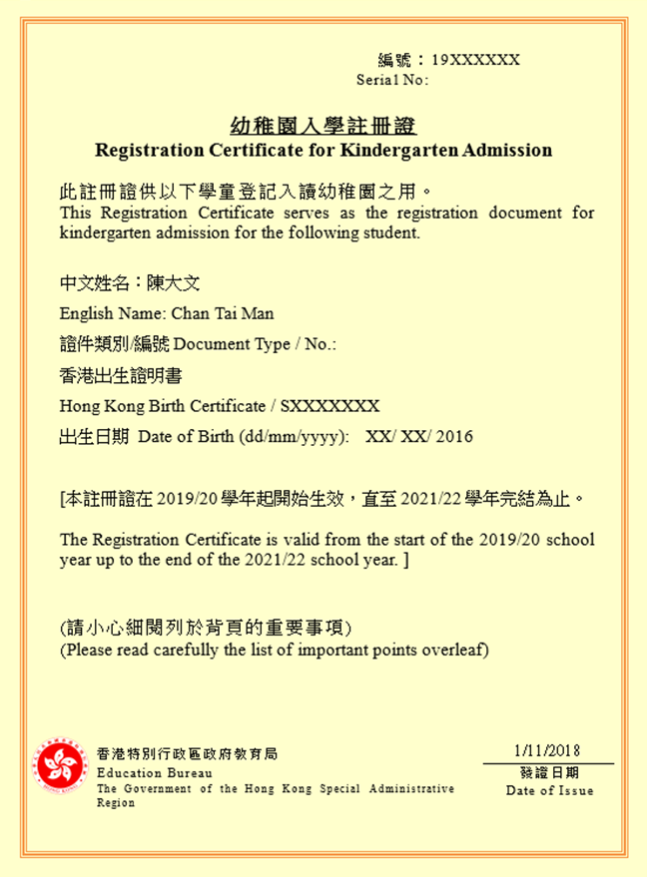
Sample -“Registration Certificate for KG Admission”
(For students who are eligible for
receiving subsidised KG education)

Slide 21

Measures
(3) " Not More Than One Place for Each Child "Arrangements
Valid registration documents for 2019/20 school year
“Kindergarten Admission Pass”（“AP”）
For students who are NOT eligible for
receiving subsidised KG education
E.g.：
  Non-local children (who can receive education in HK upon obtaining permission from the Director of Immigration) :
    holder of a form of recognizance
    whose parent(s) is/are holding a student visa
    Students who receive the 4th year of KG education but NOT approved for extending the validity of “RC”

Slide 22
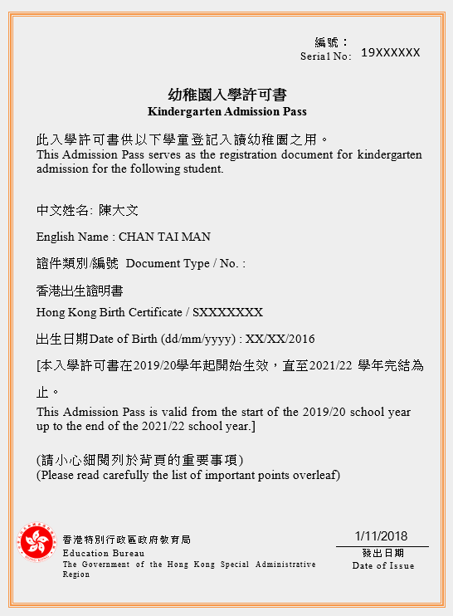
Sample - “Kindergarten Admission Pass”
(For students who are NOT eligible for
receiving subsidised KG education )

Slide 23




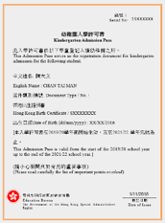
Can receive education in HK
Cannot receive education in HK
Eligible for Subsidy
Not Eligible
for Subsidy
“RC”
    “AP”

Slide 24
Measures
(3) “Not More Than One Place for Each Child "Arrangements
-Points to note
EDB will issue a registration document to each student who can receive education in Hong Kong
    “RC”／“AP”
    All Scheme-KGs can only admit students with “RC”／“AP”
RC”／“AP” must be submitted to KG during the “Centralised Registration Dates "and retained by the KGs until the respective students finish their studies.
Parents are required to apply to the EDB for the“RC”from September to November 2018. Details on application will be announced in or before September this year and uploaded to EDB’s website.
Upon receipt of the applications with all necessary information and documents provided, EDB will generally take six to eight weeks to complete processing of the applications and issue the “RC” to applicants who are eligible for receiving subsidy under the Scheme by post.
If a student cannot obtain an “RC” as he/she can receive education in Hong Kong but is not eligible for receiving subsidy under the Scheme
    EDB will issue an “AP” to the student concerned.
    Students can use “AP” for registration and admission to a Scheme-KG.
    Parents are required to pay full school fees before deduction of subsidy under the Scheme as shown on the Fees Certificate.

Slide 25
“Provisional Registration Letter”
(Application starts from November)

Slide 26



Measures
(3) “Not More Than One Place for Each Child "Arrangements
Valid registration documents for 2019/20 school year
“Provisional Registration Letter”
．Mainly for provisional registration when
transferring to another KG/ repeating K1 in the
same KG
．Must be replaced by “RC” or “AP” on or before the 1st day of officially attending the KG

Slide 27
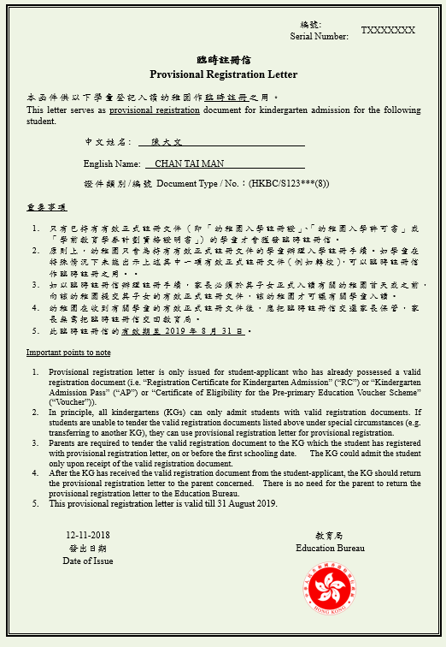
Sample - “Provisional Registration Letter”

Slide 28
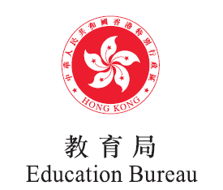

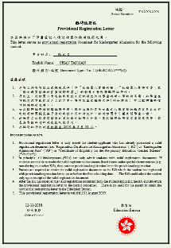

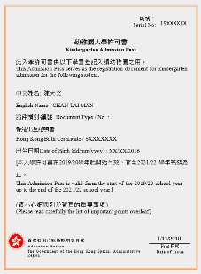
When is "Provisional Registration Letter" required? (Example)
Studying in a K1 class
in School A in the
2018/19 school year
Transferring to School B
A
B
Wish to transfer to a K1 class in School B in the 2019/20 school year
Apply for the “Provisional Registration Letter” from EDB from November 2018
Submit the “Provisional Registration Letter” for registration during the “centralised registration dates”

Slide 29
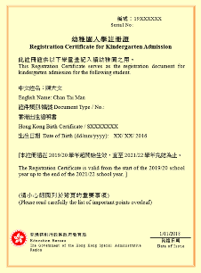
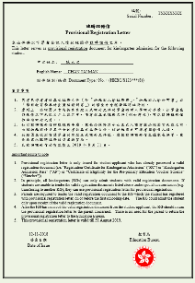
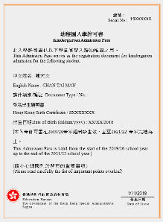
When is "Provisional Registration Letter" required? (Example)
Studying in a K1 class
in School A in the
2018/19 school year
Transferring to School B
A
B
Must submit “RC” or “AP” to School B on or before the 1st day of officially attending School B.

Slide 30
Application procedure – Points to note
Parents should understand from KGs about their school-based admission mechanism, including the admission procedure and criteria, the interview arrangements, application fee, etc. Relevant information on K1 Admission Arrangements provided by KGs should be in both Chinese and English.
To facilitate parents of non-Chinese speaking (NCS) children in obtaining the relevant information, parents can note the icon or simple message in English on the school webpage. If necessary, parents can also enquire with KGs whether the contact number of a designated staff is available.
Parents should collect and submit application forms in accordance with the requirements of individual KGs.

Slide 31
Application procedure – Points to note
Approved ceiling of application fee is $40.
Scheme-KGs cannot collect fees exceeding the approved ceilings. Parents should approach individual KGs should they have any related enquiries.

Slide 32
    Registration procedure – Points to note
To complete the registration, parents are required to submit the following items to the KG concerned during the “Centralised Registration Dates” （i.e. 10-12 January 2019)
    ”RC”／”AP”；and
    Registration fee
KGs should not require parents to complete the registration procedure, pay the registration fee or other fees (e.g. for purchasing school uniforms, tea and snacks, etc.) in any forms before the “centralised registration dates”.
Scheme-KGs cannot collect registration fees exceeding the approved ceilings:
    Half-day session : $970
    Whole-day session: $1,570
Should parents wish to change to another KG after registration, they should get back the registration document from the KG that they have registered with. The KGs should return the registration document to the parents as soon as possible. Generally, registration fee paid will not be refunded.
The registration fee must be refunded to any student who pays the registration fee and subsequently takes up the place within the 1st month of the school year concerned after receiving the 1st installment of the school fee from the student, if any.

Slide 33
Registration procedure – Points to note
If parents decide to defer K1 study of their children for one year(i.e. 2020/21 school year) with regard to their own circumstances, they should return the ”RC” to EDB stating that the ”RC” should be voided. Parents can resubmit an application in the next year, EDB will reissue an ”RC” with a validity period of 3 years (starting from the 2020/21 school year)
Please note that the returned ”RC”must have not been used for receiving subsidised KG education.

Slide 34
Measures
(4) Release of Vacancy Information
EDB will collect information from KGs on K1 vacancies in the 2019/20 school year about a week after the “Centralised Registration Dates” through an electronic platform, and publish a list of KGs in various districts in end-January 2019.
Only the vacancy situation of individual KGs will be released but not the number of vacancy of individual KGs.
School Name |  | Telephone | Vacancies
1. | AAA KG | XXXX XXXX | Y
2. | BBB KG | XXXX XXXX | N
3. | CCC KG | XXXX XXXX | P
Y – With vacancy
N – Without vacancy
P – Applications on the waiting list being processed

Slide 35
Measures
(5) Referral arrangements for students
KG student admission is a school-based matter
    EDB encourages parents to apply for a K1 place by themselves; and
    provides relevant information to support parents
Under special circumstances, EDB will make referrals as appropriate if individual students (i.e. those at risk of developmental delay and NCS children) encounter difficulties in applying for admission :
    K1 Places for 2019/20 s.y. : Starting from April 2019
    K2 & K3 Places for 2019/20 s.y. : Starting from July 2019
    By Regional Education Offices and Joint Office for Kindergartens and Child Care Centres

Slide 36
“2019/20 K1 Admission Arrangements ”
Flowchart

Slide 37
"2019/20 K1 Admission Arrangements" Flowchart
Applicants apply to EDB for the “RC”
from September to November 2019
KGs process
2019/20 K1 admission applications
Upon receipt of the applications with all necessary information and documents provided, EDB will generally take six to eight weeks to complete processing the applications and issue the “RC”/ “AP” to applicants by post
KGs inform applicants of the application result before 21 December 2018
If application is successful
If application is not successful
Applicants register with one KG during the “centralised registration dates”
(i.e. 10 to 12 January 2019)
by submitting the “RC” / “AP” and paying registration fee
Applicants refer to the K1 vacancy information released by EDB
after the “centralised registration dates”
(i.e. from the end of January 2019)

Slide 38
Enhanced Education Support for NCS students

Slide 39
Enhanced education support for NCS students
The government is committed to encouraging and supporting the early integration of NCS students (notably ethnic minority students) into the community, including facilitating their adaptation to the local education system and mastery of the Chinese language.

Slide 40
Enhanced education support for NCS students
A series of measures have been in place to support the learning of NCS students in KGs:
  The KG Education Curriculum Guide launched in February 2017 has included recommendations on how schools could support NCS students, specifically on Chinese learning for NCS children.
  For Scheme-KGs admitting 8 or more NCS students, an additional grant comparable to the salary of a KG teacher is provided to help them enhance the support for these students.
  EDB is strengthening teacher training and school-based support services for NCS students in KGs. All KGs, regardless of the number of NCS students admitted, may apply to join.

Slide 41
Enhanced education support for NCS students
The earlier the NCS students began schooling or received support in learning, the more effective their learning will be.
NCS students studying at KGs with Chinese as the medium of instruction (MOI) performed significantly better in the Chinese Language compared to NCS students studying at KGs with English as MOI.
Parents are encouraged to make good use of children’s prime time in learning the Chinese language and consider schools with a language-rich environment which would facilitate children’s learning of the Chinese language with authentic, meaningful and developmentally appropriate language learning experiences through try-outs, exploration and interpersonal interactions.

Slide 42
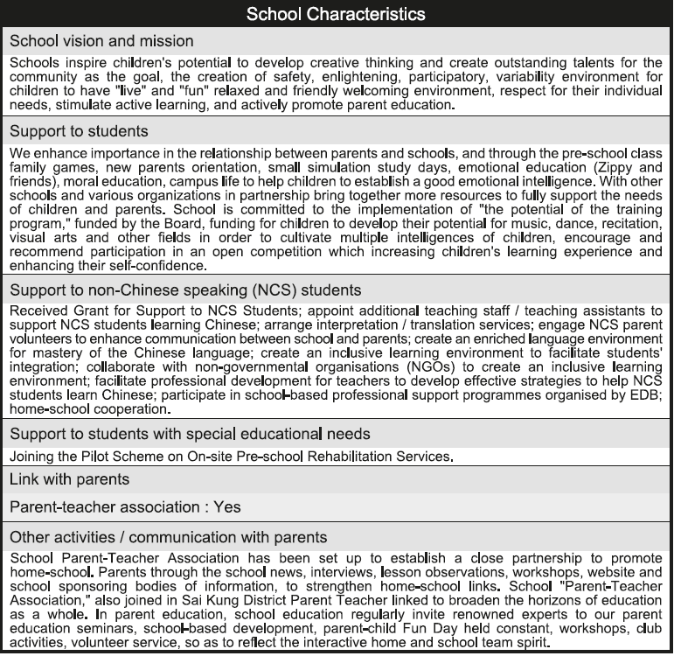
Enhancement on Profile of KGs and KG-cum-Child Care Centres

Slide 43
Major considerations in choosing a KG
Kindergartens :
        Vision and mission, management and development, school culture.
Curriculum：
        Balanced curriculum, diversified learning activities.
Parents ：
        Understanding children’s uniqueness, abilities, interests and needs.
        Number of KGs to submit the applications (not restricted by districts)
Reference materials :
        School visits, school websites
        Profile of Kindergartens and Kindergarten-cum-Child Care Centres (to be updated in September)
        http://www.chsc.hk/kindergarten/

Slide 44
Enquiry
EDB ─
        Webpage: http://www.edb.gov.hk/k1-admission_e
        24-hour automatic telephone enquiry system: 2891 0088
        The Regional Education Offices or the Joint Office for Kindergartens and Child Care Centre
Hotline: 3540 6808 / 3540 6811
Monday to Friday | 8:30am to 1:00pm 2:00pm to 6:00pm
Saturdays , Sundays and Public holidays | Closed

Slide 45
Thank you！

