Slide 1
Laying a solid foundation for development:
How to build a positive parent-child relationship?
Strand I: Understanding of Child Development
Parent Education Resource Package
for Primary Schools

Slide 2
Outline
Acts of service
Gifts
Physical touch
Words of affirmation
Quality time: Play
Quality time: Chatting

Slide 3
Parent-child relationship is the foundation for raising children
Build a solid parent-child relationship
Develop positive behaviours
Reduce negative behaviours

Slide 4

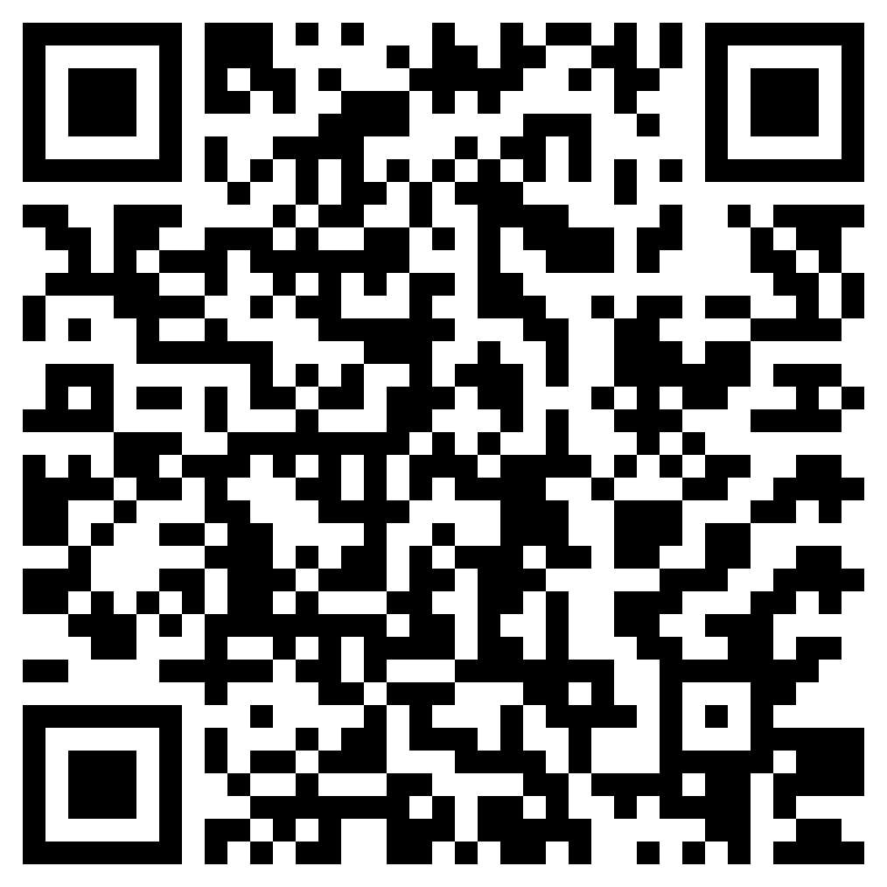
What the children in the short video want their parents to do the most?
Light Up a Bright Future with Your Child
Parent Education Video Production Contest
Watch the video
(Chinese Version Only)
Notes:
短片：https://www.youtube.com/watch?v=I_rMIMlVddg

Slide 5
Five ways to express love to your children
Acts of service
Gifts
Physical touch
Words of affirmation
Quality time
Chapman, G., & Campbell, R. (2016). The 5 Love Languages of children: The Secret to loving children effectively. Moody Publishers.

Slide 6
Five ways to express love to your children
Ways | Content | Example
Acts of service | Parents take care of their children's daily needs according to their age and abilities. | Packing school bags, washing clothes, tidying up their room, preparing meals, taking children to and from school, studying with them, etc.
Gifts | Parents prepare gifts for their children based on their preferences and personalities. | Gifts need not to be expensive and can be small handicrafts made by parents (such as origami), paintings drawn by parents, or even a printed photo.
Physical touch | Parents express care, comfort and love to their children through physical touch. | Hugging and kissing children from time to time, cuddling children, reading books together, watching TV together, etc. Parents can hold their children’s hands, touch their hair or pat their shoulder.
Words of affirmation | Parents make their children feel appreciated and valued by praising them verbally. | Praise children’s actions, efforts and strategies, as well as directly tell children how much you love them.
Quality time | Parents put down their mobile phones, turn off the TV and concentrate on interacting with their children. | Chatting and playing with children regularly, going shopping and hiking, doing crafts, or playing sports with them.

Slide 7
Acts of service
Reminder for parents
Acts of service include:
  Packing school bags
  Washing clothes
  Tidying up their rooms
  Preparing meals
  Taking children to and from school
  Studying with children
Acts of service need not to be something big.
If children are already able to take care of themselves properly, parents should let them do what they can as far as possible. Providing children with overmuch acts of service may weaken their self-reliance, self-discipline and autonomy. They may also misunderstand that they are not doing well enough.
Chapman, G., & Campbell, R. (2016). The 5 Love Languages of children: The Secret to loving children effectively. Moody Publishers.

Slide 8
Gifts
Reminder for parents
Gifts include:
  Food
  Clothes
  Stationery
  Toys
  Daily supplies
Gifts have to be prepared sincerely and need not to expensive ones.
Small handicrafts made by parents (such as origami and small toys), paintings drawn by parents or non-routine parent-child activities (such as going hiking, playing badminton or going to a theme park) may be more attractive than stationery or toys!
Chapman, G., & Campbell, R. (2016). The 5 Love Languages of children: The Secret to loving children effectively. Moody Publishers.

Slide 9
Physical touch
Positive effects of physical touch on the body
  Slowing down the heart rate
  Reducing blood pressure
  Reducing the stress hormone cortisol ➔ reducing negative responses of the body caused by stress, such as rapid heartbeat, dizziness, etc.
  Increasing the love hormone oxytocin ➔ increasing positive emotions and prosocial behaviours in social interactions, such as feeling warm, taking the initiative to get close to others, etc.
Field, T. (2010). Touch for socioemotional and physical well-being: A review. Developmental Review, 30(4), 367-383.

Slide 10
Physical touch
Positive effects of physical touch on behaviours
  More emotionally stable and more able to control one’s emotions when under pressure
  Being more friendly to peers and exhibiting less violent behaviours
Field, T. (2010). Touch for socioemotional and physical well-being: A review. Developmental Review, 30(4), 367-383.

Slide 11
Words of affirmation
“I’m so happy to see you studying without needing to be told to! Dad is glad!”
Actions
Well done!
“You study for two hours every day. Everyone can see how focused you are and your hard work!”
Efforts
“Creating charts is a really great way to memorise the content that you need to know for your exam!”
Strategies
Lam, C.B., Cheung, Y.M. (2022). Spending Time with Children—100 Tips for Happy Parenting. Ming Cheung Publications.

Slide 12
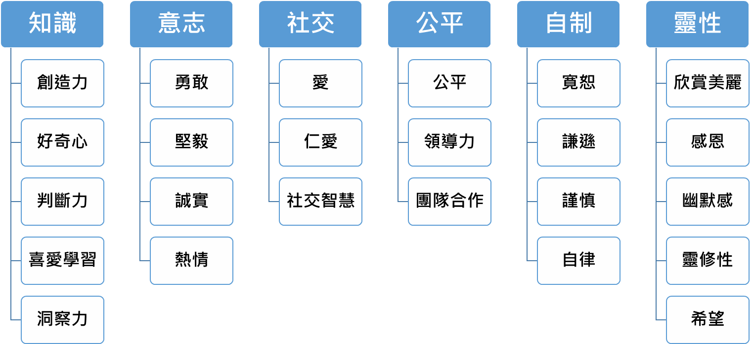
Words of affirmation
Knowledge
Willpower
Social
Fairness
Self-control
Spirituality
Creativity
Bravery
Love
Fairness
Forgiveness
Appreciation of beauty
Curiosity
Perseverance
Kindness
Leadership
Humility
Gratitude
Judgement
Integrity
Social intelligence
Teamwork
Prudence
Humour
Love of learning
Zest
Self-regulation
Spirituality
Perspective
Hope
Park, N., Peterson, C., & Seligman, M. E. (2004). Strengths of character and well-being. Journal of Social and Clinical Psychology, 23, 603-619.

Slide 13
Words of affirmation
Describe the child’s positive behaviour | “I really appreciate how you took the initiative to greet the uncle just now!”
Let them know the impact it has on others | “I really appreciate how you took the initiative to greet the uncle just now! Did you see that? He smiled so brightly after that!”
Link their positive behaviour with their strengths | “I really appreciate how you took the initiative to greet the uncle just now! Did you see that? He smiled so brightly after that! You’re really good at making friends with people!”

Slide 14
Words of affirmation
Describe the child’s positive behaviour | “Thank you for taking the initiative to tidy up your room!”
Let them know the impact it has on others | “Thank you for taking the initiative to tidy up your room!” I feel really comfortable and relieved when I come home from work to see your room looking neat and tidy!”
Link their positive behaviour with their strengths | “Thank you for taking the initiative to tidy up your room!” I feel really comfortable and relieved when I come home from work to see your room looking neat and tidy! You’ve become really self-disciplined and have grown up now!”

Slide 15
Quality time: Play
Use “loose parts”
        Loose parts can be manufactured products, recycled plastics or natural materials
        They should be:
    Easy to move around
    Can be put together in different ways
    Can form different combinations
    Can be arranged in different ways
Nicholson, S. (1971). How not to cheat children: The theory of loose parts. Landscape Architecture, 62, 30-34.

Slide 16
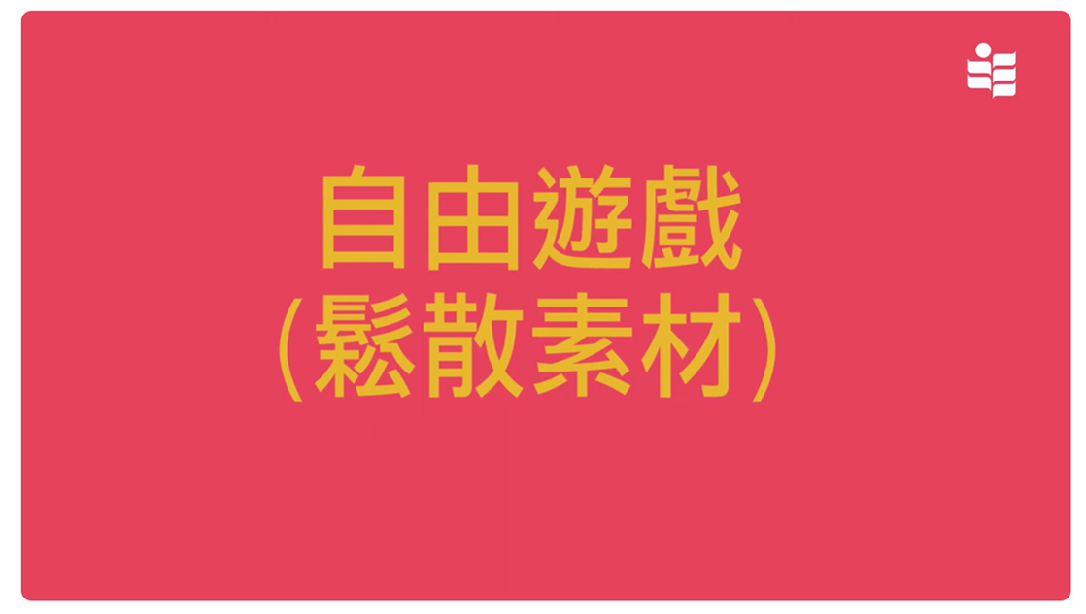
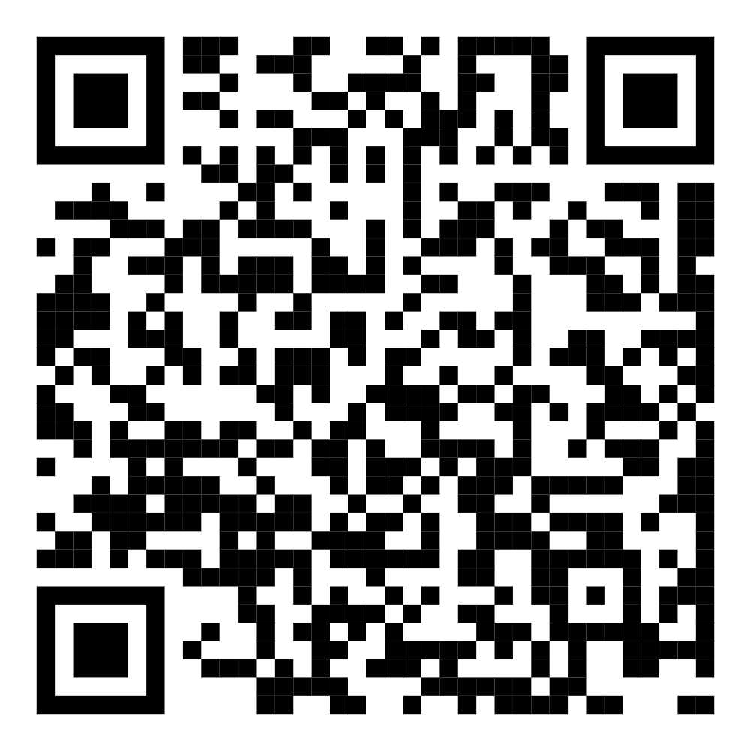
Quality time: Play
Play
(Loose Parts)
Watch the video
Notes:
Short video: https://youtu.be/wWzIyNinMjg?si=hrLLC155rKyIZLPX

Slide 17
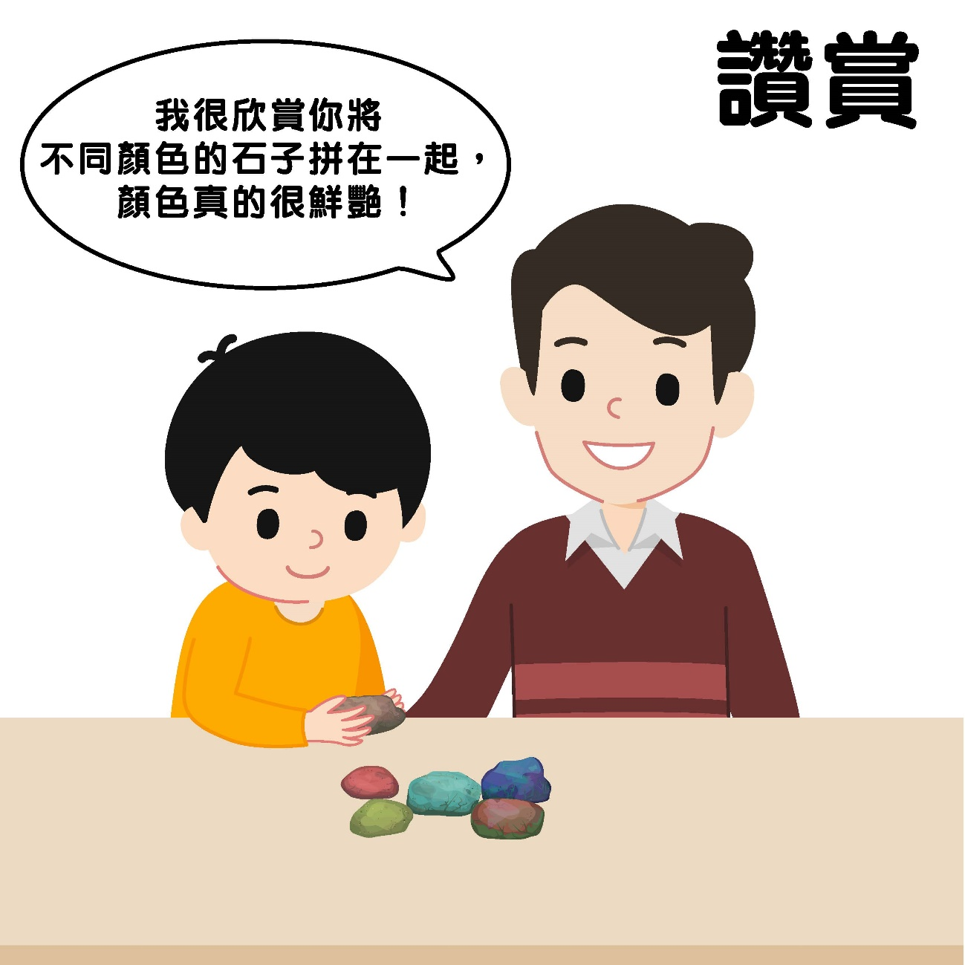
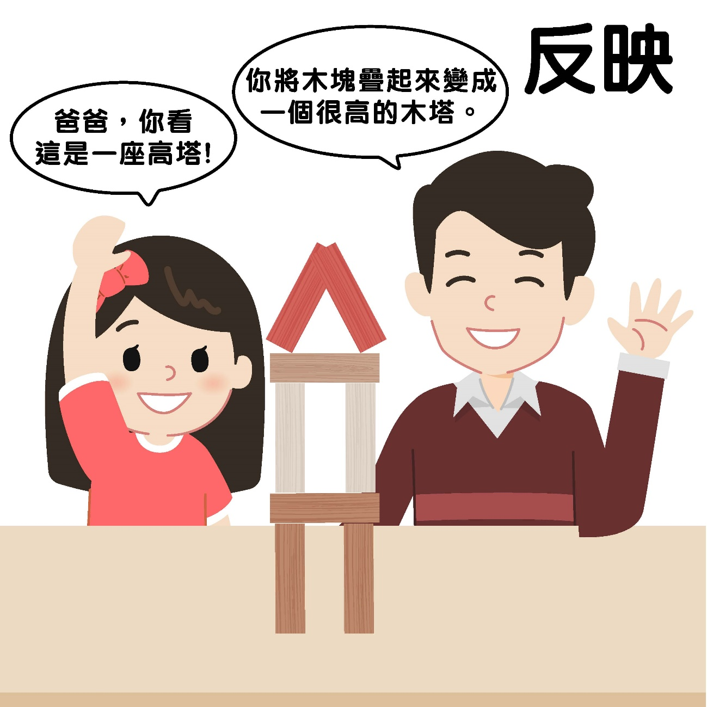
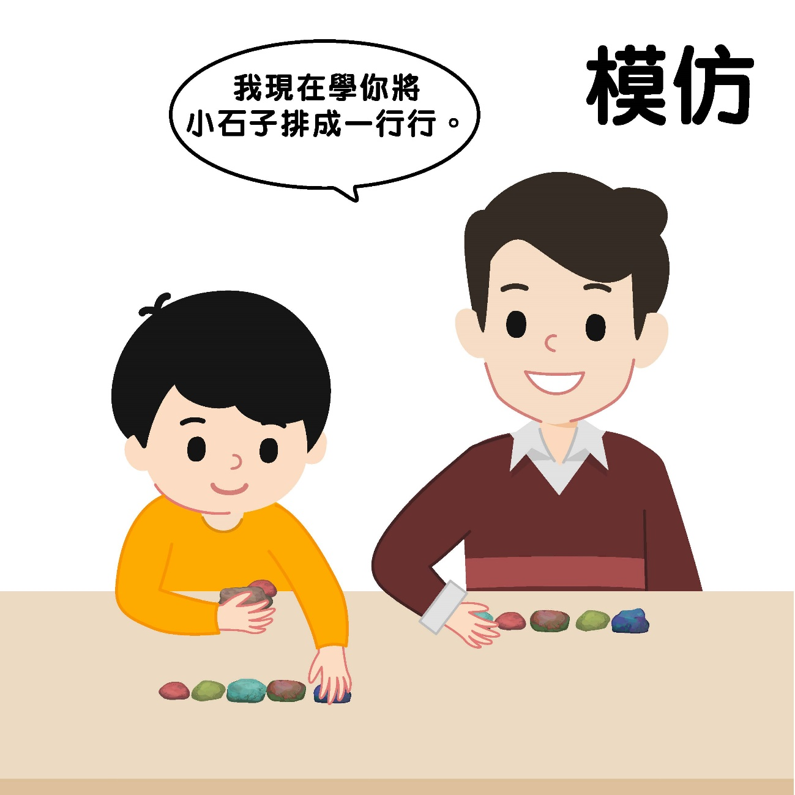
Quality time: Play
“I really like how you put different coloured pebbles together. The colours are really vibrant!”
Praise
“You’ve stacked wooden blocks to make a tall wooden tower.”
Reflect
“I’ll follow what you did and arrange pebbles in rows.”
Imitate
Praise
“Dad, look at this tall tower!”
Parents describe their children’s positive behaviours while playing and give praise.
Parents pay attention to what their children are saying and reflect and expand on the meaning of their words.
Parents imitate how their children are playing and describe their own intentions.

Slide 18
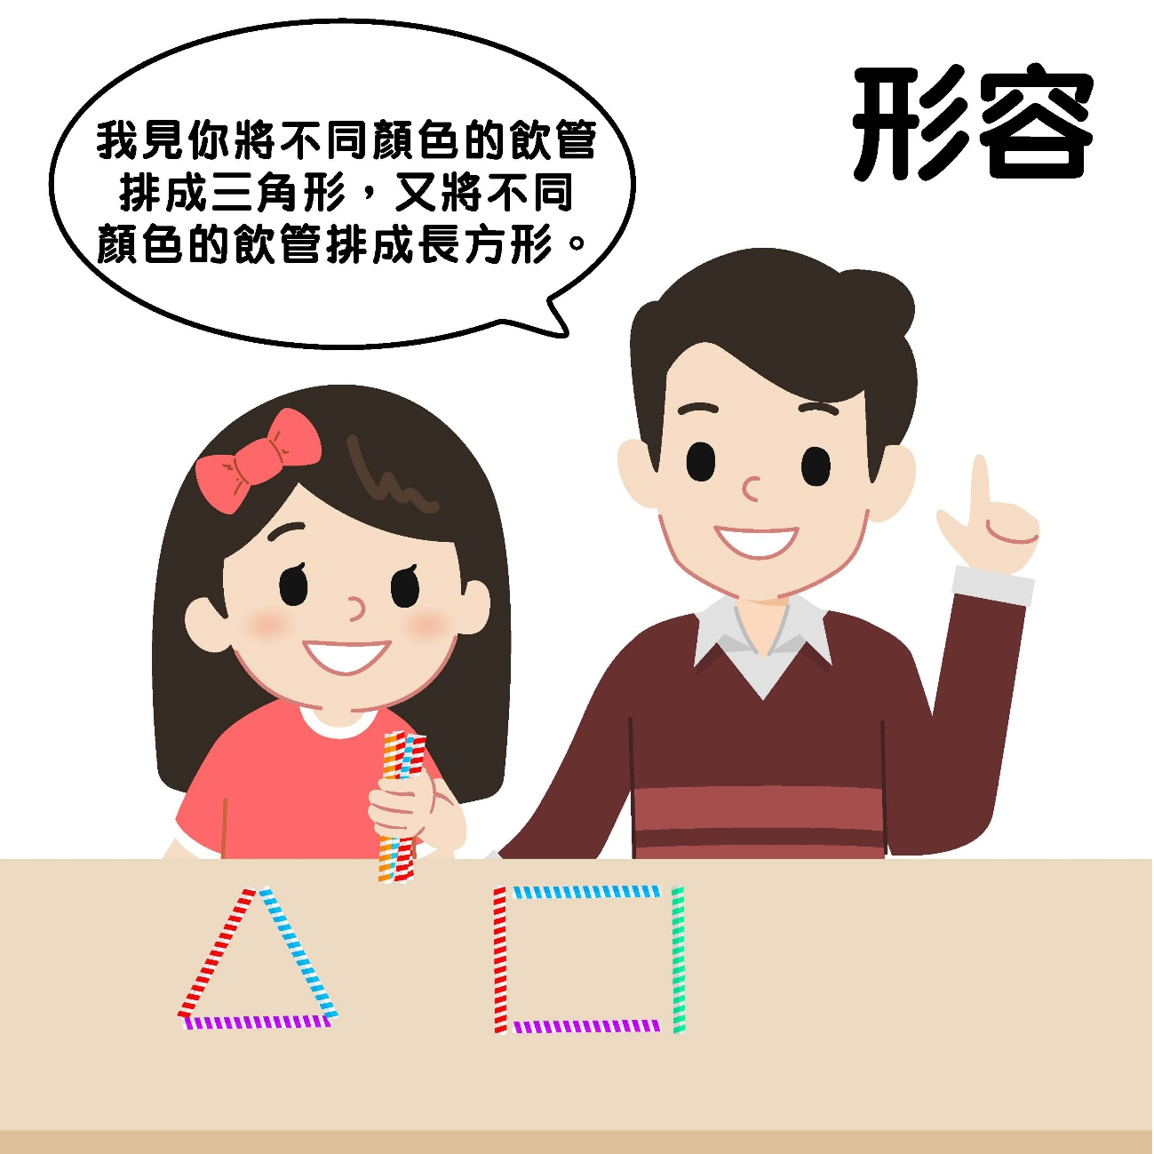
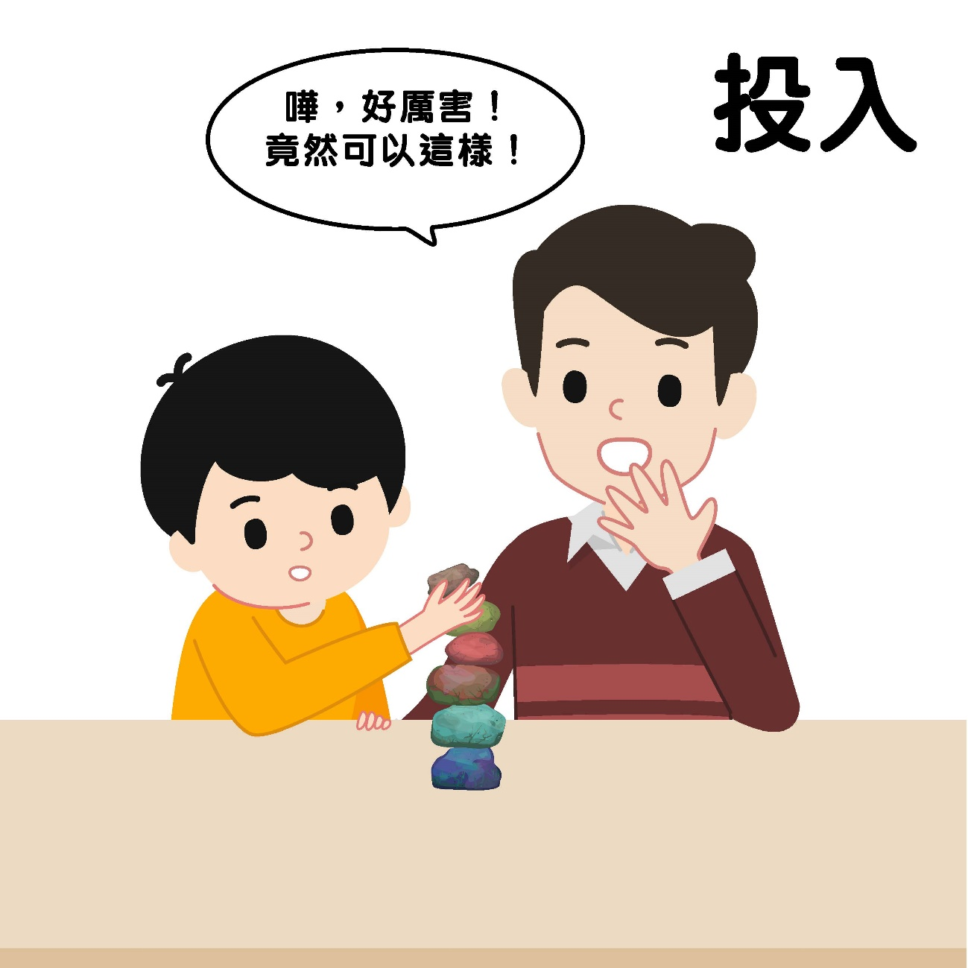
Quality time: Play
“I saw that you used straws in different colours to form a triangle, and also other straws in different colours to form a rectangle.”
Describe
“Wow, that’s amazing! I didn’t know it can be done in this way!”
Engage
Parents pay attention to their children’s every move and describe their actions and intentions.
Parents and children stay fully present while playing.

Slide 19

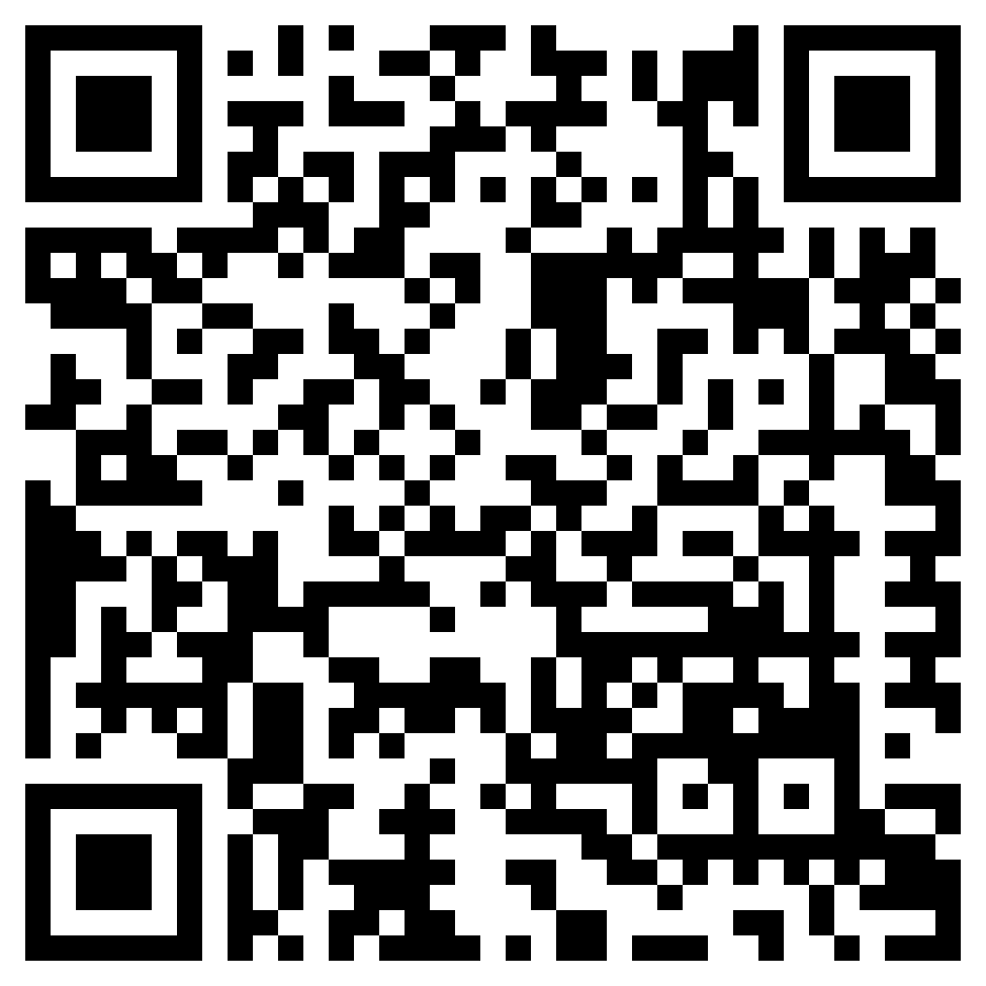
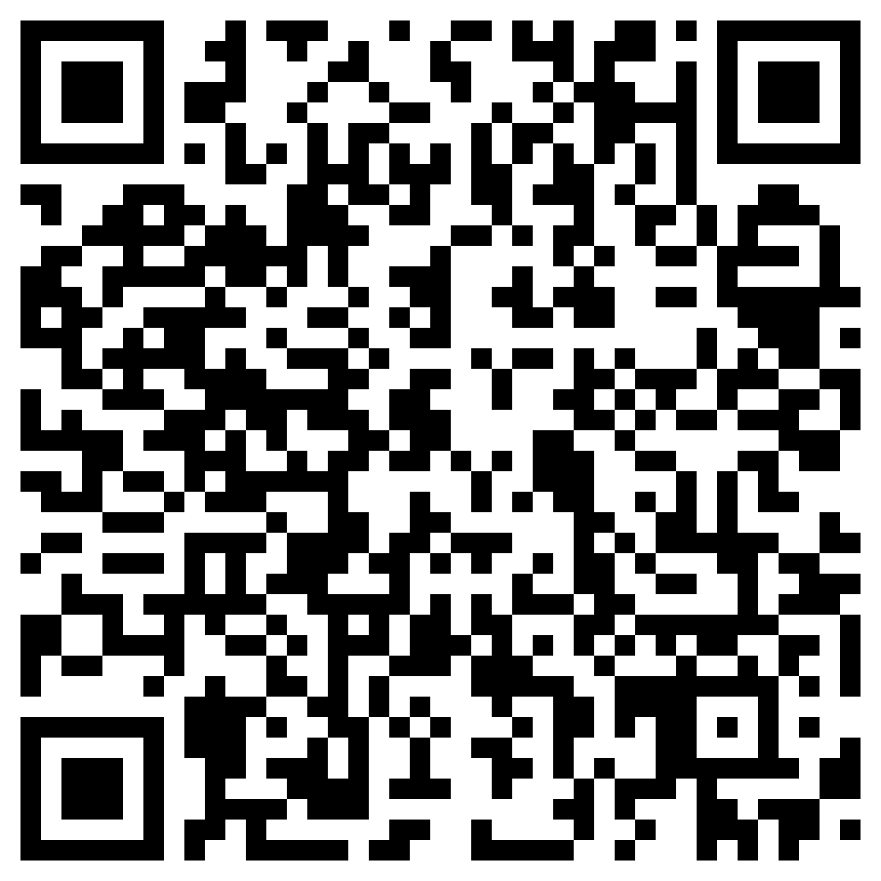
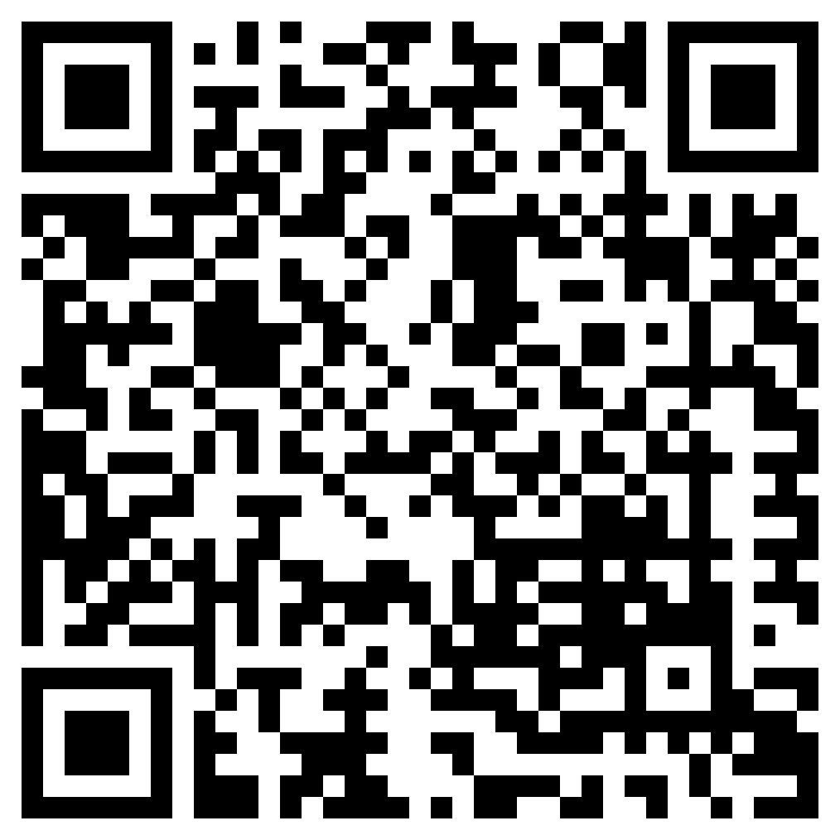
Quality time: Play
Game | QR code
Guess What I Drew (Chinese Version Only)
2. True or False (Chinese Version Only)
“Playtime with Children”
Parent Education Resource Kit
Spending Quality Time With Children
Download the resource kit
(Chinese Version Only)
Notes:
遊戲一：https://www.youtube.com/watch?v=euljNFmdre8&list=PLH5Tll_SkIgmAse-LYOm_Qt1ZQUtDmn6n&index=16
遊戲二：https://www.youtube.com/watch?v=xr2e9Mwvys8&list=PLH5Tll_SkIgmAse-LYOm_Qt1ZQUtDmn6n&index=20

Slide 20
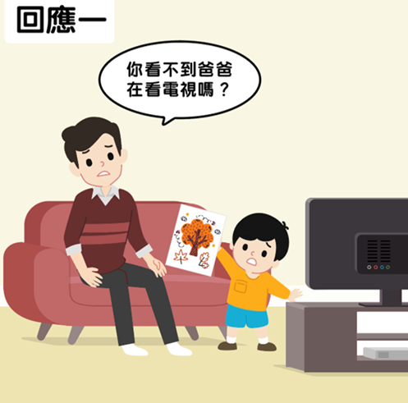
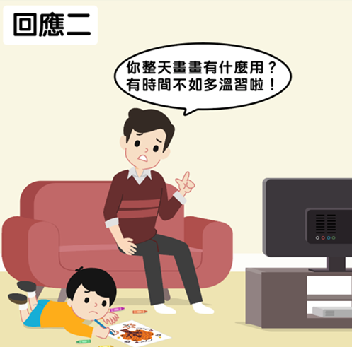
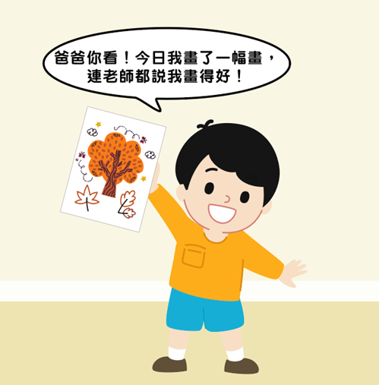
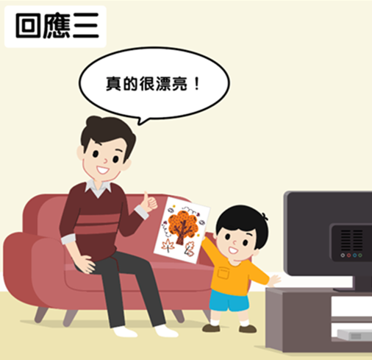
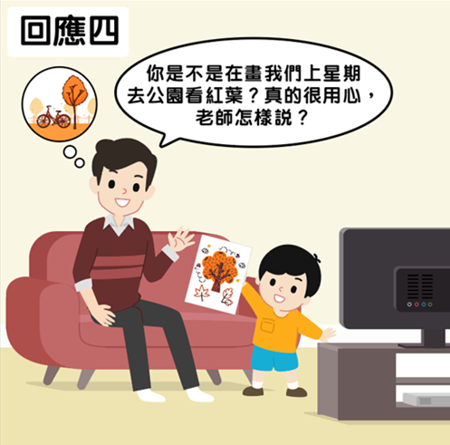
Quality time: Chatting
Response 1
Response 2
“Can’t you see that I’m watching television?”
“What’s the point of drawing all the time? You should spend that time studying!”
“Dad, look! I drew a picture today, even the teacher said I did well!”
Response 3
Response 4
“Did you draw a picture of us visiting the park to see the maple leaves last week? You really put your heart into it! What did the teacher say?”
“It looks really beautiful!”
Gable, S. L., Reis, H. T., Impett, E. A., & Asher, E. R. (2004). What do you do when things go right? The intrapersonal and interpersonal benefits of sharing positive events. Journal of Personality and Social Psychology, 87, 228-245.

Slide 21
Quality time: Chatting
 | Passive | Active
Destructive responses | Response 1: The parent has an “I don’t care” attitude because he thinks the child is sharing something that is not important. | Response 2: The parent thinks what the child is sharing is bad and that the thing they are interested in is harmful to them.
Constructive response | Response 3: The parent thinks what the child is sharing is good but is not very interested in the details or the child’s feeling? | Response 4: The parent thinks what the child is sharing is good and asked question after question because he is interested in the child’s thoughts and feelings.
Gable, S. L., Reis, H. T., Impett, E. A., & Asher, E. R. (2004). What do you do when things go right? The intrapersonal and interpersonal benefits of sharing positive events. Journal of Personality and Social Psychology, 87, 228-245.

Slide 22
Quality time: Chatting
Three steps of active encouragement:
Asking questions | Descriptive praises | Showing excitement
Open questions 5 W 1H Who What When Where Why How | Praising the child’s strategies Praising the child’s actions Praising the child’s efforts | Smiling Laughing Nodding Clapping Patting their shoulder Giving them a thumbs-up
Gable, S. L., Reis, H. T., Impett, E. A., & Asher, E. R. (2004). What do you do when things go right? The intrapersonal and interpersonal benefits of sharing positive events. Journal of Personality and Social Psychology, 87, 228-245.

Slide 23
Quality time: Chatting
Three steps of active listening:
Asking questions | Reflecting on content | Reflecting on negative emotions
Open questions 5W 1H Who What When Where Why How | Summarising what the child said in your own words and saying it out loud | Guilty Disappointed Upset Worried Angry Confused Lonely | Fear Nervous Exhausted Discouraged Frustrated Jealous Discriminated
Jones, S. M., Bodie, G. D., & Hughes, S. D. (2019). The impact of mindfulness on empathy, active listening, and perceived provisions of emotional support. Communication Research, 46(6), 838-865.

Slide 24
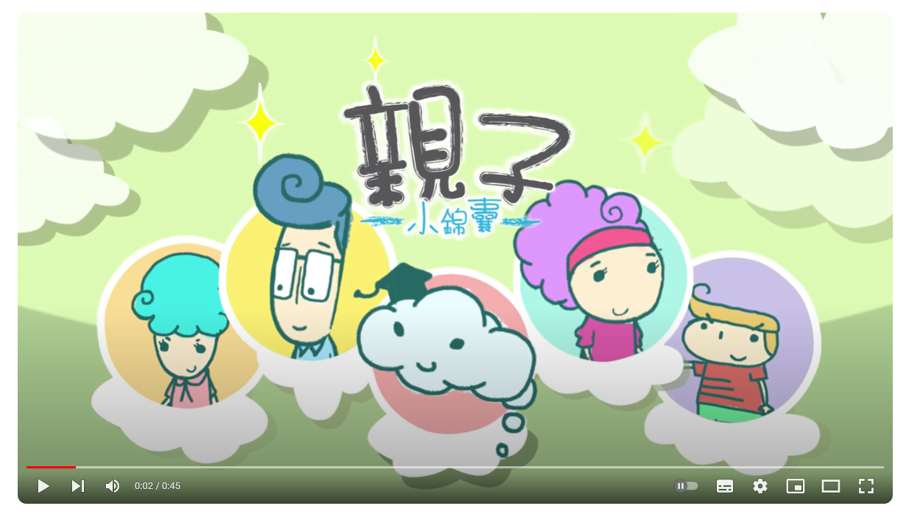
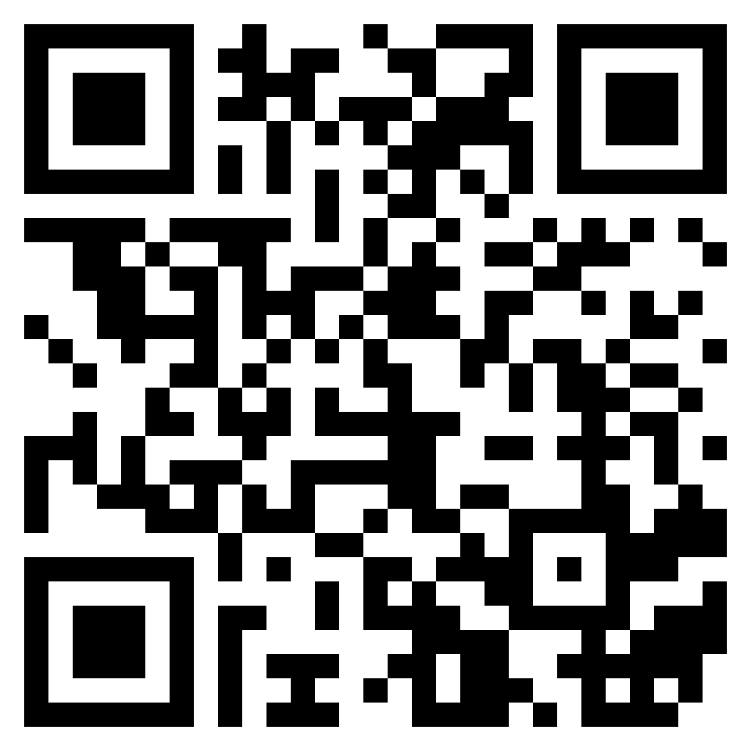
How can the parents in the video use active listening to understand what happened?
Parenting Tips
Watch the video
(Chinese Version Only)
Notes:
短片：https://www.youtube.com/watch?v=P5mg0pS4fMA

Slide 25
How can the parents in the video use active listening to understand what happened?
Role play:
  In groups of three:
    The sharer (parent 1) plays the role of a daughter who does not want to go to school because her classmates do not play with her. The sharer can improvise as they wish.
    The active listener (parent 2) plays the role of the mother and tries to respond using the active listening skills of asking questions and reflecting on the content of their responses and expressing the daughter’s negative emotions.
    The observer (parent 3) pays attention to the positive impact the parent’s active listening has on the child. For example: Does the daughter feel understood after talking to her mother? Does she feel relieved? Have her emotions become more stable?

Slide 26
How can the parents in the video use active listening to understand what happened?
Mum: “You’re hiding in bed crying. Did something happen?” (Asking questions)
Daughter: “My classmates don’t play with me! I don’t want to go to school anymore!”
Mum: “Your classmates don’t want to play with you? You must be feeling terrible! I understand. You’re feeling so bad that you don’t want to go to school and see them, right?” (Reflecting on content)
Daughter: “That’s right! They are really mean! They always make fun of me!”
Mum: “Do you feel angry when they make fun of you?” (Reflecting on emotions)
Daughter: “Yes! I’ve already told them to stop doing it, but the more I tell them to stop, the harder they laugh!”
Mum: “They haven’t stopped even though you’ve asked them many times to stop teasing you. You may feel a little frustrated and helpless.” (Reflecting on content + reflecting on emotions)
Daughter: “Yes, mum! I’m feeling really miserable.”

Slide 27
Active Listening
It shows children their parents’ empathy, which helps them feel understood
This will make them more willing to listen to their parents’ advice and accept their help

Slide 28
Conclusion
Acts of service
  Examples: Packing school bags, washing clothes, taking children to and from school, etc.
  If children are already able to take care of themselves properly, parents should let them do what they can as far as possible
Gifts
  Examples: Food, stationery, toys, etc.
  Small handicrafts made by parents and special parent-child activities may be more attractive than material gifts
Physical touch
  Helps children deal with stress and regulate their emotions
Words of affirmation
  Praise children’s actions, efforts and strategies
  Take note of children’s strengths and link them to the children’s strengthen this
Quality time
  Let children take the lead while using techniques such as praise, reflect, imitate, describe and engage
  Use active encouragement and active listening

