Slide 1
Homework and exams made easy:
How to support children’s learning at home?
Strand IV: Fostering Home-school Co-operation and Communication
Parent Education Resource Package
for Primary Schools

Slide 2
Outline
The role of parents in supporting children’s learning at home
How to create an effective learning environment?
How to support children’s learning through self-regulated learning?
How to support children to do homework and revisions effectively?

Slide 3
The role of parents in supporting children’s learning at home
Companion : Keeps children company when they are learning
Guide : Gives appropriate demonstrations to guide children’s learning and motivate them to think and explore
Facilitator : Uses different strategies to help children learn better when they encounter difficulties
Education Commission (2019). Task Force on Home-school Co-operation and Parent Education (2019). Education Commission.

Slide 4
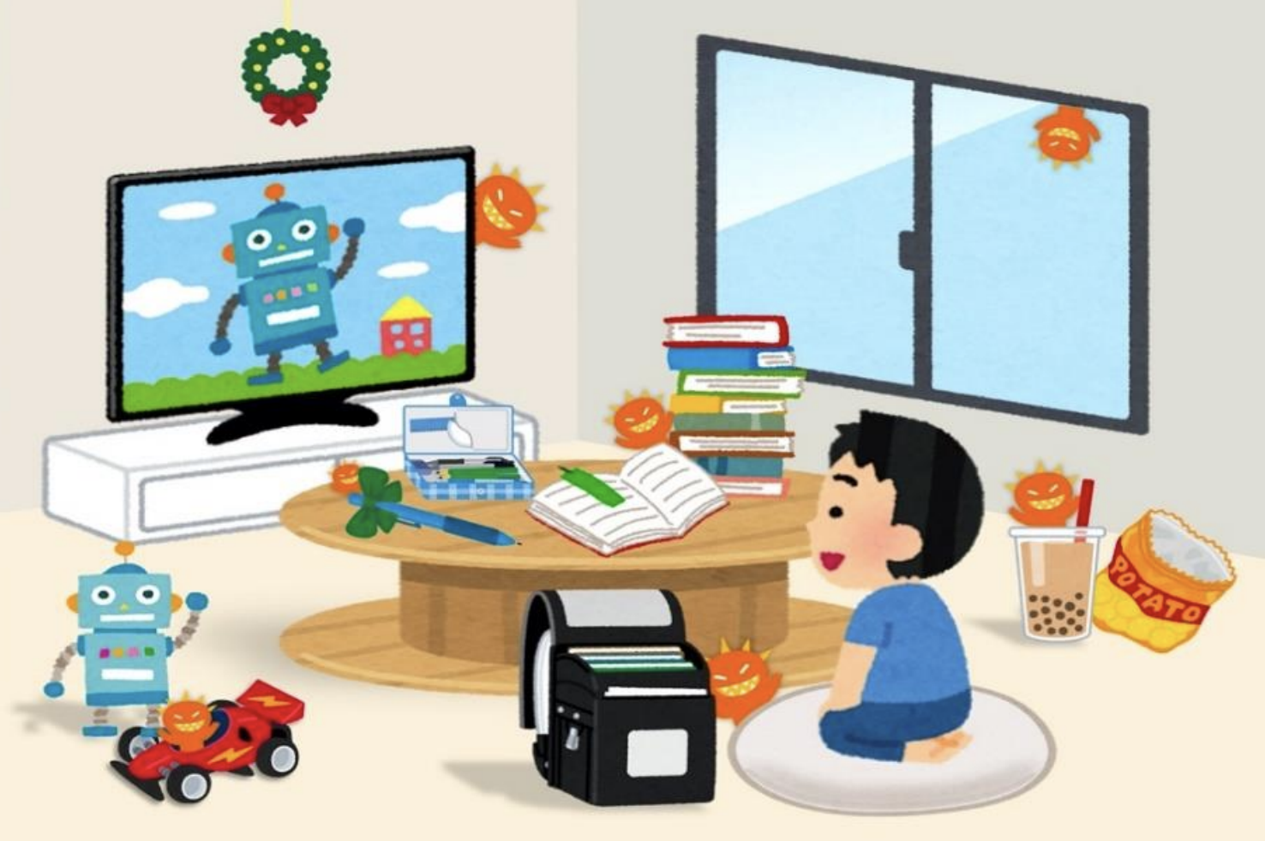
How to create an effective learning environment?
Why do you think this child isn’t able to focus on doing his homework?
Education Bureau (2022). Learn Smart - Be a TOP student (Primary School Students). From: https://sense.edb.gov.hk/uploads/content/adhd/8.2022/Learn%20Smart%20-%20Be%20a%20TOP%20student%20%28Primary%29_Aug%2022.pdf.

Slide 5
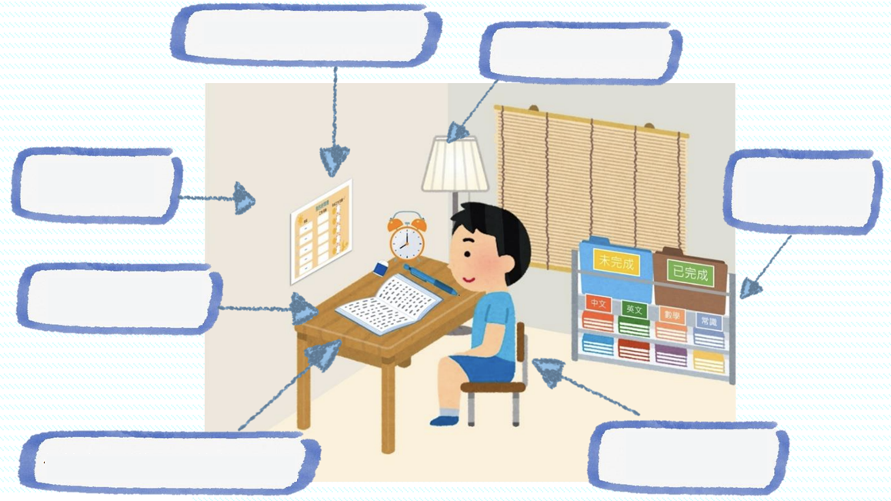
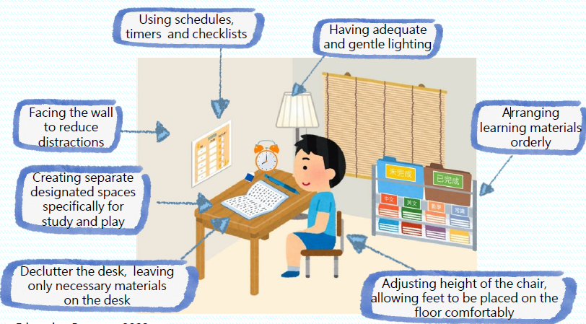
Clean and tidy environment
Education Bureau (2022). Learn Smart - Be a TOP student (Primary School Students). From: https://sense.edb.gov.hk/uploads/content/adhd/8.2022/Learn%20Smart%20-%20Be%20a%20TOP%20student%20%28Primary%29_Aug%2022.pdf.

Slide 6
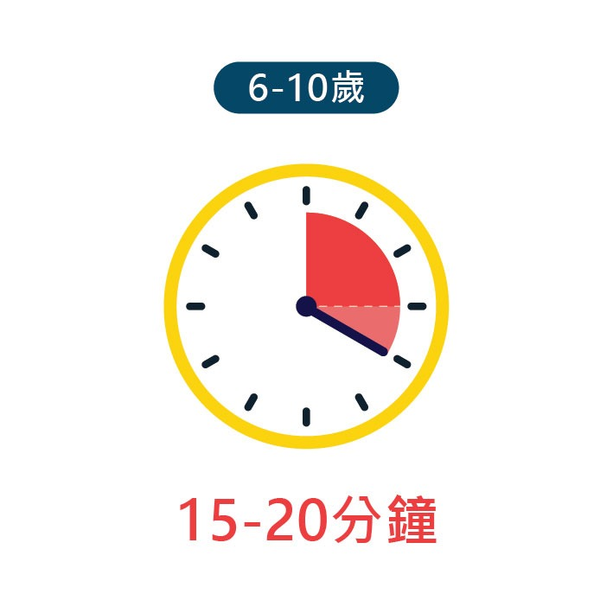
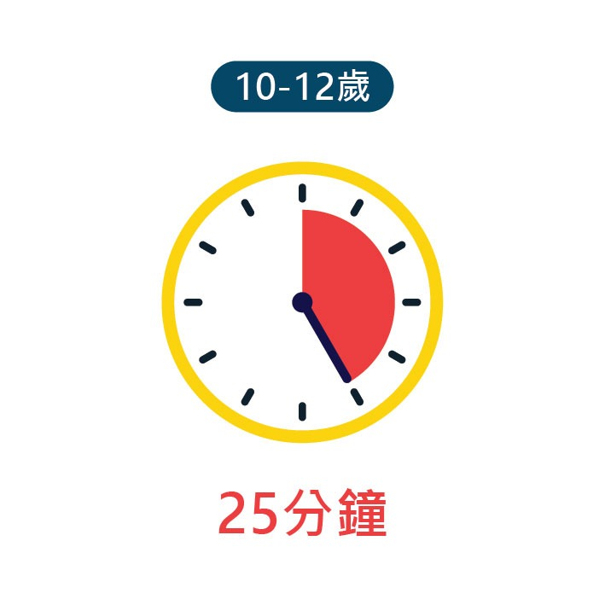
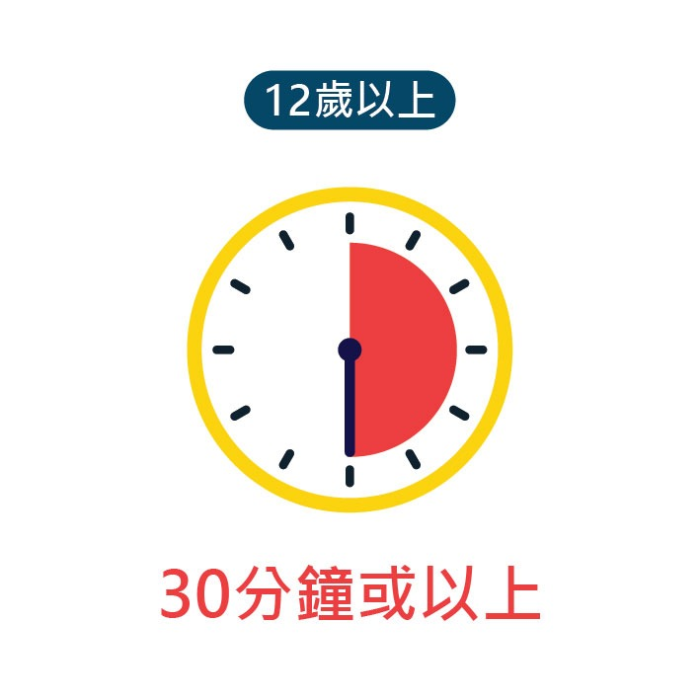
Children’s attention span
6-10 years old
10-12 years old
Above 12 years old
15-20 minutes
25 minutes
30 minutes or more
Levin, E., Bernier, J. (2011). Attention span. In S. Goldstein & J. A. Naglieri (eds), Encyclopedia of child behavior and development. Springer.

Slide 7
Devising an effective timetable with children
Pay attention to the following when devising a timetable:
  Include enough time for rest and leisure activities, such as looking at the street, stretching, taking a shower/bath, surfing the Internet, taking a nap, etc.
  Set rewards for the completion of tasks, such as eating snacks, watching movies, etc.
  Display the timetable in a conspicuous place and mark each task with a ✓ after completion
  Let children get involved in designing timetable and express their own ideas to strengthen their sense of ownership
Education Bureau (2022). Learn Smart - Be a TOP student (Primary School Students). From: https://sense.edb.gov.hk/uploads/content/adhd/8.2022/Learn%20Smart%20-%20Be%20a%20TOP%20student%20%28Primary%29_Aug%2022.pdf.

Slide 8
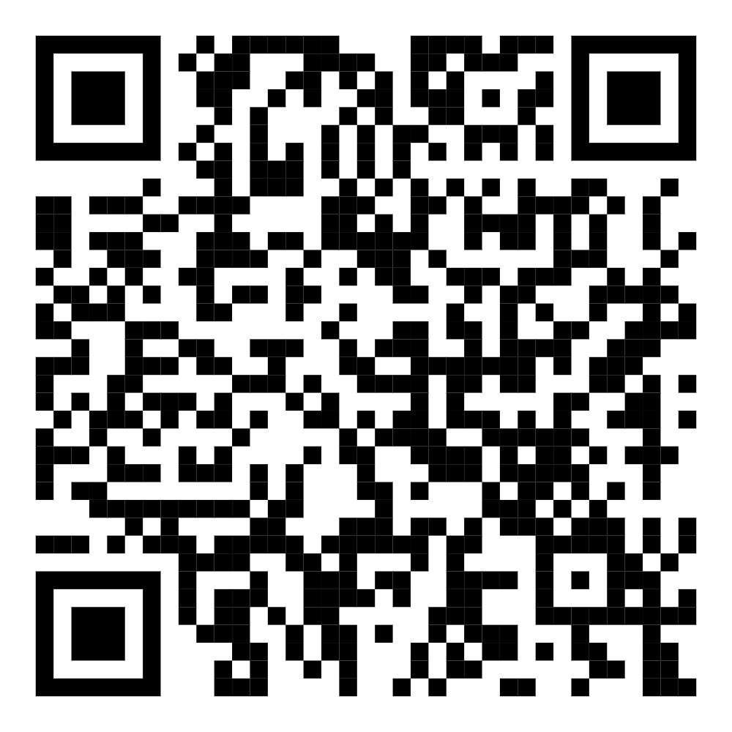
What should I do if my child procrastinates?
Why do I Procrastinate?
Student Health Service, Department of Health
Watch the video
(Link)
Notes:
Play the video: https://www.youtube.com/watch?v=hIKmuXAuhW4

Slide 9
Using the appropriate ways to handle children’s procrastination
Reason | Ways to handle
Perfectionism The child is worried that they cannot perform perfectly | Help your child understand that nobody is perfect, and it is because we are imperfect that we can keep improving. Praise the process more instead of just focusing on the result. For example, you can praise your child for using an appropriate strategy and being hardworking.
Feeling difficult The child is finding it difficult to do homework or revision | Teach your child to try first, and do what he/she can before seeking help from parents, teachers or classmates to complete whatever is left. Break down difficult tasks into parts and complete them separately. Do easier or less time-consuming homework first.
Being easily distracted The child is easily distracted by their mobile phone, computer or other things when doing homework or studying | Prepare in advance and put away the items that might distract your child, such as mobile phones, computers, etc. Plan what they can do when you are distracted and unable to concentrate in advance. For example, they can stretch for one minute, tell themselves to focus on the task at hand for another 15 minutes, etc.

Slide 10
How to support children’s learning through self-regulated learning?
Adjust the number of reminders you give to children based on their abilities at the moment. The goal is to give just the appropriate number of reminders:
Child: Mum, can you check this and tell me if I’ve done this English tenses exercise correctly?
Mother: Look at this sentence.
Child: What’s wrong with it?
Mother: Try reading this sentence aloud.
Child: Mary and Susan play chess yesterday.
Mother: Look, the time word used here is yesterday. What does that mean?
Child: Oh! Does that mean I need to use past tense?
Sanders, M., ＆ Mazzucchelli, T. (2013). The promotion of self-regulation through parenting interventions. Clinical Child and Family Psychology Review, 16, 1-17.

Slide 11
How to support children’s learning through self-regulated learning?
Mother: Yes. What can we do to indicate that this event happened in the past?
Child: Mary and Susan played chess yesterday.
Mother: That’s right! Take a look at this sentence too.
Child: Mary and Susan play chess now.
Mother: Look, the time word used here is now. What does that mean?
Child: Oh! That means I need to use present continuous tense! Mary and Susan are playing chess now.
Mother: Well done! When doing homework next time, you should pay more attention to the adverbs of time in the sentences…
Sanders, M., ＆ Mazzucchelli, T. (2013). The promotion of self-regulation through parenting interventions. Clinical Child and Family Psychology Review, 16, 1-17.

Slide 12
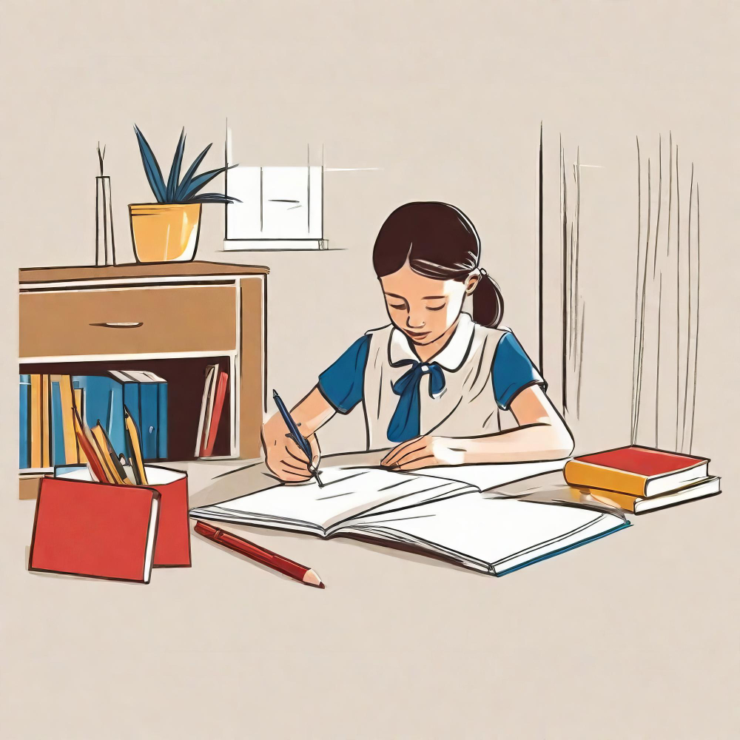
How to support children to do homework and revisions effectively?
Using visual and action reminders
Providing structures and assistance in classifying data
Reading the question before answering
Planning and implementing goals
Image source: http://www.freepik.com
Notes:
Image source:
https://www.freepik.com/premium-ai-image/girl-studying-librarygirl-studying-libraryyoung-girl-studying-home-with-book-sketc_90230947.htm

Slide 13
1a) Using visual reminders:
A task on Chinese language
鋭氣
How can parents help children write Chinese characters?

Slide 14
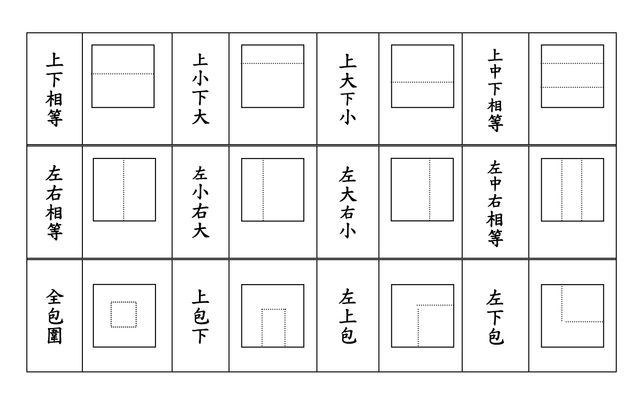
Character Structure Table (Chinese Version Only)
Education Bureau (2002). Fun with Reading and Writing: A Resource Pack for Primary School Students. (Chinese Version Only) From: http://tiny.cc/eu7dvz.

Slide 15
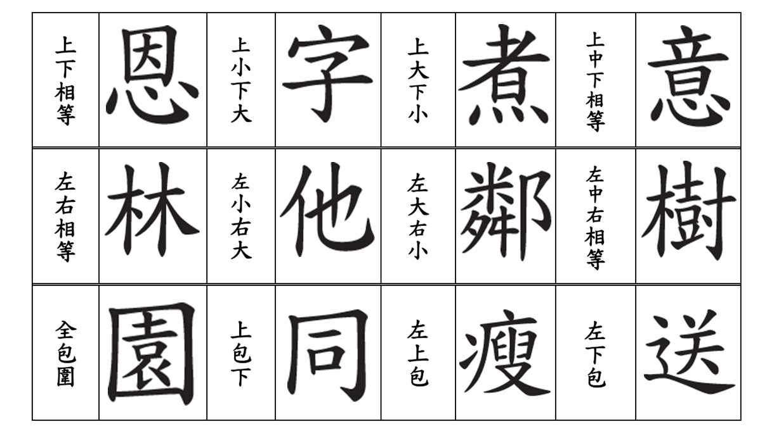
Character Structure Table (examples)
(Chinese Version Only)
Education Bureau (2002). Fun with Reading and Writing: A Resource Pack for Primary School Students. (Chinese Version Only) From: http://tiny.cc/eu7dvz.

Slide 16
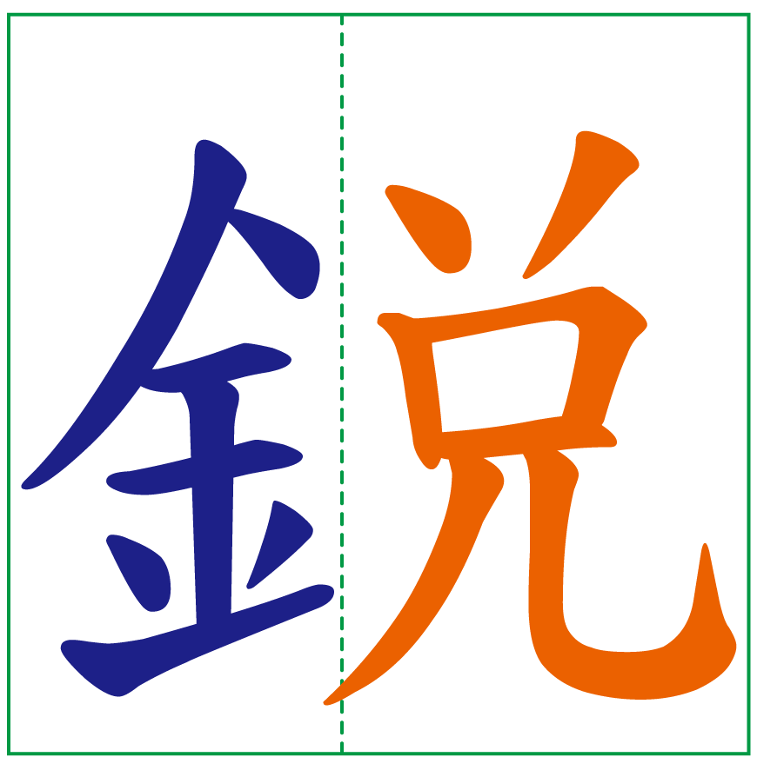
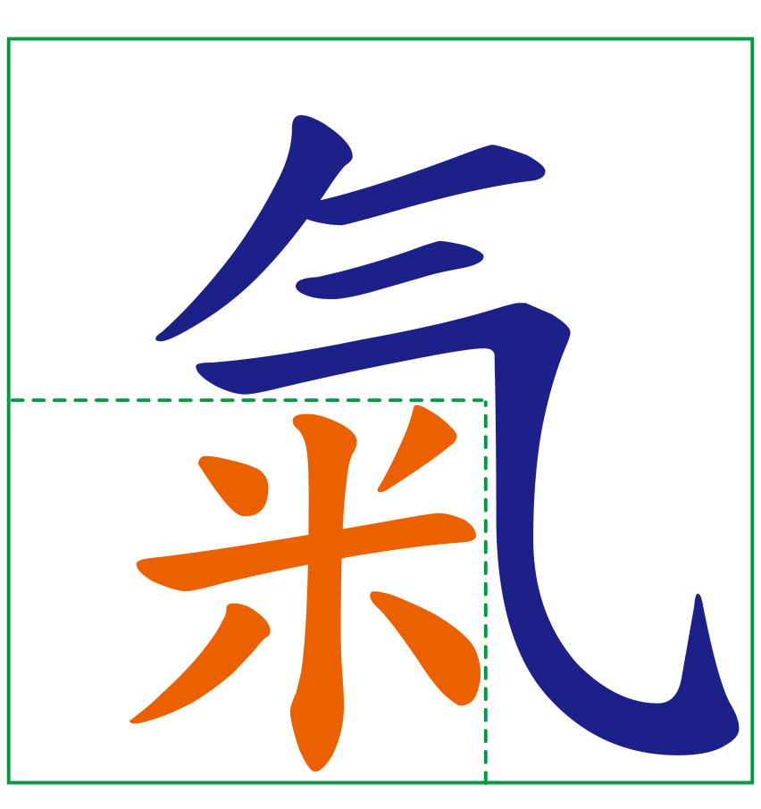
The structure of the characters “銳” and “氣” are… (Chinese Version Only)
左右結構字
部首：金
半包圍結構字
部首：气

Slide 17
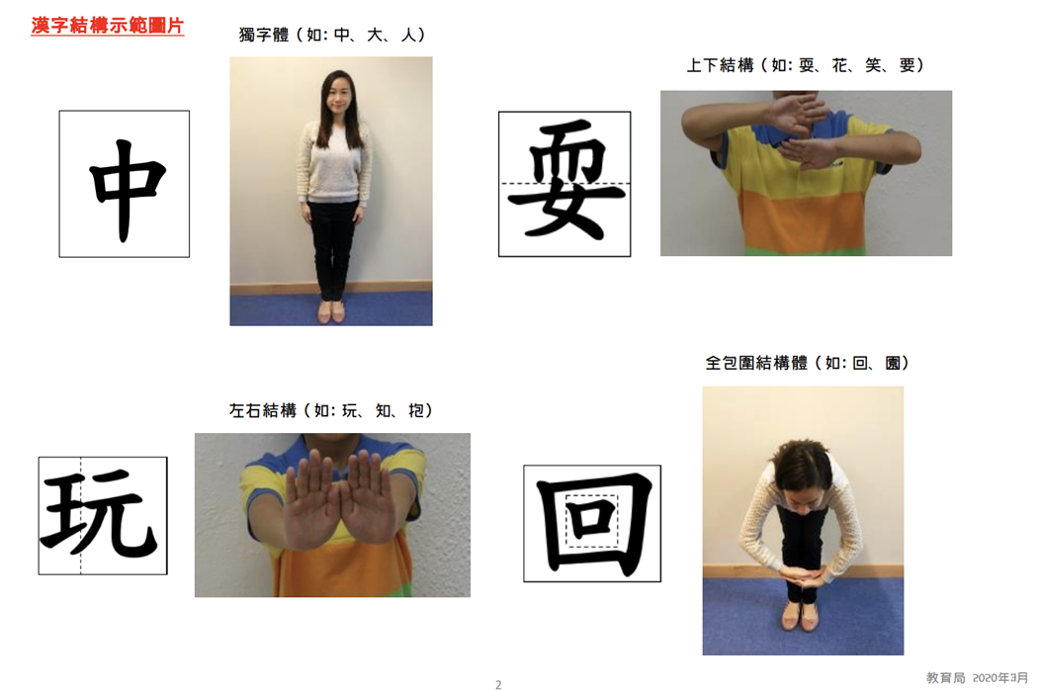
1b) Using action reminders: Character Structure Exercise (Chinese Version Only)
Education Bureau (2020). Tips for Parents on Supporting Children with SpLD. (Chinese Version Only) From: https://sense.edb.gov.hk/uploads/content/spld/spld_parent_tips_2a.pdf 。

Slide 18
Using visual and action reminders: Mathematics question
How can parents help children solve mathematics questions?
I have 21 candies and my mother gave me 3 more. How many candies do I have?
What visual reminders can parents give?
Draw pictures of candies on a piece of paper
What action reminders can parents give?
Make small candies out of paper balls

Slide 19
2) Providing structures and assistance in classifying data
How can parents help children organise data?
Education Bureau (2022). Tips for Parents: Tip 3: Boosting Memory. From: https://sense.edb.gov.hk/uploads/content/adhd/3.2023/English_No.%2019-24_Checked%20%20by%20the%20Proofread%20Contractor/24_ADHDP3_English_Typeset_v4.pdf.

Slide 20
2a) Classification
How can parents help children organise data?
Education Bureau (2022). Tips for Parents: Tip 3: Boosting Memory. From: https://sense.edb.gov.hk/uploads/content/adhd/3.2023/English_No.%2019-24_Checked%20%20by%20the%20Proofread%20Contractor/24_ADHDP3_English_Typeset_v4.pdf.

Slide 21
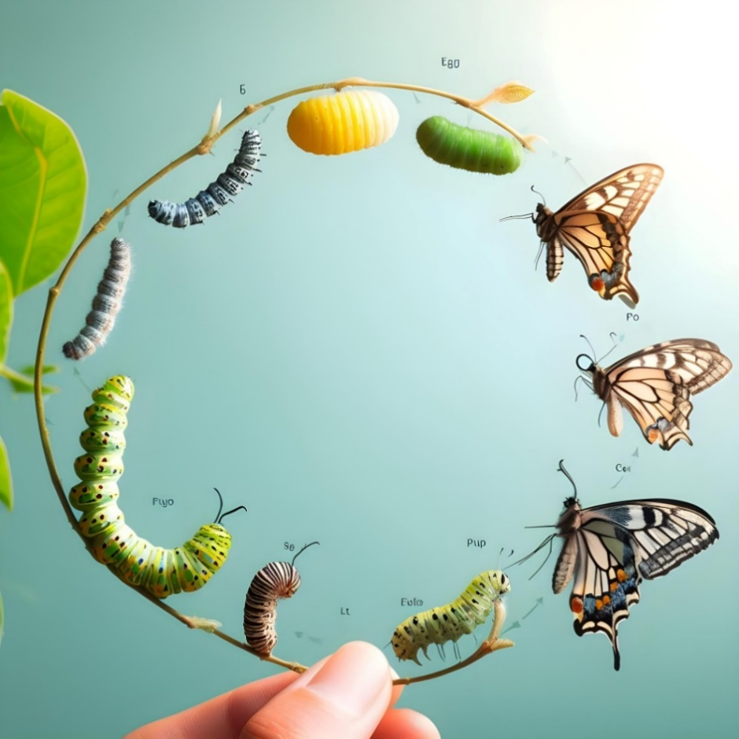
2b) Visual organisers
Use a chain to learn the phases of insect growth
Egg
Larva
Pupa
Adult
Education Bureau (2010). Development of Executive Skills Resource Package. (Chinese Version Only) From: https://sense.edb.gov.hk/tc/types-of-special-educational-needs/attention-deficit-hyperactivity-disorder/resources/teaching-resources/62.html.
Image source: http://www.freepik.com
Notes:
Image source:
https://www.freepik.com/premium-ai-image/butterfly_83470048.htm

Slide 22
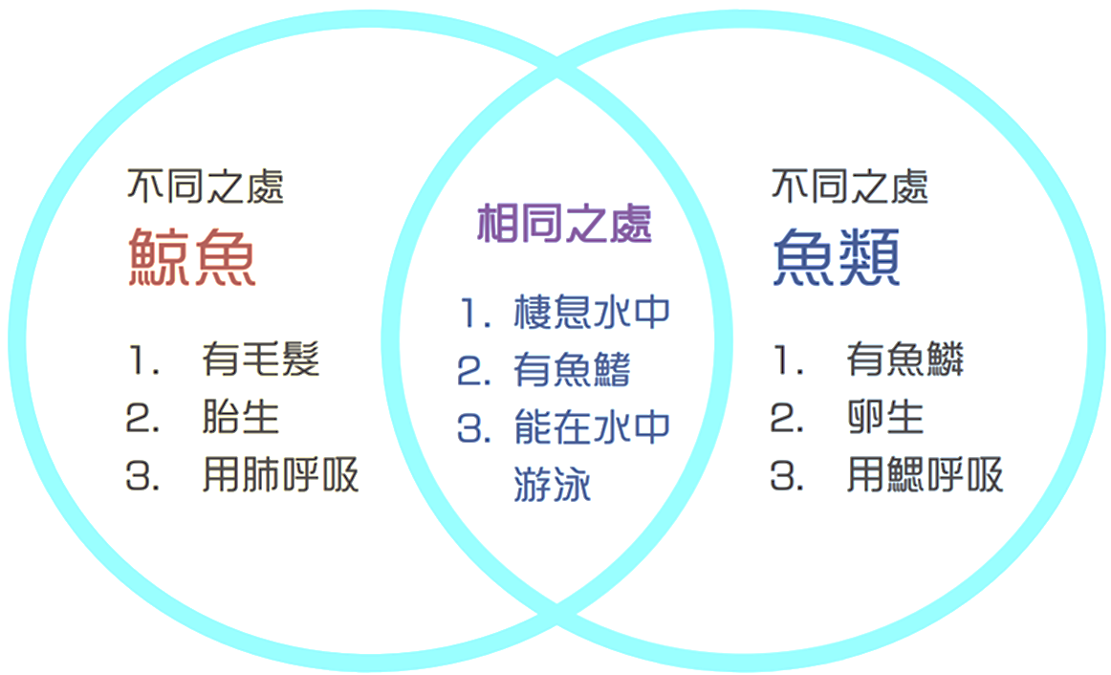
Use a Venn diagram to learn about the similarities and differences between whales and fish
Differences
Whales
Have hair
2. Viviparous
3. Breathe with their lungs
Differences
Fish
Have scales
2. Oviparous
3. Breathe through gills
Similarities
Live in water
2. Have fins
3. Can swim in water
Education Bureau (2010). Development of Executive Skills Resource Package. (Chinese Version Only) From: https://sense.edb.gov.hk/tc/types-of-special-educational-needs/attention-deficit-hyperactivity-disorder/resources/teaching-resources/62.html.

Slide 23
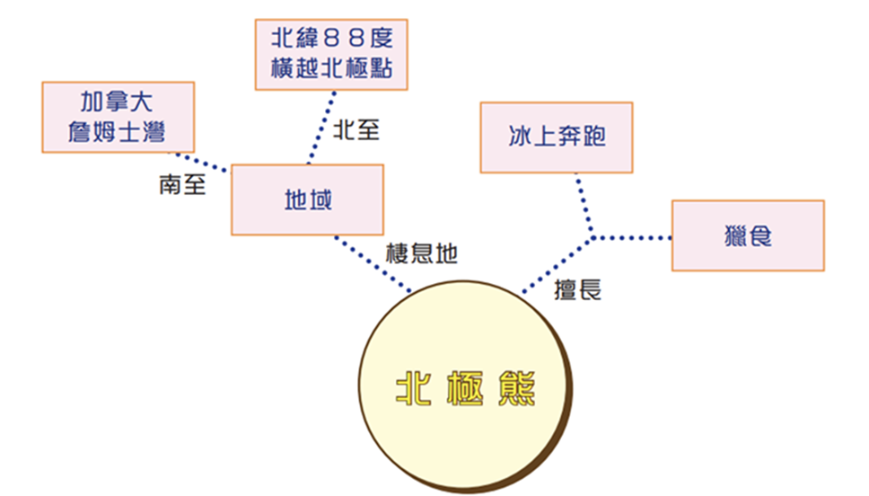
Use a concept map to learn about polar bears’ habitats and strengths
Latitude 88 degree north (88°N)
Crossing the North Pole
Canada
James Bay
North to
Running on ice
South to
Area
Hunting
Habitat
Good at
Polar bear
Education Bureau (2010). Development of Executive Skills Resource Package. (Chinese Version Only) From: https://sense.edb.gov.hk/tc/types-of-special-educational-needs/attention-deficit-hyperactivity-disorder/resources/teaching-resources/62.html.

Slide 24
3) Reading the question before answering
Guess the general meaning from the title
Read the question and circle keywords
Search for the information required to answer the question
Chinese reading comprehension
Education Bureau (2017). Enhancement of Executive Skills: A Classroom-based Approach. (Chinese Version Only)
From: https://sense.edb.gov.hk/tc/types-of-special-educational-needs/attention-deficit-hyperactivity-disorder/resources/teaching-resources/61.html

Slide 25
The garden after rain (Chinese Version Only)
問題：我在花園裡看到什麼？聽到什麼？嗅到什麼？
星期日的早上，一直下着大雨，我留在家中寫作業。正當納悶的時候，聽到雨聲滴答，雨點稀稀疏疏的。我急不及待相約朋友到附近的花園遊玩。我們沿着花園的小徑走，籬笆長滿色彩繽紛的花兒，有紅的、橙的、粉紅的、紫的，多如繁星。晶瑩的水珠頑皮地在花瓣上滾動，然後跳落到地上。花兒散發着淡淡的花香，引來蝴蝶和蜜蜂在捉迷藏，牠們在花間吸吮花蜜兒，就像是大自然的天使，為花園增添不少生氣。我們走得累了，便坐在椅子上休息。我抬頭一看，大樹充滿生命力；鳥兒在樹上互相唱和，熱鬧極了。雨停了，天邊出現了一道彩虹；幾朵白雲在天空中飄盪；微風撫摸我的臉龐。公園裏的景色美麗極了，是一幅美麗的大自然圖畫。
Education Bureau (2014). Tiered Intervention Model on the Learning and Teaching of Chinese Language in Upper Primary Schools: Tier 2 Reading and Writing Resource for Primary 4 Students. (Chinese Version Only) From: https://sense.edb.gov.hk/tc/types-of-special-educational-needs/specific-learning-difficulties/resources/teaching-resources/for-primary-schools/45.html.

Slide 26

Solving the Mathematics Word Problem
Circle the key words in the question
Divide 1.4 kg of granulated sugar into 0.3 kg packages. How many packages can it be divided into at most? How many kilograms of sugar would be left?
Image source: http://www.freepik.com
Notes:
Image source:
https://www.freepik.com/premium-ai-image/purely-vector-illustration-white-background_57387677.htm

Slide 27
Mathematical symbol | + | - | × | ÷
Key words | Add, sum, total, combined | Subtract, remaining, remainder, left, difference, missing, compared, get back | Multiply, product, times, each | Divide, quotient, fraction, per, average

Slide 28
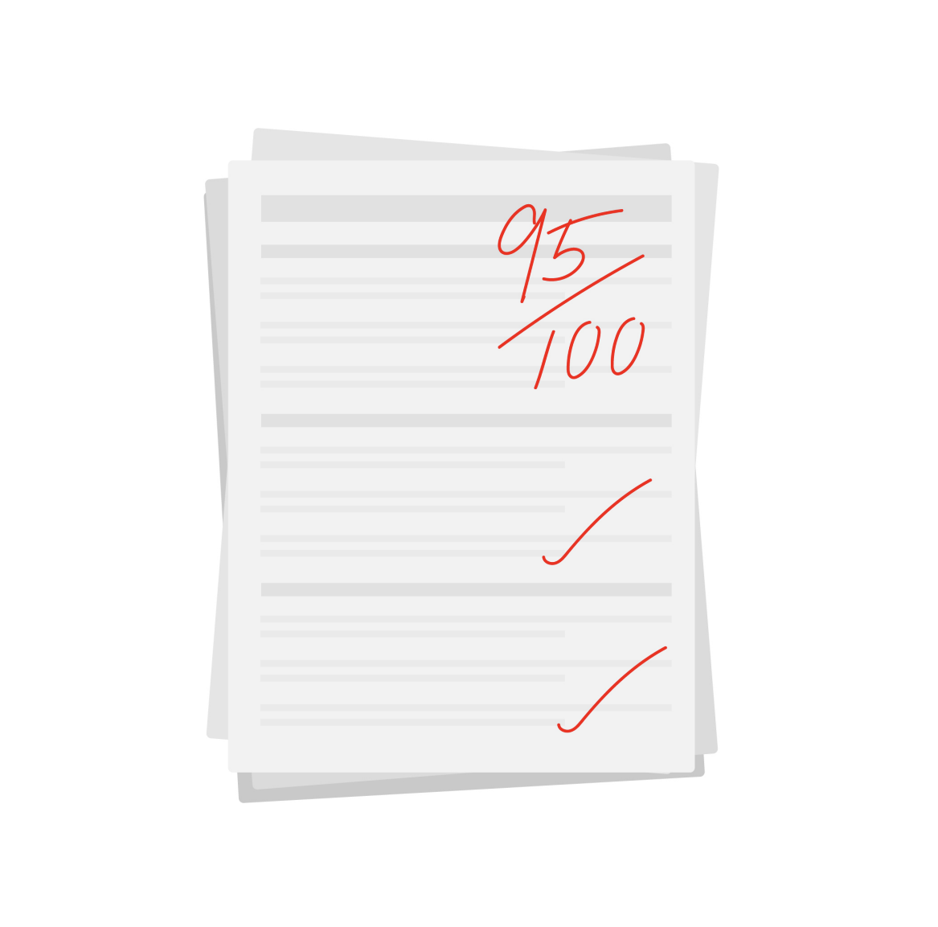



4) Planning and implementing goals : WOOP framework
Wish
Outcomes
Obstacles
Plan
Oettingen, G., & Reininger, K. M. (2016). The power of prospection: Mental contrasting and behavior change. Social and Personality Psychology Compass, 10, 591-604.

Slide 29
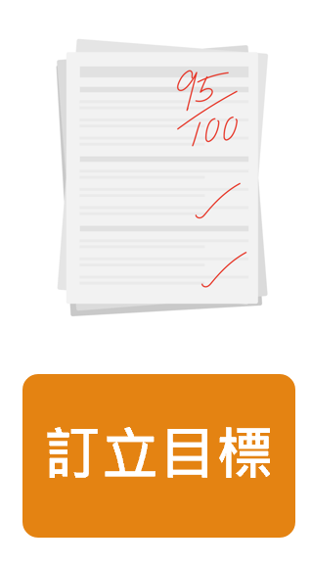
Step 1: Wish
“I wish to get 95 or above in the next English test.”
The goal must be:
  Specific ➔ Indicate the desired outcomes, the more specific the better
  Measurable➔ Goals must have measurable indicators
  Achievable➔ Goals must be within the child’s abilities
  Relevant➔ How will achieving this goal help?
  Time-bound➔ It must be completed within a limited time
Wish

Slide 30
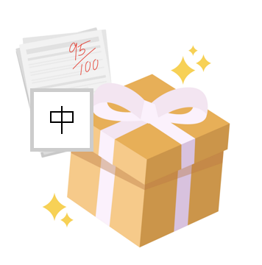
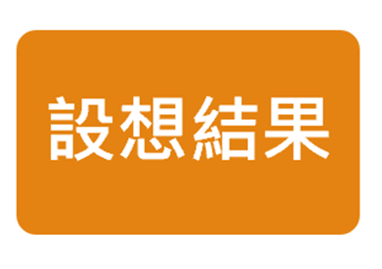
Step 2: Outcomes
“What are the positive outcomes after achieving the goal?”
For example:
    “Mum and dad promised to buy me a gift.”
    “I’ll have proved that I can improve.”
    “The teacher will praise me.”
ENG
Outcomes

Slide 31

Step 3: Obstacles
What obstacles might children encounter when trying to achieve their goals?
For example:
    “I often watch TV when I’m studying for tests.”
    “I often make grammatical mistakes in tests.”
    “I often study hurriedly at the last minute.”
Obstacles

Slide 32
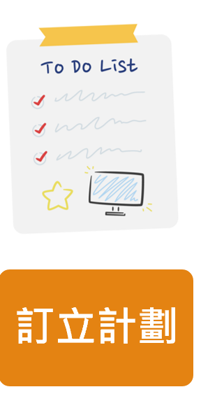
Step 4: Plan
What can be done to deal with the difficulties that may arise? What opportunities do children need to seize, and what strategies can they use?
Parents can teach children to use the “If… I’ll…” sentence structure when formulating strategies.
For example:
    “If I want to watch TV when I should be studying for a test, I’ll give the remote control to my mother.”
    “If I often make grammatical mistakes in tests, I’ll set aside 10 minutes to review the test paper for grammatical mistakes.”
    “If I only start studying the night before a test, I’ll make a timetable, break down the content I need to study into small parts, and complete them in phases.
Plan

Slide 33

Conclusion
The role of parents in supporting children’s learning at home
    Parents play the roles of companion, guide and facilitator
How to support children to do homework and revisions effectively?
    Using visual and action reminders
    Providing structures and assistance in classifying data
    Reading the question before answering
    Planning and implementing goals
How to create an effective learning environment?
    Keep the child’s environment tidy and organised
    Maintain a neat and organised environment
    Use appropriate way to handle your child’s procrastination
How to support children’s learning through self-regulated learning?
    Give just the appropriate number of reminders to help children complete their homework
Image source: http://www.freepik.com
Notes:
Image source:
https://www.freepik.com/premium-ai-image/happy-asian-mother-helping-her-son-doing-homework-home-education-concept_59664200.htm

