Slide 1
What to do when stressed out?
How to cope with parental stress?
Strand III: Promotion of Parents’ Physical and Psychological Well-being
Parent Education Resource Package for Primary Schools

Slide 2
Outline
What is parental stress?
How can we cope with parental stress?
    Increase self-awareness
    Identify the source of stress
    Coping with stress
        Emotion-focused
        Problem-focused

Slide 3
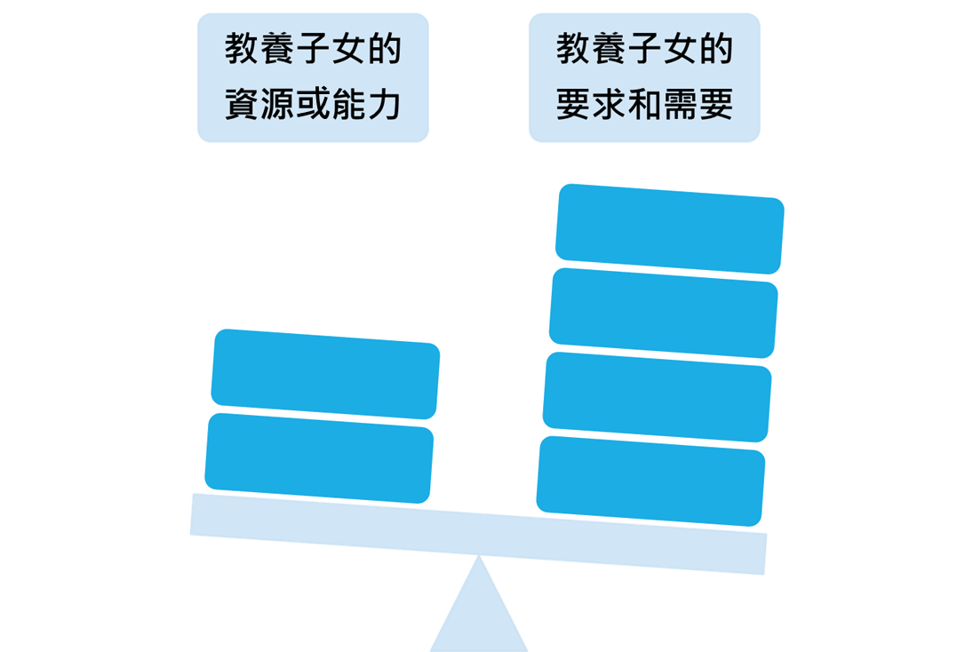
What is parental stress?
When parents perceive that the demands and needs of parenting exceeding their own resources or capacity, negative emotions will arise and even become stress.
Child-raising resources and ability
Child-raising demands and needs
Deater-Deckard, K., & Panneton, R. (2017). Unearthing the developmental and intergenerational dynamics of stress in parent and child functioning. In K. D. Deckard, & R. Panneton (Eds.), Parental stress and early child development (pp. 1–11). Springer.

Slide 4
How can we cope with stress?
Increasing self-awareness
What negative emotions might I experience while taking care of my children?
Guilty
Worried
Anxious
Sad
Angry
Annoyed
Embarrassed
Fed up
Tired
Unhappy
Lonely
Defeated
Lieberman, M. D., Eisenberger, N. I., Crockett, M. J., Tom, S. M., Pfeifer, J. H., & Way, B. M. (2007). Putting feelings into words. Psychological Science, 18(5), 421-428.

Slide 5
How can we cope with stress?
Express your emotions in words and describe why you feel that way
Increasing self-awareness
What negative emotions might I experience while taking care of my children?
(1) I feel_________ because___________________________.
(2) I feel_________ because___________________________.
(3) I feel_________ because___________________________.
Lieberman, M. D., Eisenberger, N. I., Crockett, M. J., Tom, S. M., Pfeifer, J. H., & Way, B. M. (2007). Putting feelings into words. Psychological Science, 18(5), 421-428.

Slide 6
How can we cope with stress?
Self-compassion
Mindfulness: “I’m feeling stressed, anxious and uneasy right now because...”
Common humanity: “Every parent will feel stressed, anxious and uneasy sometimes...”
Self-kindness:
    “May I be merciful to myself.”
    “May I be accepting of myself.”
    “May I be forgiving of myself.”
Gouveia, M. J., Carona, C., Canavarro, M. C., & Moreira, H. (2016). Self-compassion and dispositional mindfulness are associated with parenting styles and parenting stress: The mediating role of mindful parenting. Mindfulness, 7, 700-712.

Slide 7
How can we cope with stress?
Increasing self-awareness
What positive emotions might I experience while taking care of my children?
Happy
Surprised
Optimistic
Enthusiastic
Trusting
Satisfied
Relieved
Moved
Proud
Intimate
Excited
Warm
Lieberman, M. D., Eisenberger, N. I., Crockett, M. J., Tom, S. M., Pfeifer, J. H., & Way, B. M. (2007). Putting feelings into words. Psychological Science, 18(5), 421-428.

Slide 8
How can we cope with stress?
Be simultaneously aware of your own negative and positive emotions when taking care of children
Increasing self-awareness
What positive emotions might I experience while taking care of my children?
(1) I feel_________ because___________________________.
(2) I feel_________ because___________________________.
(3) I feel_________ because___________________________.
Lieberman, M. D., Eisenberger, N. I., Crockett, M. J., Tom, S. M., Pfeifer, J. H., & Way, B. M. (2007). Putting feelings into words. Psychological Science, 18(5), 421-428.

Slide 9
How can we cope with stress?
Less controllable stress ➔ emotion-focused coping methods
Identifying the source
Less controllable
Children’s abilities and personality
Other people’s opinions
Children’s reactions
Past events
More controllable stress ➔ problem-focused coping methods
More controllable
How others treat your children
Children’s behaviour
The ways you treat your children
Learning opportunities you provide for your children
Your own time and activity arrangements
Cheng, C., Lau, H. P. B., & Chan, M. P. S. (2014). Coping flexibility and psychological adjustment to stressful life changes: A meta-analytic review. Psychological Bulletin, 140(6), 1582-1607.

Slide 10
How can we cope with stress?
Coping with less controllable stress
Emotion-focused coping methods: Try to regulate negative emotions caused by stress
    Relaxing the body
        Body scan meditation exercise
    Positive thinking
        Combating thinking traps

Slide 11
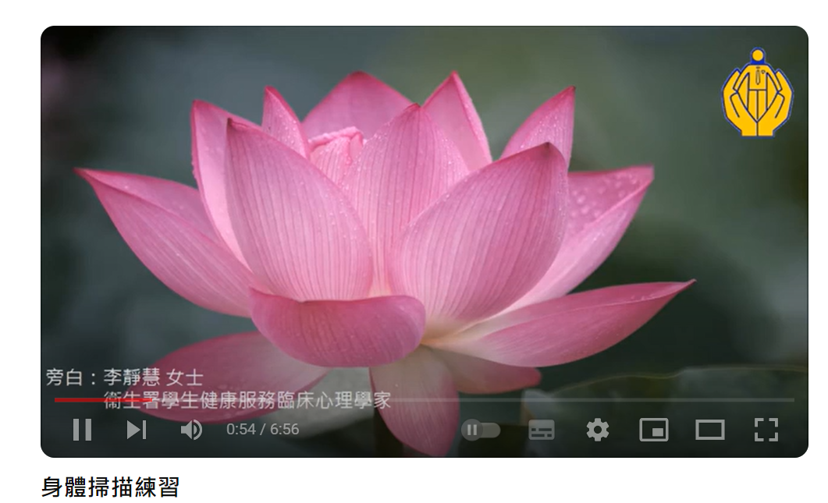
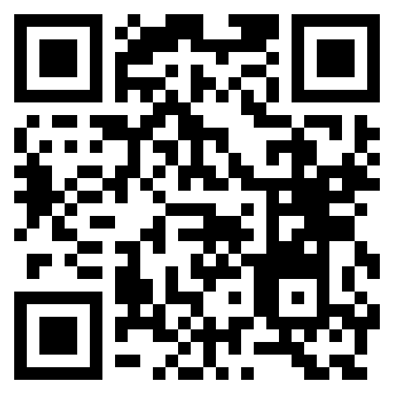
How can we cope with stress?
Relaxing the body: Body scan meditation exercise
Watch the video
(Chinese Version Only)
Ditto, B., Eclache, M., & Goldman, N. (2006). Short-term autonomic and cardiovascular effects of mindfulness body scan meditation. Annals of Behavioral Medicine, 32(3), 227-234.
Notes:
播放短片：https://youtu.be/joymqWAqI0s

Slide 12
How can we cope with stress?
Positive thinking: Combating thinking traps
Thinking traps are thoughts about the reality or the future that may not necessarily be true but can cause people to have strong negative emotions or feel a lot of pressure. For example:
  Catastrophising
  Overgeneralisation
  Every time is the same
  Perfectionism
  Fortune telling
  Personalising
Beck, A. T. (1976). Cognitive therapy and emotional disorders. International Universities Press.

Slide 13
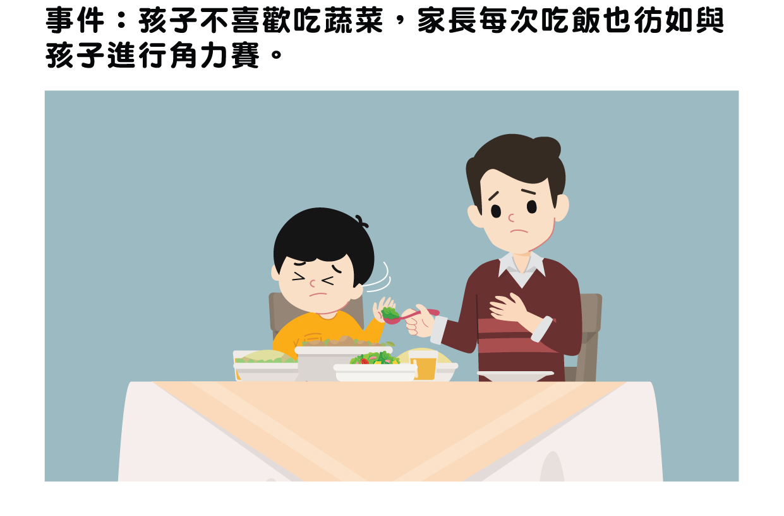
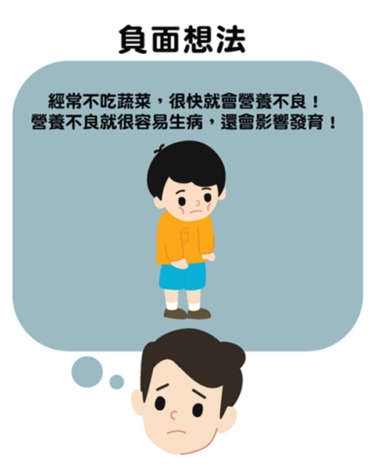
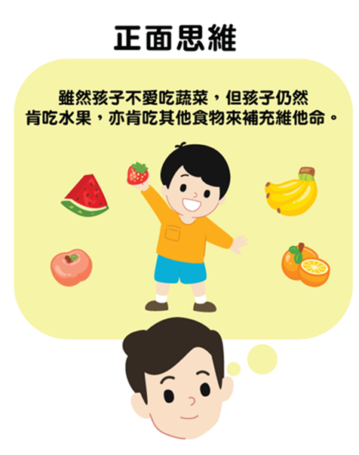
Catastrophising
Catastrophising
Situation: The child doesn’t like to eat vegetables, and the parent needs to fight with the child at every meal.
Positive thinking
Negative thinking
He’ll have poor nutrition because he won’t eat vegetables. If that happens, he’ll get sick easily, and his growth might be affected!
Positive thinking
Although he doesn’t like eating vegetables, he still likes to eat fruit, so he’ll get vitamins from other food.

Slide 14
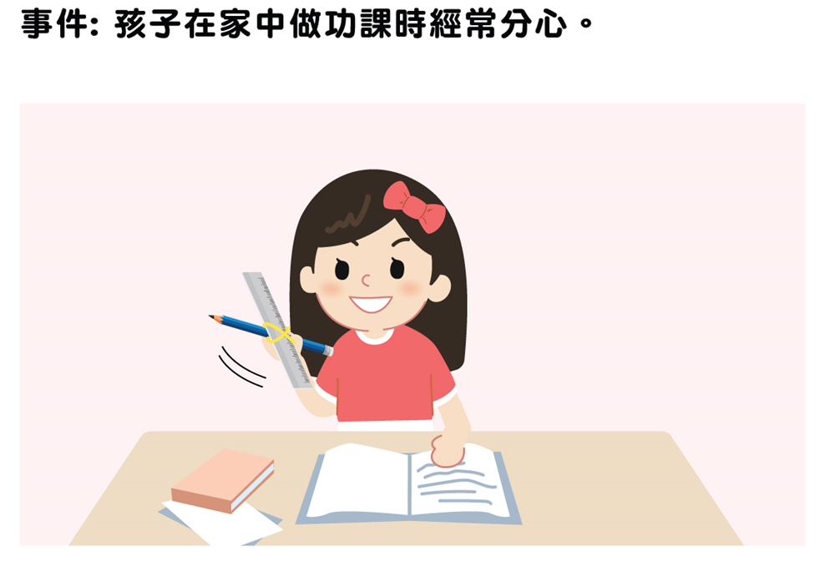
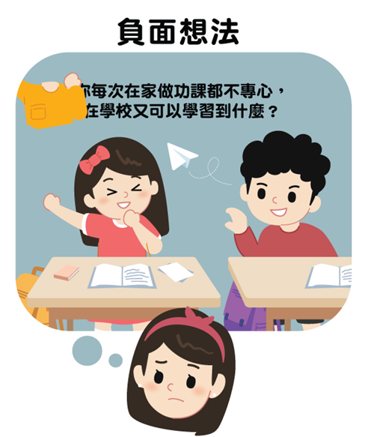

Overgeneralisation
Situation: The child always gets distracted while doing homework at home.
Positive thinking
Negative thinking
The environment can have a great impact! The teacher said she was getting better and better at school. I can ask her teacher for tips to help her learn at home.
If you’re always so distracted when you do homework at home. What do you actually learn at school?

Slide 15
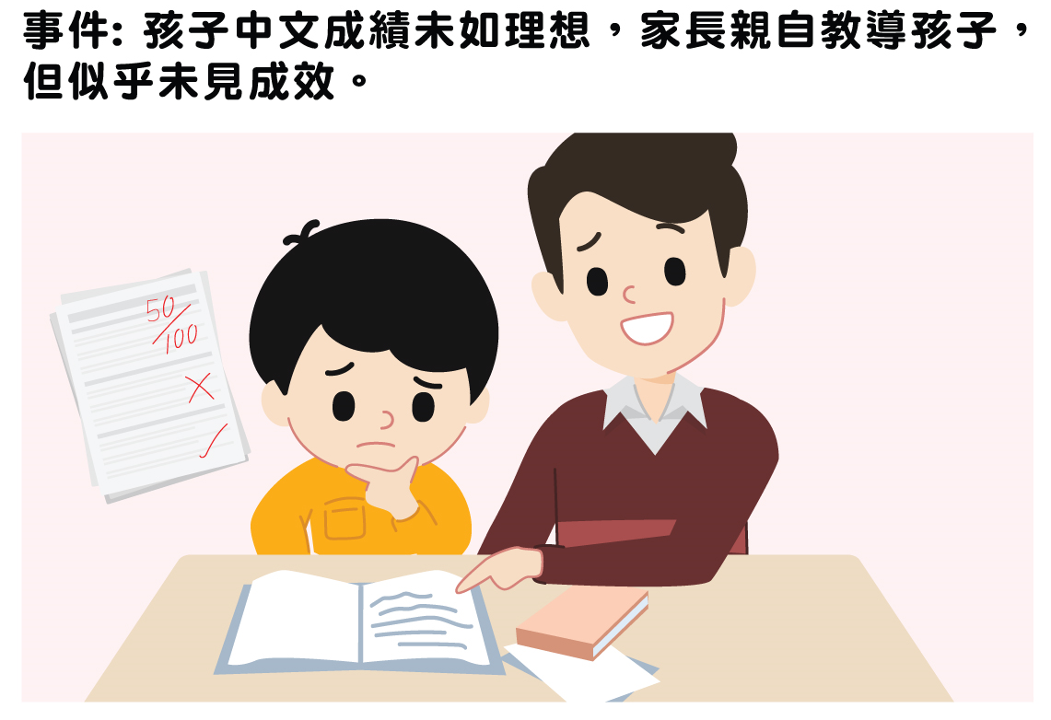
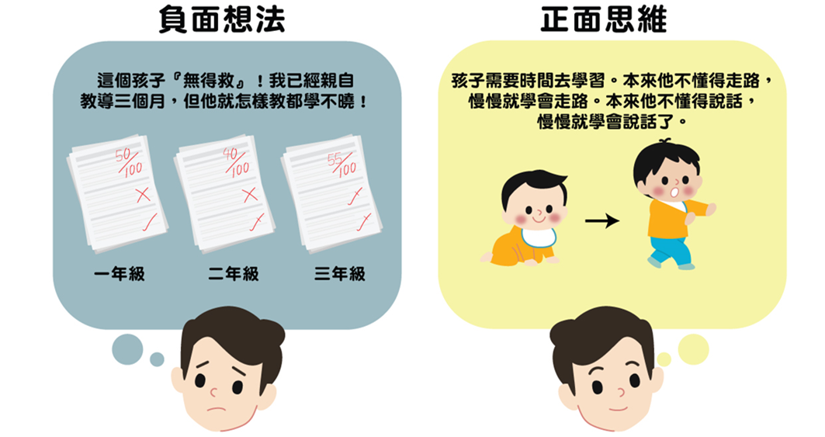
Every time is the same
Situation: The parent takes time to teach the child Chinese because the child’s grades aren’t ideal, but it doesn’t seem to be working.
Positive thinking
Negative thinking
He’s beyond redemption! I’ve taught him for three months already, but he just doesn’t seem to understand!
He needs time to learn. He did not know how to walk at first, but gradually learnt how to walk. He did not know how to speak at first, but gradually learnt how to speak.
Year 1
Year 2
Year 3

Slide 16
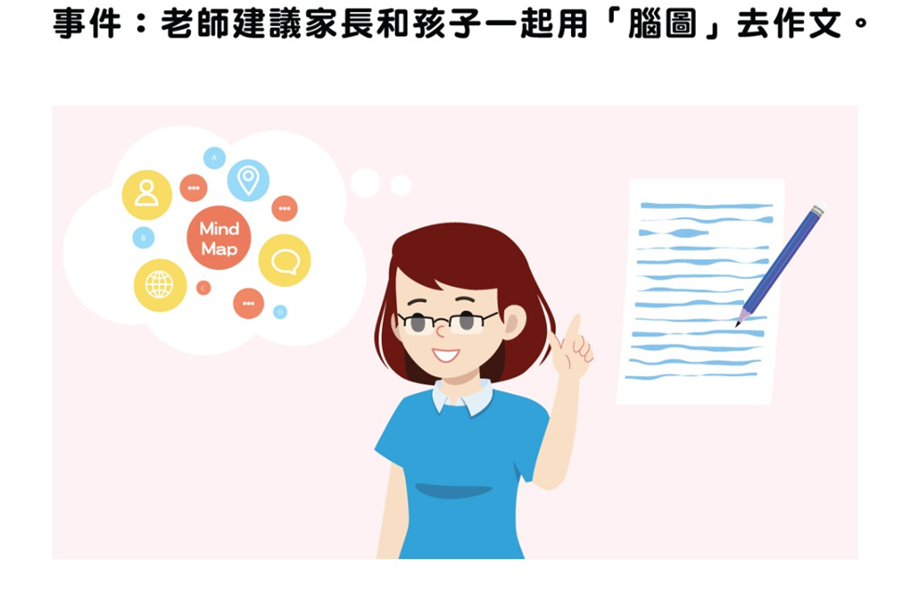
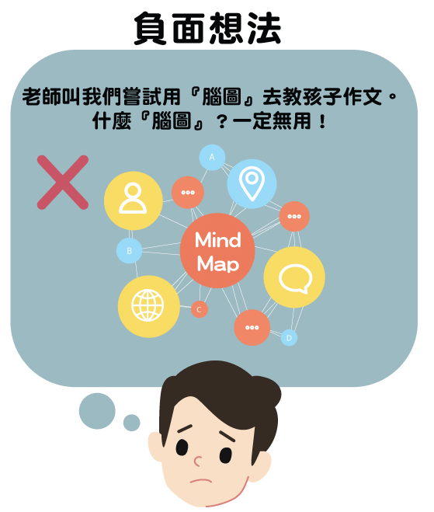
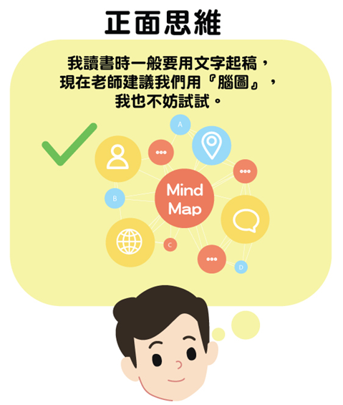
Fortune telling
the child’s grades aren’t ideal
Situation: The teacher suggests that parents use a mind map with their child to write an essay.
Positive thinking
Negative thinking
I used to start writing essays directly when I was a student, but since the teacher suggested that we use a mind map, let’s give it a try.
Teacher asked us to try using “mind map” to teach children composition. What’s “mind map”? Does it work?

Slide 17
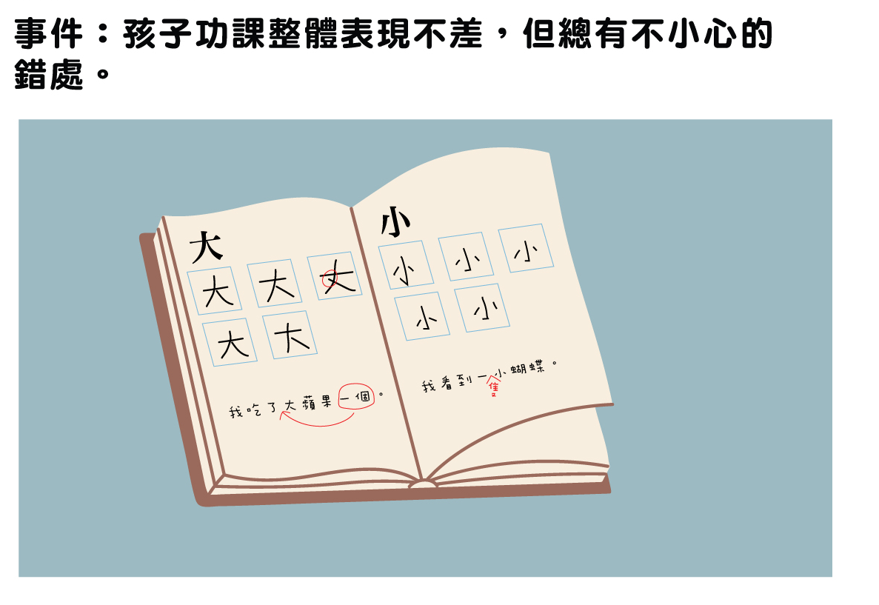
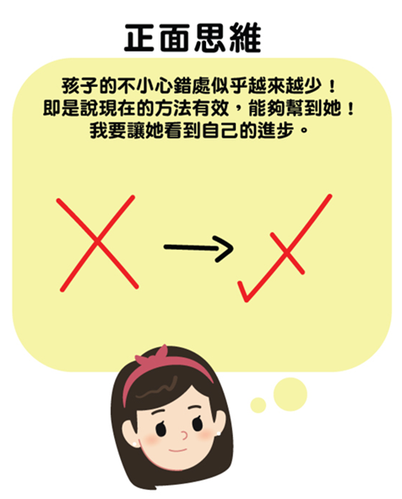

Perfectionism
Situation: The child does well with homework but always makes careless mistakes.
Positive thinking
Negative thinking
She seems to be making fewer and fewer careless mistakes! This means my method is working and helping her! I want her to see her own improvement.
There’s a grammatical error in this sentence! Why does she always make careless mistakes?

Slide 18
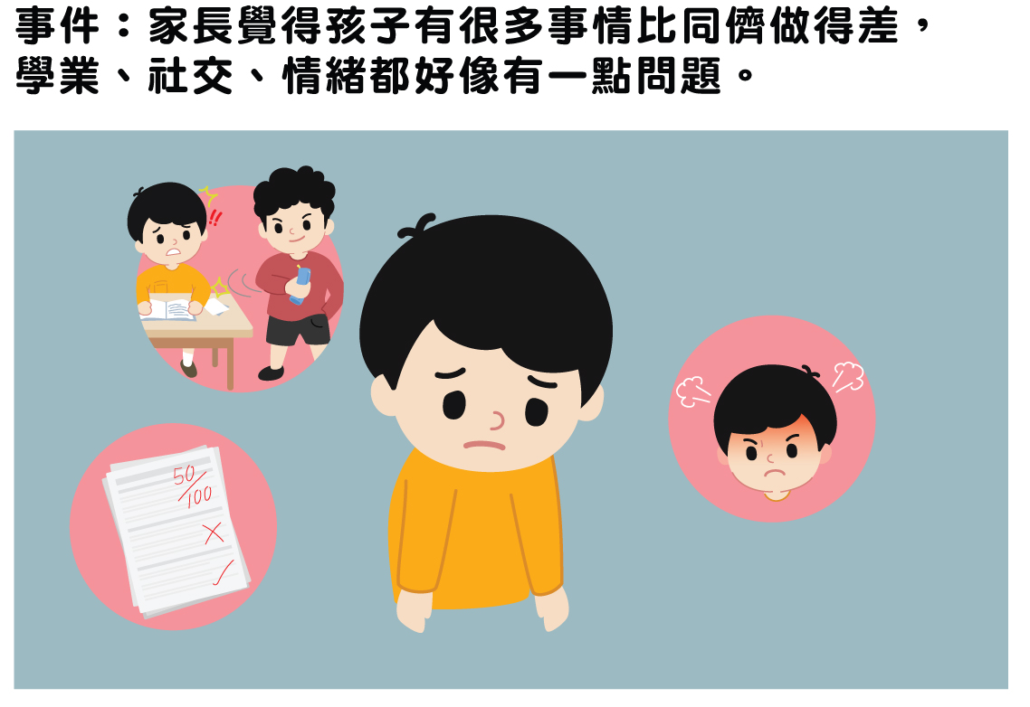

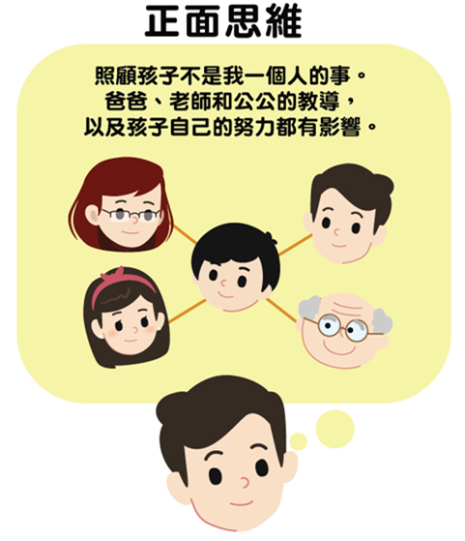
Personalising
Situation: The parents think their child doesn’t do as well as his peers in many aspects. They also think there are problems with his studies, social life and emotions.
Positive thinking
Negative thinking
Taking care of a child is not one person’s job. The teaching of the father, teacher and grandfather, as well as the efforts of the child himself, all has some impact.
It must be because I’m doing a bad job of teaching him! I’m such a terrible parent!

Slide 19
How can we cope with stress?
Coping with more controllable stress
Problem-focused coping method: Try to solve the problem causing the stress
Define the problem
Search for a solution
Envision the consequences
Make a decision
What problem am I facing?
Search for resources on the Smart Parent Net website
Which method is more suitable for my children?
Try a method and observe the results

Slide 20
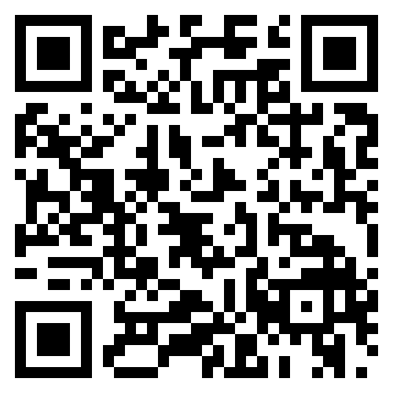
Education Bureau’s “Smart Parent Net” website
Problem-focused coping method: Try to solve the problem causing the stress.
Search for a solution: Search for education resources on the “Smart Parent Net” website, such as short videos, articles, games, advice from experts, etc.
Smart Parent Net website

Slide 21
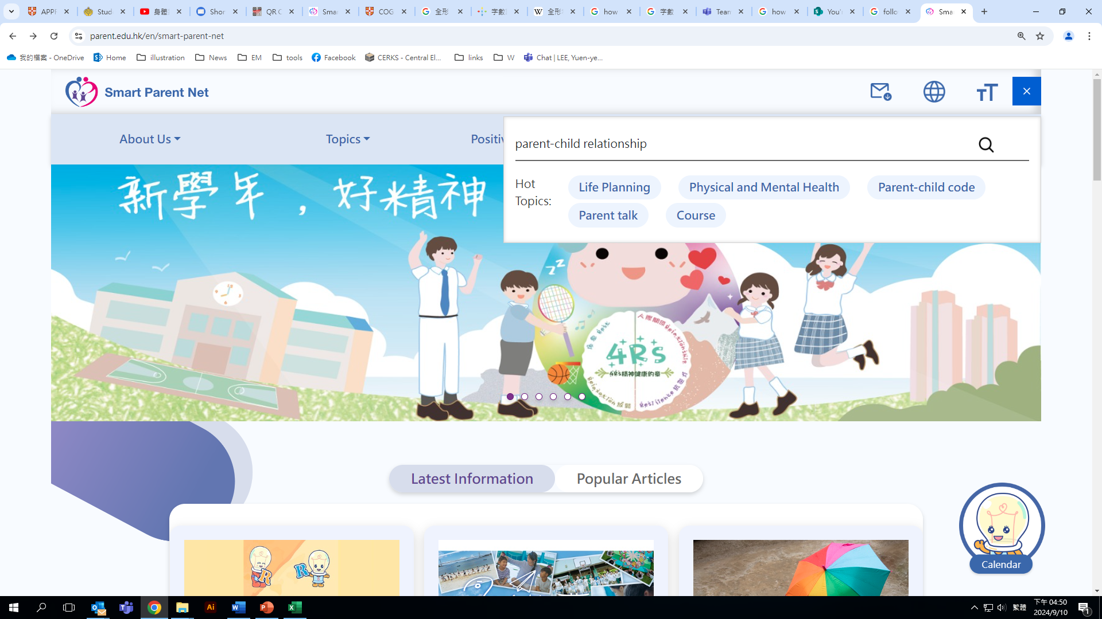
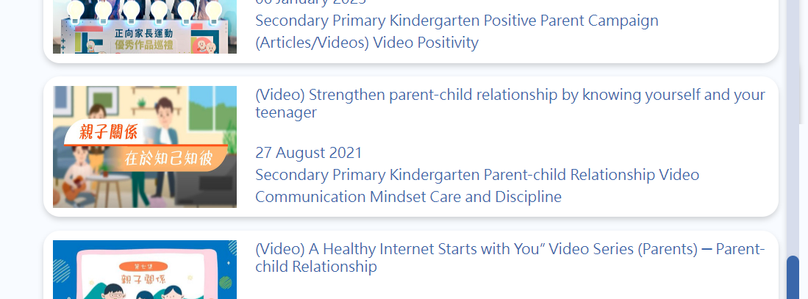
Ways of solution: Go to Smart Parent Net to search for information
Make a decision: Choose a method that is suitable for yourself and your children

Slide 22
Conclusion
What is parental stress?
  When parents perceive that the demands and needs of raising children exceeding their own resources or capacity, negative emotions will arise and even become stress.
Increasing self-awareness
  Express your emotions in words and describe why you feel that way
  Be kind to yourself, be compassionate to yourself, accept yourself and forgive yourself
  Be simultaneously aware of your own negative and positive emotions when taking care of children
Distinguishing between less controllable and more controllable stresses
  When coping with less controllable stress, use emotion-focused coping methods
    Relaxing the body: Body scan meditation
    Positive thinking: Combating thinking traps
  When dealing with more controllable stress, use problem-focused coping methods

