Slide 1
Activity 1
Introducing T-standard⁺

Slide 2
Watch the Video
Chapter 1 Introduction

Slide 3
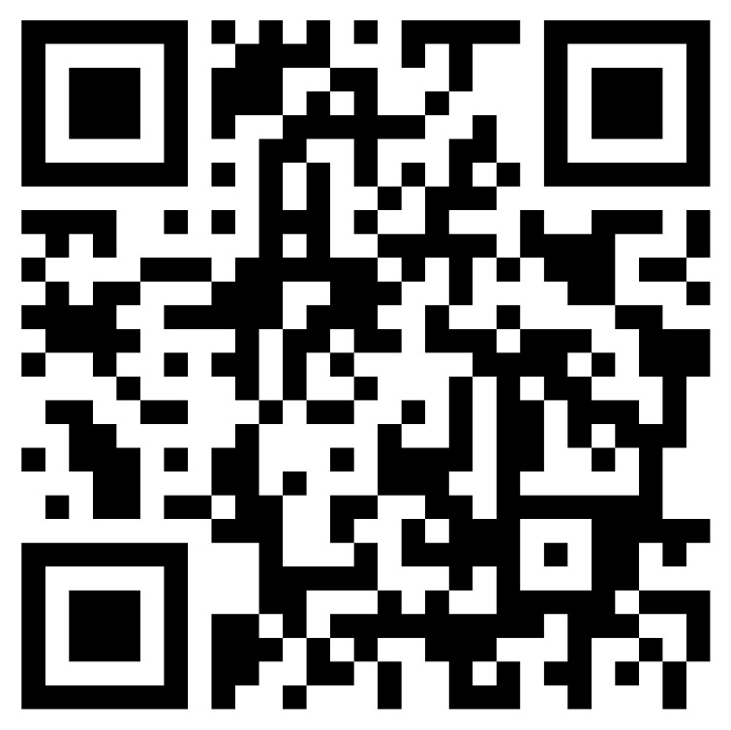
Watch the Video
Chapter 2 Background and Development

Slide 4
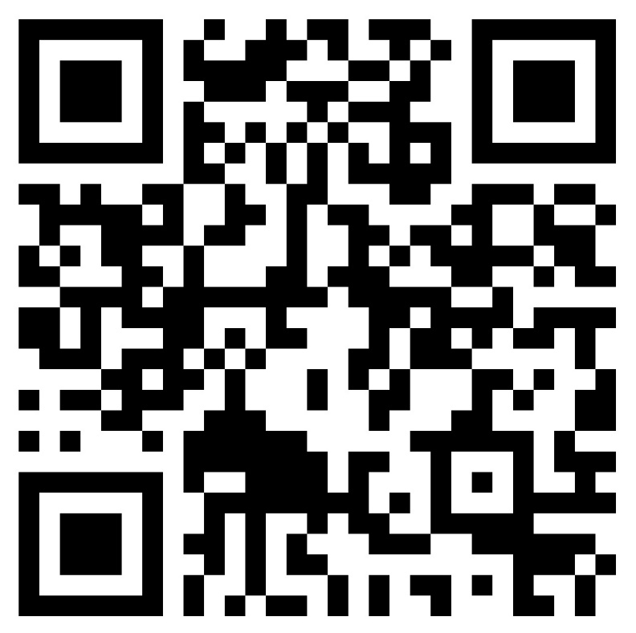
Watch the Video
Chapter 3 Who am I?

Slide 5
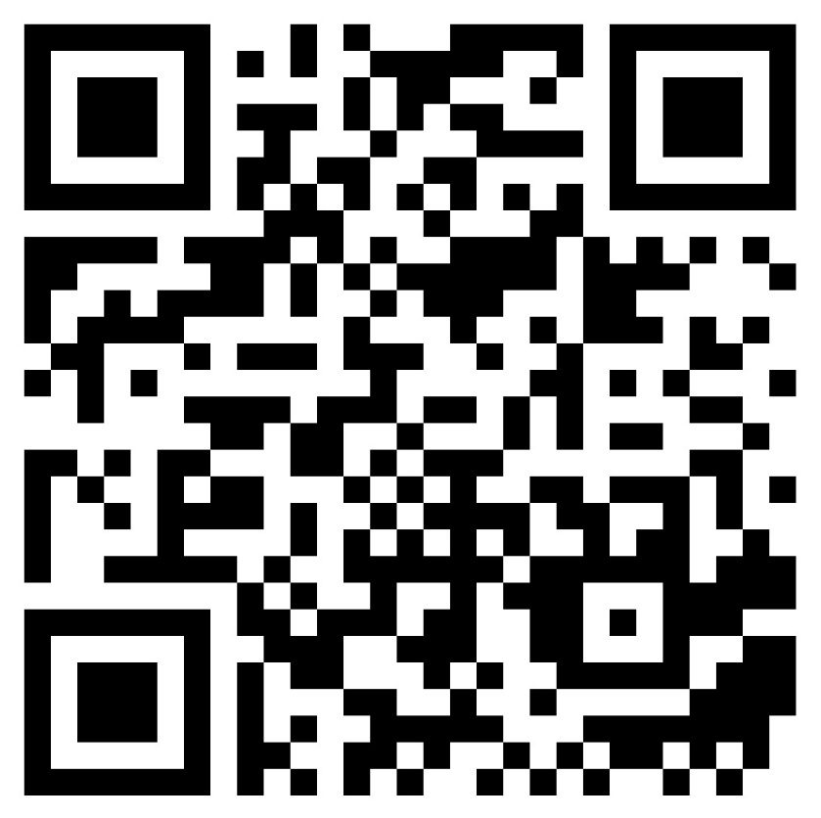
Watch the Video
Chapter 4 Where am I going?

Slide 6
Watch the Video
Chapter 5 Where am I?

Slide 7
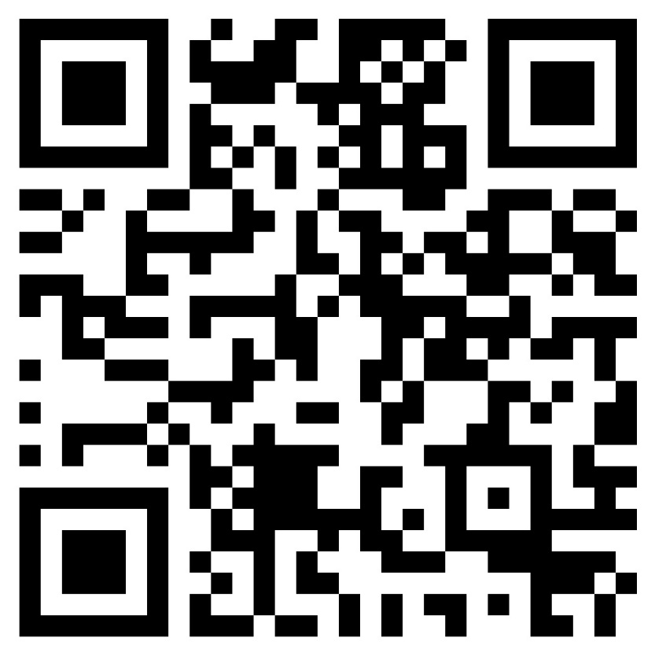
Watch the Video
Chapter 6 Conclusion

