Slide 1
Activity 2
Understanding T-standard⁺

Slide 2
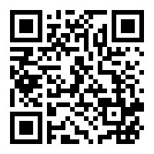
Animated video introducing the T-standard⁺
https://www.cotap.hk/pop_video.php?file=zL4kyM7U

Slide 3
Answer the following questions with the
information provided in the animated video:
1. What does COTAP stand for?
2. What are the most important guiding principles of the T- standard⁺?
3. What are the three attributes that Hong Kong students should possess?
4. What are the professional roles of teachers in Hong Kong?
5. What are the professional roles of principals in Hong Kong?

Slide 4
What does COTAP stand for? (Tell your learning partners)
Committee On Professional Development of
Teachers And Principals (COTAP)

Slide 5
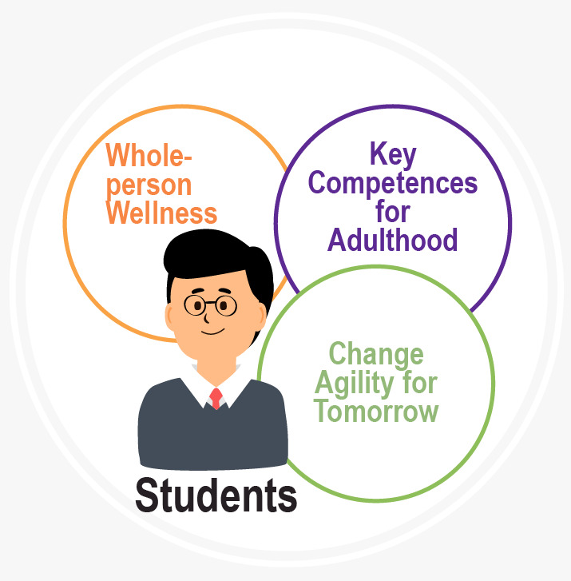
Nurture Learners Today and Leaders Tomorrow
The most important guiding principle: Student-centred?
Pivot around the development and learning needs of students!
Whole-person Wellness
Key Competences for Adulthood
Change Agility for Tomorrow

Slide 6
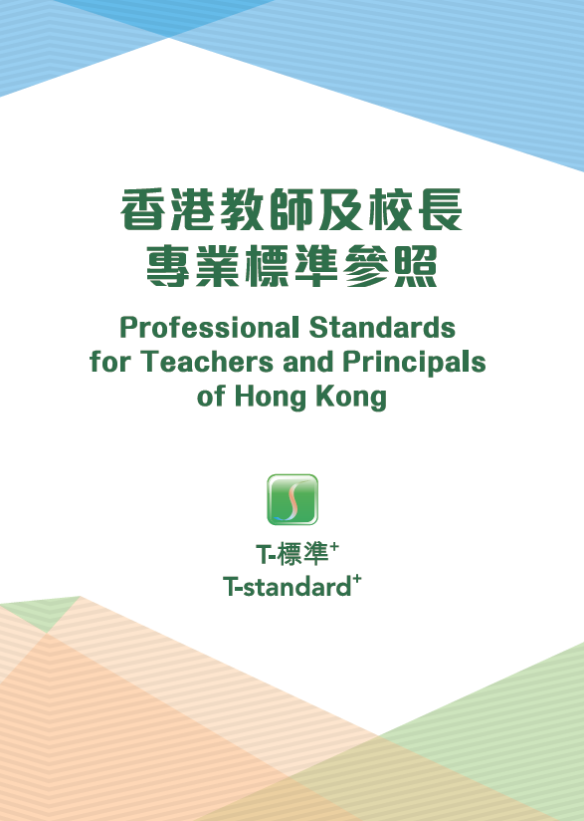
Standards and Roles
What are the three roles of teachers under the T-standard⁺? (Tell your partners)
Standard 1
Caring Cultivators of All-round Growth
Standard 2
Inspirational Co-constructors of Knowledge
Standard 3
Committed Role Models of Professionalism

Slide 7
Standards and Roles
What are the three roles of principals under the T-standard⁺? (Tell your partners)
Standard 1
Ethical Enablers of All-round Growth and Balanced Advancement
Standard 2
Versatile Architects of Vibrant Learning Organisations
Standard 3
Visionary Edupreneurs of Educational Transformation and Continuous School Improvement

Slide 8
Questions for further reflection:
Why should Hong Kong students exhibit these three attributes today?
How does defining “professional roles” help teachers have more focused reflections and seek targeted improvement on their journey of professional development?
Are the Professional Standards for Teachers (PST) something that teachers need in this complex and ever-changing society? How does the PST facilitate professional reflections and continuous learning?
Is it true that teachers/schools can set more specific education goals by identifying the attributes that students should exhibit in the future?
How does the PST (the three professional roles of teachers) help teachers understand their own strengths and weaknesses through more focused reflections?
[Schools are not required to use all of these questions, and may choose the ones that are most appropriate for their needs.]

