Slide 1
Activity 4
Story Viewing and Sharing

Slide 2
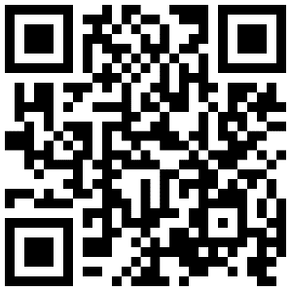
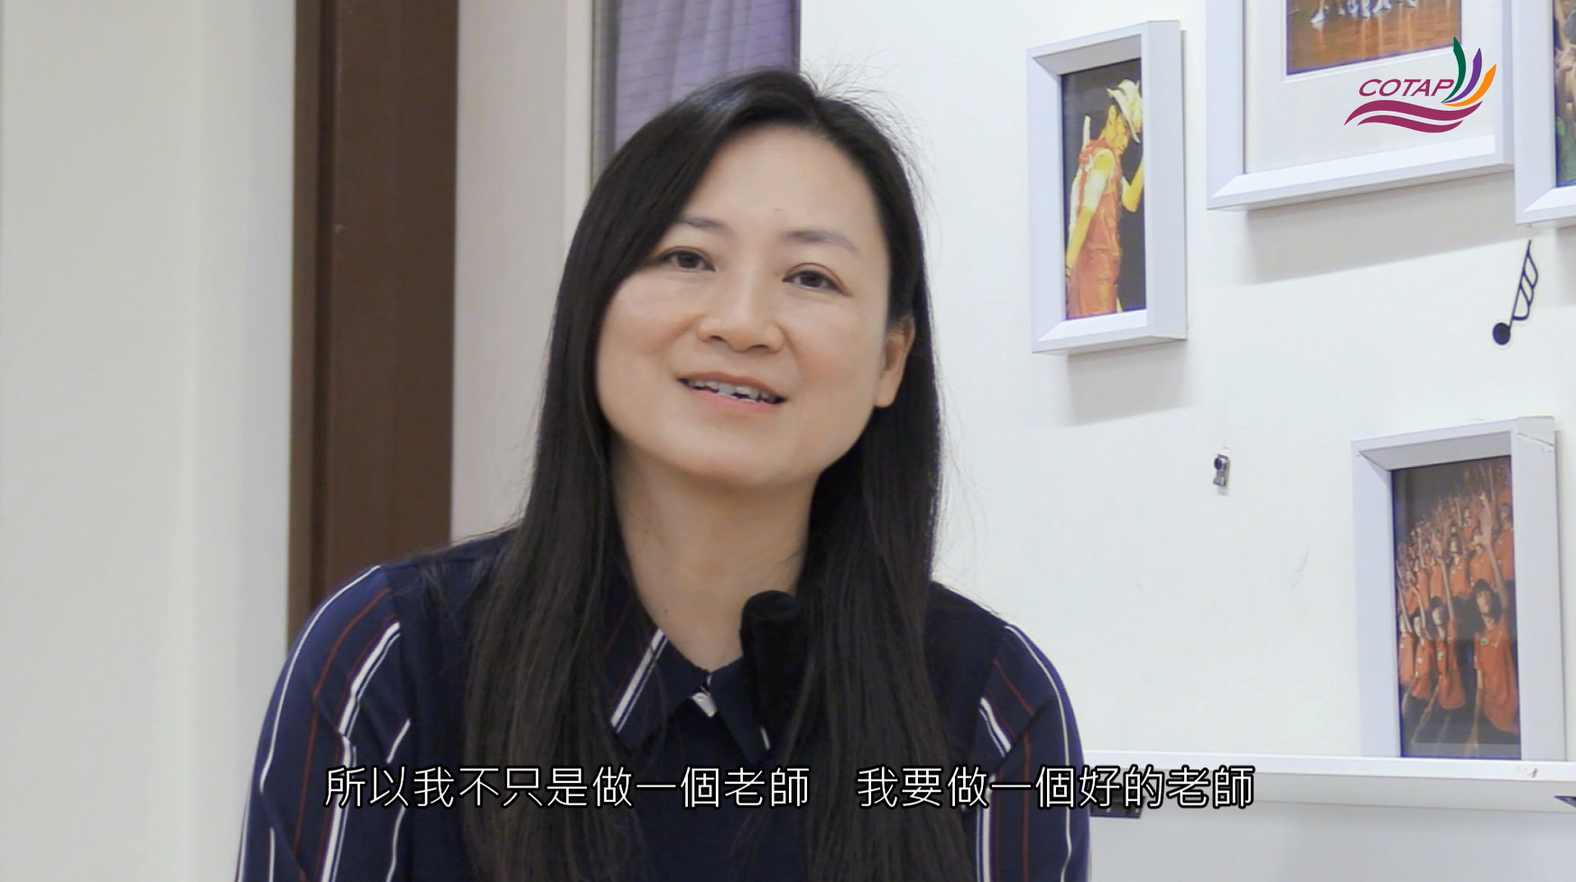
Story of Ms LIU Yuet-ming
“So I am not content with being merely a teacher; I want to be a good teacher.”

Slide 3
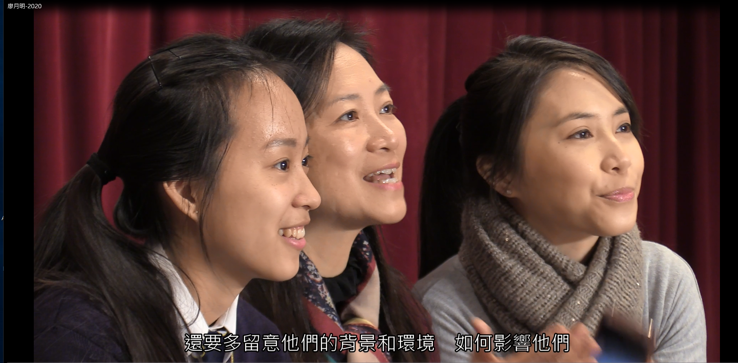
Which teachers’ professional role as portrayed in the Professional Standards for Teachers of Hong Kong does Ms LIU’s story exemplify? Why do you think so?
Caring Cultivators
Inspirational Co-constructors
Committed Role Models
“More attention should be given to how they are affected by their backgrounds and circumstances.”

Slide 4
Post-viewing group discussion
2. Which part of the story strikes a chord with you?
3. Have you been inspired by or learned anything from the story?
4. Does the story ring a bell? Have you met a teacher like her
or come across similar stories in your school days or your
teaching life?
“More attention should be given to how they are affected by their backgrounds and circumstances.”

Slide 5
