Slide 1
Overview
Using T-standard⁺ Training Activities Flexibly

Slide 2
Teachers’ Professional Roles under T-standard⁺
School-based Training Activities
1.
(i) Follow-up to Lesson Preparation – Quiz Game
(ii) Follow-up to Lesson Preparation – Understanding
T-standard⁺ and the Three Professional Roles of Teachers
Textual study
Story viewing and sharing
Exploring concepts and co-constructing knowledge
Sharing experiences in exemplifying teachers’ professional
roles
Self-reflection
Mutual appreciation – Making Heartfelt Cards
2. 3. 4. 5. 6. 7.

Slide 3
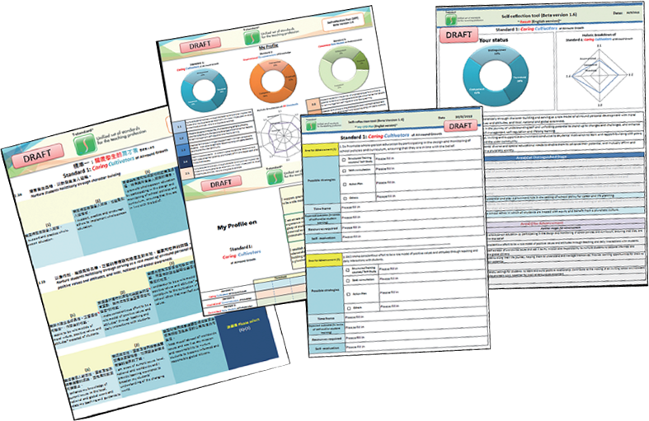
Example
School-based Application 1: for Individual Teachers
Individual
……
Subject Panel and Committee
……
School
At the individual level:
Some schools include an item called “Personal Development Plan” in the appraisal reports of teachers. Teachers may use the Self-Reflection Tool (SRT) to reflect on their own performance, and then formulate a professional development plan, complete with an action plan, resource requirements and success indicators for the medium term or the coming year.
Recommended Professional Development Activity:
Making use of the Self-Reflection Tool

Slide 4
Example
School-based Application 2: Assisting Subject Panels and Committees in Formulating Professional Development Plans
Individual
Individual
……
Subject Panel and Committee
……
Subject Panel and Committee
School
School
At the subject panel and committee level:
Upon reviewing the overall performance of teachers in fulfilling the role of a Caring Cultivator, the Student Development and Support Committee of a school identified aspects of the role that warranted further attention and drew up professional development plans for teachers accordingly.
Recommended Professional Development Activities:
Story viewing and sharing
Sharing experiences in exemplifying teachers’ professional roles

Slide 5
Example
School-based Application 3: Understanding Teachers’ Professional Roles under T-standard ⁺
Individual
……
Subject Panel and Committee
……
School
At the school level:
A school organised a professional development activity after examinations to introduce teachers to the three professional roles under T-standard⁺, using school-based examples and video clips provided by COTAP as illustrative aids. Teachers were invited to share their experiences, and figure out how the school can help foster their professional growth in respect of performing the three professional roles as well as which role requires additional emphasis.
Recommended Professional Development Activities:
Understanding T-standard⁺: The Three Professional Roles of Teachers
Textual study
Sharing stories of exemplifying teachers’ professional roles

Slide 6
Make good use of T-standard⁺ for self-reflection and mutual support
Teachers’ self life-planning
T-standard⁺
A portrayal of Hong Kong teachers
A guide to teachers’ professional journey
……

