Slide 1

July 2023
中学体适能测试
Fitness Assessment for Secondary Schools
香港高等教育科技学院
运动及康乐学系副教授 陆子聪博士
Dr LUK Jim Associate Professor
Department of Sports and Recreation
Technological and Higher
Education Institute of Hong Kong

Slide 2
测量项目及方法
Testing items and protocols

Slide 3
测量项目(中学)
Testing items (Secondary)
一分钟仰卧起坐 (1-min Sit-up)
坐前伸(Sit-and-Reach)
九分钟耐力跑(9-min Run) 或
15米渐进式心肺耐力跑 (15-meter PACER)
直体掌上压(Push-up) (中学男生) /
屈膝掌上压 (Knee Push-up) (中学女生) 或 倾斜式引体上升 (Inclined Pull-up)

Slide 4

Sit Up Test
一分钟仰卧起坐测试

Slide 5
一分钟仰卧起坐(1-min Sit-up)
步骤 (Procedures)
  曲膝在垫上仰卧，双足由同伴按着，脚跟贴地
    Student should lie on mat with knees bent, and partner should hold his/her feet, keeping the heels in contact with the ground
  脚跟与臀部相距30至45厘米，大腿与地面成45度角
    Heels should be 30 to 45 cm away from the buttocks, and the thighs should be at about 45° to the floor
  双臂在胸前交迭，手掌放在双肩上，下颔卷向胸前
    Arms should be crossed in front of chest, with hands on the shoulders, and the chin tucked to the chest

Slide 6
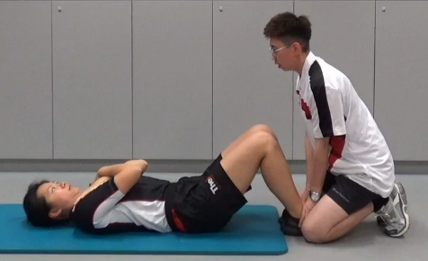
一分钟仰卧起坐(1-min Sit-up)
  由仰卧姿势开始动作
    Start the movement from the lying down position
  上身向前卷曲，至手肘触及大腿后，再向后仰卧至肩胛骨触地，即计算为一次仰卧起坐
    Curl the upper body forward until the elbows touch the thighs, and then lower the body until scapula touch the mat. Completing the above actions will count as one sit-up
  可在中途仰卧或坐在垫上休息
    Resting in a lying down or sitting position is allowed
  由同伴负责记录正确次数
  Partner is responsible for recording the number
  of correct repetitions

Slide 7
Sit and Reach Test
坐前伸测试

Slide 8
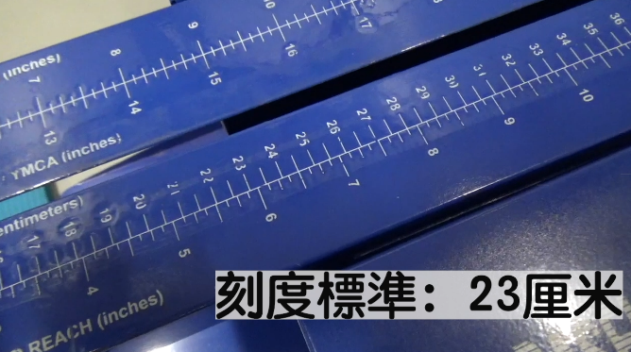
坐前伸 (Sit-and-Reach)
  用具 (Equipment)
  坐地前伸木箱(Sit-and-reach box)
    箱上有刻度，每刻度为一厘米
      Each scale is one cm on the box
    刻度二十三厘米的位置为双足贴着端板的垂直位置
      Adjust the marking to 23 cm which align with the position of the end board

Slide 9
坐前伸 (Sit-and-Reach)
步骤 (Procedures)
  脱去鞋子，直膝坐在垫上，双足贴着木箱端板
    Take off your shoes, sit on the mat with knees fully extended, and place your feet against the end board
  双足距离约为肩膊阔度
    Feet place at about shoulder-width apart
  双手前伸，手掌互迭向下，中指齐平
    Reach forward with arms and palms facing down, and overlap the middle fingers with one hand on top of the other
  上身慢慢前伸，手指尽量前伸
    Slowly reach forward with upper body, extending the fingers as far as possible

Slide 10
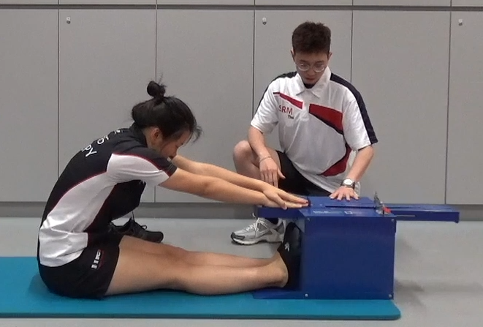
坐前伸 (Sit-and-Reach)
  头部自然垂下在两臂之间
    Keep head naturally placed between arms
  前伸时手掌必须按在箱上刻度，最少停两秒
    During the reach, palms should be in contact with the measuring scale of the sit-and-reach box. The final position should be held for at least 2 seconds
  量度单位为厘米
    The measurement unit is in cm

Slide 11
9-min Run Test
九分钟耐力跑测试

Slide 12
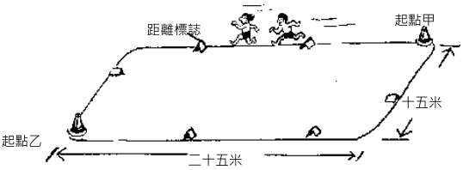
九分钟耐力跑(9-min Run)
场地 (Venue)
  - 篮球场 Basketball court
  - 任何平坦及周界约 80 米的空地上进行测量 Any flat area with a perimeter of about 80 meters

Slide 13
九分钟耐力跑(9-min Run)
步骤 (Procedures)
  在规定时间内跑／行最远的距离
    Run / walk as far as possible within the specified time
  在最后三分钟及最后十五秒提示学生剩余时间
    Remind students for the last 3 minutes and
    15 seconds
  在最后十五秒提醒计圈员准备记录完成的距离
    Reminded lap scorers to be ready to record the distance covered during the last 15 seconds

Slide 14
九分钟耐力跑(9-min Run)
  备注 (Remarks)
  提示学生逐渐加速并尽量保持均速
    Remind students to accelerate gradually and try to keep running at a steady pace
  继续跑步直至听到教师发出到达时限的讯号为止
    Keep running until a stopping signal is given by the teacher
  量度单位精确至10米
    Measure the distance to the nearest 10 m
  测试完成后应继续步行一圈或两圈
    Continue walking for 1 or 2 laps after completing the test
  如学生气力不继，可改作步行
    Students are allowed to walk if they are tired

Slide 15
15-meter PACER Test
15米渐进式心肺耐力跑测试

Slide 16
十五米渐进式心肺耐力跑
15-meter Progressive Aerobic Cardiovascular Endurance Run
(15m PACER)
场地 (Venue)
  跑道的两端需要15米以进行来回跑
    Having shuttle running between 2 parallel baselines which are 15 meters apart
  每条跑道的阔度不少于 1.4米
    The width of each track should be at least 1.4 meters
  标志物需设置在跑道的两端
    Markers should be set at both ends of the track
  将音乐播放器设置在跑道外侧的中间位置
    Music player should be placed in the middle outside the track

Slide 17
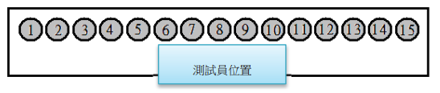
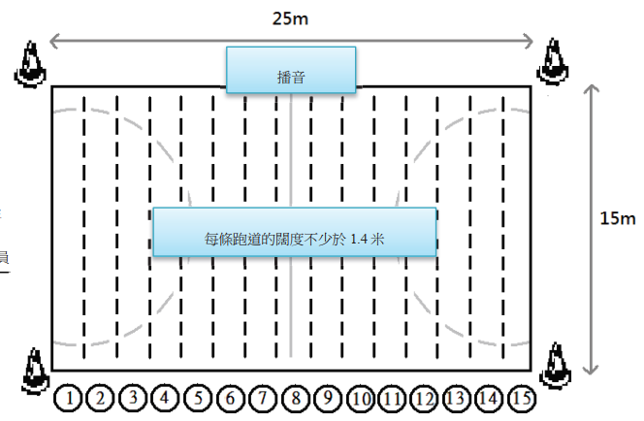
场地区域 Area set up

Slide 18
十五米渐进式心肺耐力跑
15m PACER
步骤 (Procedures)
  站于起点线后准备，按录音的指示开始测试
    Stand behind the starting line and get ready, and start running according to the instruction in the recording
  当听到开始的讯号后，学生向前跑至另一端，在「哔」声响起时最少以一脚踏在端线，以示到达，然后马上转身折返跑，如此类推
    After hearing starting signal, students should run to the opposite side of the lane. They should step on baseline with at least one leg when a beep sound is heard. Then students should run back to the opposite baseline and continue the test

Slide 19
十五米渐进式心肺耐力跑
15m PACER
  如学生于「哔」声未响已到达端线，应在原地等待下一次「哔」声响才进行折返跑
    If students reach baseline before next beep sounds, they need to wait and run until the next beep sounds is heard
  如学生于「哔」声响起时未能到达另一端线，应马上转身继续折返跑，并加速以追上在下一次「哔」声响起时能到达端线
    If students cannot reach baseline when beep sounds is heard, they need to turn around and return immediately, and reach the opposite baseline before the next beep sounds

Slide 20
十五米渐进式心肺耐力跑
15m PACER
  当学生两次未能在「哔」声响时到达端线,测试立即终止(不需要是连续二次未能到达端线)
    Test will be terminated if students fail to reach the baseline with the beep sound for two times (consecutive failure are not necessary)
  一声「哔」响表示已完成一圈，三声「哔」响表示已完成一个阶段
    A single beep sound represents student has completed a single lap whereas three consecutive beep sounds represent the completion of one level

Slide 21
十五米渐进式心肺耐力跑
15m PACER
  备注 (Remarks)
  下一阶段将会加快节奏，测试员应告知学生需要加速和继续进行测量
    Time allowed between interval single beep sounds quicker in every advanced level. Testers should inform students to accelerate for performing the test
  测试结束后，学生可以继续步行数圈作为冷却
    After the test ends, students can continue walking a few laps for cool-down
  测试结果以完成的次数计算
    The test result is calculated based on the number of completed runs

Slide 22
Push Up Test
直体掌上压 (中学男生）测试
屈膝掌上压（中学女生）测试

Slide 23
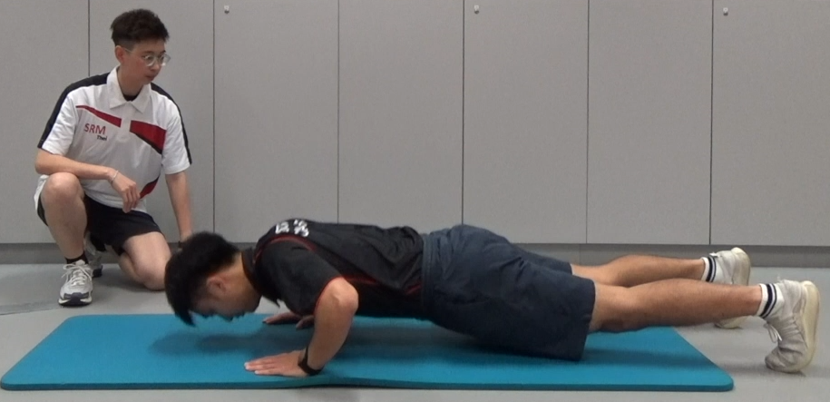
掌上压 (Push-up)
  直体掌上压（中学男子）
    手掌放在肩宽以上之距离上 Hands should be placed slightly wider than shoulder width
    双臂伸直 Keep elbows straight
    双腿伸直平排微分 Keep legs straight and slightly apart
    腰部及背部保持挺直 Keep waist and back straight
    头、背至脚保持一直线 Head, back and legs should be kept in straight line
    以脚趾支撑 Support yourself with your toes

Slide 24
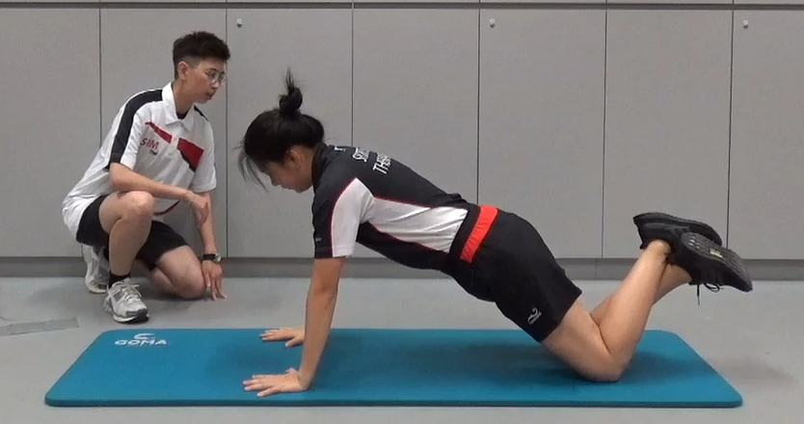
掌上压 (Push-up)
  屈膝掌上压（中学女子）
    双脚膝盖放在垫上 Knees on the mat
    脚掌离地互相交迭 Heel raised, legs and ankles crossed

Slide 25
掌上压 (Push-up)
步骤 (Procedures)
  屈曲双臂成 90 度令身体降下 Bend arms 90° so to lower the body
  双腿、腰及背仍保持挺直 Keep legs, waist and back straight
  伸直双臂推起身体 Extend arms fully to push your body up
  以推起身体至手臂完全伸直为完成一次完整的掌上压
  Follow by extending arms fully for the completion of a single push-up
  记录连续完成的掌上压／屈膝掌上压次数(期间动作必须保持畅顺) Record the number of correct and completed push-ups (Movement must keep smooth during the test)

Slide 26
训练方法
Training methods

Slide 27
训练原则 Training Principles
超负荷 Overload
适应性 Adaptability
独特性 Uniqueness
渐次编排 Progression
渐进阻力 Progression Intensity
用进废退 Continuous
频次 Frequency
保持呼吸 Breathing

Slide 28
强化心血管系统之方法
Methods to Strengthen the Cardiovascular System
主要内容
  方式 Type
  运动强度 Intensity
  时间 Time
  频率 Frequency
  发展改进 Progression

Slide 29
强化心血管系统之方法
Methods to Strengthen the Cardiovascular System
热身 Warm up (5–10分钟)
主要训练内容 Exercise (20–60分钟)
  心肺、肌肉适能
缓和 Cool Down (5–10分钟)
方式 Method
  大肌肉组群 Muscle group
  节拍 Rhythm
  长时间 Endurance

Slide 30
按运动经验建议运动
Suggested Exercise according to Exercise Experience
运动经验 | 运动特点 | 例子
无经验的初学者 | 较易维持稳定而低的运动强度 能量消耗较低 运动强度易受自己控制 技巧较少 | 步行 踏单车 行跑步机
间中有运动的参加者 | 在能够控制稳定的运动强度下，多作与技巧有关的活动 | 游泳 溜冰 跳健康舞
经常参与剧烈运动者 | 技巧与运动强度都是必须考虑因素 多于一人的群体项目，但比赛性质尽可降低，以免运动过剧。 | 球拍类运动项目 队制球类项目如篮球、足球

Slide 31
运动进度
Progress of Exercise
考虑因素 Factors:
  个人能力、健康状况、年龄、兴趣、目标
    Ability, Health status, Age, Hobbits, Targets
心肺耐力训练计划阶段
Cardiorespiratory Endurance Training Program Stage：
  初阶（预备时期）４－６星期 Beginner
  进阶（进步时期）６－８星期 Advance
  维持（维持时期）８星期之后 Sustainable

Slide 32
年龄阶段
Age Group
儿童期 Childhood
  早期 Early 1 – 6 岁
  中期 Middle 7 – 10 岁
  后期 Late 发育期Developmental Period:
    女 9-15 岁
    男 12-16 岁
青少年期发育期至成年
Adolescence Developmental to adulthood

Slide 33
儿童运动处方基本目标
Aims of Exercise Prescription for Children
维持活动
Maintenance of activity
享受活动的乐趣
Enjoyment of the activity
发展活跃的生活模式并养成习惯
Develop active lifestyle with habits

Slide 34
儿童运动处方之原则
Principles of Exercise Prescription for Children
容许自然活跃
  Allow active style
容许儿童控制运动强度及运动时间
  Children are able to control exercise intensity and time
享受活动
  Enjoy the activity

Slide 35
儿童运动处方之原则
Principles of Exercise Prescription for Children
多鼓励儿童在户外活动而不是玩计算机游戏或看电视
  Encourage outdoor activity instead of playing video game or watching TV
多参与各类型运动项目
  Engage in different kind of sports
各家庭成员作儿童之模范，多做运动
  Family member be role model to do more exercises

Slide 36
儿童重量训练
Weight Training for Children
重量训练之考虑因素：
  Factors for weight training
  增强力量 strengthening
  防止受伤 prevent injury
  增进运动表现 improve sports performance
  增强自我形象 build up self image
  学习正确技巧 learning proper skills

Slide 37
儿童重量训练
Weight Training for Children
重量训练计划特点:
  Characteristics of weight training program
  近距离和持续之监察来训练
    Monitoring closely and consistently to train
  充足热身 (较慢及渐进)
    Adequate warm up (slowly with progression)
  每组高重复次数 (在青春发育期前祗可做轻于 6-8RM 之重量)
    Light weight (<6-8RM) with higher repetition
  每节练习须有足够休息时间 (每周最多做2-3次)
    Enough inter-set rest (Maximum 2-3 times per week)

Slide 38
儿童重量训练
Weight Training for Children
  在早期之练习，可以体重作负荷或以很轻之重量作练习
    Lighter weight/ body weight in early stage for training
  强调正确的动作及身体姿势
    Emphasize the correct body movement and posture
  包括柔软度练习 (特别在青少年增高阶段)
    Include flexibility training
  若需增加运动量时，首先增加每组次数及组数，最后才增加重量
    Increasing repetition and set before weight if you need to increase intensity

Slide 39
Cardiorespiratory
Endurance Training
Endurance Running
(Treadmill)
心肺耐力训练
跑步机耐力跑

Slide 40
心肺耐力/
上肢肌力训练
运水游戏
Cardiorespiratory Endurance
Upper Body Strength Training
Water-Carrier Game

Slide 41
柔韧度训练
腘绳肌伸展
Flexibility
Hamstring
Stretching

Slide 42
核心肌群训练
仰卧起坐
Core Training
Sit Up

Slide 43
Upper Body
Strength Training
Push Up
上肢肌力训练
掌上压

Slide 44
核心肌群训练
平板支撑
Core Training
Plank

Slide 45
核心肌群训练
侧平板支撑
Core Training
Side Plank

Slide 46
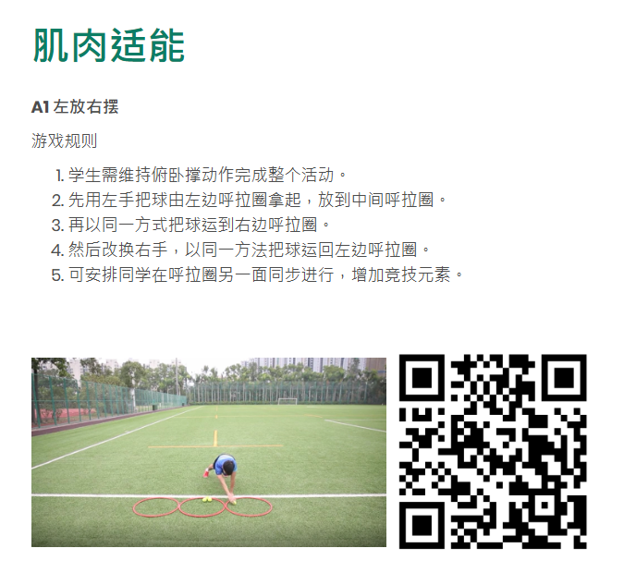
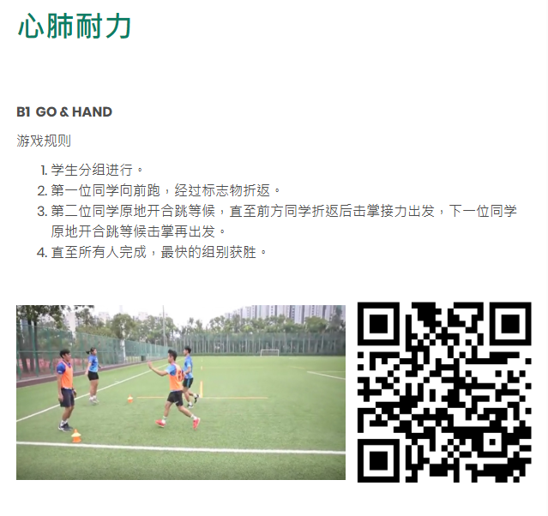
学与教资源–体适能游戏
Learning and teaching resources – Physical Fitness Games
https://www.edb.gov.hk/sc/curriculum-development/kla/pe/games/index.html

Slide 47
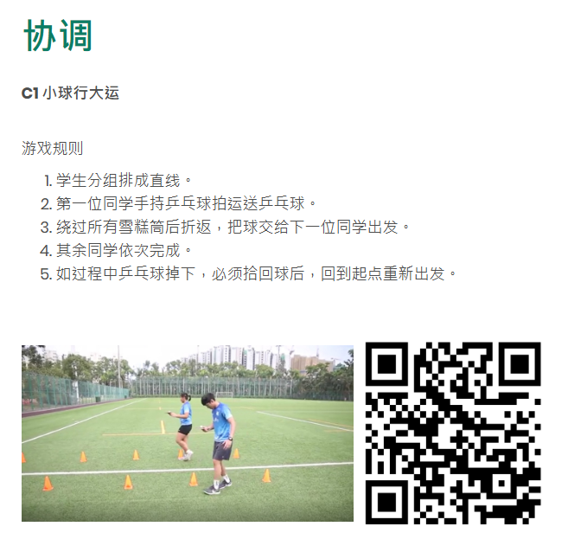
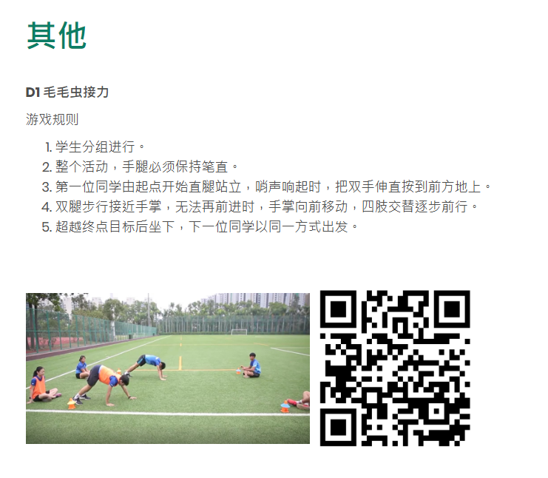
学与教资源–体适能游戏
Learning and teaching resources – Physical Fitness Games
https://www.edb.gov.hk/sc/curriculum-development/kla/pe/games/index.html

