Slide 1
Social Distancing and the Spread of COVID-19
Junior Secondary Mathematics
Curriculum Development Institute, Education Bureau

Slide 2
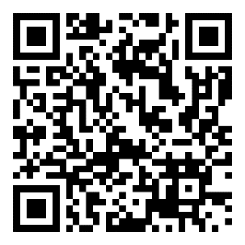
Background
To minimise the risk of COVID-19 spreading in the community, we all need to work together on social distancing. While the Government will adopt the “Suppress and Lift” approach (張弛有度、能收能放), members of the public are advised strongly to observe the announced measures that could help enhance social distancing.
Why is social distancing so important?
In this activity, we are going to use a simple mathematical model to study the spread of virus with/without social distancing.
Government website on social distancing:
https://www.coronavirus.gov.hk/eng/social_distancing.html

Slide 3
Data and Assumptions
Before interpreting the effect of social distancing, we need to collect related data and make appropriate assumptions. Data below are needed for modelling the spread of COVID-19:
The average number of infections from an infected person
The average effective period of infection by an infected person
It is important to collect information and data only from reliable sources, such as websites of government departments concerned or well-established academic institutions.

Slide 4
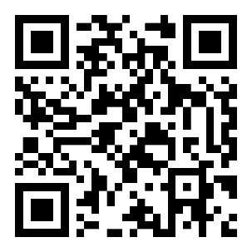
Data and Assumptions
The average number of infections from an infected person
We may consider the “real time effective reproduction number for local cases” announced by the LKS Faculty of Medicine, HKU (i.e. the current average number of persons who will be infected by an infected person).
To simulate the scenario at the beginning of the local outbreak of the disease, we adopt the first peak value on 27 Jan 2020 in this activity, which is roughly 1.8.
Real-time Dashboard by School of Public Health, The University of Hong Kong:
https://covid19.sph.hku.hk

Slide 5
Data and Assumptions
The average effective period of infection by an infected person
Assumption 1: We may assume that the incubation period equals to the period of infection.
[Incubation period means the time between catching the virus and beginning to have symptoms of the disease]
Q1) Please give a reason to support the above assumption.
Q2) How long is the incubation period for COVID-19?

Slide 6
Data and Assumptions
The average effective period of infection by an infected person
Assumption 1: We may assume that the incubation period equals to the period of infection.
Q1) Please give a reason to support the above assumption.
During the incubation period, the infected person may not notice his/her infection and would go on contacting other persons. After the symptoms developed, the person would be consequently quarantined, and become no longer infective to the society.

Slide 7
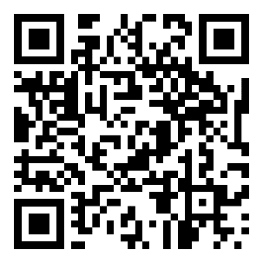
Data and Assumptions
The average effective period of infection by an infected person
Assumption 1: We may assume that the incubation period equals to the period of infection.
Q2) How long is the incubation period for COVID-19?
From the website of Centre for Health Protection, most estimates of the incubation period for COVID-19 range from 1 to 14 days, most commonly around 5 days.
FAQ 6, Frequently Asked Questions on COVID-19, Centre for Health Protection:
https://www.chp.gov.hk/en/features/102624.html#FAQ6

Slide 8
Data and Assumptions
Lastly, we make an assumption on effect of social contact to the reproduction number:
Assumption 2: It is assumed that the reproduction number will be directly proportional to the number of persons closely contacted during the period of infection.
For example, if the number of persons closely contacted by an infected person is reduced by half, the reproduction number will also be reduced by half.

Slide 9
Building the Model
To start with, assume that there is one infected person at day 0.
Let y be the total number of infected person.
In 5 days (i.e. after 1 period of infection),
Question: How about 5 more days later?
Already infected
Newly infected
The number is derived from statistical data. It does not imply fractional infection.

Slide 10
Building the Model
By assumptions, while the original infected person would be quarantined, each of the 1.8 newly infected persons will infect another 1.8 persons within a period of infection. Hence, in 10 days (2 periods of infection), the total number of infected persons y is
Already infected
Newly infected

Slide 11
Building the Model
Q3) By observing the above calculations, try to calculate the total number of infected persons, y , after 15, 20, 25 and 30 days using a spreadsheet.
no. of periods | no. of days | Total no. of infected persons (without social distancing, cor. to 1 d.p.)
0 | 0 | 1
1 | 5 | 2.8
2 | 10 | 6.0
3 | 15
4 | 20
5 | 25
6 | 30
Remarks: Non-integral numbers of persons are derived from statistical data.

Slide 12
Building the Model
Q3) By observing the above calculations, try to calculate the total number of infected persons, y , after 15, 20, 25 and 30 days using a spreadsheet.
no. of periods | no. of days | Total no. of infected persons (without social distancing, cor. to 1 d.p.)
0 | 0 | 1
1 | 5 | 2.8
2 | 10 | 6.0
3 | 15 | 11.9
4 | 20 | 22.4
5 | 25 | 41.3
6 | 30 | 75.3
Remarks: Non-integral numbers of persons are derived from statistical data.

Slide 13
Building the Model (Extension)
Q3*) From the formula used in the spreadsheet for the calculation of total number of infected persons, can you write down a formula in mathematics?
After n periods of infection, the total number of infected persons is
Answer:

Slide 14
Building the Model
Q4) Using the spreadsheet in Q3, present the total number of infected persons by a suitable statistical graph.
Answer:

Slide 15
Effect of social distancing
Suppose the measures that could enhance social distancing reduce our amount of social gatherings by half, let's see what will happen.
By Assumption 2, the reproduction number is also reduced by half, that is, 1.8 is now reduced to 0.9

Slide 16
Effect of social distancing
Q5) By modifying the formula used in the spreadsheet for Q3, find the total number of infected persons y in 5 , 10 , 15, 20 , 25 and 30 days time with measures that could enhance social distancing.
no. of periods | no. of days | Total no. of infected persons (cor. to 1 d.p.)
 |  | without social distancing | with social distancing
0 | 0 | 1 | 1
1 | 5 | 2.8
2 | 10 | 6.0
3 | 15 | 11.9
4 | 20 | 22.4
5 | 25 | 41.3
6 | 30 | 75.3
Remarks: Non-integral numbers of persons are derived from statistical data.

Slide 17
Effect of social distancing
Q5) By modifying the formula used in the spreadsheet for Q3, find the total number of infected persons y in 5 , 10 , 15, 20 , 25 and 30 days time with measures that could enhance social distancing.
no. of periods | no. of days | Total no. of infected persons (cor. to 1 d.p.)
 |  | without social distancing | with social distancing
0 | 0 | 1 | 1
1 | 5 | 2.8 | 1.9
2 | 10 | 6.0 | 2.7
3 | 15 | 11.9 | 3.4
4 | 20 | 22.4 | 4.1
5 | 25 | 41.3 | 4.7
6 | 30 | 75.3 | 5.2
Remarks: Non-integral numbers of persons are derived from statistical data.

Slide 18
Effect of social distancing
Q6) Construct a graph presenting the numbers of infections for the two cases in Q5, and compare the two cases.
Answer:

Slide 19
Effect of social distancing
Q7) Briefly describe the effect of social distancing (assuming reducing social contact by half) as observed from the graph for Q6.
As observed from the graph, without social distancing, the total number of infected persons increases at a greater rate. An infected person will result in a total of around 75 infected persons in 30 days.
With measures that could reduce social contact by half, the total number of infected persons will be around 5 in 30 days. There is a great difference in the rate of increase.

Slide 20
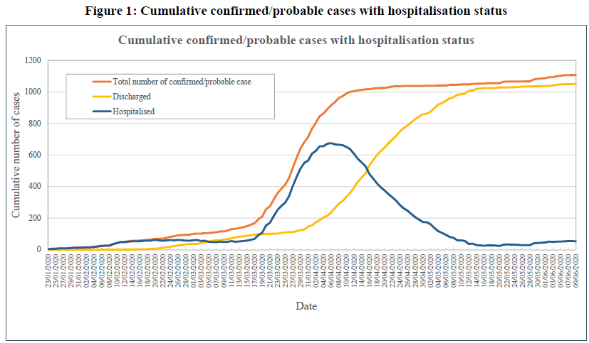
Prohibition on group gathering
Retrieved from https://www.chp.gov.hk/files/pdf/local_situation_covid19_en.pdf
Figure above shows the cumulative number of confirmed/probable cases in Hong Kong (up and until 11/6/2020).

Slide 21
Prohibition on group gathering
29/3/2020
With all our concerted effort to follow the regulations put in place to reduce group gatherings from 29/3/2020 onwards, the total number of confirmed/probable cases began to flatten out in around 10 days!

Slide 22
Together, we fight the virus!
To conclude, let’s be responsible citizens helping oneself and the others, keeping all of us away from the spread of COVID-19 by continuously following the regulations on reducing social gatherings.
Join Hands!
Fight the Virus!

