Slide 1
Recognising the COVID-19 Pandemic from data
Senior Secondary Mathematics (Compulsory Part): Uses of Statistics
Curriculum Development Institute, Education Bureau

Slide 2
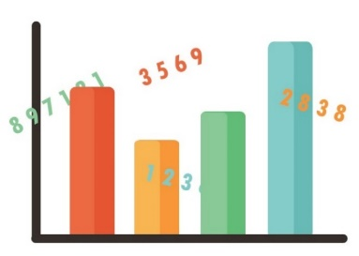
Recognising the local epidemic
If we wish to have a deeper understanding of the local epidemic of COVID-19 and explore the infection of virus by age groups, how should we proceed?
Before finding relevant data for analysis, students are reminded that
Data should be sought from reliable sources (e.g. websites of relevant Government Departments)
Analyse data with a careful and rigorous attitude to avoid subjective and false conclusions

Slide 3
Recognising the local epidemic
If we wish to have a deeper understanding of the local epidemic of COVID-19 and explore the infection of virus by age groups, how should we proceed?
Reliable data source:
For example, the data of government departments. The government's “DATA.GOV.HK" webpage provides data on COVID-19 from the Department of Health (in addition to accurate and reliable data, the webpage provides CSV files, which can be operated with spreadsheet software) https://data.gov.hk/tc-data/dataset/hk-dh-chpsebcddr-novel-infectious-agent

Slide 4
Activity 1: Analysing the ages of confirmed patients using IT
Firstly download the data "Details of suspected/confirmed 2019 coronavirus cases in Hong Kong" from the "Data in Coronavirus Disease (COVID-19)" of the website "DATA.GOV.HK". In this activity, students will use a spreadsheet to analyse the data and complete the following table.
Confirmed cases |  | Male | Female | All
Number
Age | Range
 | Mean
 | Mode
 | Median
 | Upper quartile
 | Lower quartile
The following steps demonstrate how to analyse the data of Male’s confirmed cases.

Slide 5
Step 1: Download the latest data from the "Data in Coronavirus Disease (COVID-19)" of the website "DATA.GOV.HK".
Step 2: Select “HOME” → “Sort & Filter”→ “Filter”
HOME
Sort & Filter
Filter

Slide 6
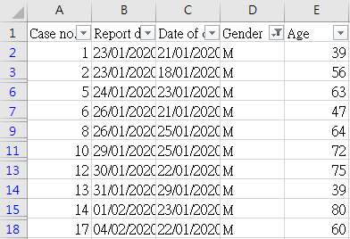
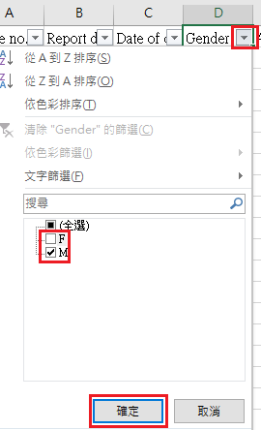
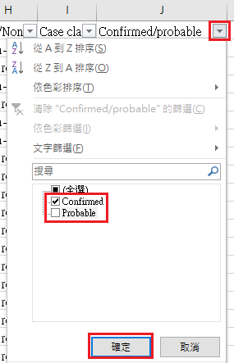
Step 3: Click the arrow button next to “Gender”, choose “M” only and click “confirm”. Then, click the arrow button next to “Confirmed/probable” and choose “Confirmed” and click “confirm”. The results are the confirmed cases for male only. It shows at the bottom of the table that there are 599 records, i.e. the number of the confirmed cases for male is 599 (use data as at 16 June 2020).
confirm
599 records

Slide 7
Step 4: Use the mouse to click the first record of “Age” (i.e. cell E2), then press the three buttons “Shift”, “Ctrl” and down arrow together to select all the records of age for all male confirmed cases. Then, press “Ctrl” and “C” to copy these records.
Step 5: Click the “plus” sign next to “worksheet 1” to create a new worksheet.

Slide 8
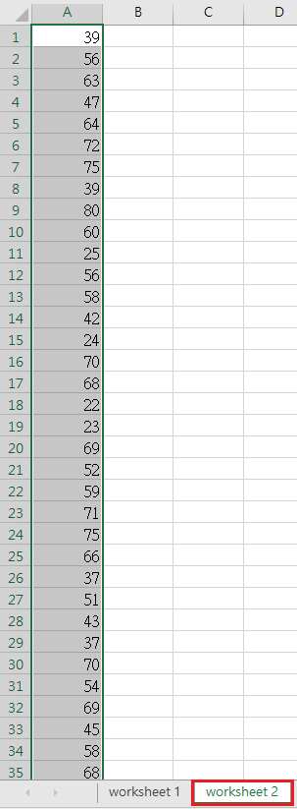
Step 6: Click cell A1 of “worksheet 2” and press “Ctrl” and “V” to paste all records of male confirmed cases under Column A of “worksheet 2” (as shown on the right).
Then, we can use different functions to find the values on the table below.
Confirmed cases |  | Male
Number |  | 599
Age | Range
 | Average
 | Mode
 | Median
 | Upper Quartile
 | Lower Quartile

Slide 9
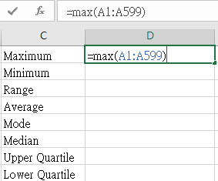
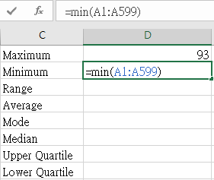
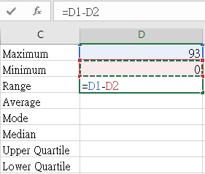
Step 7a: Input related information under Column C and enter different formulae in the relevant cells under Column D.
As this activity involves a large number of data, it is suggested to use information technology to calculate the statistics. Students can then focus on analysing the results.

Slide 10
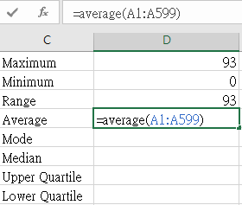
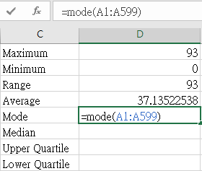
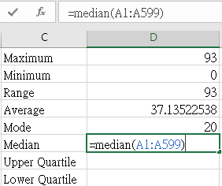
Step 7b: Input related information under Column C and enter different formulae in the relevant cells under Column D.

Slide 11
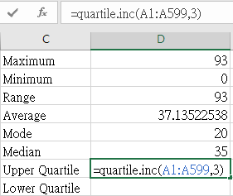
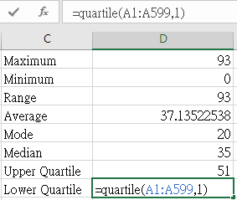
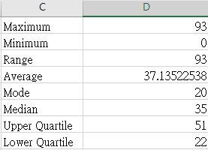
Step 7c: Input related information under Column C and enter different formulae in the relevant cells under Column D.

Slide 12
Activity 1: Analysing the ages of confirmed patients using IT
Refer to the above steps, try to get the relevant values for female and all cases and complete the following table.
Confirmed cases |  | Male | Female | All
Number |  | 599
Age | Range | 93
 | Mean | 37.1
 | Mode | 20
 | Median | 35
 | Upper quartile | 51
 | Lower quartile | 22
Represent the ages of male, female, and all patients by boxplots and compare their distributions.

Slide 13
Suggested answers as follows (using data as at 16 June 2020)
Confirmed cases |  | Male | Female | All
Number |  | 599 | 513 | 1112
Age | Range | 93 | 95 | 96
 | Mean* | 37.1 | 38.2 | 37.6
 | Mode | 20 | 20 | 20
 | Median | 35 | 34 | 35
 | Upper quartile | 51 | 52 | 52
 | Lower quartile | 22 | 23 | 22
*correct to three significant figures

Slide 14
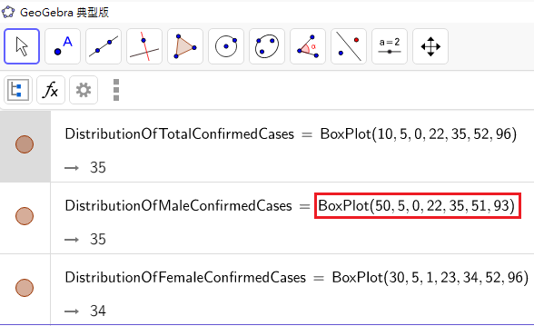
We can use the software “GeoGebra” and input the following command to draw the required boxplots.
The command of BoxPlot is “BoxPlot(50, 5, 0, 22, 35, 51, 93)”, the meanings, in sequence, of these seven numbers are: the position of the boxplot, the width of the boxplot, minimum values, lower quartile, median, upper quartile and maximum value.
Ages of male, female and all confirmed cases (as at 16 Jun 2020)
By observing the boxplots, we find that the distributions of ages of male, female and all cases are very similar.

Slide 15
Activity 2: Comparing the cases in different age groups
Observe and guess
By observing the above table and boxplots, some students find that no matter whether it is male, female or all cases, 25% of the data are concentrated between the twenties and the thirties and the modal age of three groups are all 20. Do these results indicate that the age group of near 20 years old is more commonly infected with COVID-19 than other age groups?

Slide 16
Activity 2: Comparing the cases in different age groups
Analysis
To know whether the guess is correct, we may first notice that numbers of people in different age groups are different. So, we need that data in order to further analyse which age group of people is more commonly infected with COVID-19.
Population of Hong Kong by age and sex, mid-2018
Sources: “Census and Statistics Department: Living with Statistics”
https://www.censtatd.gov.hk/hkstat/sub/sc460.jsp?productCode=B8XX0025

Slide 17
Activity 2: Comparing the cases in different age groups
Complete the following table by the data “Details of suspected/confirmed 2019 coronavirus cases in Hong Kong“ used in Activity 1.
Age group | 0-14 | 15-24 | 25-34 | 35-44 | 45-54 | 55-64 | 65+ | Total number
Male
Female
All

Slide 18
Activity 2: Comparing the cases in different age groups
Age distribution of confirmed cases being infected with COVID-19 in Hong Kong (use data as at 16 June 2020)
Age group | 0-14 | 15-24 | 25-34 | 35-44 | 45-54 | 55-64 | 65+ | Total number
Male | 24 | 165 | 105 | 111 | 63 | 88 | 43 | 599
Female | 17 | 128 | 114 | 76 | 56 | 76 | 46 | 513
All | 41 | 293 | 219 | 187 | 119 | 164 | 89 | 1112
Do you know how to get the above figures using a spreadsheet?

Slide 19
Activity 2: Comparing the cases in different age groups
Try to get the "population by age group" data from the Census and Statistics Department website, analyse which age group of people are more commonly infected with COVID-19.
Still remember getting data from reliable sources? Census and Statistics Department:
https://www.censtatd.gov.hk/hkstat/hkif/index_tc.jsp

Slide 20
 | Age Group | 0-14 | 15-24 | 25-34 | 35-44 | 45-54 | 55-64 | 65+
Male | Confirmed | 24 | 165 | 105 | 111 | 63 | 88 | 43
 | Total number | 450 700 | 350 600 | 454 000 | 465 200 | 497 000 | 589 400 | 616 100
 | Percentage | 0.005% | 0.047% | 0.023% | 0.024% | 0.013% | 0.015% | 0.007%
Female | Confirmed | 17 | 128 | 114 | 76 | 56 | 76 | 46
 | Total number | 424 200 | 348 500 | 594 800 | 712 600 | 665 100 | 633 300 | 705 900
 | Percentage | 0.004% | 0.037% | 0.019% | 0.011% | 0.008% | 0.012% | 0.007%
All | Confirmed | 41 | 293 | 219 | 187 | 119 | 164 | 89
 | Total number | 874 900 | 699 100 | 1 048 800 | 1 177 800 | 1 162 100 | 1 222 700 | 1 322 000
 | Percentage | 0.005% | 0.042% | 0.021% | 0.016% | 0.010% | 0.013% | 0.007%
From the results of spreadsheet, we know that the percentages of number of confirmed cases to the total population in the age groups range from 0.004% to 0.047%. Among the age groups, the 15-24 age group has the highest percentage of confirmed cases for both male and female cases, while the 0-14 age group has the lowest.

Slide 21
Activity 2: Comparing the cases in different age groups
[Extended exploration] The percentage of confirmed cases in the 15-24 age group is relatively high. Is it because the people in this age group have weaker immunity to the coronavirus? Or do we have to consider whether the cases are local or imported? What extra data do we need to know? Try to explore and illustrate the conclusions by tables/charts.

Slide 22
END

