Slide 1




Facing changes
Mr. Albert Wong
Chairman, AiTLE ; IT Coordinator, LKYMS
Email : albertwong@aitle.org.hk
Image Source : http://bookboonglobal.com/wp-content/uploads/2013/09/How-demographic-changes-will-impact-organizations-and-managers.png ; http://www.noborderslegal.com.au/templates/nblegal2014/img/articles/changes.jpg

Slide 2

Who am I ?
A School Teacher (~ 25 years)
Major : Biology
Teaching Math, Biol & IS at the first 9 years
Change to the IT in Education field then
  School IT Infrastructure
  Computer subject teaching
Image Source : http://fscomps.fotosearch.com/compc/UNN/UNN298/u25140337.jpg

Slide 3
My background
IT Coordinator / Head of IT … of
  Kiangsu-Chekiang College
  Victoria Shanghai Academy
  Law Ting Pong Secondary School
  Lee Kau Yan Memorial School
    serving now
  School type : Aided, DSS, PIS

Slide 4
My background
Chairman
  Association of IT Leaders in Education (AiTLE)
    formed by a group of school IT Coordinators in 2002/2003
      to promote quality of education through the use of IT
      in form of peer-sharings, seminars and workshops
    Now has 1123 members
    In frequent contact of schools & teachers
      Through activities
      Different formats of free consultancy services
    In frequent contact with vendors/SI & professionals

Slide 5
AiTLE . eLearning
Highly involved in the following eLearning Projects
  WaaS
  WiFi 100
  Samsung Smart Citizenship
  AiTLE-ETC Education Software TestBed
  MDM
  eLearning Seminar for Parents
More detail
  www.aitle.org.hk

Slide 6
B4 Facing changes
Image Source : http://bookboonglobal.com/wp-content/uploads/2013/09/How-demographic-changes-will-impact-organizations-and-managers.png ; http://www.noborderslegal.com.au/templates/nblegal2014/img/articles/changes.jpg

Slide 7
WiFi 100 & WiFi 900
Deploy when you really need it
It is not a Jetso,
  It is a need
    You already prepared for it before you deploy
  It is a revolution to your school
  It is a responsibility
  You need to face to public accountability

Slide 8
WiFi 100 & WiFi 900
You need to consider yours situation and also understand others
  Others
    EDB
    Market affordability
    Colleagues affordability
    Students’ need
    Parent acceptability

Slide 9
WiFi 100 & WiFi 900
If you apply, the following people must be involved
  School Management
  School Academic committee
  School IT
  Some subject pioneers

Slide 10
WiFi 100 & WiFi 900
You can seek advices from
  EDB
  Trustable partners
    Vendor / SI
    Universities
    Professional Association
    Pilot Projects, WiFi 100 Schools
Do more research before start

Slide 11
WiFi 100 & WiFi 900
Experience from WiFi 100
  Subscription
  Implementation consideration
    First year
    Coming years
    Before subscription contract end
  Technical expression / conversation / communication with vendor
More to share later

Slide 12
Facing changes
Image Source : http://bookboonglobal.com/wp-content/uploads/2013/09/How-demographic-changes-will-impact-organizations-and-managers.png ; http://www.noborderslegal.com.au/templates/nblegal2014/img/articles/changes.jpg

Slide 13
In the past, we should be
All by school IT
  School PC setup and maintenance
  Server setup & maintenance
  Network setup & maintenance
  School IT Development
  School IT Training & Support
  Teaching

Slide 14
But in the past, in fact we are
All by school IT
  School PC setup and maintenance
  Server setup & maintenance
  Network setup & maintenance
  School IT Development
  School IT Training & support
  Teaching

Slide 15
With the enhancement of technologies
eLearning
  WiFi
  BYOD (bring your own device)
  MDM (mobile device management)
  AUP (acceptable user policy)
  Resistance from colleagues
  Cultural change to L&T

Slide 16
Your scope of work increases

Slide 17
Your scope of work changes

Slide 18
Otherwise, your Future will be
All by school IT
  School PC setup and maintenance
  Server setup & maintenance
  Network setup & maintenance
  School IT Development
  School IT Training & support
  WiFi
  BYOD
  MDM
  AUP
  Teaching

Slide 19
Challenges
WiFi to student
  Internal hacking
External need
  Hacking
  Phishing
Parent concern
Need of IT people fr market ➔ TSS

Slide 20

job

Slide 21
Facing changes
Image Source : http://bookboonglobal.com/wp-content/uploads/2013/09/How-demographic-changes-will-impact-organizations-and-managers.png ; http://www.noborderslegal.com.au/templates/nblegal2014/img/articles/changes.jpg

Slide 22
Our Future should be
  School PC setup and maintenance
  Server setup & maintenance
  Network setup & maintenance
  School IT Development
  School IT Training & support
  WiFi
  BYOD
  MDM
  AUP
  Teaching

Slide 23
Phases leading to our ideal future
Phase 1 : WiFi
Phase 2 : Server & MITS
Phase 3 : SSO
Phase 4 : LMS
    MITS : Managed IT Services
    SSO : Single Sign On
    LMS : Learning Management System

Slide 24
Phase 1 : WiFi
WiFi Subscription
  From the experience of
    WaaS
    WiFi 100
  Most technical period
    Before and right after Tendering
    Setup

Slide 25
Phase 1 : WiFi
WiFi Subscription
  After setup
    Service call
      vendor find your problem and solve it before you know the problem
    Can change your infrastructure to echo the school need
  Need to take care
    School & vendor are both new to subscription
      Not all school, not all vendor know the ideal or near ideal case of subscription

Slide 26
Phase 1 : WiFi
WiFi Subscription
  Offload
    Configuration change need
    Support
    Security concern
    Technical responsibilities
  Subscription not new, and is work
    Photocopier vs printer
    Software license vs box set
    Security guard, cleaning, gardening

Slide 27
Phase 2 : Server & technical support
Domain Controller
  PDC, BDC
WebSAMS
  HTTP Server
File Server
Web Server
  Apache, IIS
  HTML based ?
  Package (WP, J) ?
Intranet Server
Email Server
ESDA Server
Library Server
Inventory Server
OMR Server
Print Server
  Centralized printing
Fax Server
Proxy Server

Slide 28
Phase 2 : Server & technical support
IP Phone Server
Octopus Server
Servers related to school-based project
Routers
Switches
backup issue
redundancy issue
security issue
access control issue
account management issue
log review

Slide 29
Phase 2 : Server & technical support
Server Migration to Cloud (SMTC)
  Migrating all (most) servers to cloud
    Backup ➔ IT Professional outside
    Redundancy ➔ IT Professional outside
    Security ➔ IT Professional outside
    Account management
    ➔ Managed IT Services (MITS)
      School system managed by Prof outside offsite
      Account management handled by call centre
      Regular onsite (school) network checking
      Most problem found & solved by Prof before we know

Slide 30
Phase 3 : SSO (Single Sign On)
Now when you login Gmail
  ➔ youtube
  ➔ HKEDCITY
Now you login Facebook
  ➔ Facebook games
Now you login Game Centre
  ➔ different online games

Slide 31
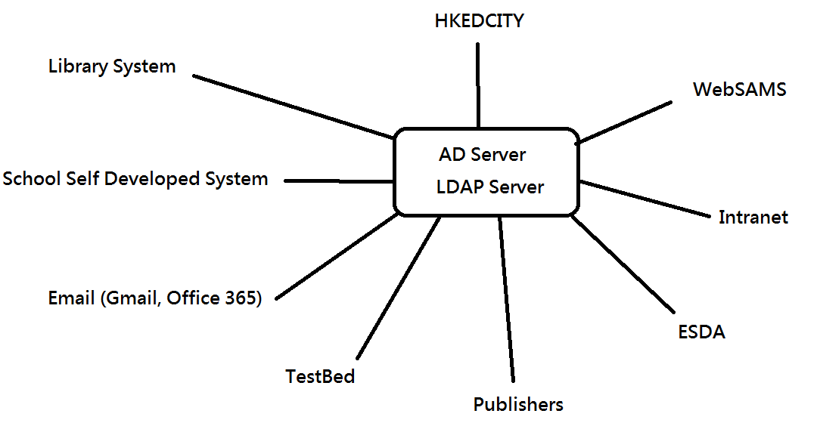
Phase 3 : SSO (Single Sign On)

Slide 32
Phase 4 : LMS
Centralized LMS (not admin system)
  With basic function
  Easy to use interface
  Good API for add-on function interfacing
  Target
    Through-train experience and depository for student
    Resource sharing

Slide 33

Facing changes
Image Source : http://bookboonglobal.com/wp-content/uploads/2013/09/How-demographic-changes-will-impact-organizations-and-managers.png ; http://www.noborderslegal.com.au/templates/nblegal2014/img/articles/changes.jpg

Slide 34
Coming AiTLE activities
In Supporting
WiFi 900 &
OGCIO Enriched IT Class Programme

Slide 35
Activity 1
Seminar re WiFi 900 for School IT and ICT Sectors
  Date : 2015-03-10 (TUE)
  Time : 1430-1700
  Venue : EDB KTESC
  Main Target : ICT Sectors
    Some of the content are already briefing in EDB Briefing session for teachers
  Detail & Reg : http://www.aitle.org.hk/?p=2568

Slide 36
Activity 2
AiTLE Seminar : Updated Technologies for ICT Teaching
  Date : 2015-03-14 (Sat)
  Time : 1430-1730
  Venue : Baptist Rainbow Primary Sch
  Content
    AR & VR
    3D Printing and/or Modeling
    Digital Games Creation
    Mobile Apps, Programming
    Robotics, IoT and sensors
    some others …
  Detail & Reg : http://www.aitle.org.hk/?p=2572

Slide 37
Activity 3
Visit to Network Operating Centre
  2015-03-20 (FRI) 1400-1630
  2015-03-20 (FRI) 1700-1930
  2015-03-26 (THUR) 1000-1230
  Detail & Reg : http://www.aitle.org.hk/?p=2578

Slide 38
Activity 4
HK e-Learning Carnival 2015
  Date & Time :
    2015-04-17 (FRI) PM – Group
    2015-04-18 (SAT) AM – Group & Public
    2015-04-18 (SAT) PM – Public
  Venue : Baptist Rainbow Primary Sch
  Target : Students and Parents
    Providing joyful & positive eLearning experience to Students and Parents

Slide 39
Activity 5
AiTLE + HKEDCITY + HKPA : 【e世代．家長童行】第三擊 : 觀塘、將軍澳、西貢區講座及工作坊
  Date : 2015-04-25 (Sat)
  Time : 1430-1700
  Venue :東華三院呂潤財紀念中學
  Sharing by schools of KT, TKO

Slide 40
Other Supports
eLearning Pilot Projects
WaaSchool & Some WiFi School
Samsung Smart Citizenship (67+13)
TestBed Project
All are willing / with responsibility to share

Slide 41
不務正業
Thank you
教育專業
Mr. Albert Wong
Chairman, AiTLE ; IT Coordinator, LKYMS
Email : albertwong@aitle.org.hk

