Slide 1
支援少數族裔學生小貼士 Tips on supporting Non-Chinese Speaking students in school
2017-01-11香港融樂會
Hong Kong Unison

Slide 2
分享內容：
少數族裔對教育的態度 Impression to ethnic minority
少數族裔在香港的教育處境 NCS students in kindergarten education
家校合作小貼士 Tips on Hone School Cooperation
有用資源 Useful resources

Slide 3
你對少數族裔有以下的印象嗎?
Do you have the following impression towards ethnic minority parents?

Slide 4
「少數族裔家長不太 花時間與子女一同學習。」
‘EM parents do not want to spend efforts in learning with children.’
「很難收齊他們的通告/回條，亦未必會出席家長會。」
They never attend parents meeting or sign any notice.
「少數族裔家長不太重視教育。」
‘Ethnic minority parents do not care about education in general.’?

Slide 5
碩士住劏房巴裔婦自食其力
|

Slide 6
少數族裔重教育 望兒女入讀主流校

Slide 7
「少數族裔之後多會 移居外國。」
Many of the ethnic minority planned to move away from HK?
「很多家長都不覺得中文是重要的。」
‘Ethnic minority parents do not think Chinese is important’?
「少數族裔家長喜歡選擇有非華語學生的學校。」
They only like schools that already have EM students?

Slide 8
大搜查：尼裔港二代 落地難生根

Slide 9
「在學校中把華裔及非華裔的小朋友放在同一班是一件很難的事。」
Its hard to put Chinese and Non-Chinese speaking students together as they speak different languages.
「這會影響華裔同學的中文學習。」
It will hinder the language learning for both of them.

Slide 10
少數族裔粵語流利靠朋友

Slide 11
非華語學生在學校有語言障礙嗎?
Does Non-Chinese speaking students face language barrier in school?
既然少數族裔在港已有多年歷史，
為何中文學習依然是一個難題?
Why is Chinese still a problem for ethnic minority when they are in hK for generations?

Slide 12
What do parents think…?
How’s my child’s learning in school?
Any chance to go to university?
How is his Chinese level?
My children are not good in Chinese. Some children’s brain are just not brilliant…
Will I be able to talk to teachers?

Slide 13
What contributes to a good language learning?
Language learning
Students
Motivation
Family support
Language environment
Extra support (eg. Tutorial)
Teacher’s support/ encouragement
Proper Chinese curriculum
+ Other factors?
I am not a teacher, why do I need to know about this? 我不是老師，
為何要知道這些?

Slide 14
家校合作小貼士
Our suggestions to enhance home-school communication

Slide 15
經驗分享：曾經嘗試過的溝通方法
What is an Effective communication channel
如何有效與家長溝通?
這些溝通方法有效嗎?

Slide 16
Other possible ways?
學校通告 School notices
Bilingual? Simple translation? Verbal? miss important information?
家訪 Home visit
Purpose? Language? Who is at home / who is going?
活動性質
Nature of activity
Join in only chinese celebration? Food arrangement?
支援網絡 Supportive network
Communication between NCS parents? Between chinese and NCS parents?
開放態度 Welcoming attitude
Do I need to know a lot about their religion & culture?

Slide 17
Social resources
有用資源

Slide 18
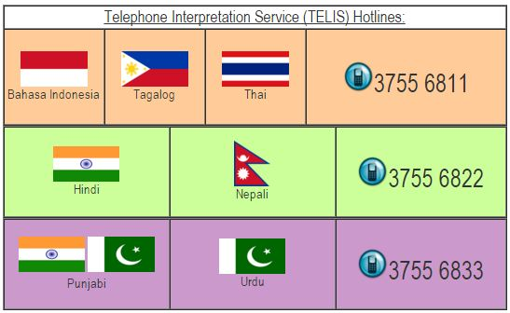
CHEER (Christian Service)
免費電話翻譯 (面談適用) Free Phone interpretation also useful for face to face meeting

Slide 19
Translation service
http://www.translateforher.org/ (Whatapp: 5691 4974)
1. Do not know the meaning of community information in Chinese.
2. Take a photo
3. Whatsapp to THEM at 56914974
4.Our voluntary translators will translate the text or pronounce the words for you!

Slide 20
Know more about culture and activities …
www.unison.org.hk

Slide 21
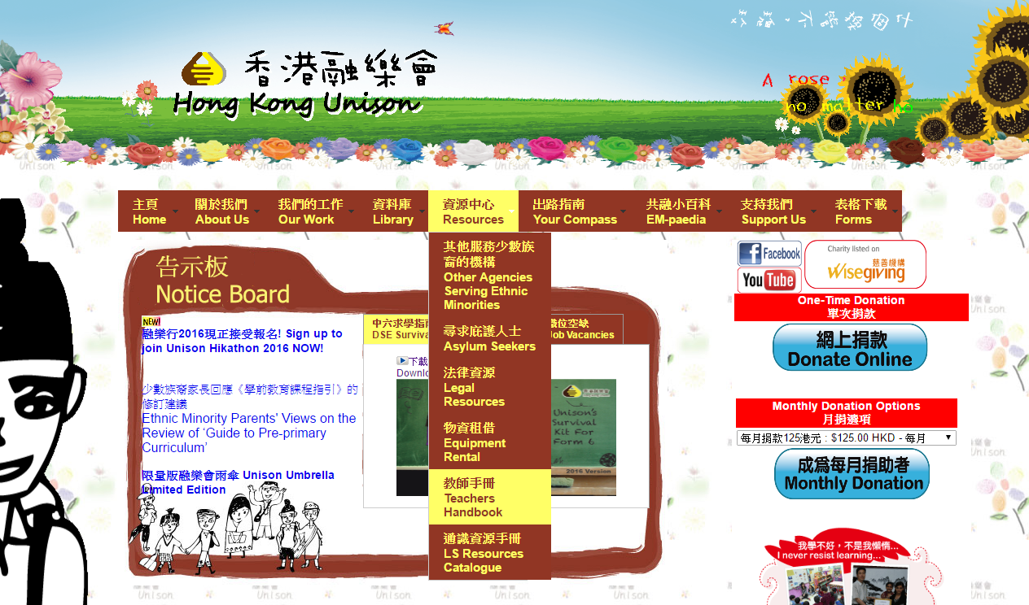

Slide 22
Looking for Parents interest group, Tea gathering discussion?
HAD EM support centre: Kwun Tong, Yau Ma Tei, Jordan, Shum Shui Po, Kwai Chung, Tuen Mun, Yuen Long, Tung Chung, Wan Chai

Slide 23
融樂會可以提供的協助? What help can Unison provide?
家長小組/ 工作坊 parents workshop eg. 主題：選校資訊/ 香港教育制度/ 如何協助中文學習
老師文化敏感度工作坊 teacher’s workshop eg. 認識少數族裔文化及學習背景
個案協助 Case sharing eg. 教育相關/ 社區資源分享

Slide 24
聯絡我們 Contact us
Hong Kong Unison
Tel: 2789 3246
Email: info@unison.org.hk

